Slide 1
Textual Languages for Modeling
A Comparative Study

Slide 2
Goals
Compare the following textual languages:
K (JPL’s homegrown textual modeling language)
OCLInEcore (Ecore + OCL)
Scala (a high-level programming language)
Java (de facto standard programming language at JPL)
Auto translating subset of OCLInEcore to SMT
Writing some models in different languages and compare “look and feel”

Slide 3
Contents
The Book example (two simple classes)
Formulated in K, OCLInEcore, and Scala
Translation from OCLInEcore to SMT
The library example (bigger example with more complex constraints)
Formulated in K, OCLInEcore, and Scala
The Shapes example
Formulated in K, OCLInEcore, Scala, and Java
OCL versus predicate logic
Feature comparison of languages
Conclusions

Slide 4
The Book Model in K

Slide 5
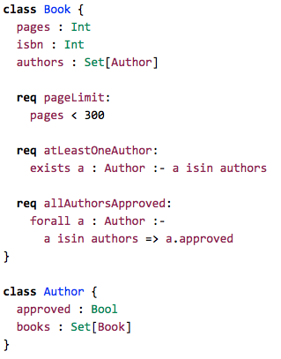

Slide 6
The Book Model in Scala

Slide 7
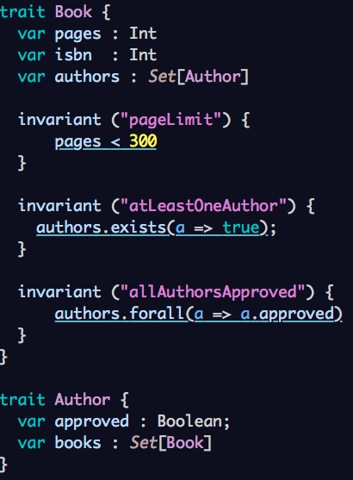

Slide 8
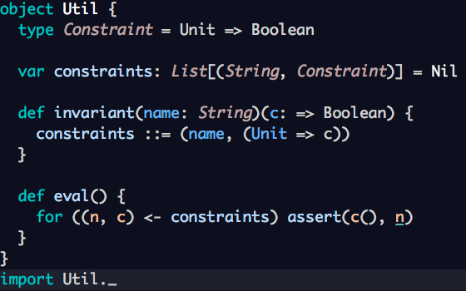
Relying on library function

Slide 9
The Book Model in OCLInEcore

Slide 10
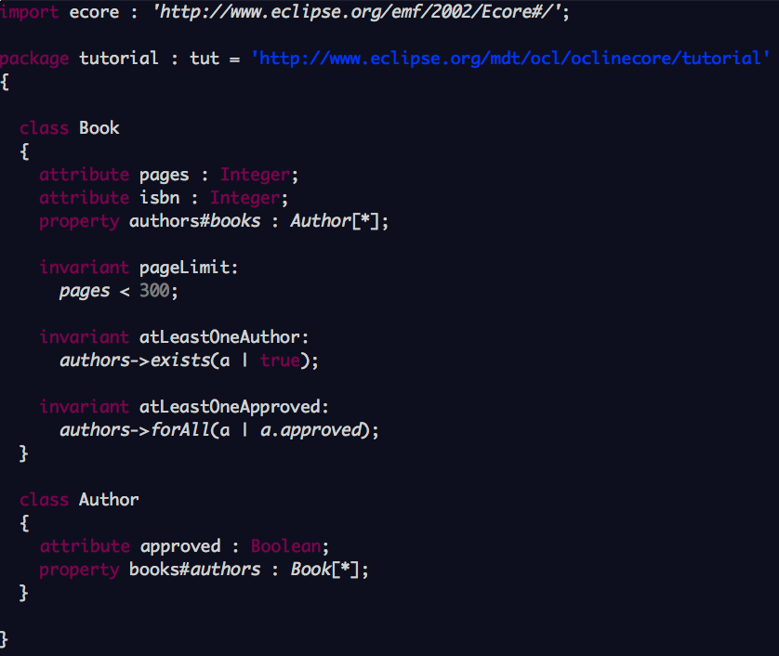

Slide 11
From OCLInEcore to SMT
An experiment writing an automatic translator
from OCLInEcore to SMT

Slide 12
Generated SMT

Slide 13
;; object references:
(define-sort Obj () Int)
;; class Book:
(declare-fun Book (Obj) Bool)
(declare-fun Book.pages (Obj) Int)
(declare-fun Book.isbn (Obj) Int)
(declare-fun Book.authors (Obj Obj) Bool)
(assert (exists ((self Obj)) (Book self)))
;; class Author:
(declare-fun Author (Obj) Bool)
(declare-fun Author.approved (Obj) Bool)
(declare-fun Author.books (Obj Obj) Bool)
(assert (exists ((self Obj)) (Author self)))

Slide 14
;; disjointness of classes:
(assert
(forall ((self Obj))
(and
(not (and (Book self) (Author self)))
)
)
)
;; invariants for class Book:
;; [pageLimit: pages < 300]
(assert
(forall ((self Obj))
(=> (Book self) (< (Book.pages self) 300))
)
)

Slide 15
;; [atLeastOneAuthor: authors->exists(a | true)]
(assert
(forall ((self Obj))
(=>
(Book self)
(exists ((a Obj)) (and (Author a) (Book.authors self a) true)))
)
)
;; [allAuthorsApproved: authors->forAll(a | a.approved)]
(assert
(forall ((self Obj))
(=>
(Book self)
(forall ((a Obj))
(=>
(and (Author a) (Book.authors self a))
(Author.approved a)))
)
)
)

Slide 16
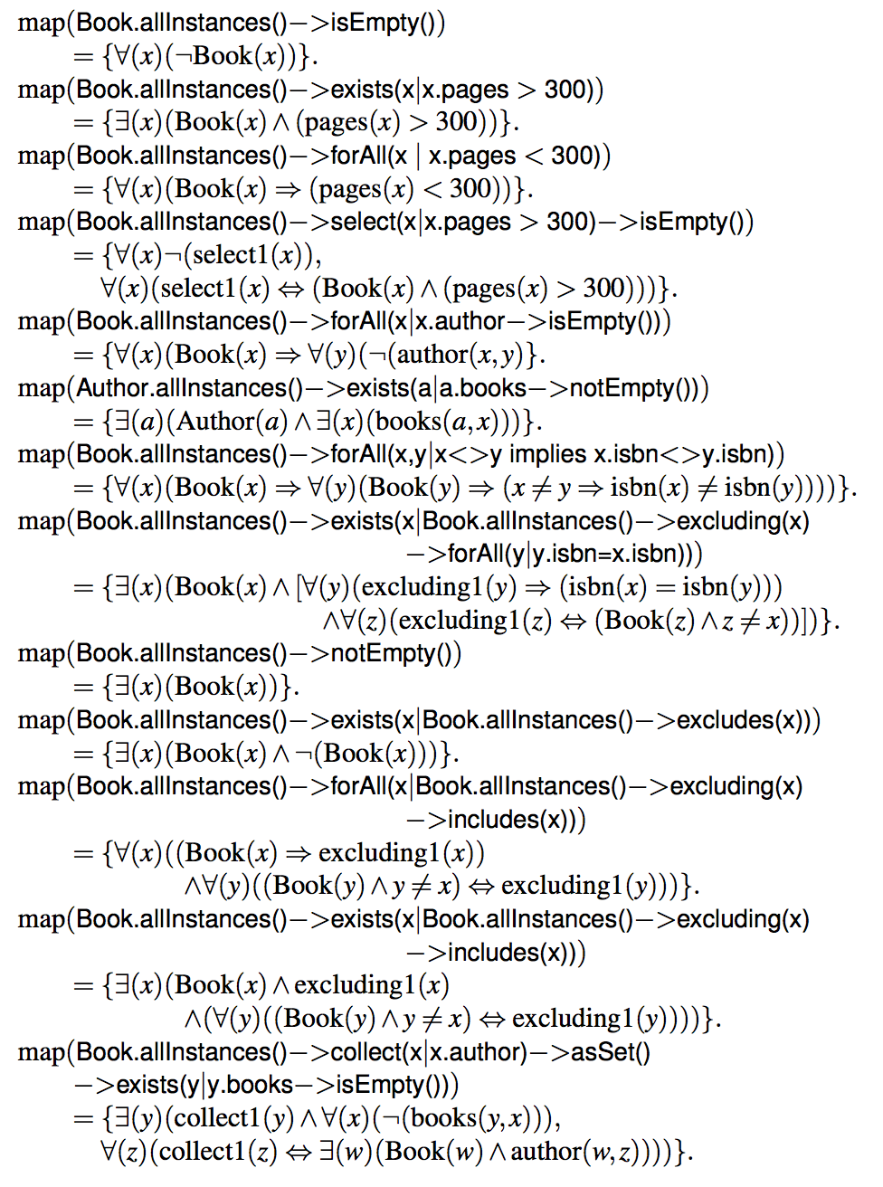
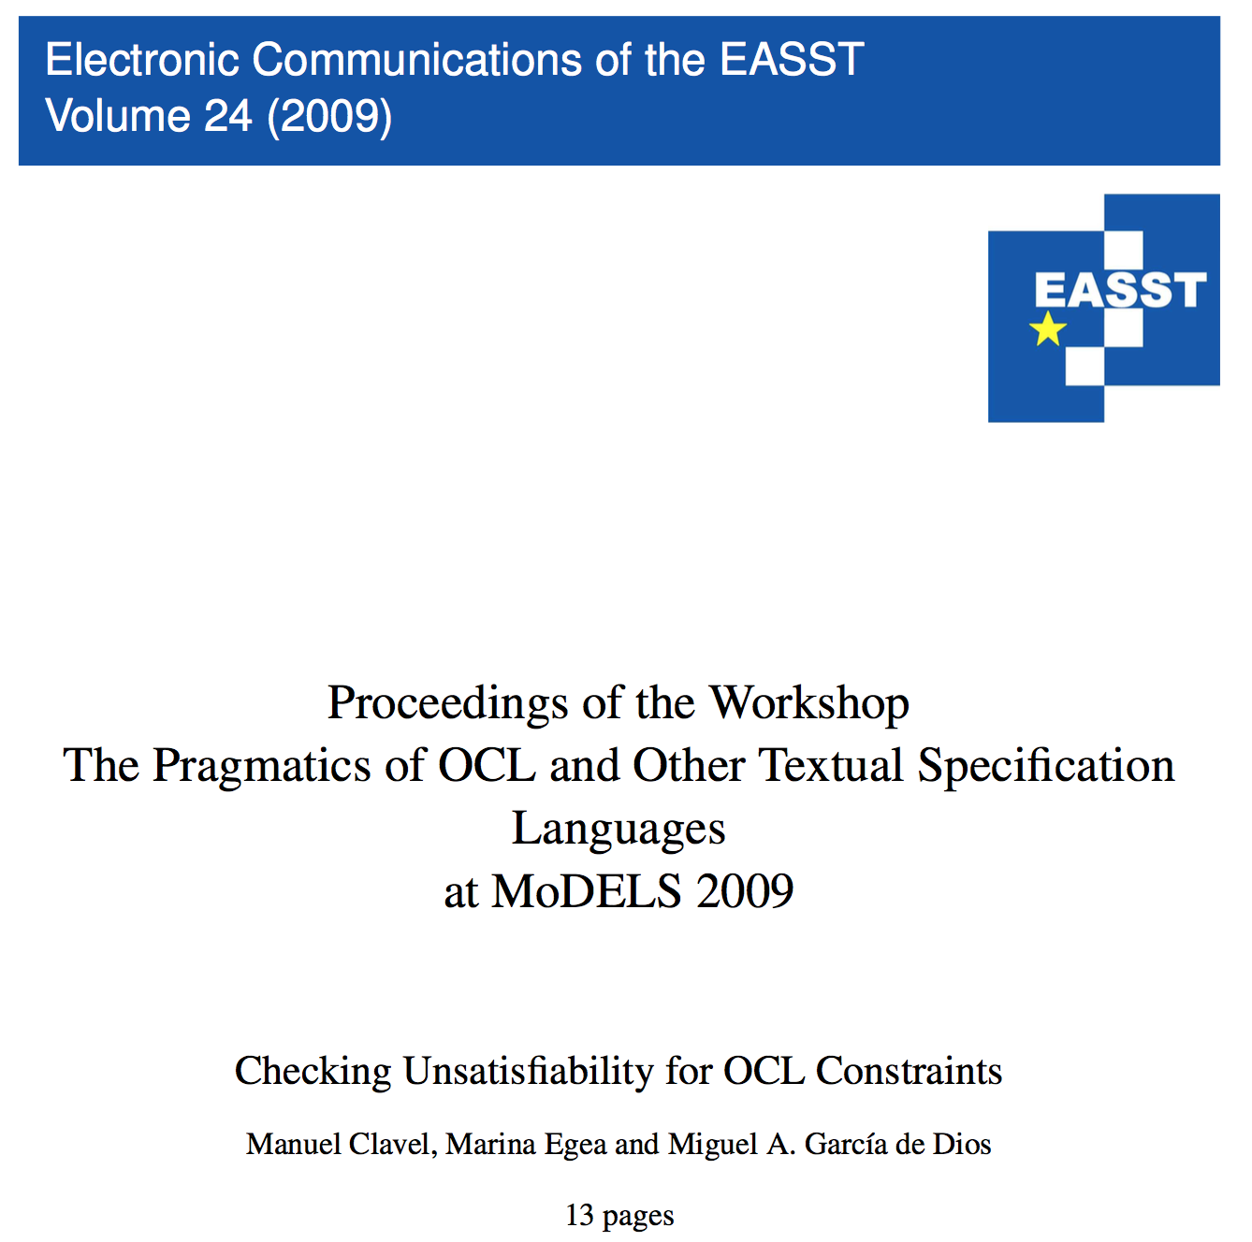
Following scheme from:

Slide 17
The OCLInEcore 2 SMT Translator
A Java program walking the OCLInEcore AST
generated by OCLInEcore
Example code snippets from:
Main program
Ecore structure visitor
OCL expression visitor
A total of 275 lines of code to handle the Book example

Slide 18

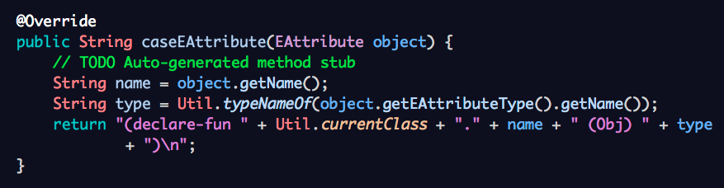
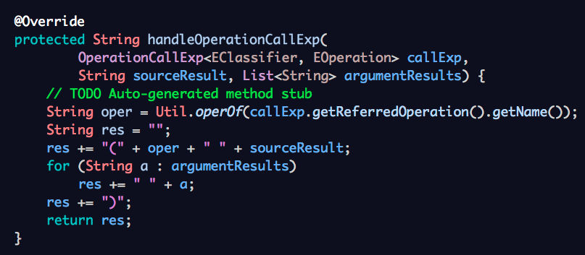

Slide 19
Lessons learned from OCLInEcore 2 SMT Translation
OCLInEcore AST is accessible and can be walked using visitor pattern.
We used new approach to translation which also could be applied to K, using un-interpreted functions instead of arrays and data types.

Slide 20
Is OCLInEcore’s Type Checker Mature?
The following wrongly typed model is not flagged as such

Slide 21
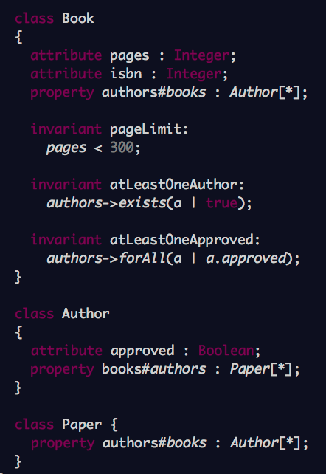
Does not have
opposite
property in
class Author.
We should
provide a such
to make this
model correct.

Slide 22
The Library Model
K
OCLInEcore
Scala
Demonstrates richer OCL expressions in OCLInEcore
corresponding to Set/Bag comprehensions in K.
Scala supports OCL-like notation (very similar).

Slide 23
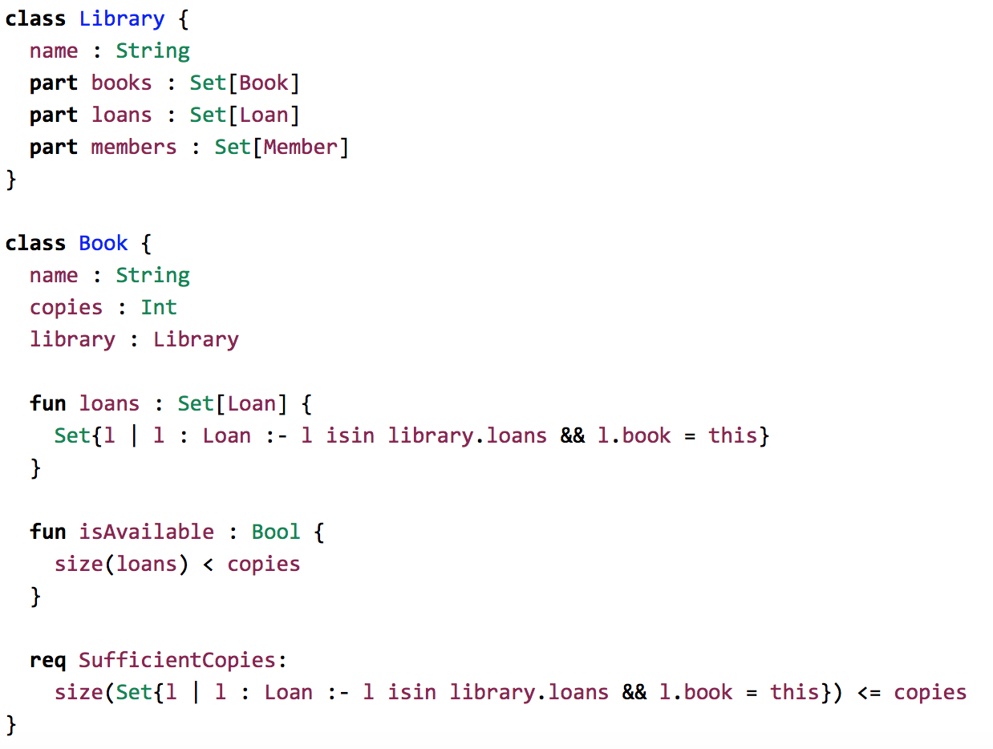
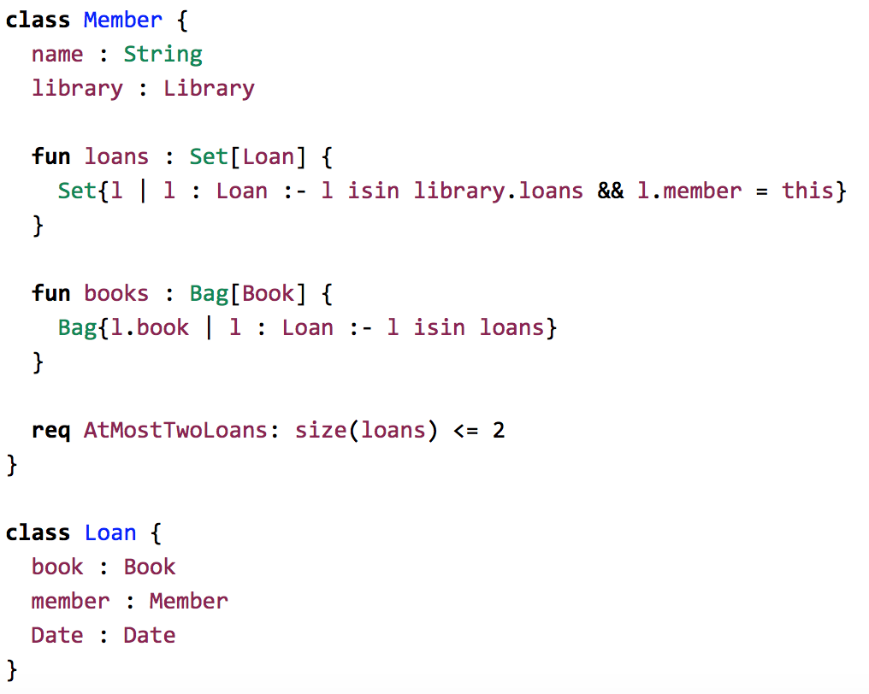
K
K

Slide 24
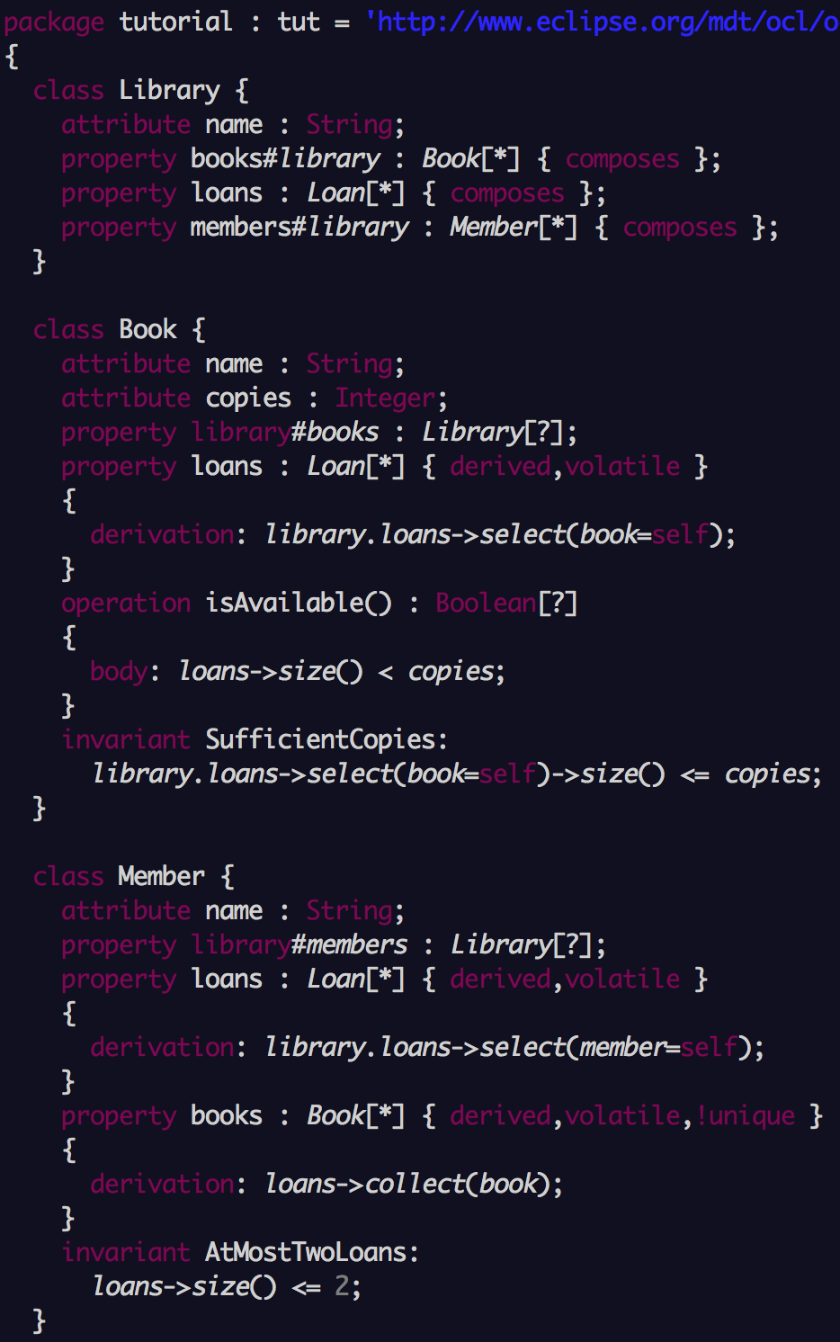
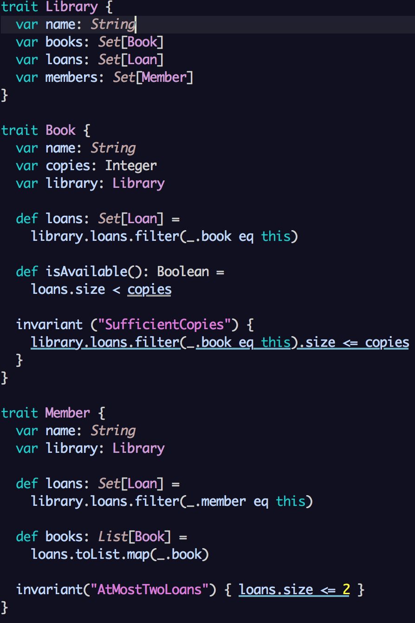
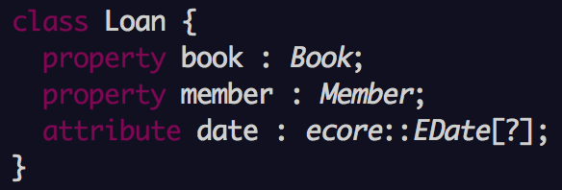
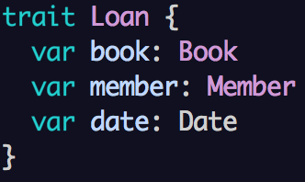
OCLInEcore
Scala

Slide 25
The Shapes Model
K
OCLInEcore
Scala
Java

Slide 26
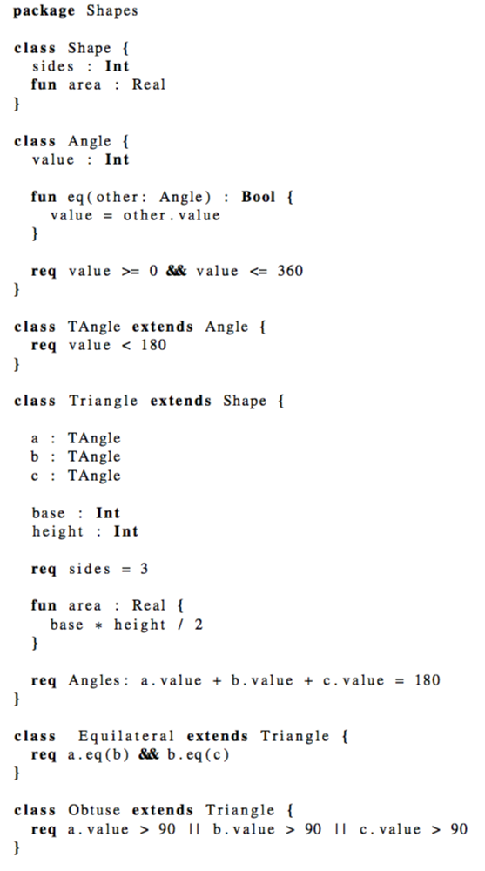
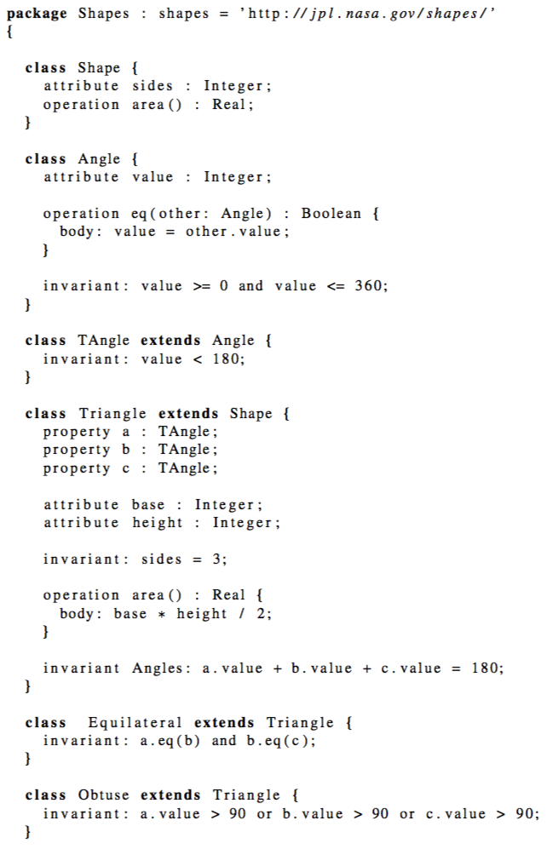
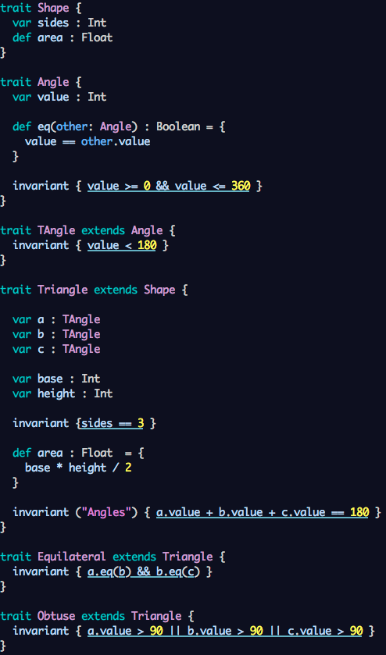
K
OCLInEcore
Scala

Slide 27
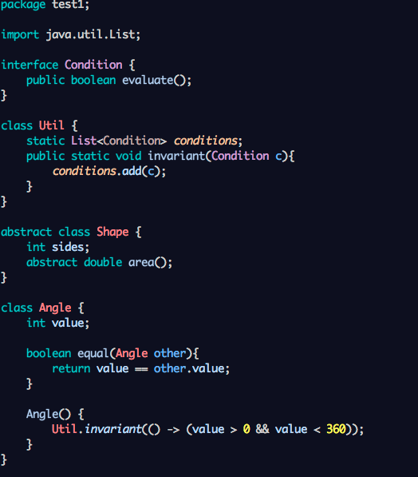
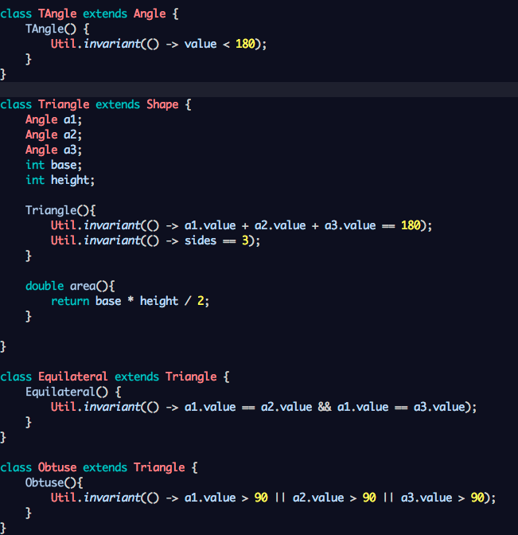
Java

Slide 28
Metrics of Shape Models
Language | Number of Lines | Number of Characters
K | 44 | 649
Scala | 44 | 714
Java | 54 | 826
OCLInEcore | 45 | 899
Models/programs edited to use same spacing, names and use same keyword for
requirements: (‘invariant’ instead of ‘req’ in K to be fair).

Slide 29
In a Graph

Slide 30
Comparing K OCLInEcore Scala Java

Slide 31
OCL versus Predicate Logic
Reqmts. expressed so far in K can be expressed in OCL (check)
OCL does not allow quantification over functions and infinite sets. It may not (or may?) be able to express traditional math.
OCL syntax is argued to be easier to use by engineers. Unclear whether this is true. Which one is easiest to read (w. renamed Scala):
OCL : authors.select(a | a.approved).collect(a | a.name)
Scala : authors.select(a => a.approved).collect(a => a.name)
K : Set{a.name | a : Author :- a.approved}

Slide 32
Commonalities between K, OCLInEcore, Scala and Java
Classes and inheritance
Attributes (simple types) and properties (collections)
Operations (pure functions and operations with side-effects)
Constraints
Annotations

Slide 33
Differences

Slide 34
 | K | OCLInEcore | Scala | Java
Ecore fit | - | + | - | -
Large user community | - | - | + | +
Supports “parts of” (black diamond) | + | + | - | -
Arbitrary deep nesting of packages | - | + | - | -
Enumeration types | - | + | (+) | +
Multiplicities | + | + | - | -
Opposite properties (library#books) | - | + | - | -
Pre/post conditions for defining operations | + | + | (+) | -
Statements for defining operations | + | - | + | +

Slide 35
 | K | OCLInEcore | Scala | Java
Operation parameters can be untyped | - | + | - | -
Operations can throw exceptions | - | + | + | +
Invariants are callable | - | + | - | -
Allows user-defined keywords for class defs. | + | - | - | -
Function types | + | - | + | (+)
General lambda expressions | + | (-) OCL has | + | + (1.8)
Predicate subtypes | + | (+) datatypes | - | -
Quantification over infinite sets (full math) | + | - | - | -
Set comprehension of infinite sets (full math) | + | - | - | -

Slide 36
 | K | OCLInEcore | Scala | Java
Class instantiation (creating objects) | + | - (GUI only) | + | +
Pattern matching | (+) | - | + | -
Global properties, operations and constraints | + | - | + | +
Control over syntax and AST | + | - | - | -
Multiple inheritance | + | + | (+) | (-) interfaces
Models (programs) are data | - | + (ecore) ? | - | -
AST is extensible | - (*) | + ?? | - (*) | - (*)
Syntax is extensible | - | - | (+) | (+)
(*) : one can extend AST but it is hard work.

Slide 37
Things Modelers Do
That programmers don’t
Store models as disassembled data (in database)
Query models in database
Transforming models (models as data)
Compare models (in ways more advanced than “diff”)
Advanced? merge of models developed by multiple users
Build/edit models with GUIs

Slide 38
Conclusions
OCLInEcore AST is accessible and can form base for SMT translation. Experiment was successful. “Counting” in SMT is, however, a problem for OCLInEcore as well as for K, and other languages.
Recommendation: Try out OCLInEcore for defining SysML. Can it support what want (ignoring SMT question)? Experiment with extending AST and extending syntax.
Systems we have not looked at seriously: Xcode, Alf and Modelica.
Scala is an option. One can define a translator from Scala to SMT. Some work has been done in this direction already: https://leon.epfl.ch.
Programming languages do not well support meta-programming and treatment of programs as data (except LISP). But they are very mature and seem to be sufficient for programmers. It would be useful to be clear about what is the difference between modeling and programming, if there is one.

Slide 39
END

