Slide 1
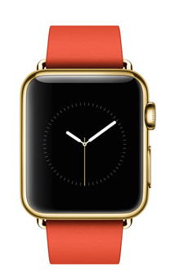
K
coming soon to your tERMINAL…

Slide 2
Language Constructs
Packages
Class
Properties (val, var)
Functions
Constraints
Association
Multiplicities
Modifiers: part, ordered, unique
Annotation
Extensible keyword set
Types: Collections (Seq, Bag, Set), Function types
Rich expression language: Predicate logic, OCL, Set theories, General programming

Slide 3
Salient Points
Relational view
Sets of atomic objects
Relations between objects
Datatypes to allow easier specification of constraints, functions
Predicate logic is combined with OCL
N-ary relations and classes
Specification and general programming (wide spectrum language)

Slide 4
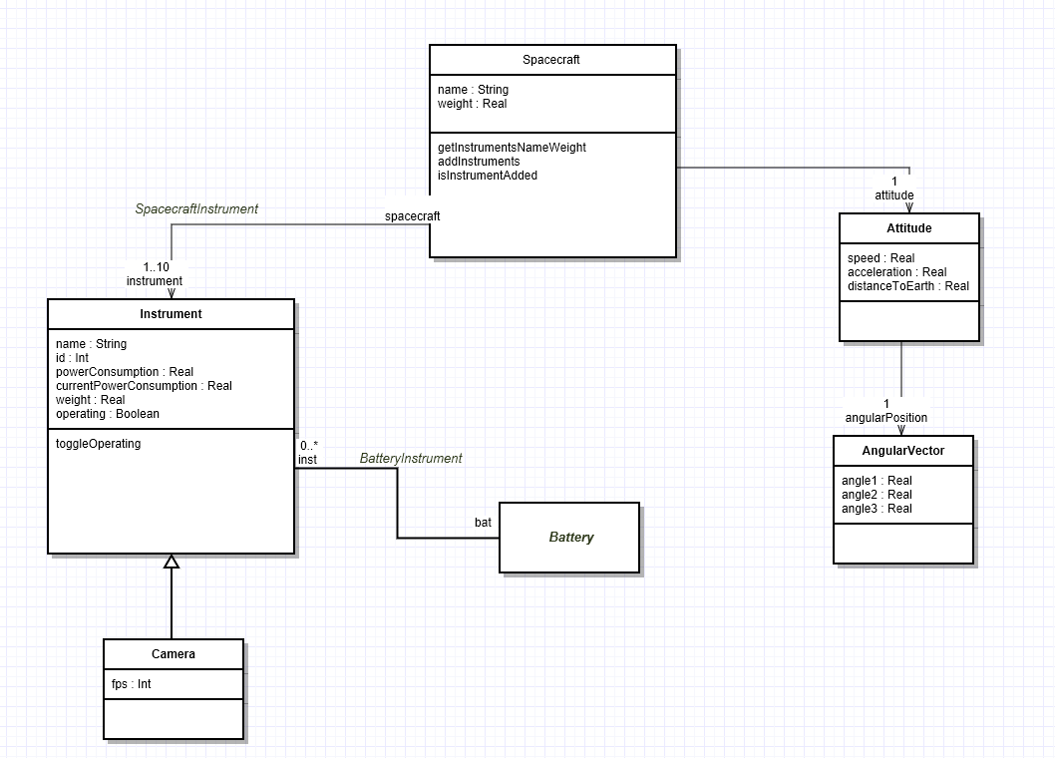
Spacecraft Example

Slide 5
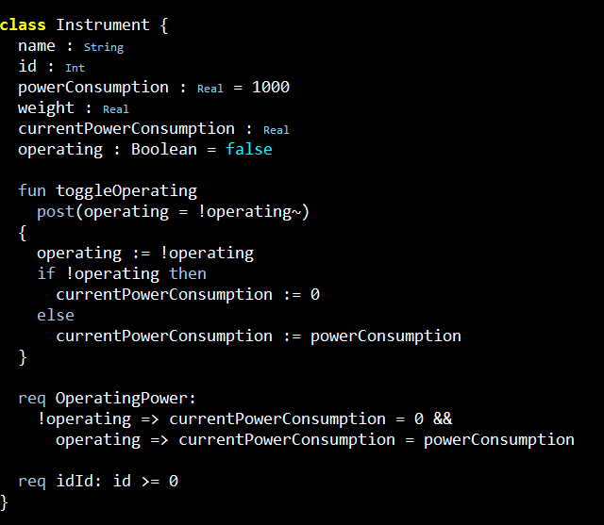
Spacecraft Example

Slide 6
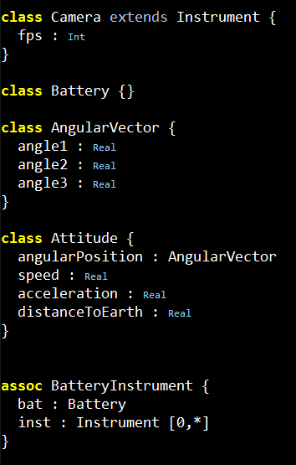
Spacecraft Example

Slide 7
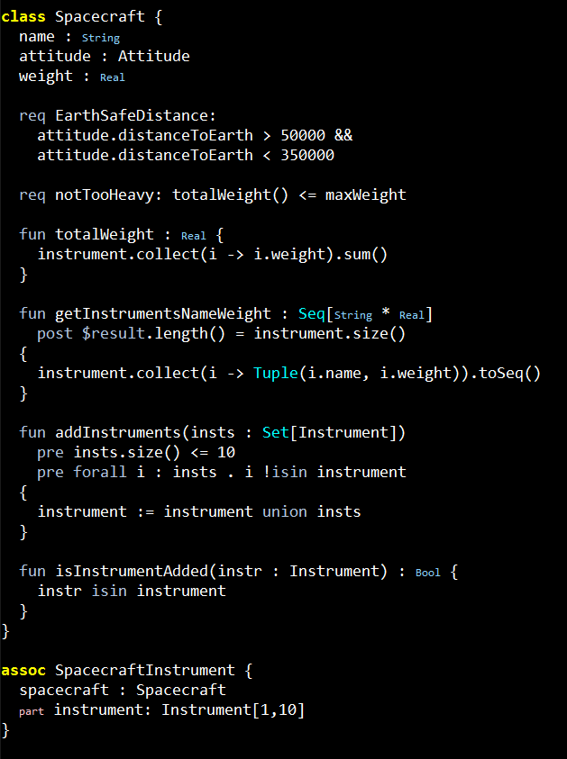
Spacecraft Example

Slide 8
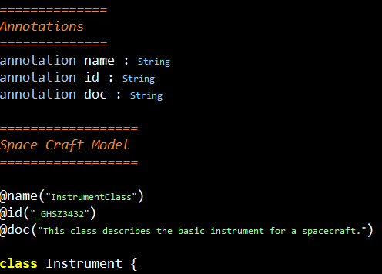
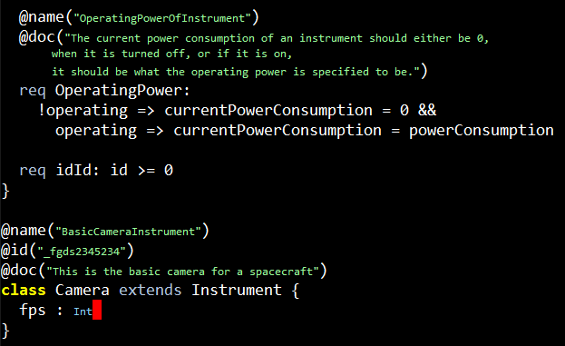
Annotations

Slide 9
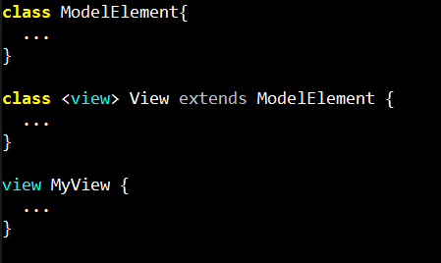
Extensible Keywords
“view” is now a new keyword that can be used in the model!

Slide 10
Extensible Keywords
You can use view instead of class.
This is the same as writing
class MyView extends View {

