Slide 1
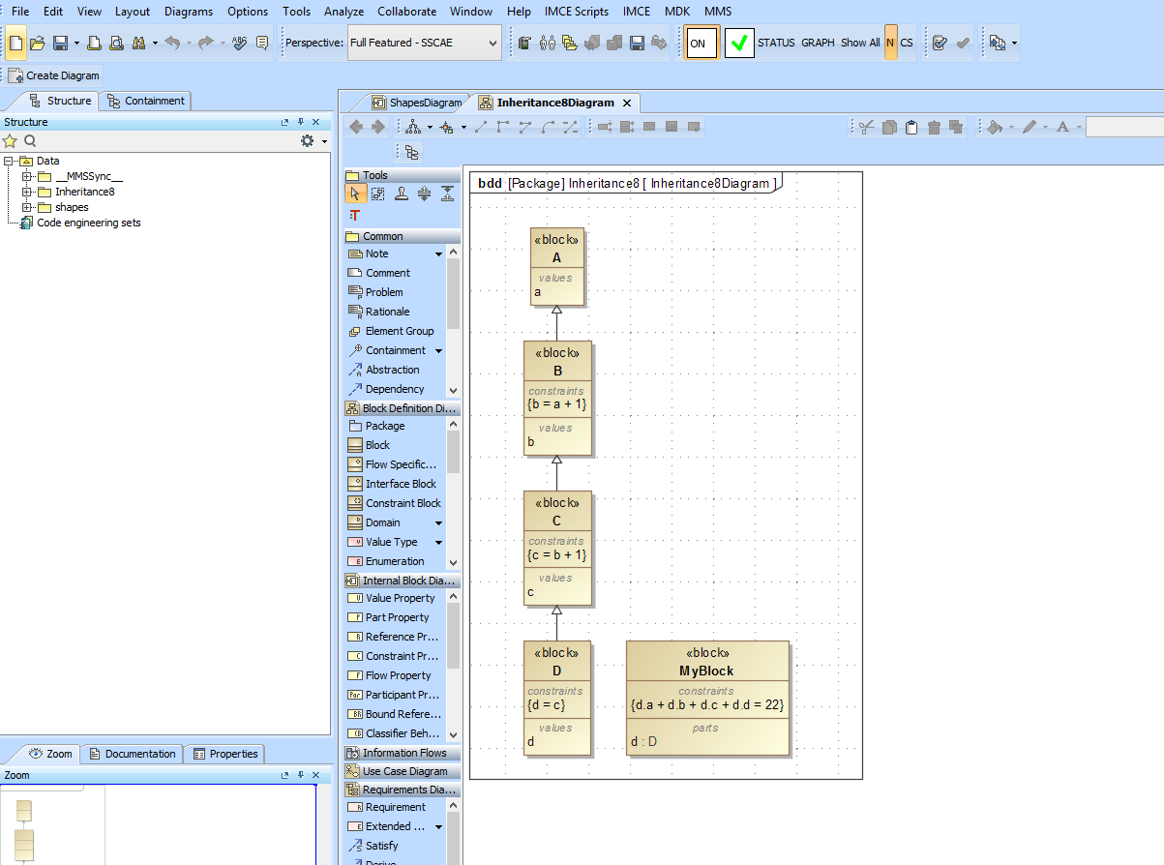
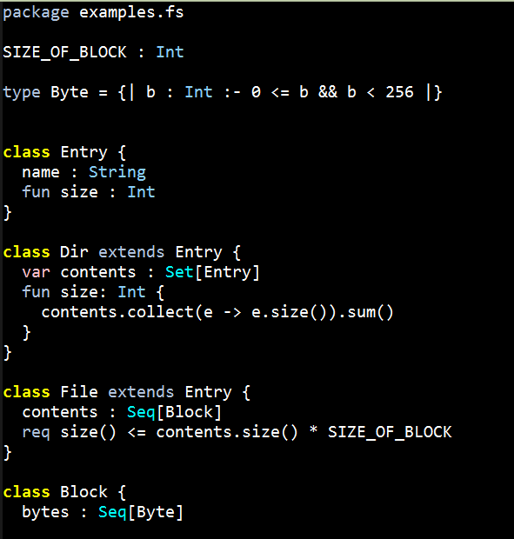
DB
JSON
K
ANTLR Grammar
ANALYSIS
Scala
JSON Visitor
Type
Checker
AST
Scala
ANTLR
ANTLR
Parser
JAVA
Visitor Interface
Scala
Visitor
SMT Analysis

Slide 2
cars
Car
*
mother
1
Person
children
Set[Person]
1
accounts
Set[BankAccount]
1,*

