Slide 1

Structured Use Cases for SysML v2
Structured Use Cases
Making use case behavior queryable, testable, and useful
An alternative use case library for SysML v2
Doug Rosenberg
September 2026
© 2026 Parallel Agile, Inc. All Rights Reserved

Slide 2
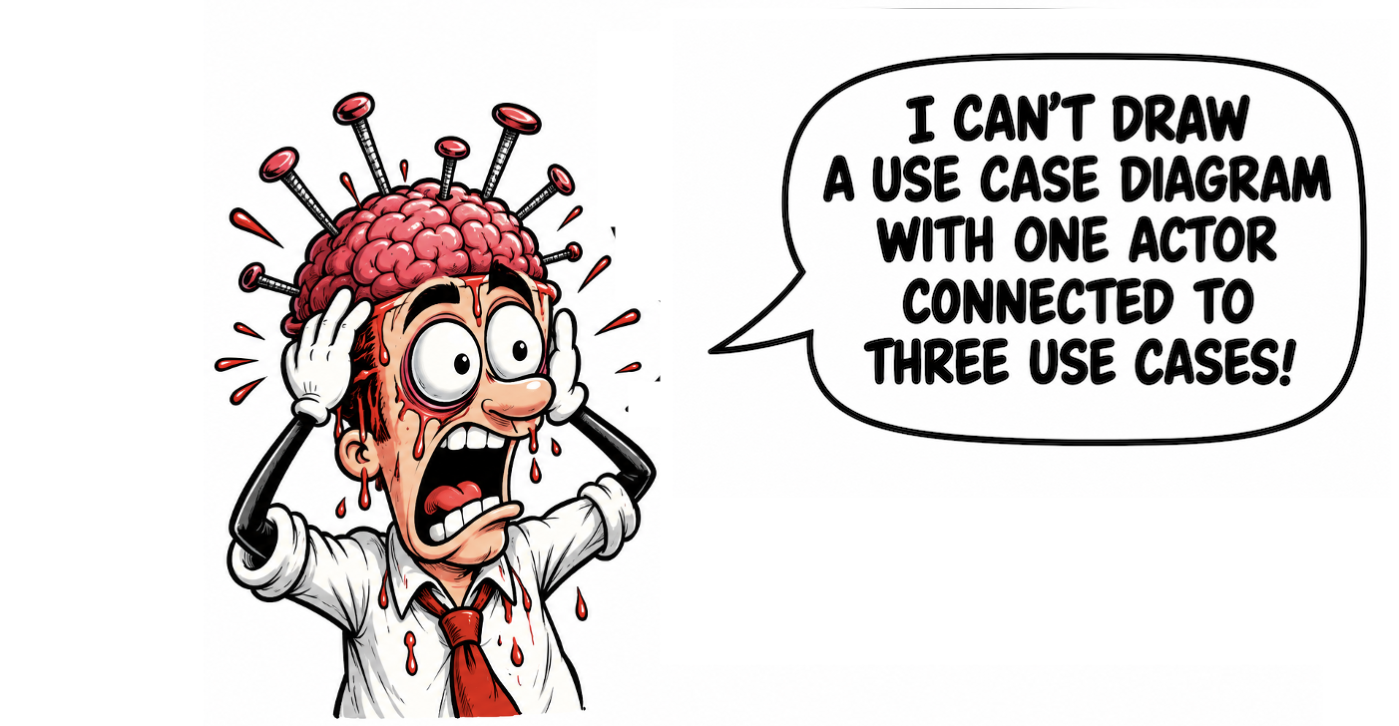
Motivation
© 2026 Parallel Agile, Inc. All Rights Reserved
Motivation

Slide 3
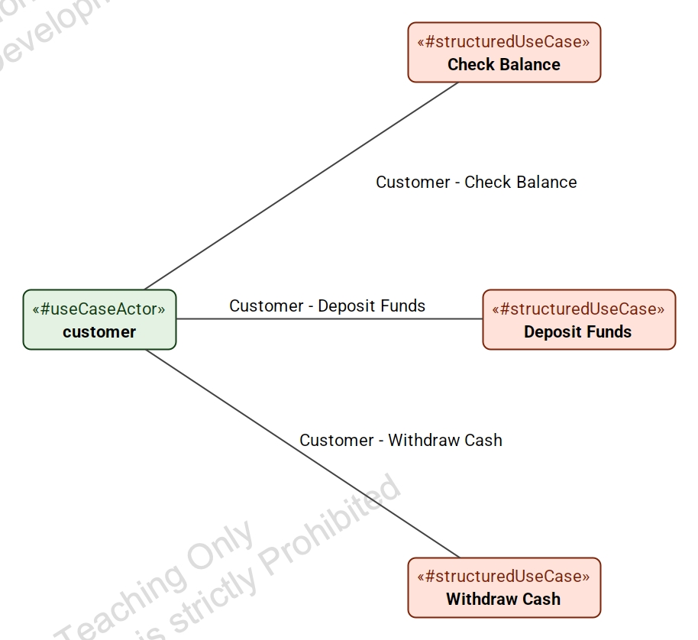
The proposal restores familiar actor-to-use-case relationships
Current SysML v2 makes this ordinary diagram pattern awkward.
The same actor can participate in several use cases.
The diagram reads like the use case diagrams engineers already know.
The actor is still modeled explicitly, so tools can analyze participation.
© 2026 Parallel Agile, Inc. All Rights Reserved
Diagram motivation

Slide 4
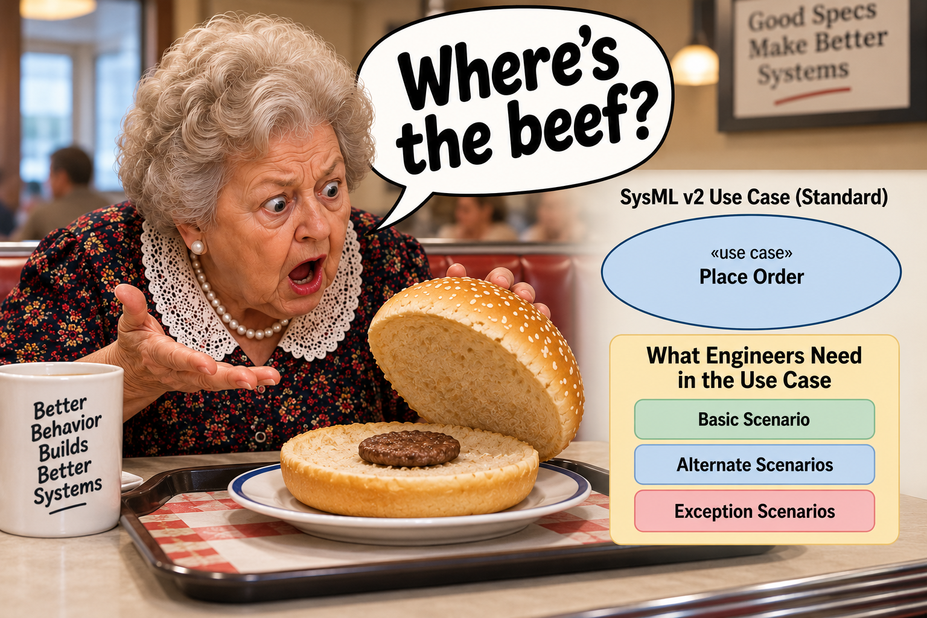
The bigger problem is missing scenario structure
© 2026 Parallel Agile, Inc. All Rights Reserved
Motivation

Slide 5
The main engineering value is in the scenarios
“The primary engineering value of use case modeling resides in the use case specifications, not in the use case diagrams.”
Diagrams are useful because they organize goals around actors.
The specification is where engineers discover missing behavior, off-nominal cases, outcomes, and verification needs.
The proposal keeps the diagram useful while making the scenario content precise enough for tools.
© 2026 Parallel Agile, Inc. All Rights Reserved
Thesis

Slide 6
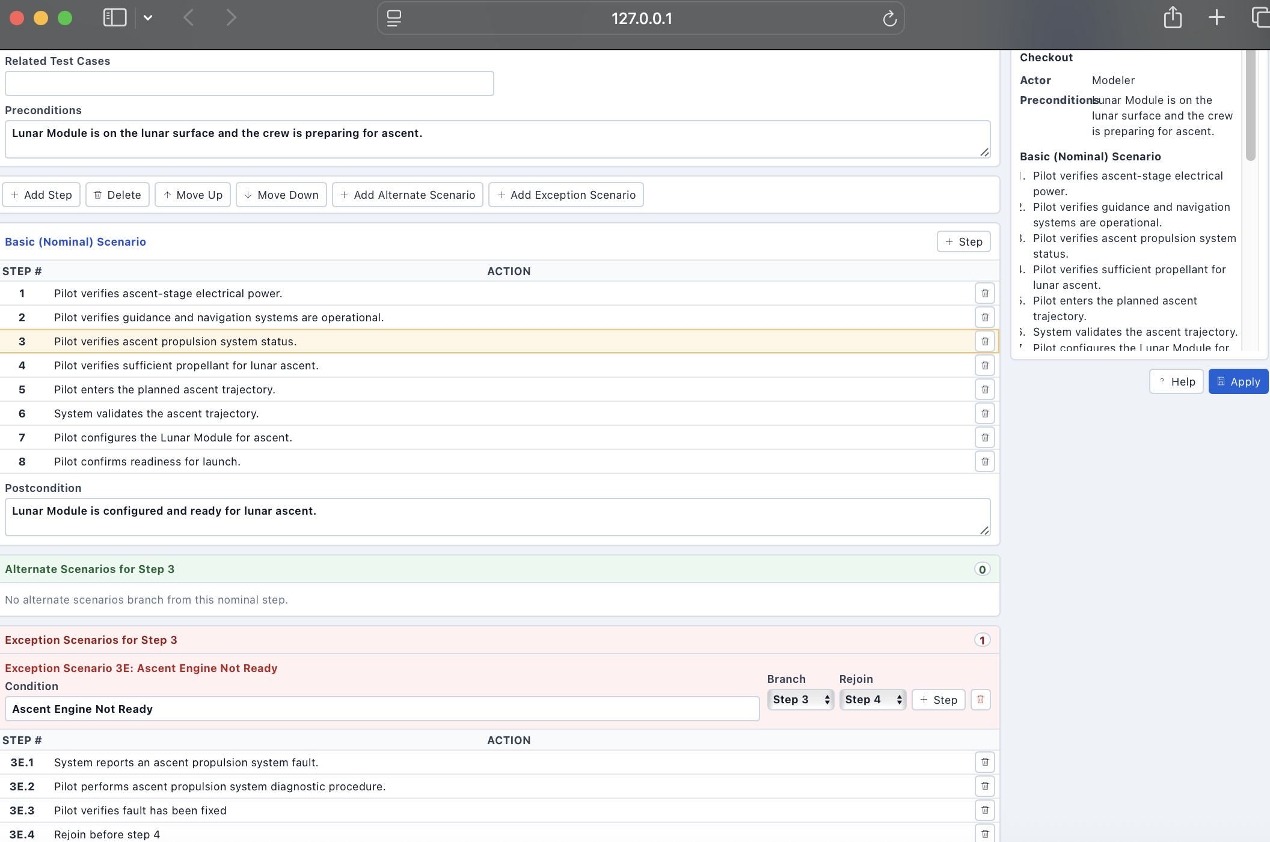
Use cases are structured into basic, alternate, and exception scenarios
© 2026 Parallel Agile, Inc. All Rights Reserved
Editor

Slide 7
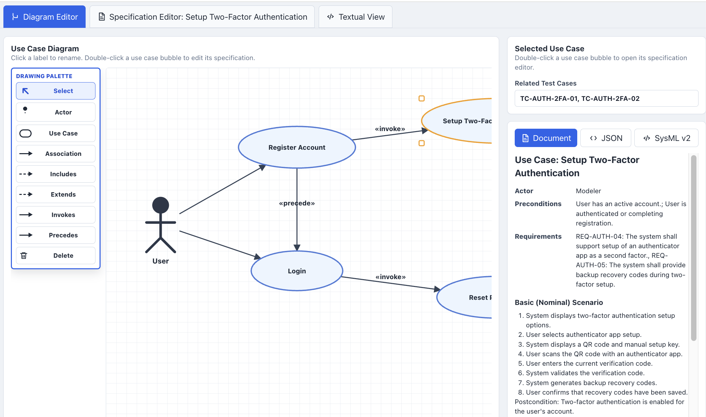
The reference editor supports familiar use case notation
© 2026 Parallel Agile, Inc. All Rights Reserved
Editor

Slide 8
SysML v2 export turns the editor model into tool-readable semantics
package AccountManagementUseCases {
private import StructuredUseCases::*;
#useCaseActor part user;
#useCaseActor part supportAgent;
use case 'Register Account' {
doc /* Primary actor: User */
action 'Basic Scenario' {
#step action '1 User opens registration page' {}
#step action '2 User enters registration information' {}
first start then '1 User opens registration page';
}
}
}
The export is generated from the structured model, not typed separately.
Use cases, actors, scenarios, and steps are represented explicitly.
The exported text can be imported into a SysML v2 tool for review and analysis.
© 2026 Parallel Agile, Inc. All Rights Reserved
Editor

Slide 9
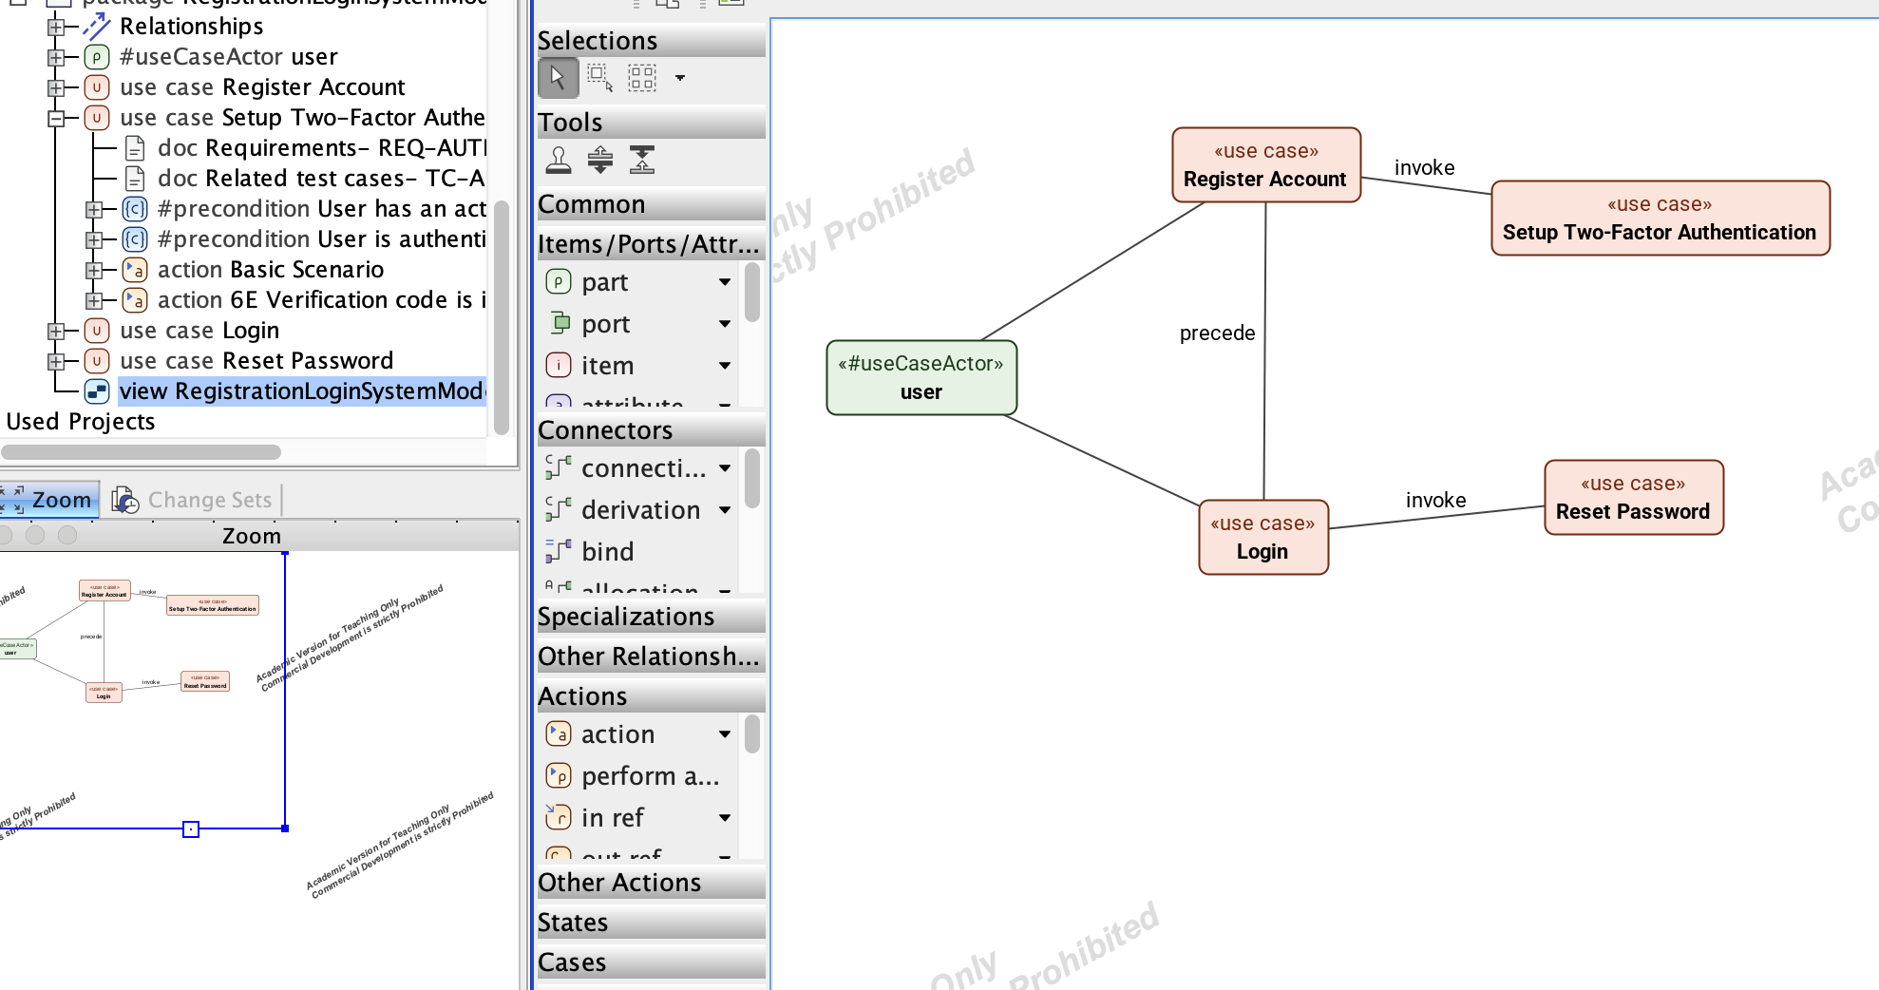
Cameo import confirms the path into SysML v2 tooling
The account-management test model was exported from the editor.
It was imported to Cameo using SysML v2.
The resulting model elements can be diagrammed, inspected, and queried.
© 2026 Parallel Agile, Inc. All Rights Reserved
Editor

Slide 10
The interchange path is intentionally simple
1
2
3
4
5
Author
Persist
Export
Import
Analyze
Create diagrams and structured specifications
Save complete models as .ucm.json
Generate SysML v2 textual notation
Load semantic model content into Cameo
Run queries over explicit behavior
© 2026 Parallel Agile, Inc. All Rights Reserved
Interchange

Slide 11
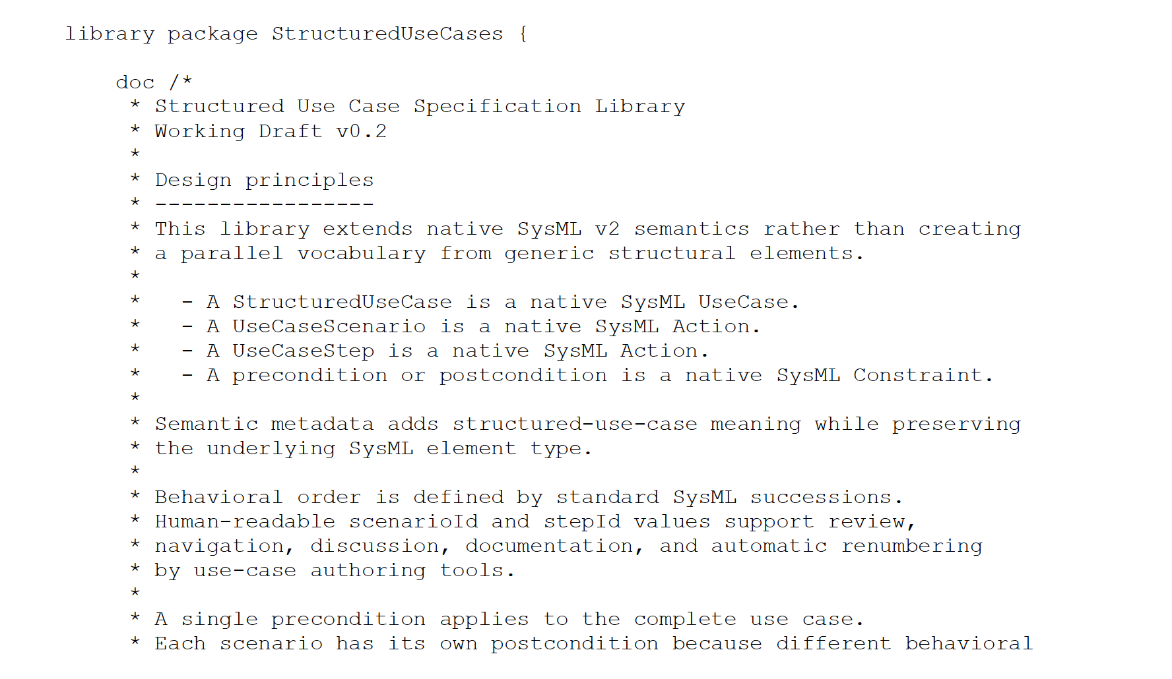
The library adds use case meaning as SysML v2 metadata
The library extends native SysML v2 semantics instead of creating a parallel vocabulary.
StructuredUseCase, UseCaseScenario, and UseCaseStep preserve their underlying SysML element types.
Scenario and step identifiers support review, navigation, documentation, and renumbering.
A single precondition applies to the complete use case; each scenario can define its own postcondition.
© 2026 Parallel Agile, Inc. All Rights Reserved
Library

Slide 12
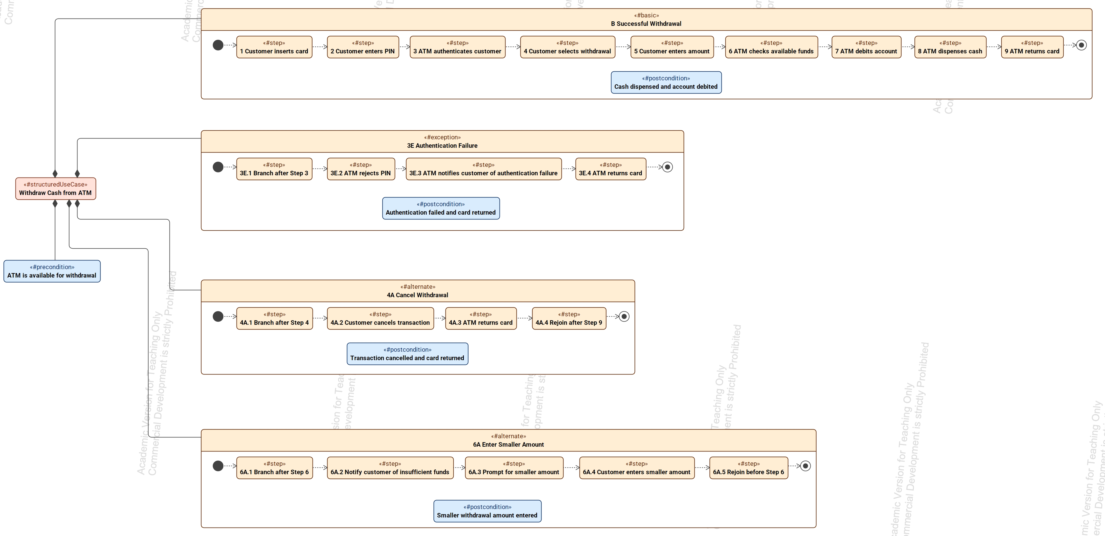
A structured use case captures nominal and off-nominal behavior
The basic path, alternate paths, and exception paths are model elements.
Steps preserve sequence, branch-after, and rejoin-before semantics.
Each off-nominal scenario can carry its own postcondition.
© 2026 Parallel Agile, Inc. All Rights Reserved
Scenarios

Slide 13
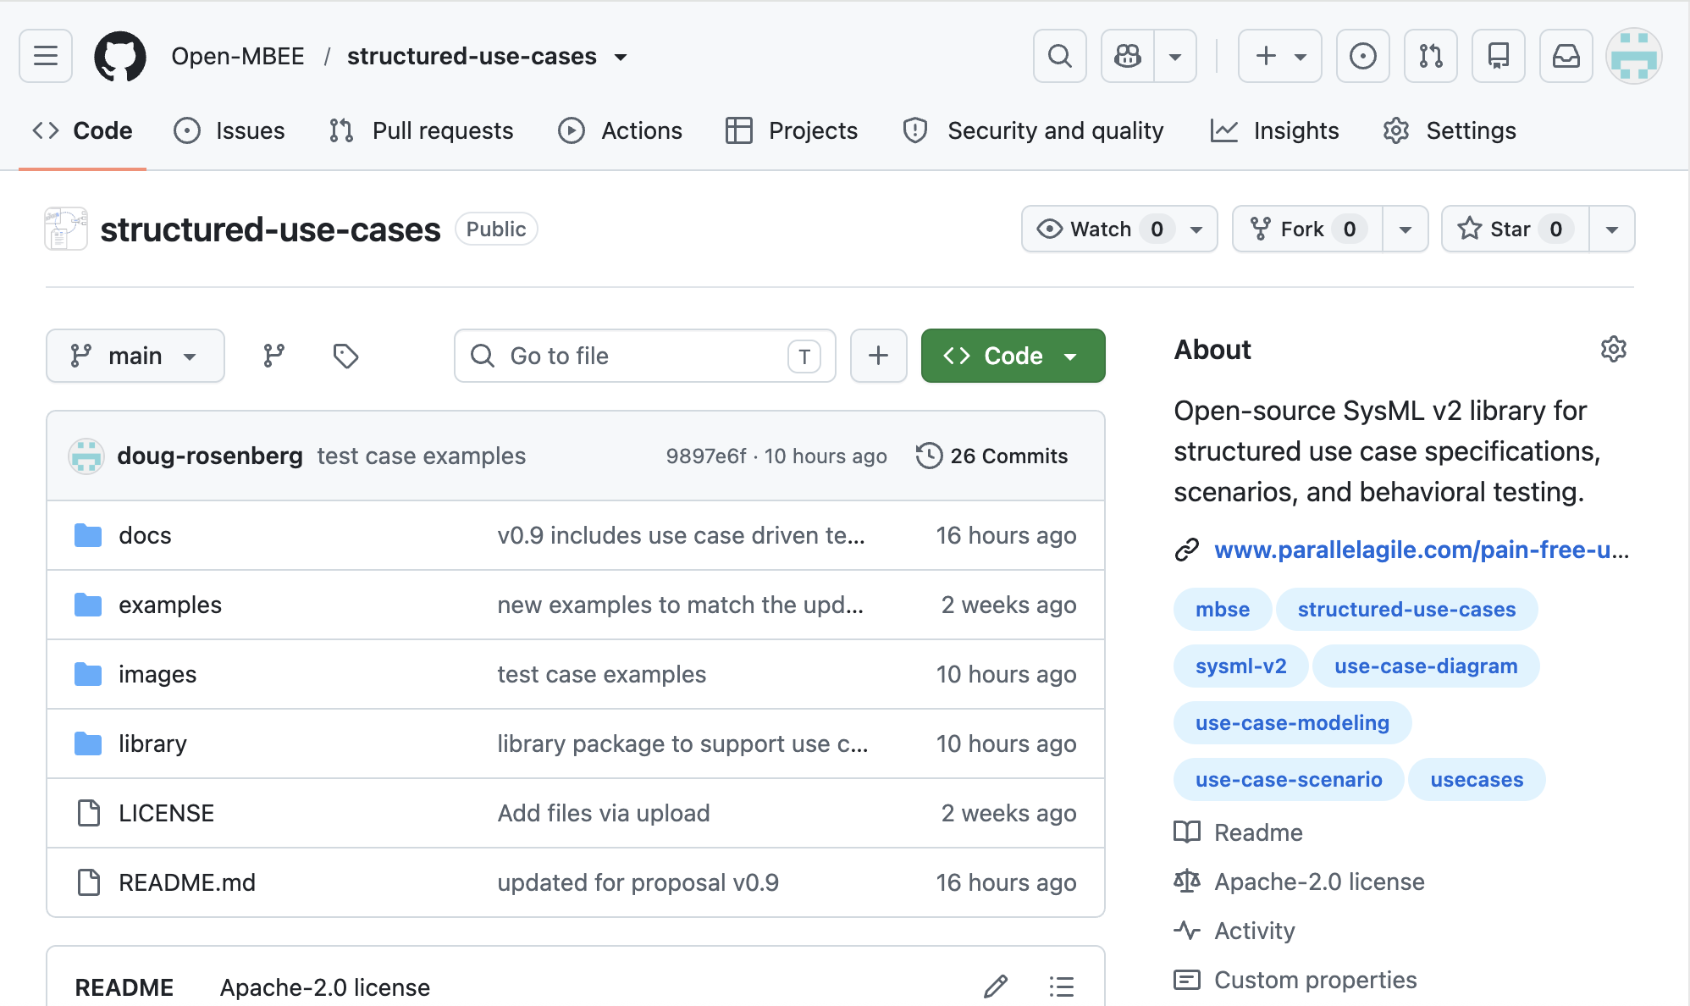
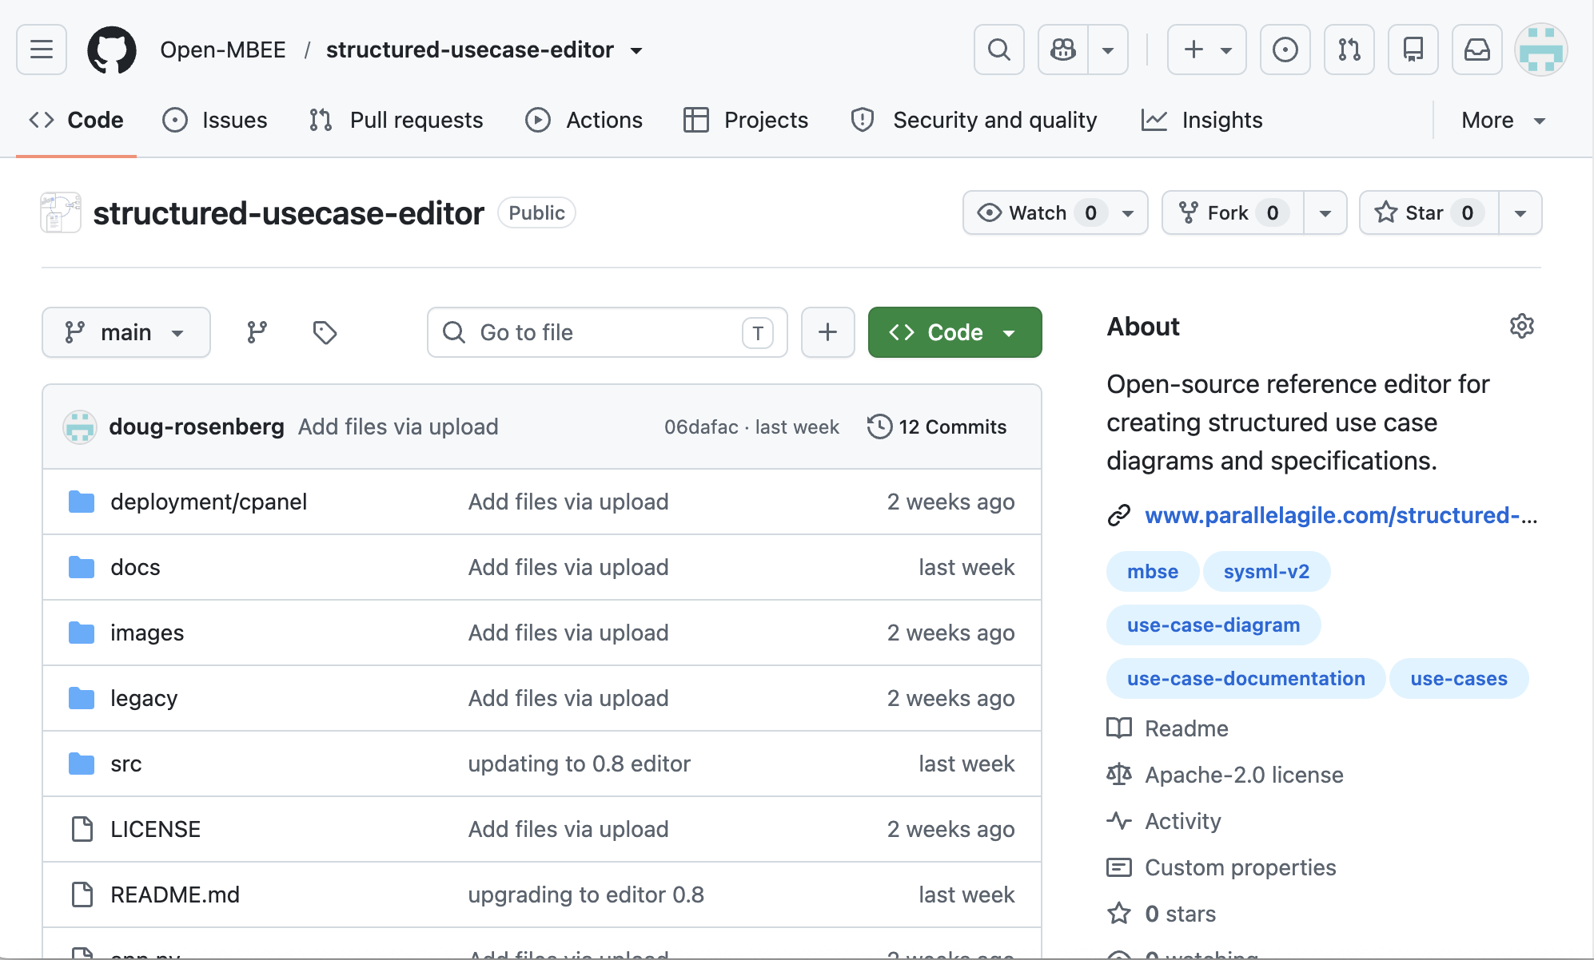
The library and editor are open source on OpenMBEE
Structured Use Cases library
Structured Use Case Editor
The proposal library and prototype editor are both publicly available under the OpenMBEE organization.
The repositories provide the SysML v2 library, examples, documentation, and reference implementation.
© 2026 Parallel Agile, Inc. All Rights Reserved
Open source

Slide 14
Testing
Use case behavior becomes testable model structure
© 2026 Parallel Agile, Inc. All Rights Reserved
Testing

Slide 15
Testing fails when off-nominal scenarios are missed
“The biggest problem with testing is failure to test the off-nominal scenarios.”
SysML v2 verification cases only support testing of requirements.
That explicit behavior can be traced to scenario-level verification.
The same semantics can support coverage analysis and test generation.
© 2026 Parallel Agile, Inc. All Rights Reserved
Testing

Slide 16
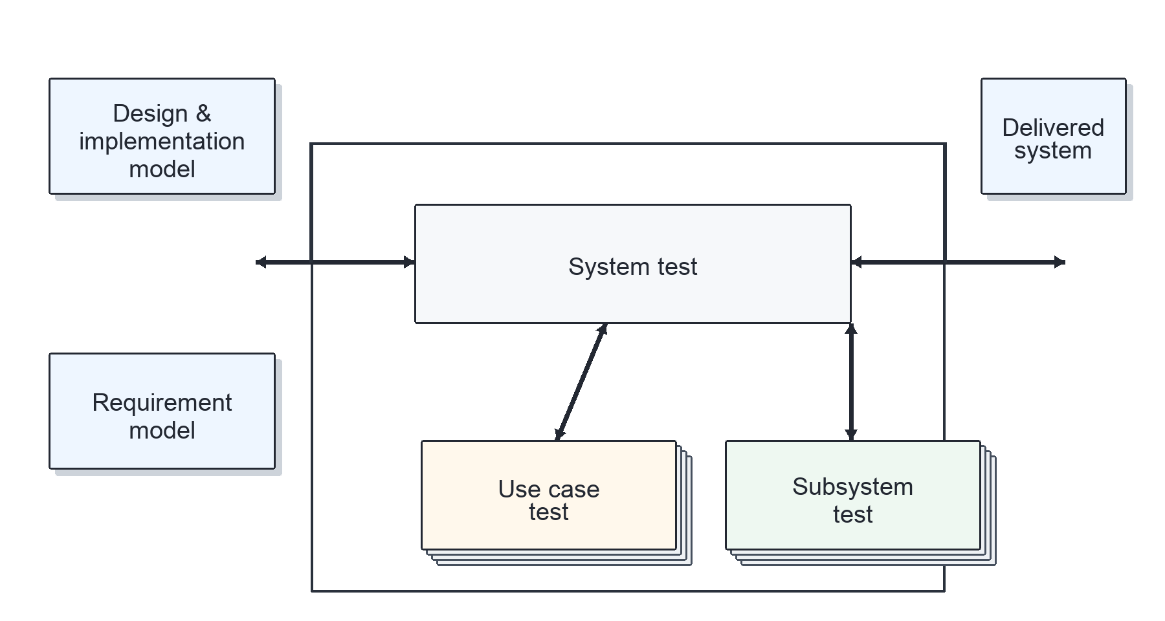
Use case-driven testing has a long pedigree
Jacobson et al. connected use case tests to system test strategy as far back as 1992.
The v0.9 proposal carries that idea into explicit SysML v2 semantics.
The new contribution is queryability: the model can reveal which behavior has not been tested.
Adapted from Ivar Jacobson et al., Object-Oriented Software Engineering: A Use Case Driven Approach, 1992, Figure 15-4.
© 2026 Parallel Agile, Inc. All Rights Reserved
Testing

Slide 17
Structured Testing adds behavioral coverage semantics
Native SysML v2
Proposed extension
Verification Cases verify Requirements.
Requirement verification remains essential.
Native semantics do not directly identify the use case scenario being exercised.
StructuredTestCase specializes VerificationCase.
TestScenario specializes UseCaseScenario.
TestStep specializes UseCaseStep.
VerifyUseCase and VerifyScenario make behavioral coverage queryable.
© 2026 Parallel Agile, Inc. All Rights Reserved
Testing

Slide 18
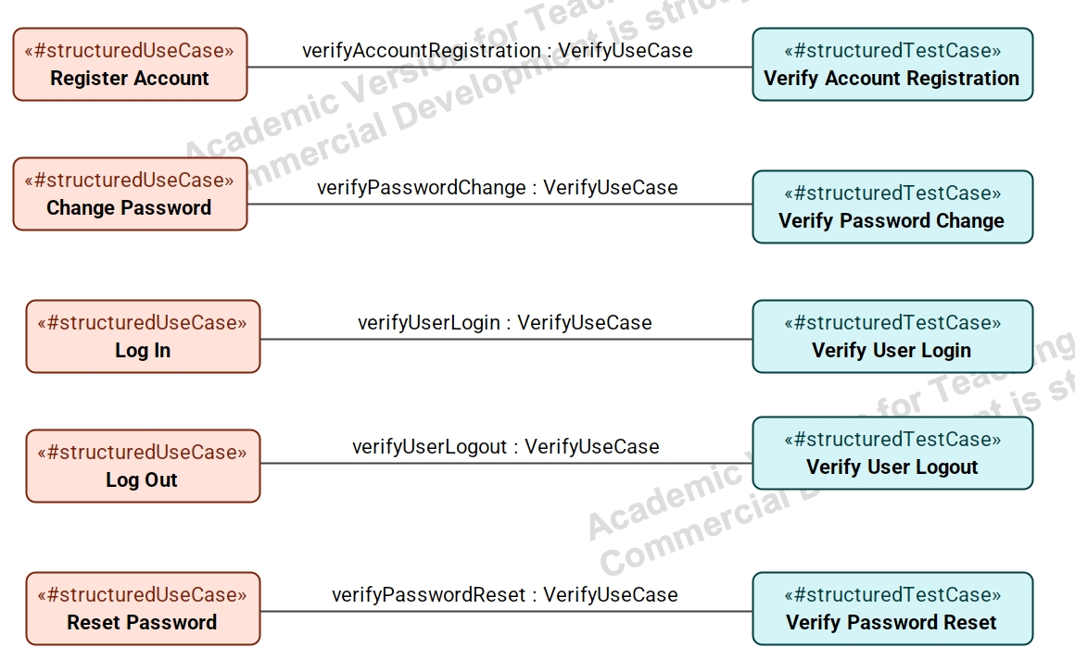
Verification relationships make use case coverage explicit
© 2026 Parallel Agile, Inc. All Rights Reserved
Testing

Slide 19
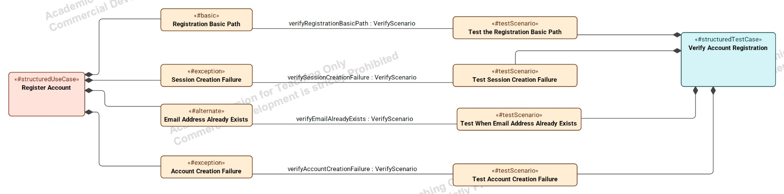
Scenario-level verification exposes coverage gaps
Basic, alternate, and exception scenarios can each have a corresponding Test Scenario.
Queries can ask which alternate and exception scenarios do not participate in VerifyScenario.
© 2026 Parallel Agile, Inc. All Rights Reserved
Testing

Slide 20
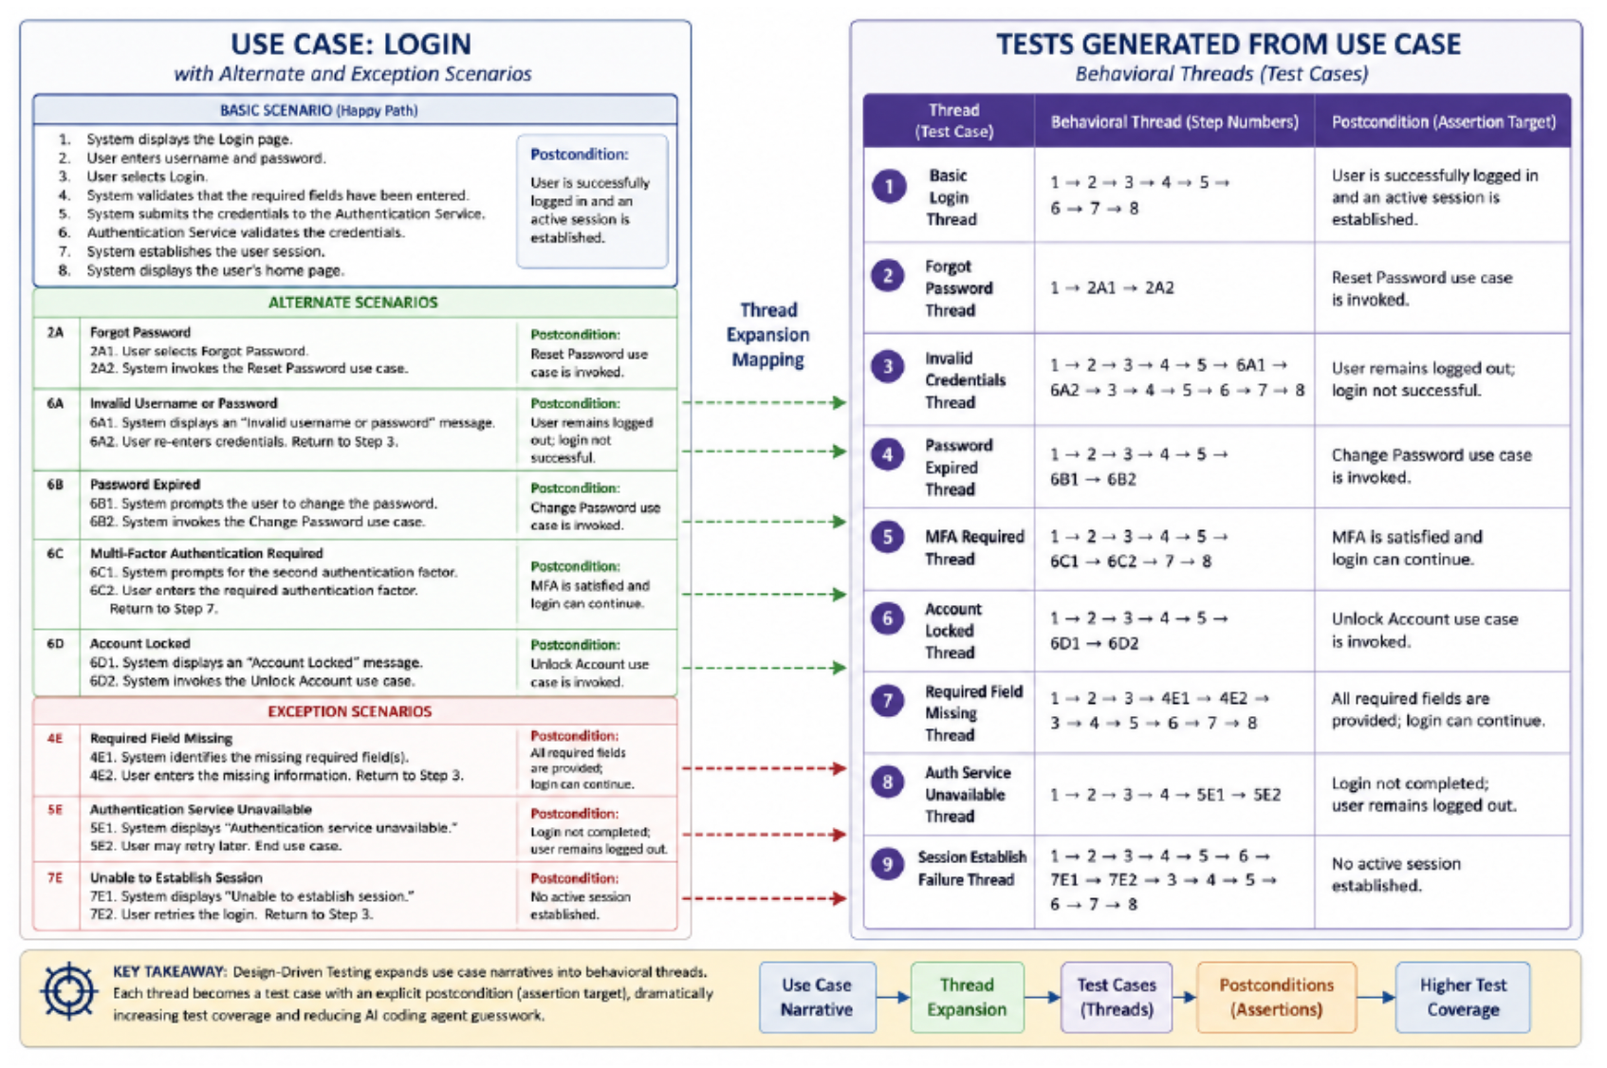
Thread expansion creates end-to-end behavioral tests
Start with the basic scenario.
Follow each reachable alternate and exception branch.
Resume at rejoin points when specified.
Return ordered steps, traversed scenarios, terminal postcondition, and trace identifiers.
© 2026 Parallel Agile, Inc. All Rights Reserved
Testing

Slide 21
Semantic behavior is queryable engineering information
Unstructured prose
Structured SysML v2 semantics
Queries, tests, traces, and transformations
Find use cases with no alternate or exception scenarios.
Extract candidate requirements from off-nominal behavior.
Find scenarios without postconditions.
Expand a use case into behavioral threads.
Trace intent from requirement to behavior to verification.
© 2026 Parallel Agile, Inc. All Rights Reserved
Queries

Slide 22
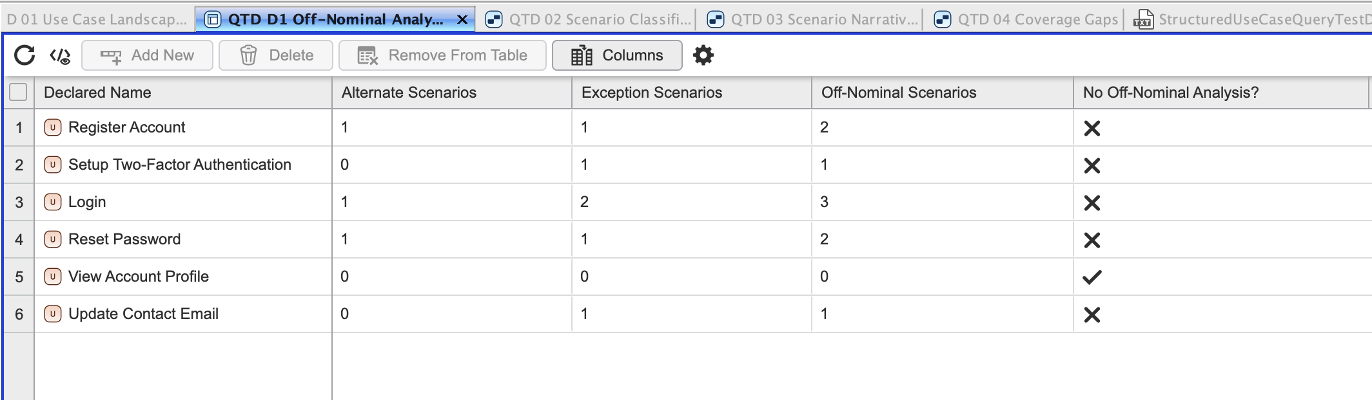
Off-nominal behavior is measurable
Alternate and exception scenarios are counted by use case.
Use cases with no off-nominal analysis become visible immediately.
This is a completeness check over model semantics, not a manual document review.
© 2026 Parallel Agile, Inc. All Rights Reserved
Queries

Slide 23
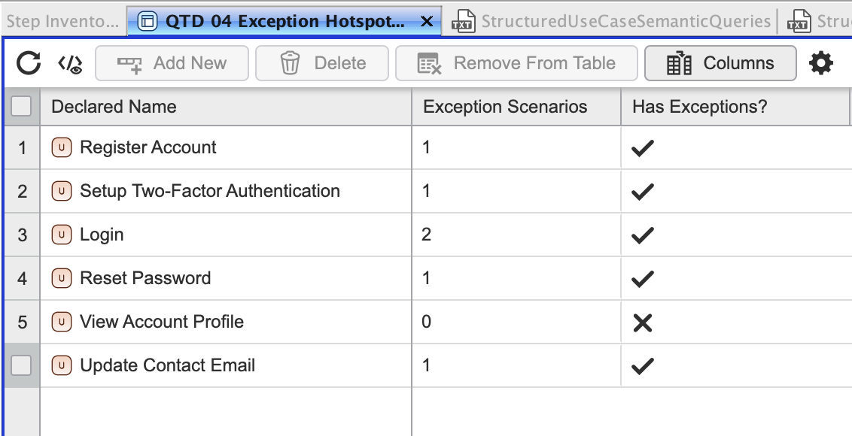
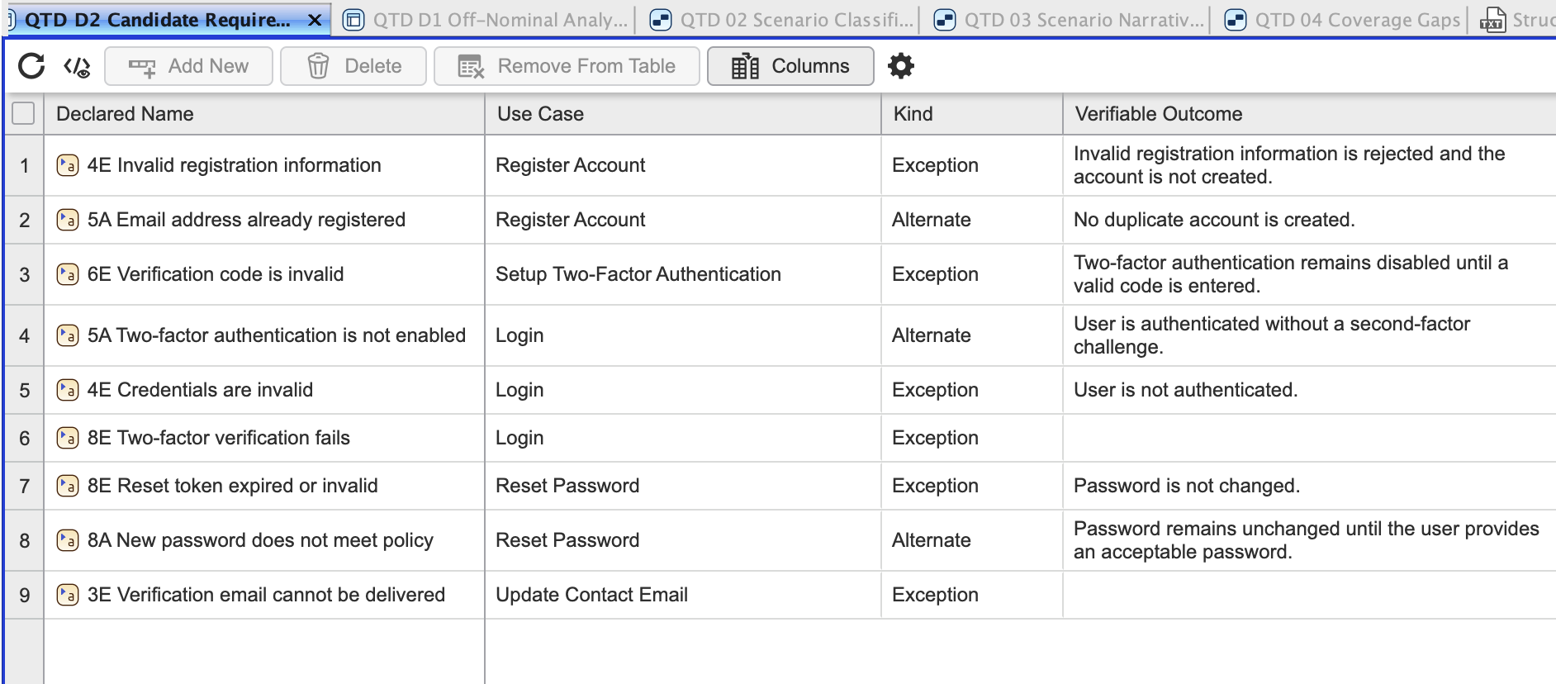
One model exposes hotspots and candidate requirements
© 2026 Parallel Agile, Inc. All Rights Reserved
Queries

Slide 24
Standardization can focus on reusable semantics
Area
What v0.9 proposes
Library
Structured use case specifications and simplified diagrams
Interchange
Use Case Model JSON plus direct SysML v2 textual export
Testing
StructuredTestCase, TestScenario, TestStep, VerifyUseCase, VerifyScenario
Analysis
Queries for off-nominal coverage, requirements, threads, and traceability
© 2026 Parallel Agile, Inc. All Rights Reserved
Standardization

Slide 25
Structured use cases make behavior available to automation
They improve how engineers specify behavior.
They expose missing requirements through alternate and exception analysis.
They support behavioral test generation and traceability.
They make model-based analysis practical because the semantics are explicit.
They create a stronger foundation for AI-assisted engineering workflows.
© 2026 Parallel Agile, Inc. All Rights Reserved
Conclusion

Slide 26
Questions?
Doug Rosenberg
Parallel Agile
www.parallelagile.com
© 2026 Parallel Agile, Inc. All Rights Reserved
Closing

