Slide 1
Landsat &
Sentinel-2 collections
Filtering
Cloud Mask
Reducing
Image Composite
User-defined variables

Slide 2
Landsat &
Sentinel-2 collections
Filtering
Cloud Mask
Reducing
Image Composite

Slide 3
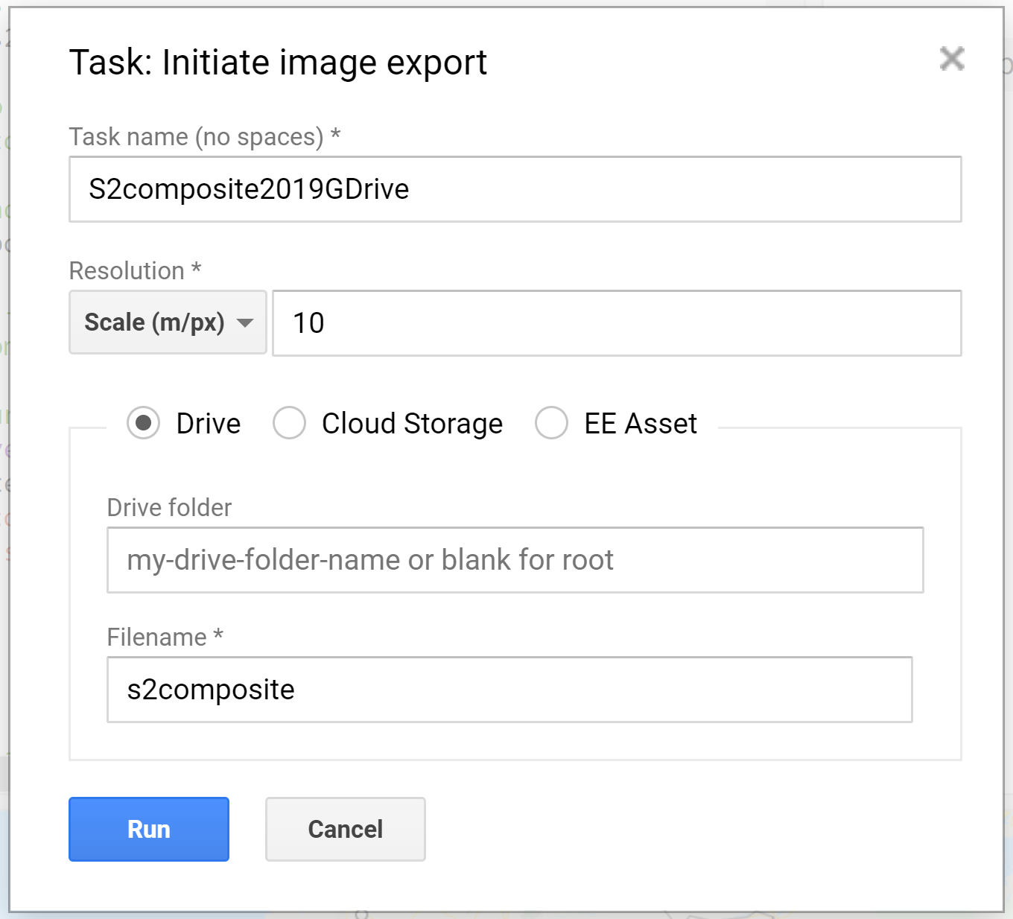
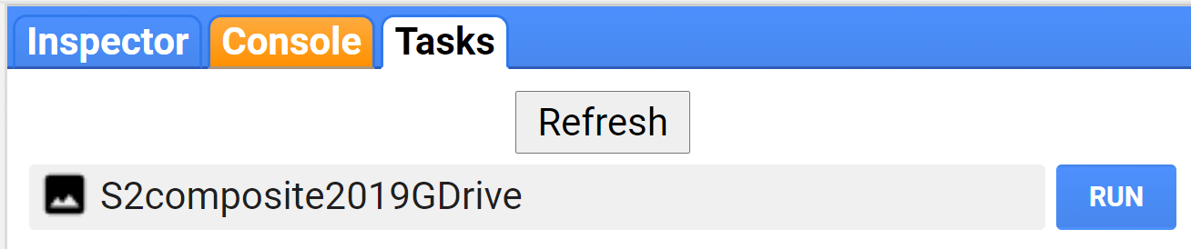

Slide 4
