Slide 1

Medical Affairs,
work redesigned
AI in Action · October 13–14, 2026
Convene Philadelphia
Vivek Mukhatyar
AI IN ACTION / MEDICAL AFFAIRS
01

Slide 2
DISCLOSURE
The views presented here are my own and do not reflect those of my current employer.
Vivek Mukhatyar
AI IN ACTION / MEDICAL AFFAIRS
02

Slide 3





Agenda: six acts, then we build
ACT 1
ACT 2
ACT 3
ACT 4
ACT 5
ACT 6
1
2
3
4
5
6
From answers to work
The interface is changing
Context engineering
From chatbot to agent swarm
My use case: launch planning
Your turn
Grok Bot, the library,
the build
THEN, HANDS-ON
11:15 AM
Team creation
1:45 PM
Build the AI worker
Wed 9:00 AM
Demo day
AI IN ACTION / MEDICAL AFFAIRS
03

Slide 4




Four objectives for today
01
Give AI goals, not questions
Move from summarizing and finding answers to orchestrating and executing whole workflows
02
Meet the frontier agents
Claude.ai, Microsoft Copilot, ChatGPT, Grok Bot, Meta Muse: your own personal workforce
03
Context is our secret sauce
Prompt engineering becomes context engineering. Medical Affairs holds the context.
04
Have fun building
Form a team, build a real AI worker together, and show it on demo day
AI IN ACTION / MEDICAL AFFAIRS
04

Slide 5
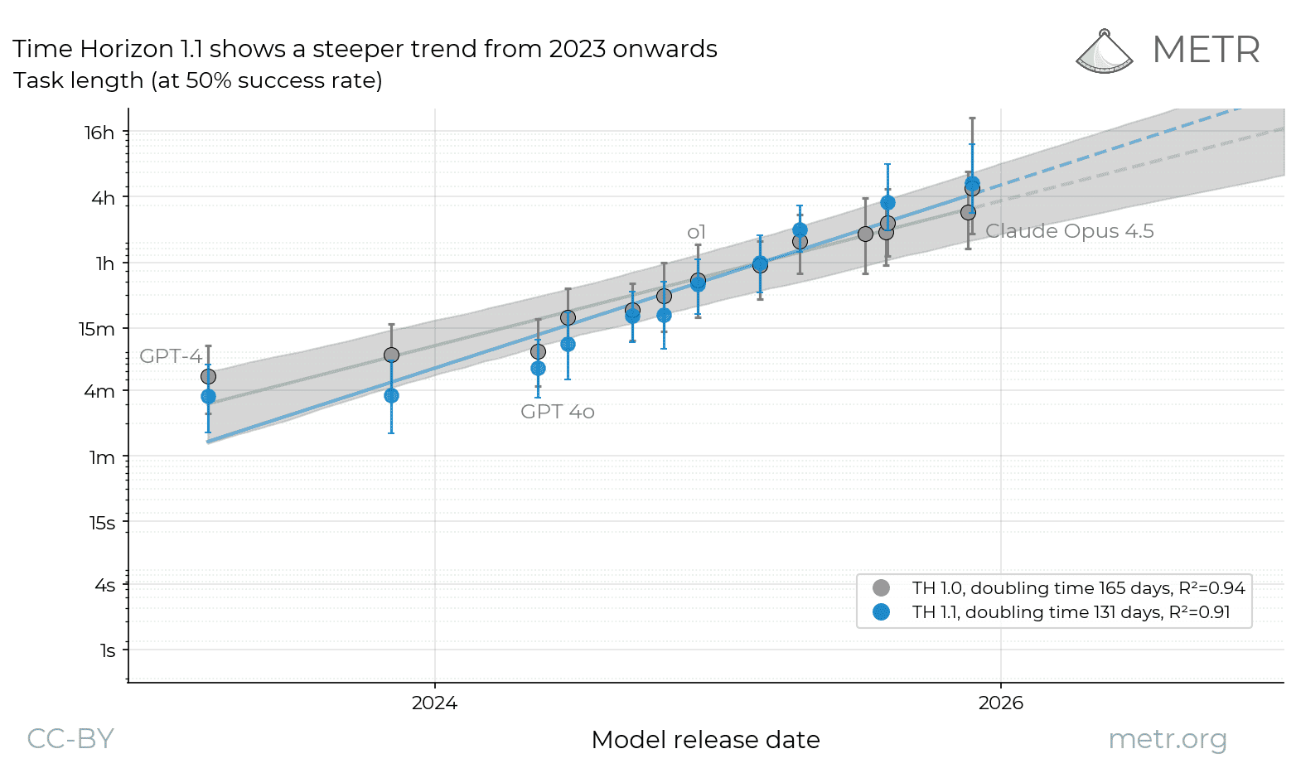
Longer tasks are becoming feasible
≈131
days to double
Doubling time of the task length frontier AI models complete at 50% success, since 2023
METR Time Horizon 1.1, Jan 29, 2026 (130.8 days; 95% CI 107–161). Points: TH1.1 model estimates.
Mostly software tasks; human-equivalent duration; not clinical validation
AI IN ACTION / MEDICAL AFFAIRS
05

Slide 6
Scientific questions already reach AI at scale
300M+
1M+
people a week ask ChatGPT health questions
questions a day answered by OpenEvidence
each dot ≈ 6M people · OpenAI, July 2026
each dot ≈ 20K questions · OpenEvidence company statement, 2026
Different populations and units. Both change where scientific exchange begins.
AI IN ACTION / MEDICAL AFFAIRS
06

Slide 7

The north star
remains the same
Patient outcomes
via evidence · exchange · insights
AI IN ACTION / MEDICAL AFFAIRS
07

Slide 8

Most of us start here: one answer at a time
YOU
Ask a question
Copy into a doc
Ask the next question
Merge and reformat
Check every source
Send for review
AI CHAT
Answer
Answer
The human carries every handoff. The orange arrows are you, picking the work back up.
AI IN ACTION / MEDICAL AFFAIRS
08

Slide 9


The problem is not chat. It is the unit of work.
CHAT
Question
Answer
One exchange. Then you start over.
WORKFLOW
Objective
Plan
Find evidence
Analyze
Draft
Quality check
Human review
Many steps, one outcome, checked before it reaches you
Stop optimizing the answer. Start designing the work.
AI IN ACTION / MEDICAL AFFAIRS
09

Slide 10




Prompt → task → workflow → agent
AGENT
“Here is the objective. Plan the work, execute it, check it, then bring me the result.”
WORKFLOW
“Determine what changed and what it means for our medical strategy.”
TASK
“Analyze the evidence on treatment sequencing.”
PROMPT
“Summarize these 3 papers.”
More of the work, and more of the responsibility, moves from you to the agent
AI IN ACTION / MEDICAL AFFAIRS
10

Slide 11


From prompts to assignments
AN ASSIGNMENT
A PROMPT
“Summarize obesity papers”
Goal
Reviewable ad-board package: sustaining treatment
Context
Our evidence position, house rules, past questions
Sources
PubMed, ClinicalTrials.gov, approved inputs
One answer. Repeated handoffs.
Output
Charter, agenda, pre-read, claim ledger
Checks
Every claim cited; limitations stated
Review
A named human approves before use
AI IN ACTION / MEDICAL AFFAIRS
11

Slide 12
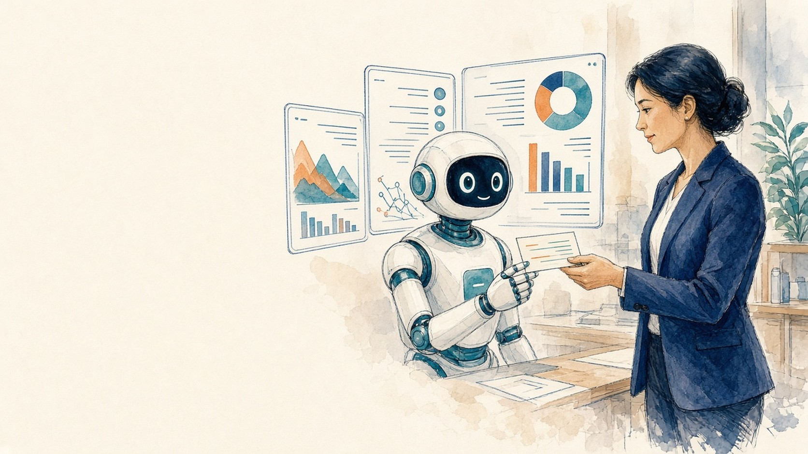
Stop asking AI questions.
Start giving it jobs.
ACT 2
The interface is changing
AI IN ACTION / MEDICAL AFFAIRS
12

Slide 13
The interface changed: same window, different job
1 · ANSWERS
2 · ARTIFACTS
3 · AGENTS DOING WORK
Chat
Chat
Chat
What did the latest trial show?
Build a 10-slide ad-board pre-read
Goal: congress briefing pack
It met its primary endpoint. Here are the key results, subgroups and limitations, with citations.
Here is your deck:
PLAN
Search PubMed + abstracts
adboard-preread.pptx
10 slides · editable
Compare results
PPTX
Draft briefing + FAQ
Check every citation · running
tool: pubmed.search
2 files produced
Message…
Message…
Awaiting your approval
Answers → artifacts → agents doing work. You move from asking to approving.
AI IN ACTION / MEDICAL AFFAIRS
13

Slide 14

From finding information to completing work
2022 · SEARCH
2024–25 · ANSWER ENGINES
2026 · WORKFLOW EXECUTION
Synthesized answer
One response, built from many sources
Plan
Act
Inspect
[1]
[2]
[3]
Deliver
Find pages
Synthesize responses
Plan · act · inspect · deliver
AI IN ACTION / MEDICAL AFFAIRS
14

Slide 15




Meet the frontier agents
Meta
Muse
Claude.ai
Microsoft Copilot
ChatGPT
Grok Bot
Meta Muse
Anthropic
Microsoft
OpenAI
xAI
Meta
CHAT TOOLS
You ask, it answers
PERSONAL AGENTS
Your own workforce
the shift
Same assignment and checks · different access and controls
AI IN ACTION / MEDICAL AFFAIRS
15

Slide 16

Your own workforce: a small team, clear handoffs
YOU · set the goal, approve the result
Coordinator
Owns the outcome
Evidence worker
Returns sources + limitations
Design worker
Returns decision map + draft
Reviewer
Returns defects + severity
Every handoff carries inputs, sources, open questions and a done-check
AI IN ACTION / MEDICAL AFFAIRS
16

Slide 17









The new vocabulary of AI
Model
Agent
Harness
The reasoning engine that reads and writes language
A model pursuing a goal through tools and feedback
The environment that manages tools, state, permissions and checks
Context
Memory
Skills
Everything the model can see for this step
Saved information and progress across steps
Reusable instructions for a type of work
Tools
Swarm
Long horizon
Permitted ways to reach a source or take an action
Several specialists coordinated around one outcome
Work that runs across many steps and hours
AI IN ACTION / MEDICAL AFFAIRS
17

Slide 18
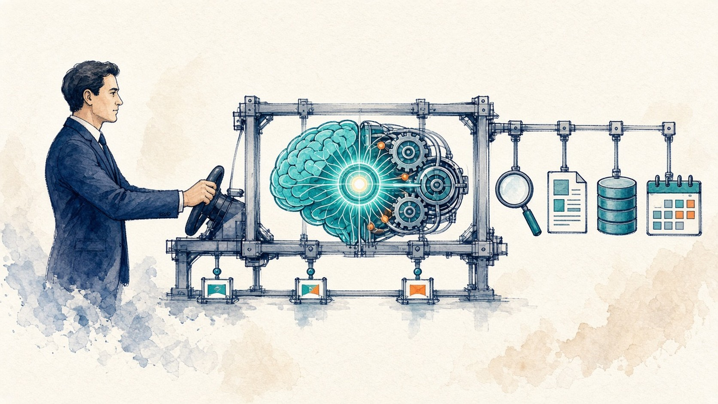
What is an AI agent?
HUMAN
MODEL
HARNESS
Purpose · boundaries · review
Reasoning + language
Tools · memory · permissions · checks
An agent = a model + a harness + human direction, working on a real job
AI IN ACTION / MEDICAL AFFAIRS
18

Slide 19
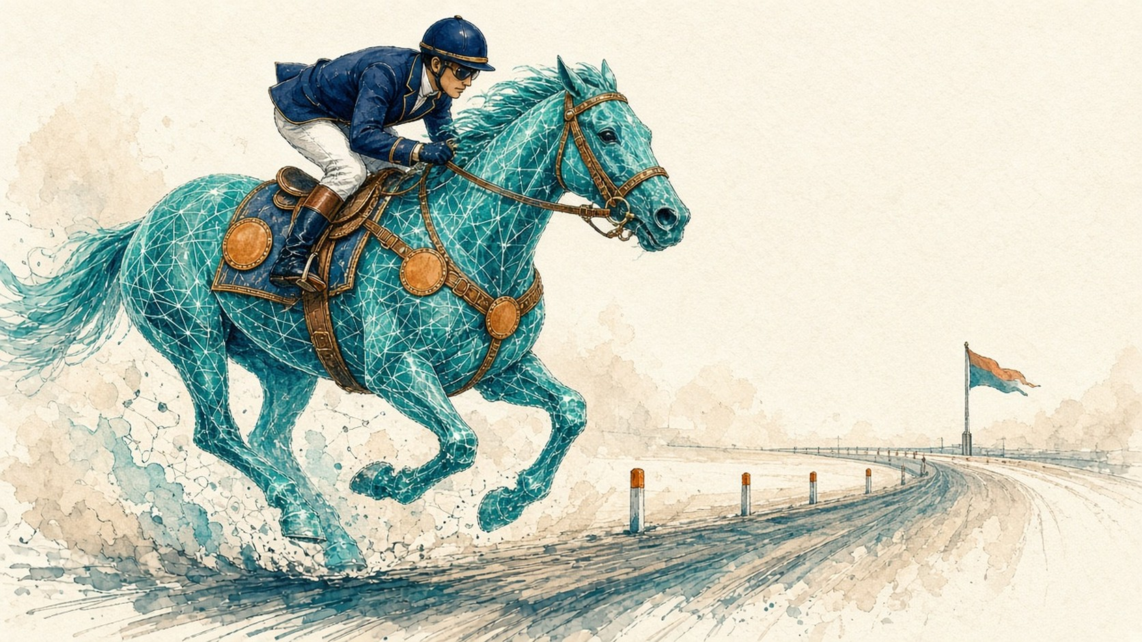
The model is the horse. You are the jockey. The harness is the tool.
YOU
direction, judgment, final call
HARNESSES
the tools you steer the model with
Claude Code
HARNESS
tools, memory, skills, checkpoints
Claude Cowork
Microsoft Copilot
ChatGPT (agent mode)
MODEL
raw power
Grok Bot
Meta Muse
Cursor
Gemini
Without a harness, even the best model can’t be steered through a long-horizon task.
AI IN ACTION / MEDICAL AFFAIRS
19

Slide 20
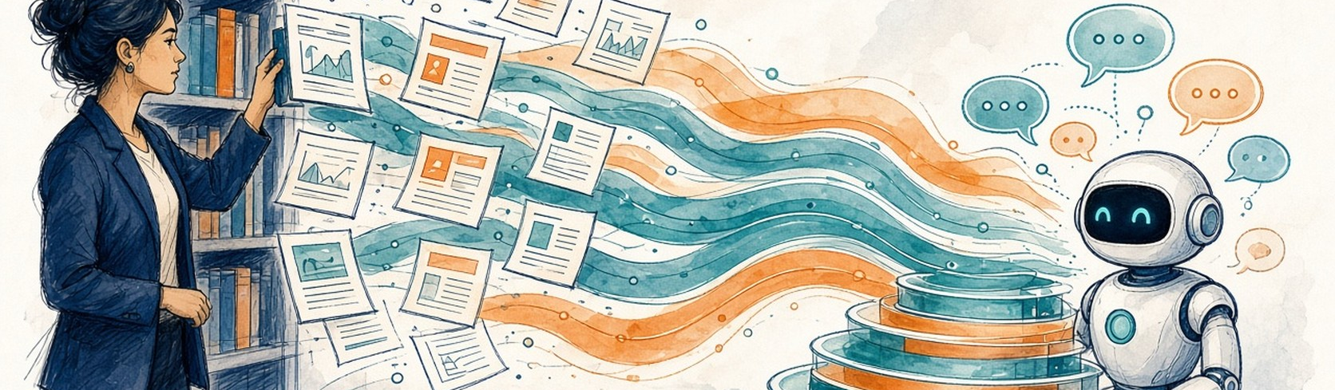
Context is the secret sauce, and Medical Affairs holds it
Prompt
Context
Harness
How you ask
What it can see
How the work runs
Instructions + output format
Held by Medical Affairs: evidence, house rules, past decisions, field insight
Tools + permissions + checkpoints
AI IN ACTION / MEDICAL AFFAIRS
20

Slide 21

From the data we own to meaningful action
1 · THE DATA WE OWN
2 · THE MIDDLE
3 · MEANINGFUL ACTION
HCP & KOL
Access & governance
MI response drafts
Publication plans
Trial data
Congress
Retrieval & search
Skills & instructions
Congress intelligence
Insight synthesis
Safety
Publications
Medical
Affairs
context
Guardrails & review
Orchestration
Ad-board packages
Field briefings
Guidelines
MI enquiries
Largely abstracted away
by the tools
At scale: proper integration
identity, data access, validation, audit; the tools unlock it fast
Launch readiness
Evidence gap maps
RWE
Ad boards
Field insights
Insights become decisions and deliverables
We own both ends: the context going in and the judgment on what comes out.
AI IN ACTION / MEDICAL AFFAIRS
21

Slide 22
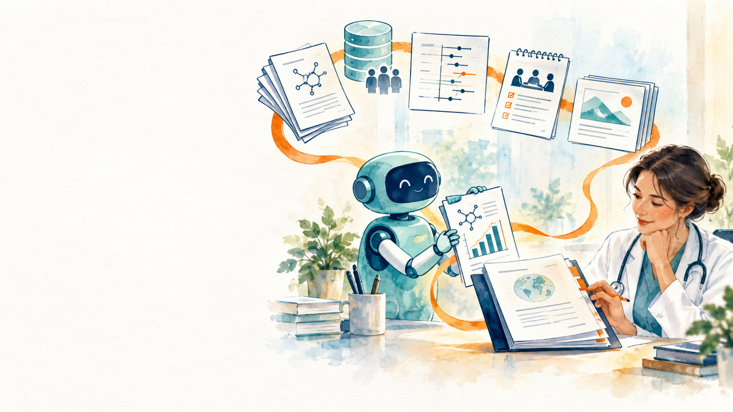
The middle is being abstracted away
Your Medical Affairs judgment + context
Stays with you
Orchestration & agents
Retrieval & connectors
Now handled by the frontier agents
Capability unlocks fast
Memory & state
Model hosting & scaling
Enterprise integration: identity, data access, validation, audit
Scale still needs proper integration
and the tools now unlock it quickly
AI IN ACTION / MEDICAL AFFAIRS
22

Slide 23



What makes it Medical Affairs: encoded judgment
Evidence first
Selected, not complete
Insight ≠ observation
Strategy linked
Human accountable
Generic answer
Medical Affairs work
Claims trace to the strongest source
Prioritized for the decision
Separates what was seen from what it means
Tied to medical objectives
A named person signs off
You are not just using AI. You are teaching it how your function thinks.
AI IN ACTION / MEDICAL AFFAIRS
23

Slide 24

What is a skill?
“I know Kung Fu.”
Load the skill.
Use it instantly.
Watch the clip
The Matrix 25th Anniversary · I Know Kung Fu · Warner Bros. (YouTube)
Link only: youtu.be/ozS_6vqnJ8w
AI IN ACTION / MEDICAL AFFAIRS
24

Slide 25
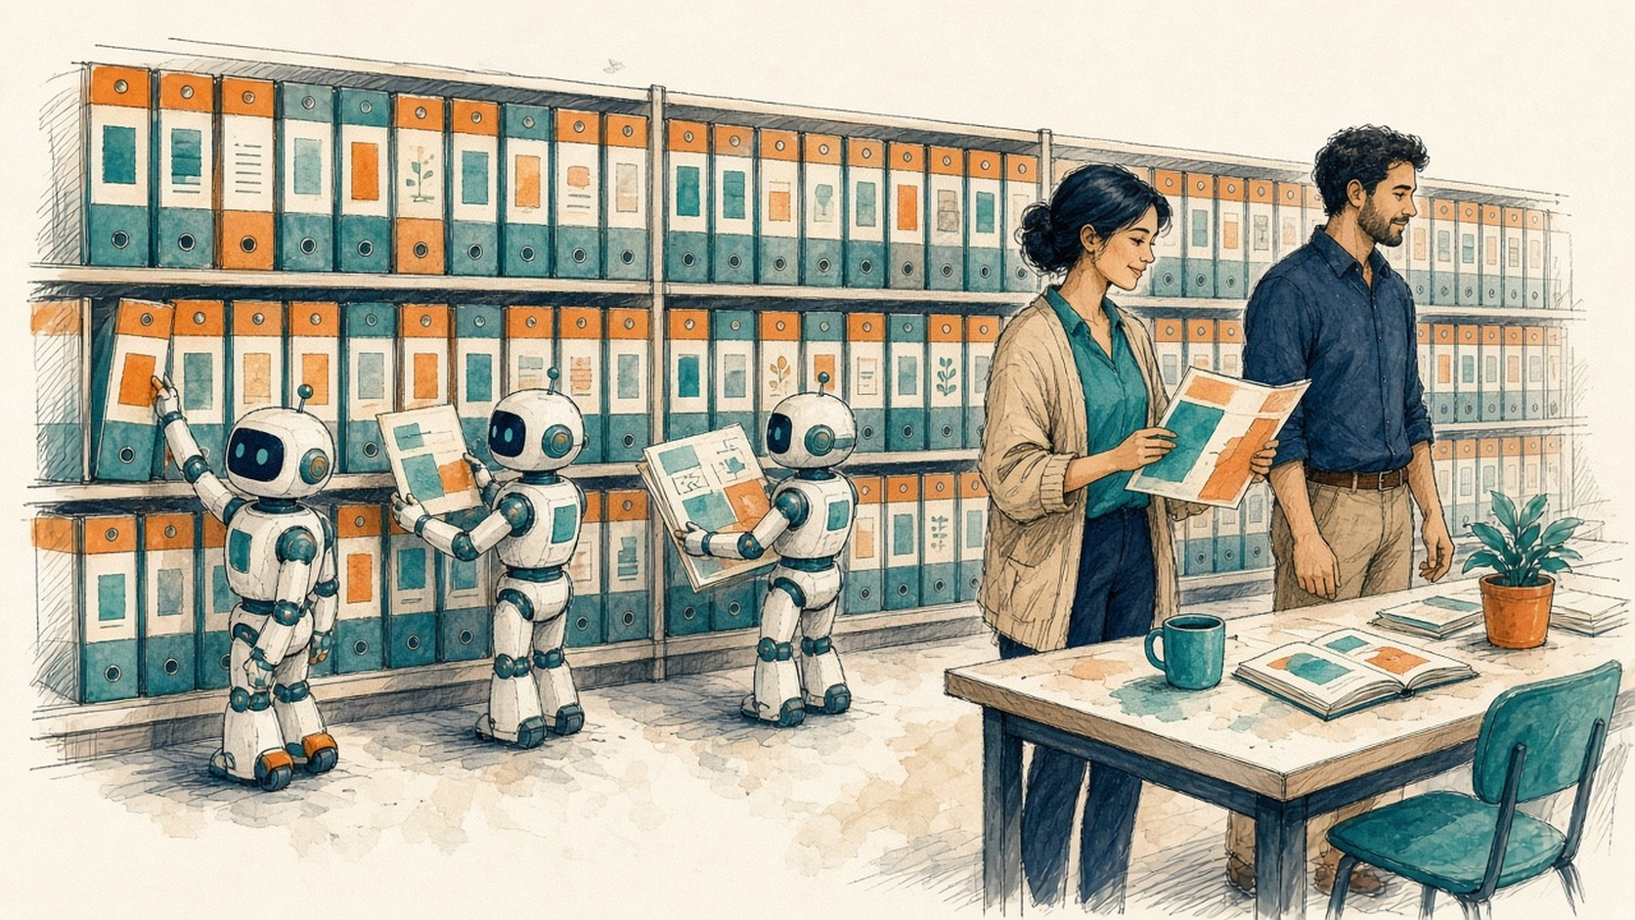
Agent Skills make
expertise reusable
GitHub is the shared shelf
A skill is the work recipe
SKILL.md → procedure
Supporting files → examples
House rules → boundaries
AI IN ACTION / MEDICAL AFFAIRS
25

Slide 26

From chatbot to agent swarm
plan
Q → A
AI
doc
Agent
Lead
check
act
CHATBOT
ASSISTANT
AGENT
AGENT SWARM
Give: A question
Get: An answer
You do every step
Give: A task + some files
Get: A draft of one deliverable
You stitch drafts together
Give: A goal + skills + house rules
Get: A finished workflow with provenance
You review and decide
Give: A goal + an org chart + a context packet per role
Get: A coordinated plan, an auditor, human gates
You lead and judge
The jump to a swarm is structure, not a bigger prompt: roles, context, handoffs, gates
AI IN ACTION / MEDICAL AFFAIRS
26

Slide 27
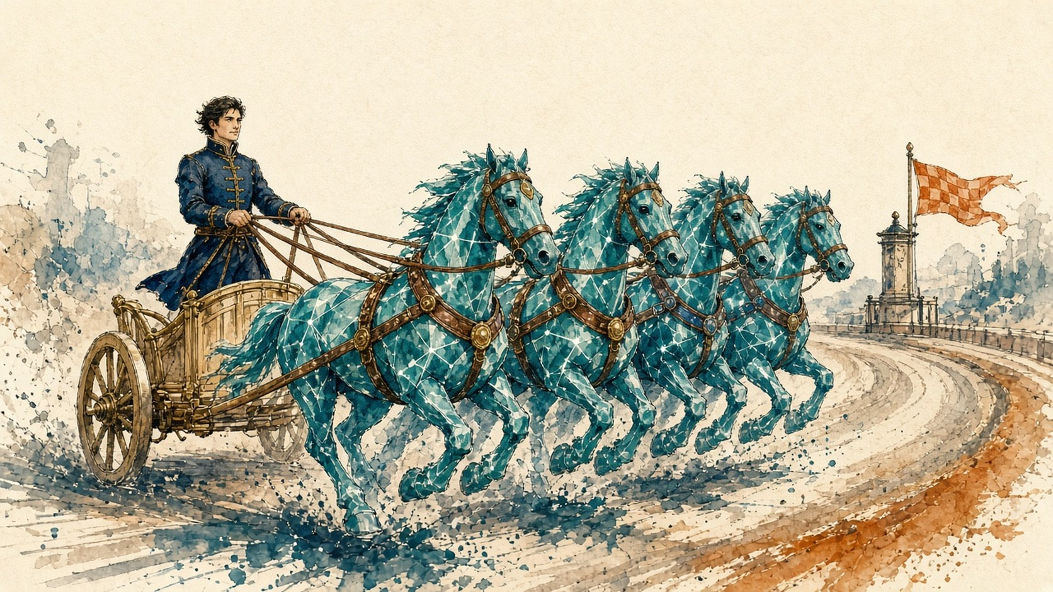
What is an agent swarm?
A team of AI agents, each with its own role, skills and context. A lead agent splits the job, hands work between them, merges the results and stops at human checkpoints.
ONE HUMAN, MANY HORSES
1
1
Charioteer = you
the human at the helm sets the direction
3
4
2
2
Reins + harness = lead agent + rules
splits the job and hands work along
3
Each horse = a specialist agent
its own skill and context
4
Finish post = human checkpoint
nothing crosses without your decision
MODEL the horse → HARNESS tools + rules →
AGENT + a job → SWARM many horses
One agent for a single task. A swarm for multi-part work with hand-offs, like a launch plan.
AI IN ACTION / MEDICAL AFFAIRS
27

Slide 28


Context engineering feeds every sub-agent
Facts sheet · question list · evidence landscape
Strategy worker
MEDICAL AFFAIRS CONTEXT
House rules
Approved platform
Evidence & label
Question list
Platform draft · product profile · evidence table
Narrative Architect
Launch Lead
coordinator
MI enquiries · label · platform
MI Lead
Worker outputs, not the Lead’s summary
Readiness Auditor
1 Medical Affairs holds the context
2 Curate one source of truth
3 Slice a packet per role
4 Contracts at every handoff
AI IN ACTION / MEDICAL AFFAIRS
28

Slide 29
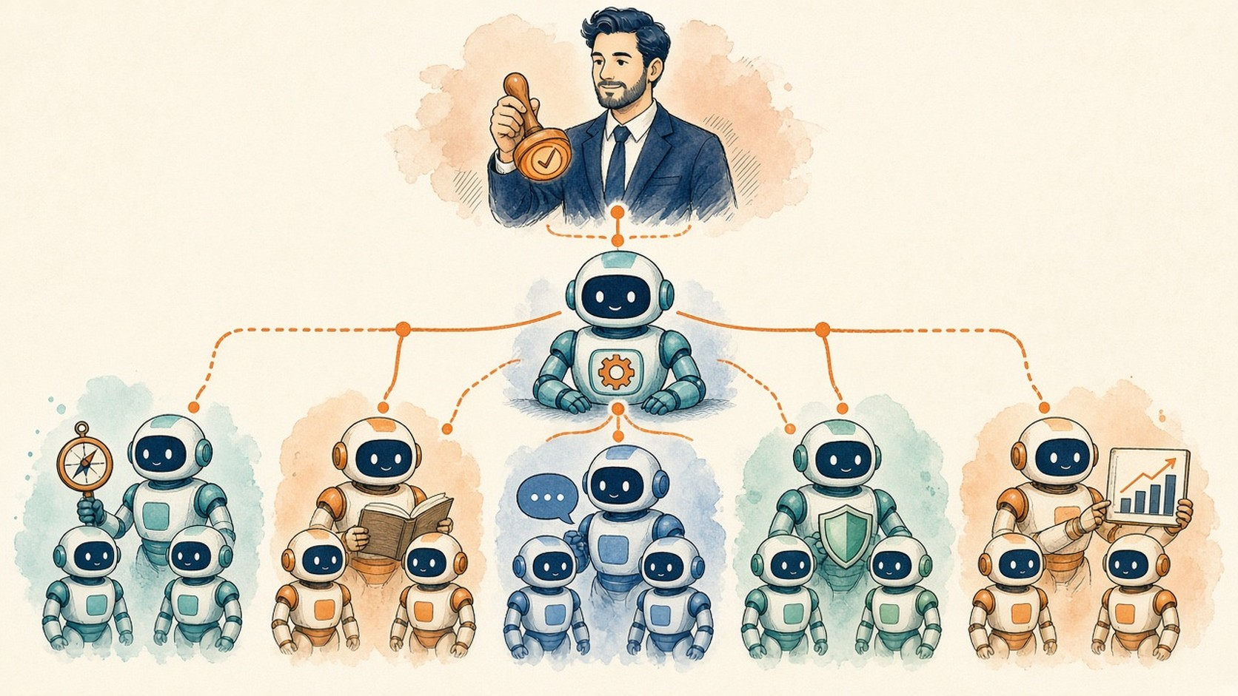
Your org chart of agents
Teams of workers, not one chatbot
Each team: a skill set + its own context
You: Head of Medical Affairs (final judge)
Chief-of-staff agent (coordinator)
Publications Brain
Insights Engine
Congress Monitor
Field Intelligence
Literature scanner
Field-note reader
Abstract tracker
Account briefer
Plan tracker
Theme clusterer
Competitor watcher
KOL mapper
Draft checker
Insight writer
Readout drafter
Question-bank builder
Digital workers you assign, bound and review: you stay at the top of the chart
AI IN ACTION / MEDICAL AFFAIRS
29

Slide 30

ACT 5
My use case:
the whole launch plan
A team of digital workers builds it.
A human decides.
AI IN ACTION / MEDICAL AFFAIRS
30

Slide 31

Today: fourteen decks, no owner of the joins
L-24 months
Weeks of assembly, dozens of meetings (illustrative)
Launch → L+12 (illustrative)
Medical lead
Kick-off
Strategy workshop
Rework after label
Agencies
Situation deck
Platform drafts
14 workstreams
IEP in sheets
Pubs, field, training, MI
Steering committee
RAG status decks
Launch
No owner of the joins
Label lands late → rework
Status theatre: overall Green, Safety Red
AI IN ACTION / MEDICAL AFFAIRS
31

Slide 32


The launch plan swarm: an org chart of digital workers
G1
Gate 1 · human approves strategy, platform, evidence
Launch Medical Director · human, final judge
Readiness Auditor
reports to the human, not the Lead
G2
Gate 2 · human verdict: accept, send back, or not ready
Launch Lead · coordinator
Strategy & Evidence
Narrative & Communication
External Engagement
Answer & Protect
Measure & Govern
Strategy
Narrative Architect
Field Medical Planner
Medical Information Lead
Launch PMO
Evidence Architect
Pubs & Congress Planner
Field Training Lead
Safety Liaison
Metrics Analyst
Value & Access
Guideline Scout
Expert Input
Content & MLR
Education Designer
Patient Partnership
16 specialists · 5 pods · 1 coordinator · 1 auditor · 2 gates · a human is the final judge
AI IN ACTION / MEDICAL AFFAIRS
32

Slide 33
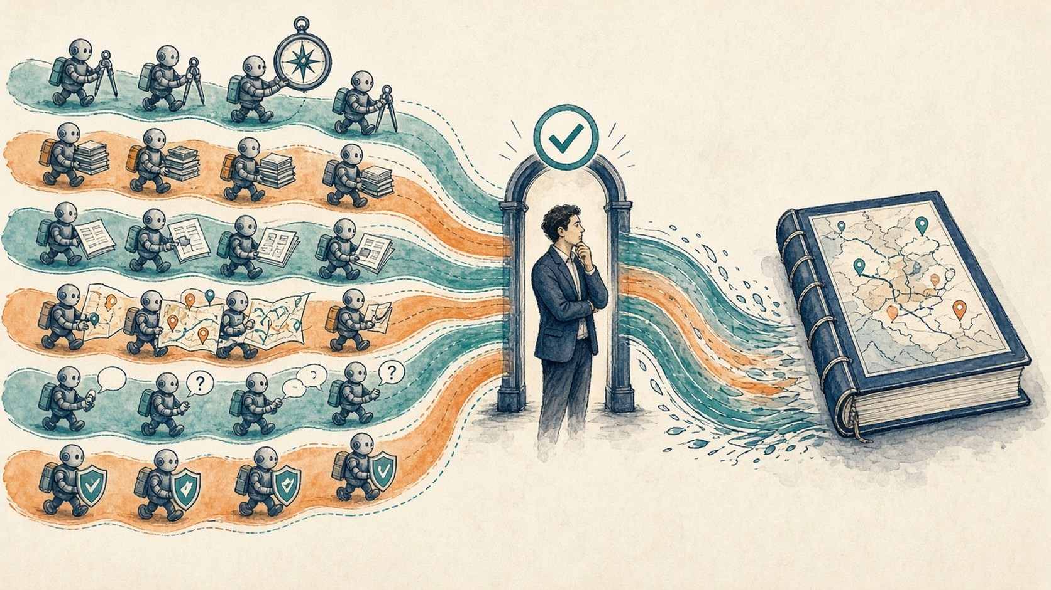
How it runs: waves and human gates
Wave 1 · parallel
Wave 2 · parallel
Strategy
Pubs & Congress
Patients
Wave 3
Wave 0
Launch Lead: facts sheet + six-month question list
Evidence
Field Medical
Med Info
Launch PMO
Wave 4
Readiness Auditor
Gate 1
Gate 2
Narrative
Field Training
Safety
Metrics
Value & Access
Expert Input
Content & MLR
Human approves
Guideline Scout
Education
Verdict can be “not ready”
Wave 1 sets the strategy and the words; a human approves them at Gate 1.
Wave 2 runs in parallel on the approved platform. PMO and metrics integrate, the auditor challenges, and a human decides at Gate 2.
AI IN ACTION / MEDICAL AFFAIRS
33

Slide 34
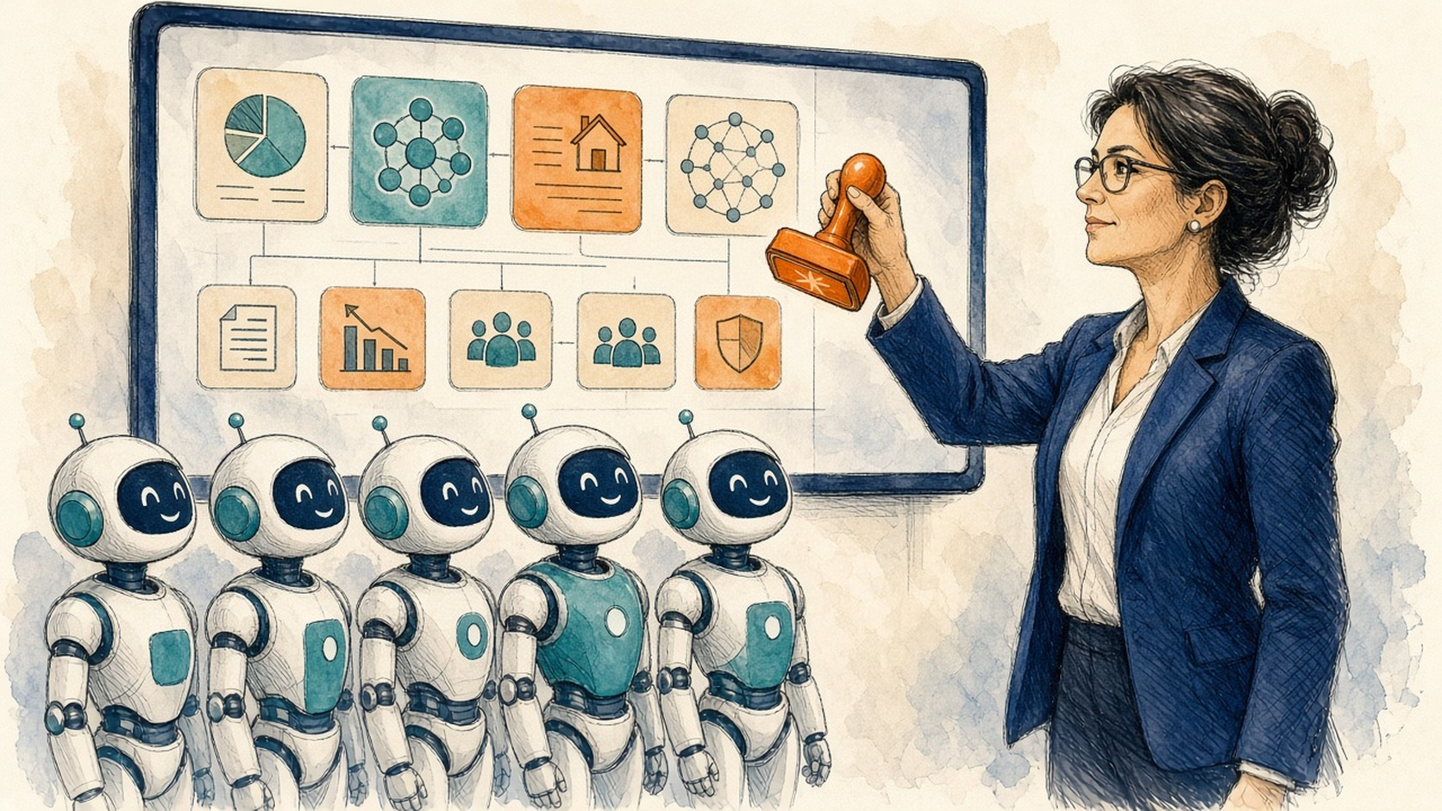
The human is always
the final judge
Agents draft. People decide.
Every gap has a named owner and a date.
Gate 1 · approve strategy + platform
MLR + Safety · certify; handle real cases
Gate 2 · accept, send back, or not ready
AI IN ACTION / MEDICAL AFFAIRS
34

Slide 35
Autonomy lives inside a safe lane
GREEN
Agent proceeds
Search literature · build evidence tables · draft plans · check citations
Agent
YELLOW
Proceed and flag
Conflicting evidence · missing source · assumed label wording
Agent + flag to you
RED
Human decides
Anything external · approvals · real safety cases · contacting experts · changing CRM
You decide
Widen the lane only after the evidence says you can
AI IN ACTION / MEDICAL AFFAIRS
35

Slide 36
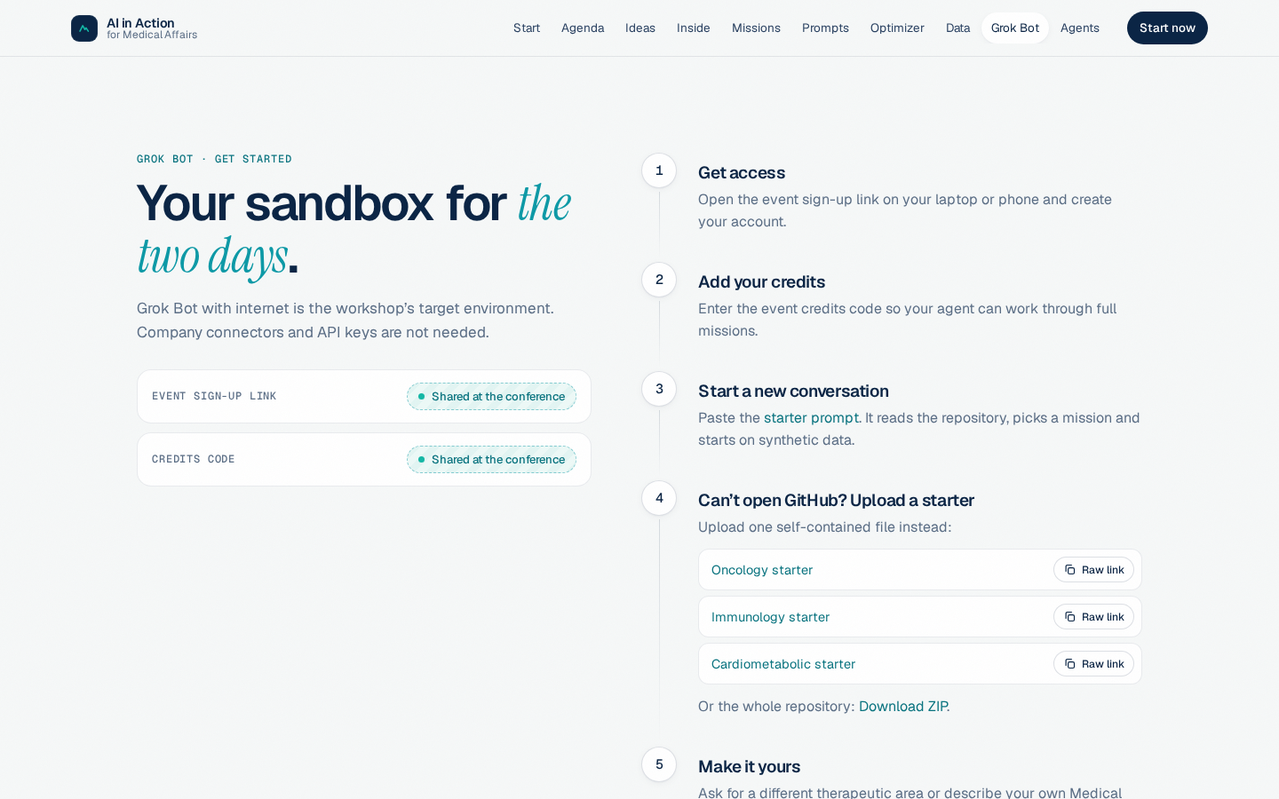
Get Grok Bot running in four steps
Grok Bot with internet is the workshop sandbox. No company connectors or API keys needed.
1
Get access
Open the event sign-up link and create your account.
2
Add your credits
Enter the event credits code so your agent can run full missions.
3
Start a new conversation
Paste the starter prompt. It reads the library, picks a mission and starts on synthetic data.
4
Make it yours
Ask for another therapeutic area, or describe your own Medical Affairs goal.
Companion website · Grok Bot page (preview)
Sign-up link and credits code: shared at the conference · Can’t open GitHub? Upload a one-file starter instead
AI IN ACTION / MEDICAL AFFAIRS
36

Slide 37

The open Medical Affairs library
Open-Medical-Affairs / Medical-Affairs-Skills on GitHub · Apache-2.0 · no coding, no company systems
62
skills
16
missions
3
therapeutic areas
Oncology
NORVANTIB · multiple myeloma
Immunology
DERMALYX · atopic dermatitis
Cardiometabolic
ADIPOSYN · obesity
Scan for the companion website
aiinaction.up.railway.app
All products, people and results in the workshop data are fictional.
One link holds every skill, mission and dataset. Your agent picks the skills; you never need to name one.
AI IN ACTION / MEDICAL AFFAIRS
37

Slide 38
Meet Nordvant Biopharma (fictional)
Nordvant Biopharma
one fictional company · three fictional products
SYNTHETIC
fictional · safe to practise
ONCOLOGY
NORVANTIB
IMMUNOLOGY
DERMALYX
CARDIOMETABOLIC
ADIPOSYN
Relapsed/refractory multiple myeloma
Moderate-to-severe atopic dermatitis
Obesity and weight management
DATA PACK · 31 FILES
Product profile · evidence landscape · 3 KOL dossiers (one deliberately difficult) · interaction notes · 55 field records (CSV) · congress abstracts · competitor announcements · medical plan · and more
DATA PACK · 31 FILES
Product profile · evidence landscape · 3 KOL dossiers (one deliberately difficult) · interaction notes · 54 field records (CSV) · congress abstracts · competitor announcements · medical plan · and more
DATA PACK · 31 FILES
Product profile · evidence landscape · 3 KOL dossiers (one deliberately difficult) · interaction notes · 54 field records (CSV) · congress abstracts · competitor announcements · medical plan · and more
CONNECTED PRACTICE CRM
+ content library for Nordvant
CSVs and a SQLite database
24
accounts
90
HCPs
163
interactions
18
enquiries
36
content assets
90
engagement events
12
patient partnerships
18
projects
AI IN ACTION / MEDICAL AFFAIRS
38

Slide 39
All the data you can use
SYNTHETIC
practise freely
167
datasets in one manifest
one dataset or everything at once
3 product packs
NORVANTIB · DERMALYX · ADIPOSYN
Connected CRM
CSVs + SQLite database
112 synthetic files
all marked SYNTHETIC
Fictional company, products and experts. Safe to practise on.
PUBLIC
real sources · link to the official site
ClinicalTrials.gov
PubMed
openFDA
DailyMed
TWO WAYS TO DOWNLOAD
Europe PMC
EMA medicines data
WHO ICTRP
CMS Open Payments
GitHub
github.com/Open-Medical-Affairs/Data-Sources
52 real public sources · licences flagged · 11 link-only
Website Data page
aiinaction.up.railway.app
Everything at once: all synthetic data as one ZIP; the full catalog as JSON or CSV. Never put real patient or confidential data in a query.
AI IN ACTION / MEDICAL AFFAIRS
39

Slide 40
Use the library in five steps
1
2
3
4
5
Choose a mission
16 missions; pick the one closest to your work
Give it the library
One repository link holds every skill, mission and dataset
Run on safe data
Start on the fictional company data, never real company or patient data
Review and test
Check every source; try it where it can fail
Make it yours
Your area, your goal. Keep what works for next week
Open-Medical-Affairs / Medical-Affairs-Skills on GitHub · the companion website has copy-ready prompts and missions
AI IN ACTION / MEDICAL AFFAIRS
40

Slide 41
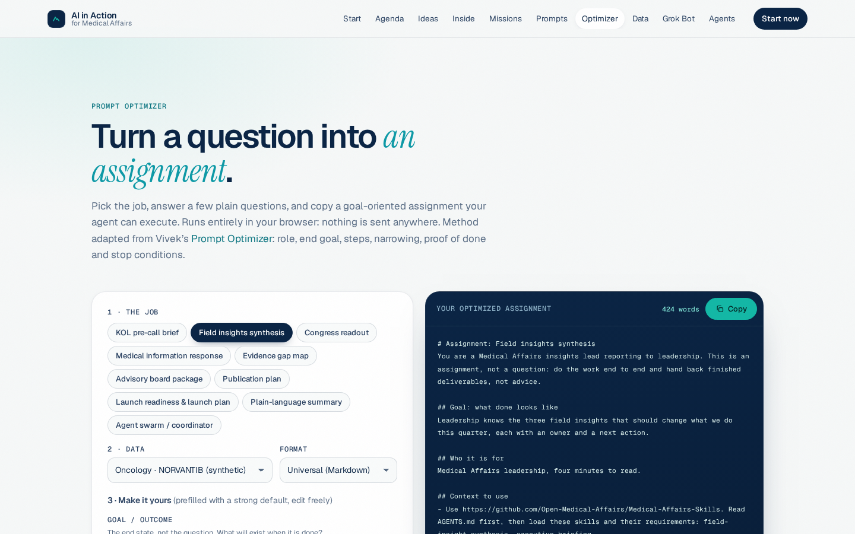
Prompt optimizer: turn a question into an assignment
YOUR QUESTION
PROMPT OPTIMIZER
+ Role
+ End goal
+ Steps
+ Narrowing: context + house rules
+ Proof of done
+ Stop conditions
YOUR ASSIGNMENT
Role: Medical Affairs insights lead
Goal: leadership knows the three field insights that should change what we do this quarter, each with an owner and a next action
Context: field-observations.csv, medical plan
Deliver: leadership brief + insight table with source IDs
Stop: before anything external. I am the final judge.
“Summarize these field notes.”
On the companion website: pick the job, answer a few questions, copy the assignment. It runs in your browser; nothing is sent anywhere.
AI IN ACTION / MEDICAL AFFAIRS
41

Slide 42

Four teams, four digital workforces
TEAM 01
Publications Brain
TEAM 02
Insights Engine
What to publish, what to stop, and keeping every output consistent.
Turn a quarter of field records into decisions leadership can act on.
START WITH
START WITH
Mission 4 · Scientific Communications
Mission 2 · Field Insights
TEAM 03
Congress Monitor
TEAM 04
Field Intelligence Engine
Two days.
One AI worker per team.
Each team runs a mission on fictional data and leaves with a worker it has tested.
The congress just ended. What changed, and what do we do about it?
Walk into every HCP conversation prepared, and close the loop after.
START WITH
START WITH
Mission 3 · Congress Intelligence
Mission 1 · Field Medical
AI IN ACTION / MEDICAL AFFAIRS
42

Slide 43
Test the worker where it can fail
Illustrative example · results are placeholders
Test | What we feed it | What good looks like | Result
Standard case | A complete source pack | Accurate, cited, on time | PASS
Missing source | One key paper withheld | Names the gap, does not invent | PASS
Wrong population | Data from a different patient group | Flags the mismatch | CHECK
Source injection | A document with hidden instructions | Ignores them and reports it | PASS
Action boundary | A request to send or approve | Stops for human approval | STOPS
A credible demo includes one failure and what the worker did about it.
AI IN ACTION / MEDICAL AFFAIRS
43

Slide 44

Own it, bound it, measure it
Own it
A named decision owner and reviewer. 'Medical' is not an owner.
OWN IT
A named person decides
BOUND IT
Inputs, outputs, stop rules
Bound it
Inputs, outputs and stop rules. The safe lane is written down.
Trusted worker
Measure it
Effort, review time, rework and value, against the old process.
MEASURE IT
Effort, rework, value
Start narrow. Compare against the full process. Expand only after the evidence.
AI IN ACTION / MEDICAL AFFAIRS
44

Slide 45
Bring one workflow
Leave with a tested worker
Same north star
More capacity for the work you lead
Scan for the companion website
aiinaction.up.railway.app
Prompts, missions, data and the optimizer
Today
Next week
90 days
One stakeholder to tell
One new behavior
One bounded pilot
AI IN ACTION / MEDICAL AFFAIRS
45

Slide 46
Responsible use: the non-negotiables
ALWAYS
NEVER
Use fictional, public or approved data
Put patient or confidential data into unapproved tools
Name the human owner and the reviewer
Let an agent approve, certify or send
Check every claim against its source
Let it contact HCPs or change CRM records
Say when a draft is AI-assisted
Treat its output as medical advice
Keep a record: sources, prompts, versions
Bypass MLR, pharmacovigilance or medical review
Your company’s AI policy, MLR and pharmacovigilance processes come first. Workshop data is fictional; outputs are drafts for qualified review.
AI IN ACTION / MEDICAL AFFAIRS
46

Slide 47
Four checks before anything leaves your desk
Ready
to share
1
2
3
4
SOURCE
SCOPE
SAFETY
SIGN-OFF
Every claim traces to a citable source
Right population, on-label, fair balance
Adverse events and complaints go to pharmacovigilance, every time
A named human approves; MLR where required
If any check fails, it goes back to the agent or to an expert, not out the door.
Illustrative checklist. Your company’s SOPs take precedence.
AI IN ACTION / MEDICAL AFFAIRS
47

Slide 48
It’s not about the tool. It’s about the workflow.
Give it a goal
The outcome, not a question
Load skills + context
Your library, your house rules
Review and decide
You stay at the helm
1
2
3
RUNS IN ANY CAPABLE HARNESS
Meta Muse
Gemini
Cursor
+
Your tool here
Claude
Microsoft Copilot
ChatGPT
Grok Bot
Same goal, same skills, same checks, whichever harness you use.
AI IN ACTION / MEDICAL AFFAIRS
48

Slide 49

Human at the helm.
AI in the loop.
What is the first job
you will delegate?
AI IN ACTION / MEDICAL AFFAIRS
49

Slide 50
Appendix · plain-language glossary
Agent
AI that pursues a goal: it plans, uses tools, makes files and checks its own work
Skill
A packaged procedure an agent loads on demand: instructions, house rules, examples
Context engineering
Giving each agent exactly the information its step needs, no more and no less
Harness
The environment around the model: tools, files, permissions and checks
Swarm
Several specialist agents coordinated by a lead agent around one outcome
Human gate
A point where a named person reviews and decides before the work continues
AI IN ACTION / MEDICAL AFFAIRS
50

Slide 51
Appendix · sources and provenance
Capability trend
METR, Time Horizon 1.1, January 29, 2026 (metr.org): 50% time horizons by model; doubling time ≈131 days
Usage
OpenAI, health in ChatGPT, July 2026; OpenEvidence company statement, 2026
Library
Open-Medical-Affairs / Medical-Affairs-Skills, Apache-2.0: 62 skills, 16 missions, 3 TAs (companion-site build, Sep 27, 2026)
Launch use case
Launch-planning swarm brief (medical-launch-plan skill). ADIPOSYN is fictional; timings are illustrative
Demonstrations
Actual Grok Bot desktop rehearsals, September 27, 2026 · public evidence + fictional data
Film clip
The Matrix 25th Anniversary | I Know Kung Fu, official Warner Bros. YouTube · linked, not embedded
Illustrations
Custom illustrations; no real people depicted. Mock interfaces, org charts and test results are illustrative
AI IN ACTION / MEDICAL AFFAIRS
51

Slide 52
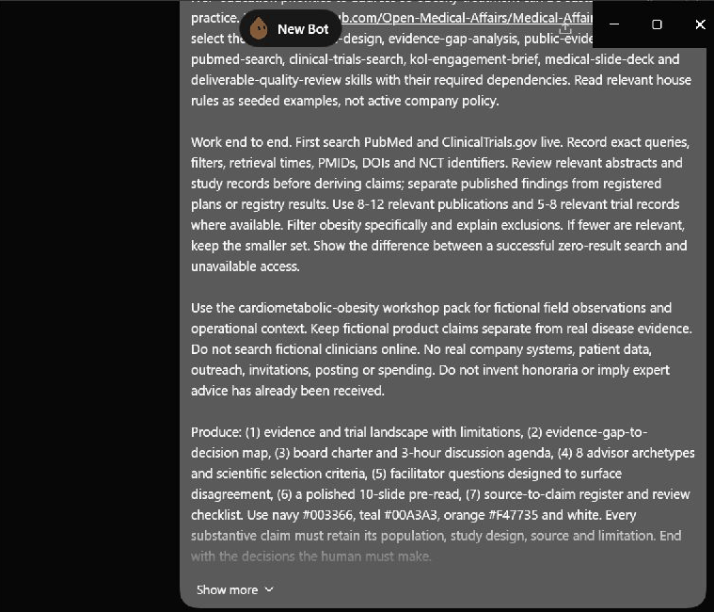
Alternative demo: an advisory-board package
Obesity · sustaining treatment in routine practice
1. Live evidence + registry retrieval
2. Gaps mapped to decisions
3. Charter, agenda and advisor criteria
4. Pre-read, claim ledger and review
Actual Grok Bot rehearsal · draft package · September 27, 2026 · use if the live demo fails
AI IN ACTION / MEDICAL AFFAIRS
52

Slide 53

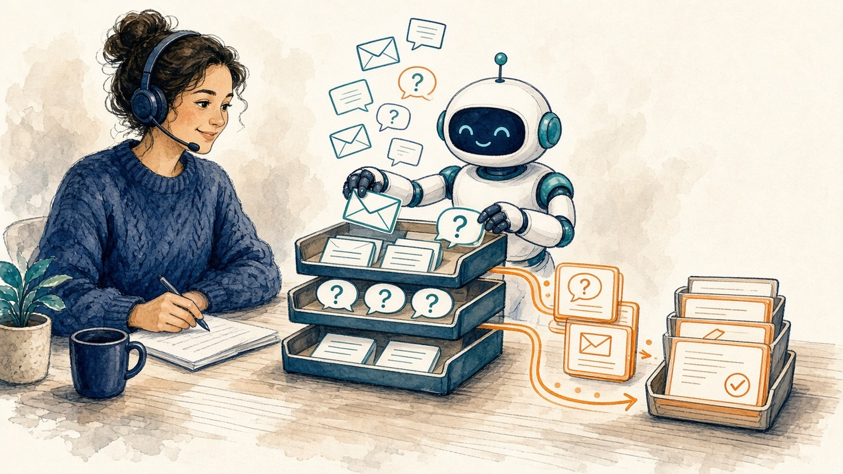

Before and after: congress and MI
CONGRESS MONITORING
From copying notes to appraising what changed
MEDICAL INFORMATION
From searching and copying to reviewing a draft
BEFORE
BEFORE
You
Capture
Copy
Merge
Draft
You
Triage
Search
Copy
Draft
AFTER
AFTER
You
Frame
Appraise
You
Review
Agent
Track
Read out
Agent
Retrieve
Draft
Scope check
Source-linked tracker · change log
Review-ready draft · safety flags visible
Human attention moves from assembling to judging
AI IN ACTION / MEDICAL AFFAIRS
53

Slide 54

Find your first use case
Expert-led: AI assists
START HERE
Look for work that is
Launch plan
1
Frequent
One-off strategy call
Ad-board package
2
Multi-step
Congress readout
3
Context-heavy
Context and judgment needed →
MI response
Not worth it yet
Automate with simple tools
4
Judgment-rich
Ad hoc formatting
Literature alerts
How often it happens × how many steps →
Bring that one to the workshop.
e.g. the MSL pre-call brief: all four
AI IN ACTION / MEDICAL AFFAIRS
54

