Slide 1

Hack the
workflow
Hackathon kickoff
AI in Action · October 13–14, 2026
Convene Philadelphia
Vivek Mukhatyar
AI IN ACTION / MEDICAL AFFAIRS
01

Slide 2
DISCLOSURE
The views presented here are my own and do not reflect those of my current employer.
Vivek Mukhatyar
AI IN ACTION / MEDICAL AFFAIRS
02

Slide 3
What is a hack?
def hack():
/ˈhak/
1. “an ingenious move”
2. “a shortcut”
i) bad → break into systems
ii) good → do impressive stuff fast..
Definition: Sundai Club
In Medical Affairs, a good hack is a clever, safe shortcut — never a way around compliance.
AI IN ACTION / MEDICAL AFFAIRS
03

Slide 4
For the next two days, you are hackers
NOW · DAYS 1–2
Hack
Prototype fast. Prove it works.
def hacker_vs_engineer():
/ˈhakər/
→ fast
→ uses structure
→ flexible, prototypes
/ˌenjəˈnir/
→ meticulous
→ builds structure
→ stable, robust
LATER
Engineer
Harden what works.
▲ YOU, FOR TWO DAYS
Source: Sundai Club
AI IN ACTION / MEDICAL AFFAIRS
04

Slide 5
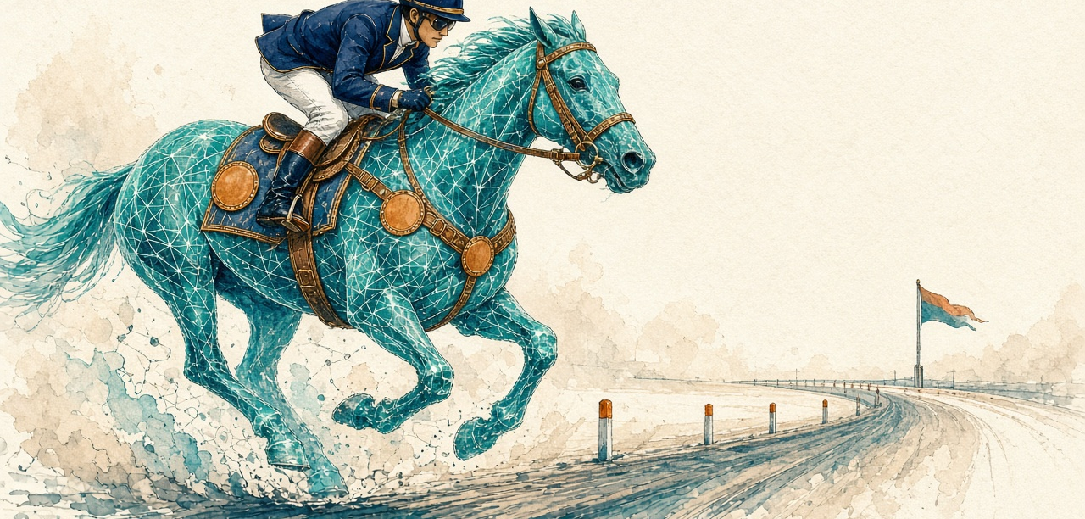
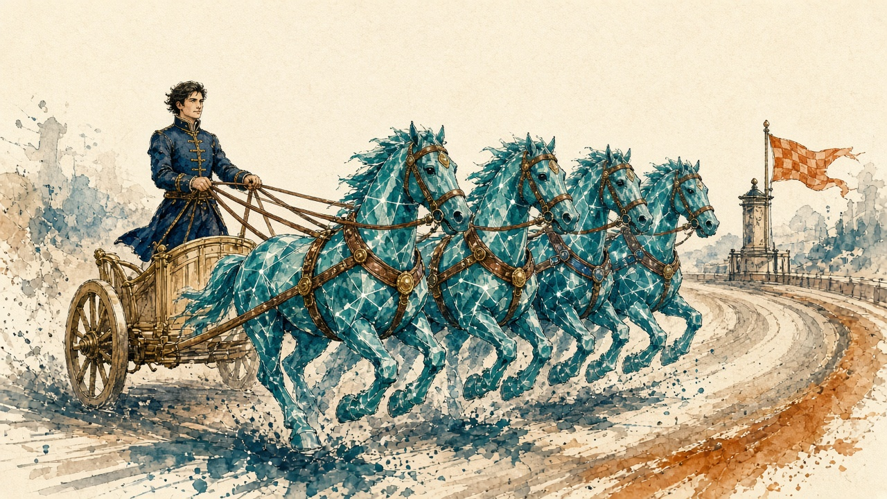
Two ways to use AI
vs
EFFICIENCY AI
Do today’s work better
Faster · cheaper · optimized
OPPORTUNITY AI
Do work that was never possible
New value · new categories
Framework: Nathaniel Whittemore (NLW), The AI Daily Brief podcast
AI IN ACTION / MEDICAL AFFAIRS
05

Slide 6

EFFICIENCY AI
Do your existing work better
Speed
The same work, done faster
Cost
Less effort and spend per output
Process
Optimize the workflows you already run
The foundation of most AI adoption
Risk: treating AI as just incremental improvement
AI IN ACTION / MEDICAL AFFAIRS
06

Slide 7

OPPORTUNITY AI
Unlock what was never possible
A mindset shift: work that was impossible or outside your current scope
New categories: innovation and value ‘orthogonal’ to your business
Race out ahead instead of competing on table-stakes efficiency
AI IN ACTION / MEDICAL AFFAIRS
07

Slide 8
Not in conflict: opportunity is built on efficiency
“
OPPORTUNITY AI
Built on top: new work, new value
What might we do now that we never would have considered before?
EFFICIENCY AI
The foundation: speed, cost, better processes
— Nathaniel Whittemore (NLW), The AI Daily Brief
Use both. Build the second on the first.
AI IN ACTION / MEDICAL AFFAIRS
08

Slide 9
What each looks like in Medical Affairs
Challenge | Efficiency AI · do it faster | Opportunity AI · do what wasn’t possible
Publications Brain | Draft and QC abstracts and plain-language summaries faster | A living publication plan that spots gaps and conflicts across every output in real time
Insights Engine | Auto-tag and summarize a quarter of field notes | An always-on insight radar that flags emerging scientific signals and drafts the leadership decision brief
Congress Monitor | Summarize sessions overnight | A swarm that maps what changed in the competitive and evidence landscape and proposes the response plan before you fly home
Field Intelligence Engine | Pre-call briefs in minutes | Every HCP conversation prepared and closed-loop, with coverage gaps found and routed automatically
AI IN ACTION / MEDICAL AFFAIRS
09

Slide 10

Your four challenges
Publications Brain
Insights Engine
What to publish, what to stop, and how to keep every output consistent
Turn a quarter of field records into decisions leadership can act on
Congress Monitor
Field Intelligence Engine
The congress just ended. What changed, and what do we do?
Walk into every HCP conversation prepared, and close the loop after
AI IN ACTION / MEDICAL AFFAIRS
10

Slide 11
Day 2: what you’ll present in 20 minutes
1
2
3
4
5
Problem statement
Workflow redesign
Human gates
Swarm orchestration demo
Impact
The workflow, and why it hurts today
How the work runs with AI in the loop
Where a person reviews and decides
Your agents, working live
Time saved, cost saved
20
minutes per team on Day 2
Five parts, one story: from the problem to the impact
AI IN ACTION / MEDICAL AFFAIRS
11

Slide 12

Rules of the hack
1
Practice data only
Fictional Nordvant Biopharma or your own non-confidential data. Never patient or confidential data.
2
Human at the helm, AI in the loop
A person reviews and decides at every gate.
3
Ship something that works
Prototype fast. Harden later.
AI IN ACTION / MEDICAL AFFAIRS
12

Slide 13

Go.
Hack for opportunity,
not just efficiency.
Scan for the companion website
aiinaction.up.railway.app
1 · Pick
2 · Build
3 · Present
Prompts, missions, data and the optimizer
Choose one of the four challenges
Prototype fast with practice data
20 minutes on Day 2, problem to impact
AI IN ACTION / MEDICAL AFFAIRS
13

