Slide 1

AI IN ACTION HACKATHON · FINAL PRESENTATION
[Team name]
[Vertical: e.g. 02 · Insights Engine]
[One line: what your AI workforce does, for whom]
[Presenter 1] · [Presenter 2] · [Presenter 3]
October 14, 2026 · Philadelphia
AI IN ACTION / MEDICAL AFFAIRS
Notes:
TIME: 0:30 (whole talk: about 20 minutes, give or take, including a few questions).
FILL IN: team name, vertical (01 Publications Brain / 02 Insights Engine / 03 Congress Monitor / 04 Field Intelligence Engine), one line saying what your AI workforce does and for whom, presenter names.
SAY: who you are and the one-sentence promise. Do not explain the agenda.
NOTE: this template is generic and disclosure-free; add your own company disclosure only if your organisation requires one. The hidden last slide is a guide for building the deck; delete it before presenting.

Slide 2
[The problem in one sentence: who loses what, how often]
[X] h
per cycle today
PROBLEM STATEMENT
When [role] needs [outcome],
today it takes [time]
because [root cause].
[N]
cycles per year
[N]
roles and hand-offs
Why it matters: [the decision, patient or HCP impact that suffers today]
[Data used: Nordvant Biopharma practice data (fictional) / our own non-confidential data]
AI IN ACTION / MEDICAL AFFAIRS
02
Notes:
TIME: 1:30.
FILL IN: the problem statement in the panel (use the pattern: When [role] needs [outcome], today it takes [time] because [cause]). Then the three numbers on the right: hours per cycle, cycles per year, roles involved. Use your own team estimates; label them as estimates.
SAY: make the room feel the pain with one concrete moment (e.g. the night before a leadership meeting). Keep the slide under 25 words of your own.
TIP: the title should be a claim, not a label. 'Leadership hears about field signals six weeks late' beats 'The problem'.

Slide 3
Today: [N] steps, [N] hand-offs, [X] hours per cycle
[Day 0]
[Where the weeks go (illustrative)]
[Day N] →
[Role 1]
[Step 1]
[Step 3]
[Role 2]
[Step 2]
[Step 5]
[Role 3 / agency]
[Step 4]
[Reviewer / approver]
[Step 6]
[Step 7]
[Pain 1: where time is lost]
[Pain 2: where errors creep in]
[Pain 3: where people wait]
AI IN ACTION / MEDICAL AFFAIRS
03
Notes:
TIME: 1:30.
FILL IN: rename the four lanes with the real roles (e.g. MSL, insights lead, agency, medical director). Rename the seven step boxes with what really happens today, left to right in time order; move or delete boxes so each sits in the lane of the person who does it. Put your three biggest pain points in the orange boxes (where time is lost, where errors creep in, where people wait).
SAY: walk the flow once, slowly, and point at the hand-offs (every vertical line is somebody waiting). Keep the step labels to 2-4 words.
SOURCE: your ideation block on Day 1 (today's-workflow map in the capture log).

Slide 4
Redesigned: agents assemble, humans decide
You · owner
G1
[Gate 1 decision]
[Set the goal]
[Output]
Lead agent
[Plan + split]
[Assemble draft]
Sub-agents
[Agent A]
[Agent B]
[Agent C]
Reviewer
[Gate 2 sign-off]
G2
BEFORE [X] h · [N] hand-offs · [N] days
AFTER [Y] h · [N] hand-offs · [N] hours
AI IN ACTION / MEDICAL AFFAIRS
04
Notes:
TIME: 2:00.
FILL IN: the same work, redesigned. Lane 1 is the human owner, lane 2 the lead agent, lane 3 the sub-agents working in parallel, lane 4 the reviewer. Rename each box; keep the two orange diamonds where your human gates sit (they must match slide 5). Fill the before/after strip at the bottom with your own estimates.
SAY: show what moved from people to agents and what stayed with people. Point out the parallel work in lane 3 and the two gates.
TIP: if a box still needs a person, keep it in a human lane. Honesty here earns trust.

Slide 5
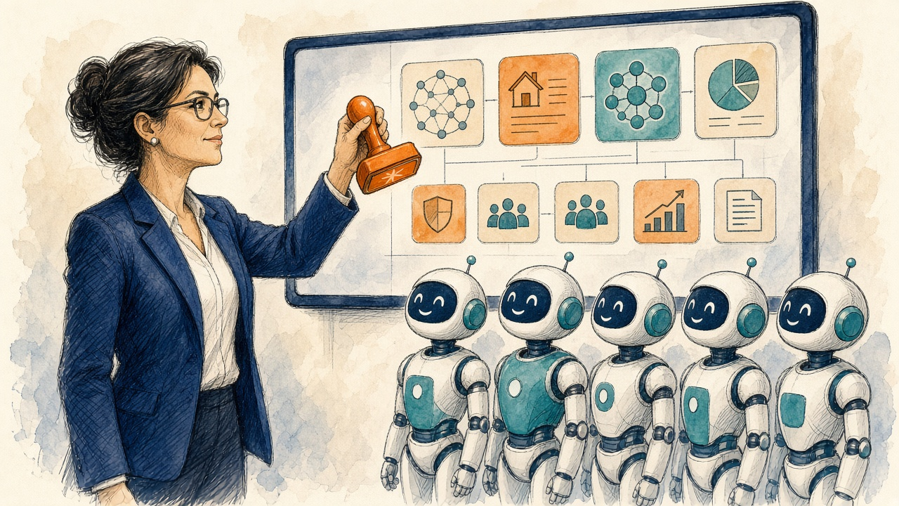
Humans decide at two gates, by design
G1
[Gate 1 name]
G2
[Gate 2 name]
Where [after which step]
Where [after which step]
Who decides [role]
Who decides [role]
Sees [evidence pack]
Sees [evidence pack]
Agents prepare. Humans approve, sign and send.
Why a human [reason]
Why a human [reason]
If rejected [what happens]
If rejected [what happens]
Always-on stop: any possible adverse event, product complaint or off-label signal goes to a human first.
AI IN ACTION / MEDICAL AFFAIRS
05
Notes:
TIME: 1:30.
FILL IN: for each gate say where it sits (after which step), who decides (a role, not a name), what they see (the evidence pack the agent prepares), why it must be a human (judgment, compliance, safety, accountability) and what happens if they reject it.
SAY: this is the slide that earns trust with Medical Affairs leaders. Be specific: 'the medical director approves the three insights and their confidence before the brief is written'.
KEEP: the always-on safety stop at the bottom; it applies to every vertical.

Slide 6
Our swarm: [N] digital workers, one human judge
G1
Gate 1 · [what the human approves]
[Human owner · role] · final judge
[Independent checker]
deliverable-quality-review · reports to the human
G2
Gate 2 · [what the human signs off]
[Lead agent] · coordinator
skill: [lead-skill-name]
[Sub-agent 1]
[Sub-agent 2]
[Sub-agent 3]
[Sub-agent 4]
Skill: [skill-name]
Skill: [skill-name]
Skill: [skill-name]
Skill: [skill-name]
Does: [one task in 6 words]
Does: [one task in 6 words]
Does: [one task in 6 words]
Does: [one task in 6 words]
Hands off → [output]
Hands off → [output]
Hands off → [output]
Hands off → [output]
[N] sub-agents · [N] skills · [N] hand-offs · 2 human gates · a human is the final judge
AI IN ACTION / MEDICAL AFFAIRS
06
Notes:
TIME: 1:00.
FILL IN: the human owner (top, orange), the lead agent and its lead skill (navy), and 3-5 sub-agents. For each sub-agent give a name, the skill(s) it loads from the Medical-Affairs-Skills library (or a skill you made with the Skill creator) and the hand-off it passes on. Delete a column if you have three sub-agents; copy one if you have five. Keep the independent checker reporting to the human, not the lead.
SAY: one sentence per worker: 'The Safety Sentinel reads every record first and stops the run if it finds an adverse event.'
LINKS: skills list https://aiinaction.up.railway.app/skills ; mission org charts https://aiinaction.up.railway.app/missions

Slide 7
Live: watch the swarm run
[Screenshot 1: the assignment + the agent's plan]
[Screenshot 2: sub-agent outputs / final deliverable]
RUN OF SHOW · 4 MIN
1
0:00
[Show the assignment we gave]
2
0:45
[Lead agent plans and splits]
3
1:30
[Sub-agents work and hand off]
4
2:30
[Gate: the agent stops; we decide]
5
3:15
[The output, and what it replaced]
Backup: [screenshots or a 60-second recording, in case the live run is slow]
AI IN ACTION / MEDICAL AFFAIRS
07
Notes:
TIME: 4:00 (the centrepiece; rehearse it twice).
FILL IN: paste two screenshots into the dashed frames (1: the assignment and the agent's plan; 2: the sub-agents' outputs or the final deliverable). Fill the run-of-show with what you will show at each minute.
DO: run live only if it is fast and reliable; otherwise show the screenshots or a 60-90 second screen recording made on Day 1. Zoom the browser to 150% so the room can read it.
SAY: narrate the hand-offs and stop at the human gate: 'Here the agent stops and asks us to approve...'.
BACKUP: always have the screenshots ready; Wi-Fi fails at the worst moment.

Slide 8
Impact: [X] hours back per year (team estimate)
(
[B] h
−
[A] h
)
×
[N]
×
$[R]
=
$[V]
baseline per cycle
AI-assisted incl. review
cycles / year
loaded rate / hour
annual value
[X] h
saved per year
$[Y]
value per year
Team estimates, not measured results. Practice data are fictional.
AI IN ACTION / MEDICAL AFFAIRS
08
Notes:
TIME: 1:30.
FILL IN: your own estimates from the impact worksheet. Baseline hours per cycle (today), AI-assisted hours per cycle INCLUDING human review time, cycles per year, and a loaded hourly rate your team agrees on. Annual hours saved = (baseline - AI-assisted) x cycles per year. Annual value = hours saved x loaded rate.
CHART: right-click the chart > Edit Data and replace the two ILLUSTRATIVE values (10 and 3) with your numbers. Then delete the word ILLUSTRATIVE from the chart title.
SAY: say clearly that these are estimates from the team, not measured results, and that the practice data are fictional. Mention one benefit that is not hours (speed, coverage, consistency).
FORMULA: (baseline h - AI-assisted h) x cycles/yr x loaded rate = annual value.

Slide 9
Risks we designed out
GREEN
Agent proceeds
[e.g. read files, build tables, draft]
Agent
YELLOW
Proceed and flag
[e.g. conflicting or missing sources]
Agent + flag
RED
Human decides
[e.g. anything external, safety, approvals]
You decide
[Risk 1]
[Risk 2]
[Risk 3]
[Guardrail we built]
[Guardrail we built]
[Guardrail we built]
AI IN ACTION / MEDICAL AFFAIRS
09
Notes:
TIME: 1:00.
FILL IN: what your swarm may do on its own (green), what it may do but must flag (yellow), and what only a human may do (red). Then your top three risks and the guardrail you built for each (e.g. 'Invented citation' -> 'citation-integrity check + source IDs on every claim').
THINK ABOUT: safety findings in the data, off-label questions, invented sources, confidential data, anything leaving the building, bias in which HCPs or insights get attention.
SAY: one breath per lane, then the risk you worried about most.

Slide 10
Faster is good. New is better.
EFFICIENCY AI
OPPORTUNITY AI
Do today's work faster
Do what was not possible
[X]% less time
[New capability]
→
[Task] takes [Y] h, not [Z] h
[e.g. every session, every HCP, every week]
[Who gets the time back]
[Who benefits, and how]
AI IN ACTION / MEDICAL AFFAIRS
10
Notes:
TIME: 1:00.
FILL IN: left = Efficiency AI (today's work, done faster: name the task and the time it no longer takes). Right = Opportunity AI (something your team could not do before at all, e.g. reading every congress session instead of the top ten, a brief before every HCP call instead of the top 20 KOLs, insights every week instead of every quarter). Name who benefits.
SAY: spend most of the minute on the right-hand side. That is what leadership remembers.
TIP: the Opportunity idea should be specific enough that someone could pilot it next quarter.

Slide 11
From hackathon to pilot
1
2
3
Next week
Next 90 days
Our ask today
[Action]
[Action]
[Action]
Owner: [role]
Owner: [role]
Owner: [role]
Needs: [data, access, sponsor]
Needs: [data, access, sponsor]
Needs: [data, access, sponsor]
[One sentence: the decision we want from leadership]
AI IN ACTION / MEDICAL AFFAIRS
11
Notes:
TIME: 1:00.
FILL IN: one concrete action per horizon with an owner (role), and what you need from the room: a sponsor, access to non-confidential data, a compliance conversation, a pilot team.
SAY: end with the ask. 'We need one brand team and four weeks of de-identified field notes to pilot this' is a good ask.
KEEP: honest about what is not built yet.

Slide 12
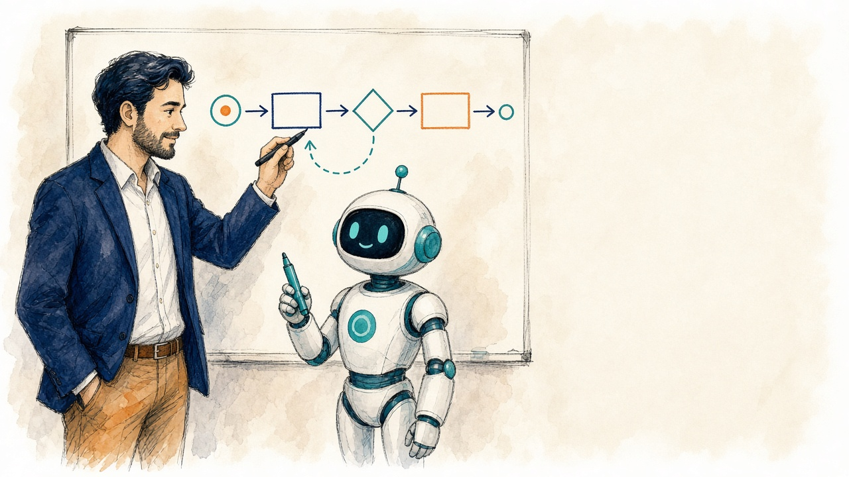
Thank you
Questions?
[Team name] · [Vertical]
[Member 1] · [Member 2] · [Member 3] · [Member 4]
Practice data: Nordvant Biopharma, NORVANTIB, DERMALYX and ADIPOSYN are fictional. Outputs are drafts for qualified human review.
AI IN ACTION / MEDICAL AFFAIRS
12
Notes:
TIME: 0:30 to thank, then a few minutes of questions (whole talk about 20 minutes, give or take).
FILL IN: team name, vertical, every member's name.
KEEP: the fictional-data line if you used the practice data. If you used your own non-confidential data, replace it with: 'Our own non-confidential data; outputs are drafts for qualified human review.'
QUESTIONS PREP: decide now who answers questions on (1) the human gates, (2) the impact numbers, (3) what it would take to pilot.

Slide 13
Template guide · hidden · delete before presenting
Slide | Time
1 Title | 0:30
2 Problem | 1:30
3 Today's workflow | 1:30
4 Redesigned workflow | 2:00
5 Human gates | 1:30
6 Swarm org chart | 1:00
7 Live demo | 4:00
8 Impact | 1:30
9 Risks & guardrails | 1:00
10 Efficiency vs Opportunity | 1:00
11 Next steps | 1:00
12 Thank you + questions | 0:30 + a few min
HOUSE RULES FOR THE FINAL DECK
1
Replace every [bracket]. Search the deck for "[" before you present.
2
Diagrams, not bullets. About 25 words per slide, at most.
3
Numbers are team estimates. Say so out loud.
4
Mark practice data as fictional (Nordvant Biopharma).
5
No confidential data, no patient data, no real HCP names.
6
Rehearse once: about 20 minutes, including a few questions.
7
Speaker notes on every slide say what to fill in.
AI IN ACTION / MEDICAL AFFAIRS
13
Notes:
This slide is hidden and will not show in Slide Show. It is a guide for the team and its agent. Delete it before you share the deck.
Agent instructions: see final-presentation-agent-instructions.md in the hackathon pack (https://aiinaction.up.railway.app).

