Slide 1

HACKATHON · OCTOBER 13–14, 2026
Hackathon
Team Map
Four teams. Four verticals.
32 hackers, one AI workforce each.
AI in Action for Medical Affairs
Convene Philadelphia · Two Commerce Square
Host: Vivek Mukhatyar
AI IN ACTION / MEDICAL AFFAIRS
01

Slide 2
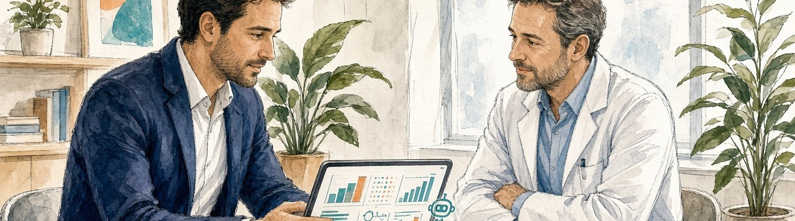
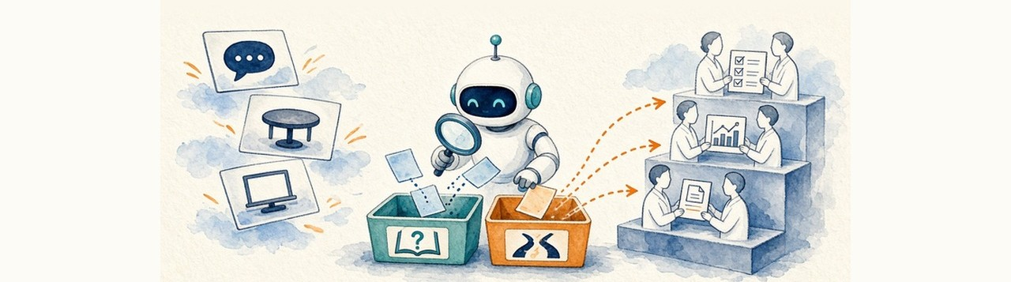
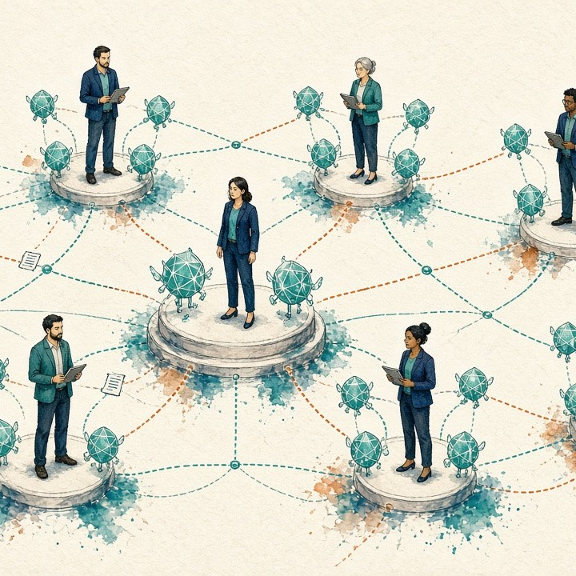
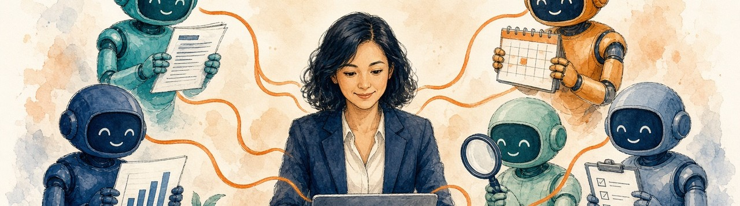
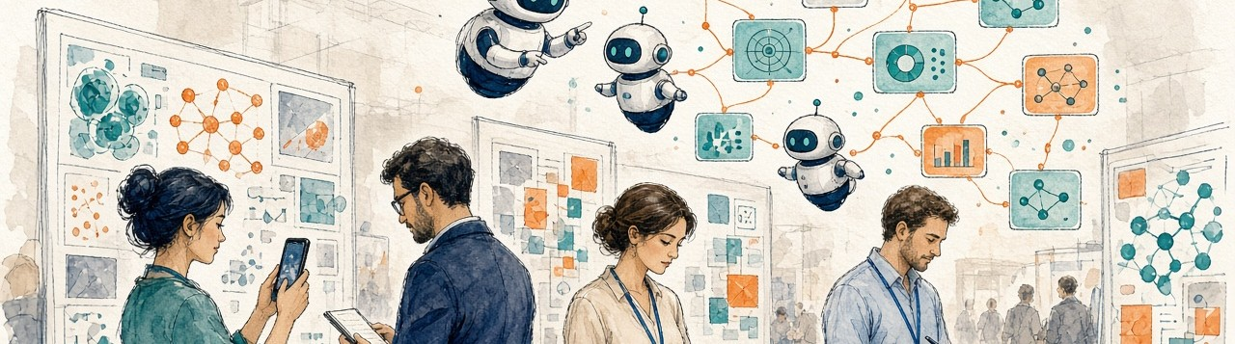
Four teams, four verticals, one map
TEAM 1 · VERTICAL 04
8
members
TEAM 2 · VERTICAL 02
8
members
Field Intelligence Engine
Insights Engine
32 hackers
TEAM 3 · VERTICAL 01
8
members
TEAM 4 · VERTICAL 03
8
members
Publications Brain
Congress Monitor
AI IN ACTION / MEDICAL AFFAIRS
02

Slide 3

TEAM 1 · VERTICAL 04 · 8 MEMBERS
Field Intelligence Engine
Walk into every HCP conversation prepared, and close the loop after.
NS
Nandini Sabharwal
AY
Andy Yan
JL
Jason Lebowitz
PM
Paul Minen
TC
Tom Canavela
TR
Tony Rebelo
AM
Allison McMullen
Field Intelligence Engine
MV
Michelle Vichnin
Guide, missions and prompts → aiinaction.up.railway.app/hackathon/field-intelligence-engine
AI IN ACTION / MEDICAL AFFAIRS
03

Slide 4
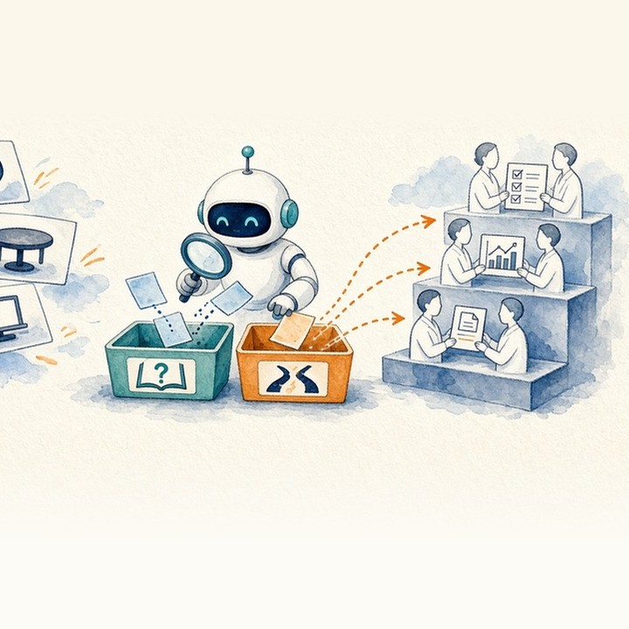
TEAM 2 · VERTICAL 02 · 8 MEMBERS
Insights Engine
Trace every care gap to the HCP knowledge or belief gap behind it, then match education to each HCP segment and stage.
AM
Anjali Mishra
Facilitator
CH
Chris Herold
JH
John Hannis
Facilitator
MP
Mamta Parikh
KK
Kara Koehler
LH
Liz Hernandez
BC
Brianna Cauley
Insights Engine
CM
Chris Miller
Guide, missions and prompts → aiinaction.up.railway.app/hackathon/insights-engine
AI IN ACTION / MEDICAL AFFAIRS
04

Slide 5
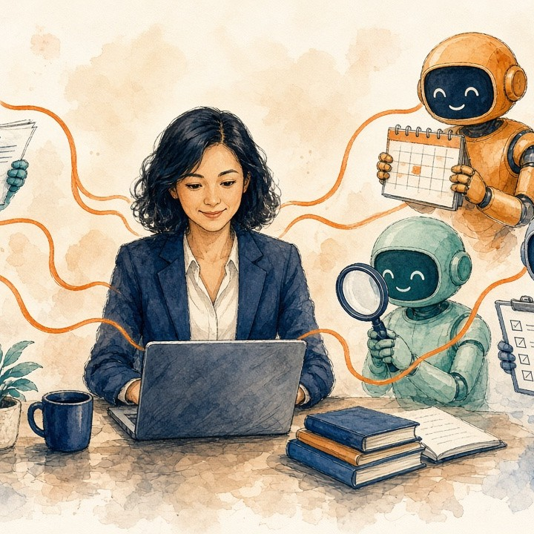
TEAM 3 · VERTICAL 01 · 8 MEMBERS
Publications Brain
What to publish, what to stop, and keeping every output consistent.
PS
Pooja Smith
LV
Lucie Vu
VK
Vijay Krishnan
CW
Charlene Wong
RG
Richa Garg
MK
Megan Kinnett
BC
Bennie Coccia
Publications Brain
JW
Jonathan Weimer
Guide, missions and prompts → aiinaction.up.railway.app/hackathon/publications-brain
AI IN ACTION / MEDICAL AFFAIRS
05

Slide 6
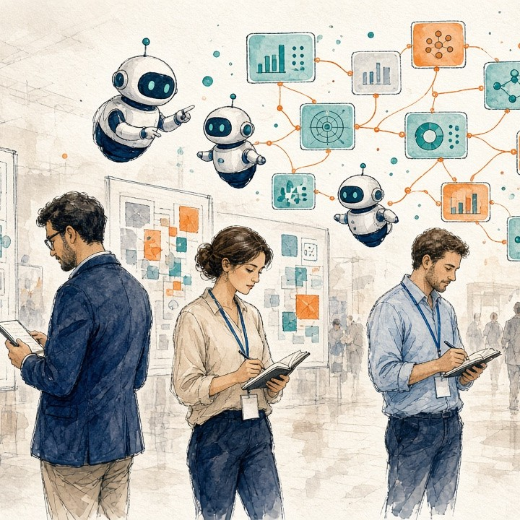
TEAM 4 · VERTICAL 03 · 8 MEMBERS
Congress Monitor
The congress just ended. What changed, and what do we do about it?
NT
Nita Thingalaya
SM
Stefanie Maurer
KK
Kristina Kipp
CB
Chelsea Bennheisel
MC
Michelle Cho
JA
Jackie Armani
YS
Yusuke Sasaki
Congress Monitor
SC
Susan Connelly
Guide, missions and prompts → aiinaction.up.railway.app/hackathon/congress-monitor
AI IN ACTION / MEDICAL AFFAIRS
06

Slide 7
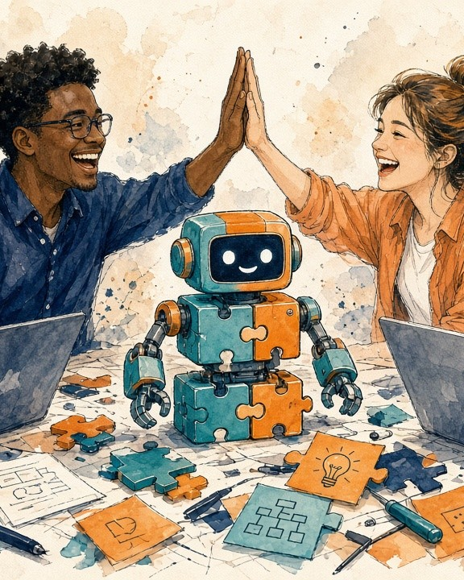

Go build.
Find your team. Open your guide.
DAY 2 · PRESENTATION ORDER
1
Publications Brain · Team 3
2
Insights Engine · Team 2
3
Congress Monitor · Team 4
4
Field Intelligence Engine · Team 1
Team map online
aiinaction.up.railway.app/hackathon/teams
AI IN ACTION / MEDICAL AFFAIRS
07

