Slide 1
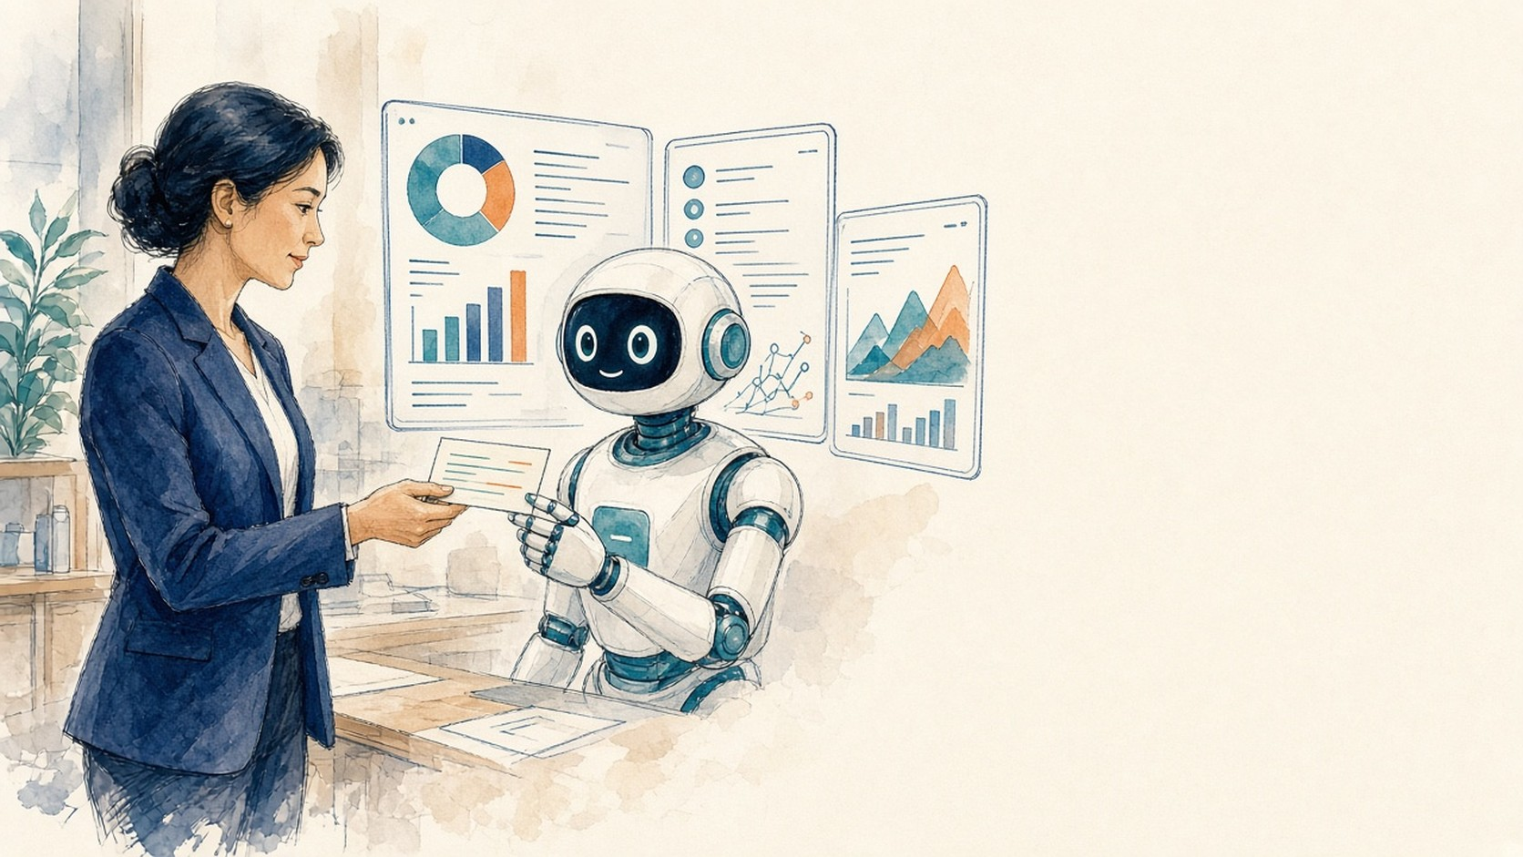
CLOSING SESSION
Closing: what we learned,
what we take home
Moderator: Vivek · Convene Philadelphia · Oct 14, 2026
AI IN ACTION / MEDICAL AFFAIRS
1

Slide 2
PANEL OPENER
When AI surprised you
Describe a moment when an AI tool in your function surprised you, did something you didn't expect, or worked around a limit.
What was your human-check setup at the time, and what did you change afterward?
AI IN ACTION / MEDICAL AFFAIRS
2

Slide 3
PANEL · Q1
Is the HCP relationship shifting?
Have you felt the HCP relationship shifting in your function: people getting answers from AI assistants instead of your MSLs, your portal, your team?
What's the most concrete example, and how did you respond?
AI IN ACTION / MEDICAL AFFAIRS
3

Slide 4
PANEL · Q2
What should an agent do — and never touch?
Coinbase's fraud agent can only score risk; it can't act, and it can't override the human system. In your function:
DO
on its own
DRAFT FOR SIGN-OFF
a human approves
NEVER TOUCH
humans only
Which tasks
should an agent
do on its own?
Which should it
only draft for
human sign-off?
Which should it
never touch?
AI IN ACTION / MEDICAL AFFAIRS
4

Slide 5
PANEL · Q3
Safe-to-fail experiments
The research says the winners just kept experimenting; most successful AI projects had failures nobody was punished for.
Tell us about a safe-to-fail experiment you ran in your function. What made it safe, and what did you learn?
AI IN ACTION / MEDICAL AFFAIRS
5

Slide 6
PANEL · Q4
Train experts to challenge AI
The data says the biggest AI gains go to people who are best at catching the machine's mistakes, not those who trust it most.
How are you training your experts (MSLs, reviewers, analysts) to challenge AI output instead of deferring to it? Give us something concrete that's worked.
AI IN ACTION / MEDICAL AFFAIRS
6

Slide 7
PANEL · Q5
Design the exam for an AI agent
Legal now grades its AI agents against strict pass/fail tests judged by real practitioners.
If you had to design the exam for an AI agent in your function, say one answering HCP questions, what would the test be, and who would you trust to grade it?
AI IN ACTION / MEDICAL AFFAIRS
7

Slide 8
PANEL · Q6
Taking a pilot to legal / compliance
Think of the last time you took an AI pilot to legal or compliance.
How did you frame the risk, and looking back, did you get the calibration right? What would you do differently?
AI IN ACTION / MEDICAL AFFAIRS
8

Slide 9
PANEL · Q7
From hackathon to real pilot
Two days ago most of this room had never built an agent; yesterday you demoed them.
Name the one thing from your hackathon team going into a real pilot, and the one thing that must be true before it touches a real HCP.
AI IN ACTION / MEDICAL AFFAIRS
9

Slide 10
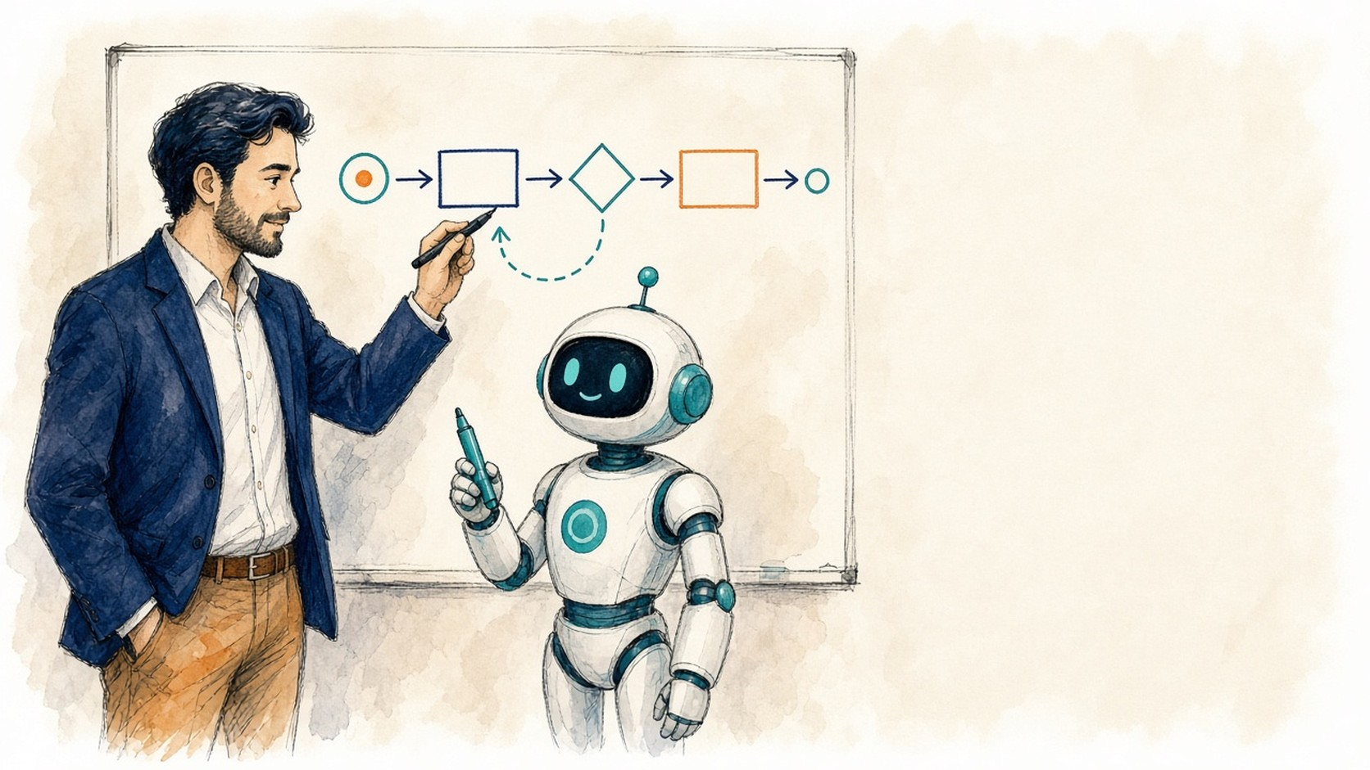
YOUR TURN
Your turn: audience
Short answers from the room.
Hands up when called.
AI IN ACTION / MEDICAL AFFAIRS
10

Slide 11
AUDIENCE
What's the one thing from these two days you'll actually use in your work next week?
1
For the MSL and med-info folks: what's the task you'd most want an agent to take off your plate, and the one you'd never hand over?
2
What was the moment in these two days when you went from skeptical to 'okay, this could actually work'? What triggered it?
3
AI IN ACTION / MEDICAL AFFAIRS
11

Slide 12
AUDIENCE
What's something you believed about AI in medical affairs on Monday morning that you no longer believe?
4
Who here tried to break someone else's agent in the red-team swap, and what did breaking it teach you about your own build?
5
Think back to the workflow you mapped on day one. After two days of building, what's the part you now realize is harder to automate than you expected?
6
AI IN ACTION / MEDICAL AFFAIRS
12

Slide 13
AUDIENCE
What's the one prompt, routine, or agent behavior going onto your deployment commitment form, and what's the first thing you'll do with it on Monday?
7
For the leaders in the room: what conversation do you need to have back home before any of this becomes real, and with whom?
8
Show of hands: who arrived worried AI would replace part of their function, and who leaves thinking it will change the function instead? What changed your mind?
9
AI IN ACTION / MEDICAL AFFAIRS
13

Slide 14
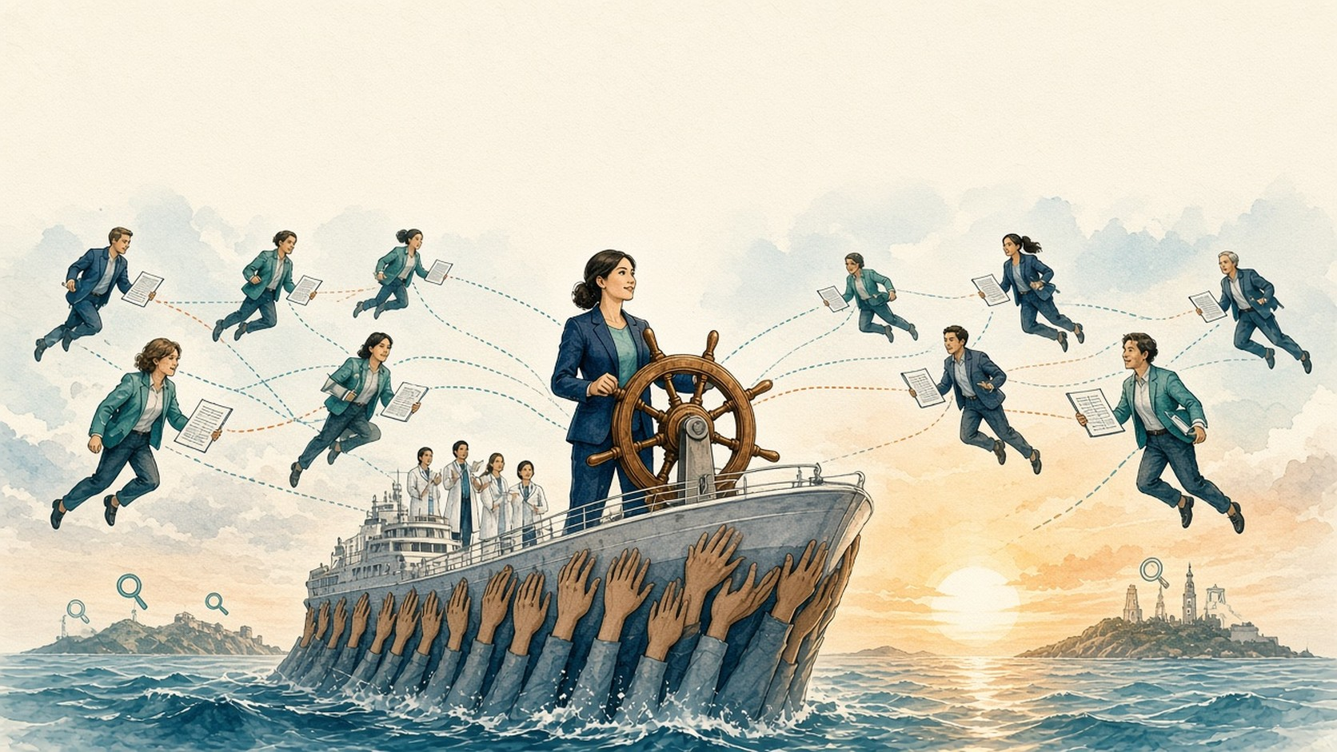
Human at the helm
Opportunity AI
Context
Trust
Medical Affairs is the steward of trust. AI helps us keep it.
AI IN ACTION / MEDICAL AFFAIRS
14

