Slide 1
Introduction to Core model from ONF Open Information Model & Tooling (OIMT) project
Nigel DAVIS (Ciena) Kam LAM (FiberHome / CICT)
2019.05.04
Beijing

Slide 2
Agenda
Brief context setting
ONF interface model – TAPI
ONF core model – TR-512 (ITU-T G.7711)
ONF interface model – TAPI
Guidelines & Tooling – TR-514, -514, -531, -543, -544

Slide 3
Abstract
This presentation will explain the ONF Core model TR-512, a standardized implementation-neutral representation of things and the relationship between those things in the SDN problem space. The presentation will show how the model has been developed through many years of practical experience.
The presentation will work through the things explaining their relevance and application, including:
Specific network functions, focusing on virtualized termination and forwarding designed to represent any network
Generalized processing functionality designed to represent any abstract function
Real physical equipment, specifically representing FRUs, non-FRUs, strands etc.
Control functions related to presentation of views, closure of loops etc.
System/scheme specifications representing the structures of systems
The presentation will explain how the model can be applied at any level of abstraction to any control/orchestration/automation layer and will work through the approach used to construct view model using TAPI as an example. The TAPI model is a Pruned and Refactored derivative of the Core model. The presentation will highlight how the TAPI model drives tooling to generate Yang and via Yang to generate Swagger definitions etc.
Some of the general principles and patterns, such as the Component-System and recursive abstraction patterns, will be exposed during the presentation.

Slide 4
Modelling SDN
The Core model provides a standardized implementation-neutral representation of things and the relationship between those things in the SDN problem space
Network functions. Model focus:
Virtualized termination/forwarding in any network
Physical Equipment supporting the network. Model focus:
Field Replaceable Units (FRUs), non-FRUs, strands etc.
Control functions supporting the network. Model focus:
Representation of functions related to closure of control loops
Presentation of views of the resources for the purpose of control
Processing functionality supporting/using the network. Model focus:
Any abstract function
Resource/System/Scheme specifications. Model focus:
Constraints, rules and specs for the overall systems
Software supporting the control
Files, Installed Software, Containers, VMs,
Most recent focus has been on Analogue Guided Media networks, using photonic networks as the key application.
TR-512.A.4 provides the explanation of the use of the Core Model for photonic networks.
This work has been used extensively by OTCC and Facebook TIP

Slide 5
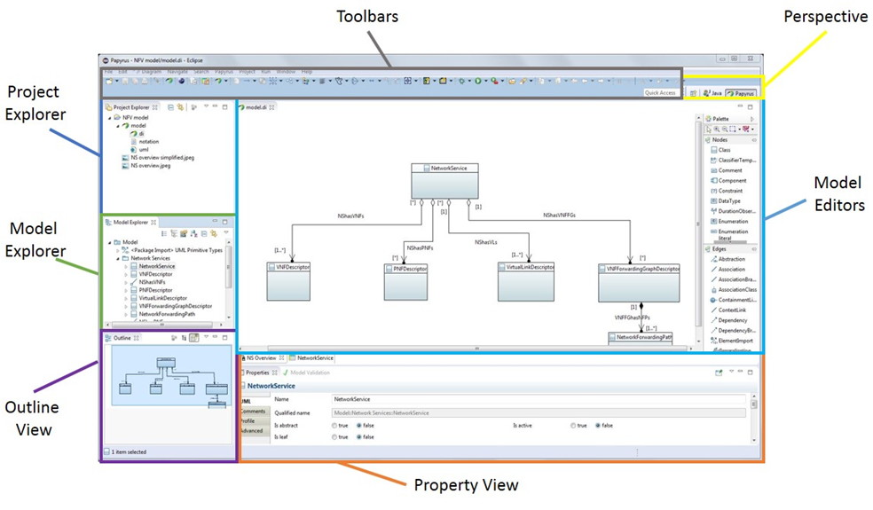
Model to create a common language
Goals:
A well defined widely applicable representation of the semantics of managed network functionality that is lightweight, has a modular architecture and is technology/technique agnostic
Reduce the formation of overlapping inconsistent implementations which hinder overall progress
Approach:
Leverage industry best-practices, patterns and tools to close the model to implementation round trip loop
Use Agile modelling methodology to construct a formal model using Papyrus UML
A graphical modeling language highlights underlying patterns
The environment provides a framework for:
Development of understanding about control of networks
Capturing a representation of the understanding
Maintaining growing insight
Promote Core Model use/extension
Use:
Derivation of Interface/database models using generators to generate consistent artefacts in JSON, Yang etc.

Slide 6
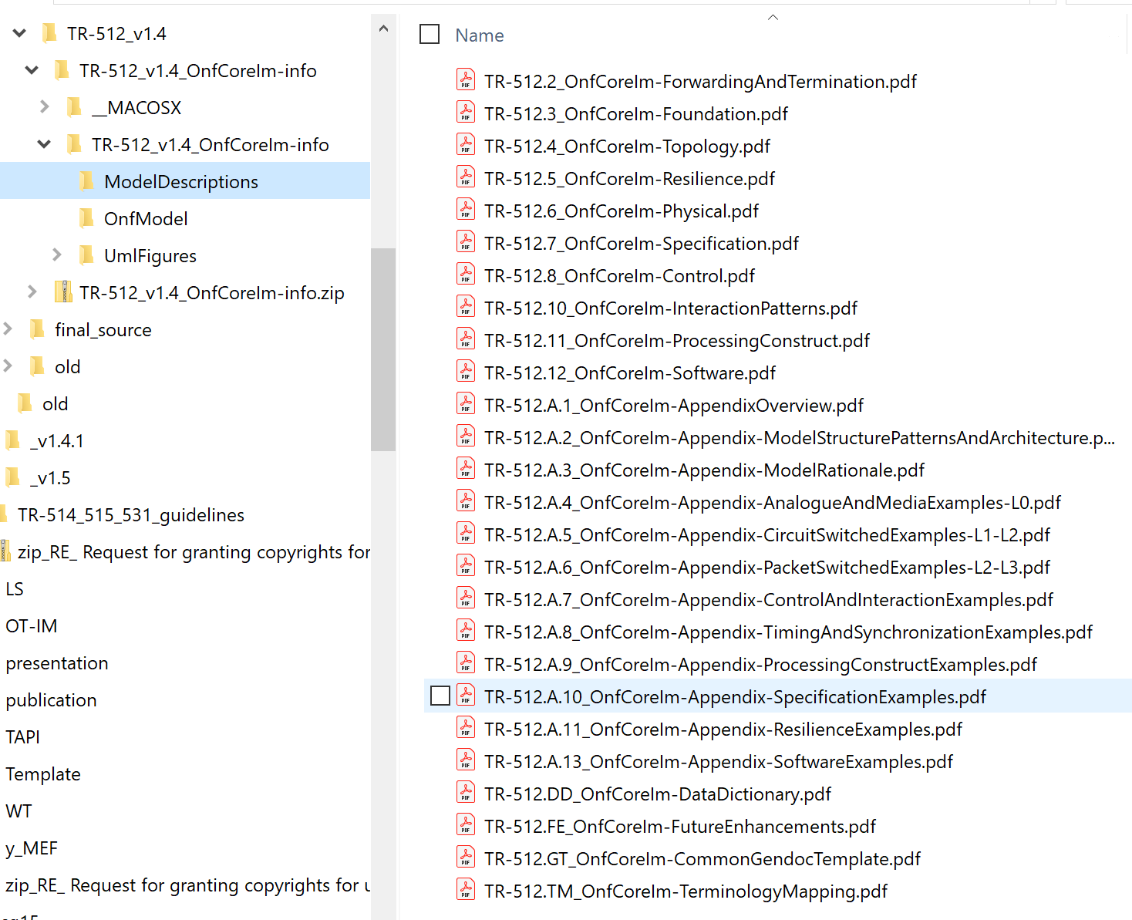
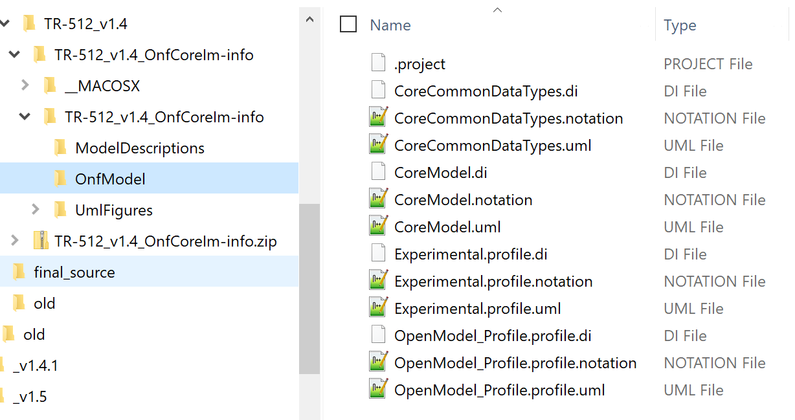
Core Model: TR-512 v1.4
A suite of description documents and XMI encoded UML constructs and diagrams.

Slide 7

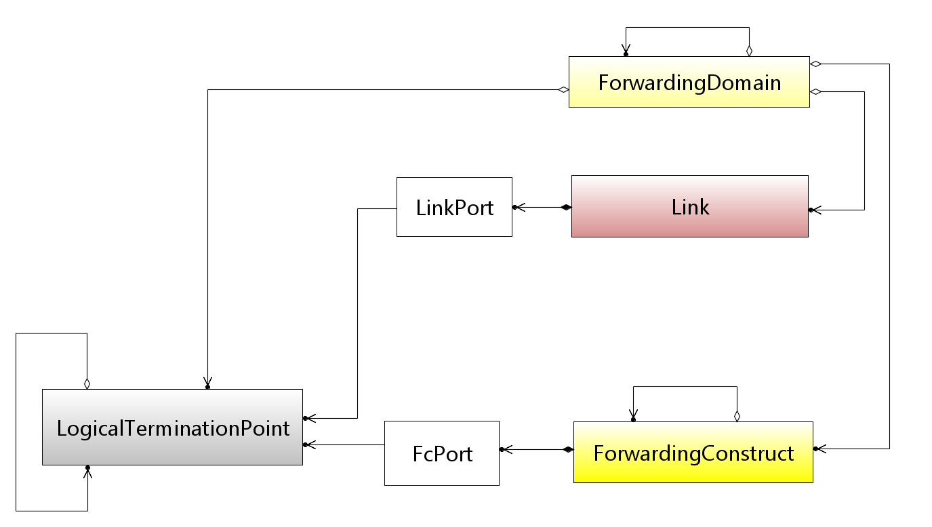
Canonical network model (virtualized/functional): Forwarding, Termination and Topology
See slide notes
Device
Network Device OR Opaque Network
Simplified view
From TR-512.2
Network
Showing layers
Derived from ITU-T and TMF work
Model for any networking, for any network technology, with any degree of virtualization, at any scale, at any abstraction and in any interrelated view.
Notes:
A general pattern for all networking focussing on transport
Any capability with the purpose of transferring information is transport
IP is transport
Essential concepts are forwarding, termination and adaptation
Pure functional, independent of physical environment but relateable at the port and as below
All forwarding/termination can use this model whether it is implemented in a traditional form or virtual/cloudified
Deals with “apparent” adjacency (Link)
Support
Stacking of layer-protocols and network layering
Navigation between views
Model for any networking for any transport network technology, with any degree of virtualization, at any scale, at any abstraction and in any interrelated view.

Slide 8
Photonic network analysis and modeling
Modelling of fundamental functions
Key (Core Model Entities)
ForwardingConstruct (FC)
Intermediate
LogicalTerminationPoint
(LTP)
Floating
Tied to physical
Modelling of Aggregated functions
Device etc. (ConstraintDomain)
Termination (in an LTP)
Modelling of Devices
Adapter (in an LTP)
C&SC
ConfigurationAndSwitchController
Modelling of Networks
From TR-512.A.4
Using the model entities to represent photonics at all scales gives a consistent model regardless of the degree of aggregation etc.

Slide 9
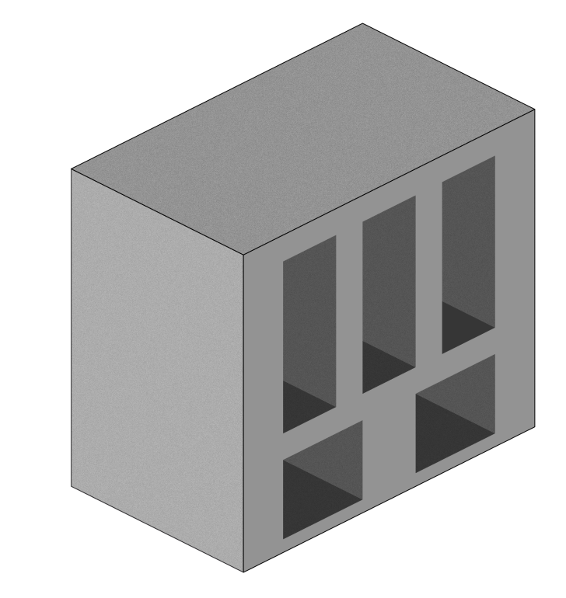
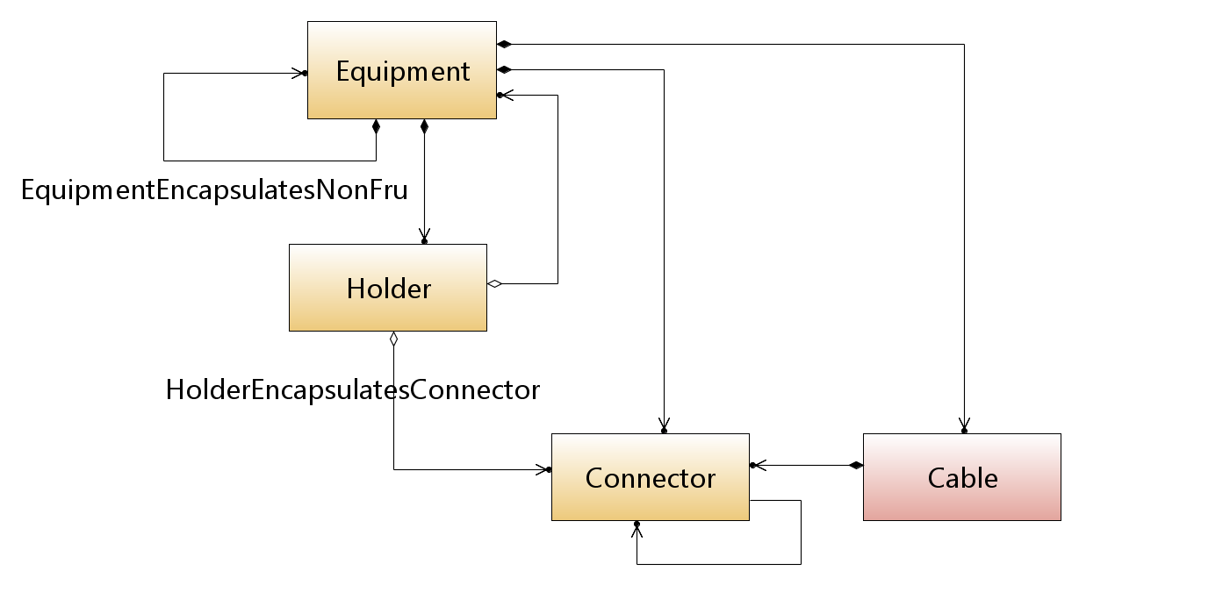
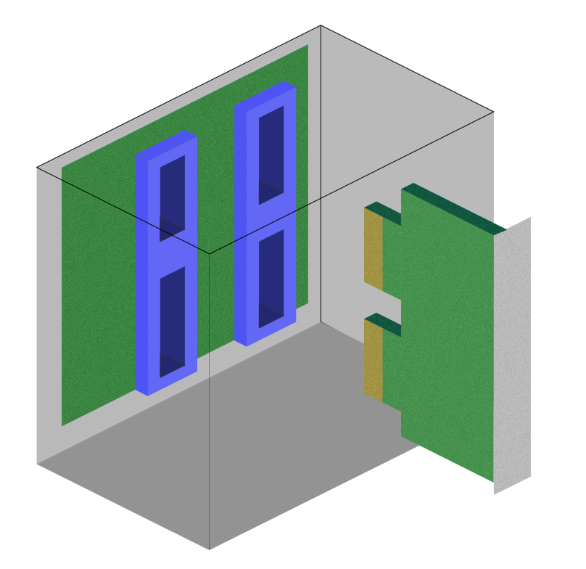
Canonical physical model
See slide notes
Represents truly physical things, i.e. things that can be measured with a ruler
From TR-512.6
Simplified view
Derived from ITU-T and TMF work
Model for any physical components that are rack/cabinet/shelf based or stand-alone in a data center or telco environment
Notes:
Represents truly physical things, i.e. things that can be measured with a ruler
Focusses on electronic equipments
Any rack based, circuit pack based solutions can use this model
Supports a stand-alone equipment
Has a representation of physical connector and abstract cable
Model for any physical components that are rack/cabinet/shelf based or stand-alone in a data center or telco environment

Slide 10
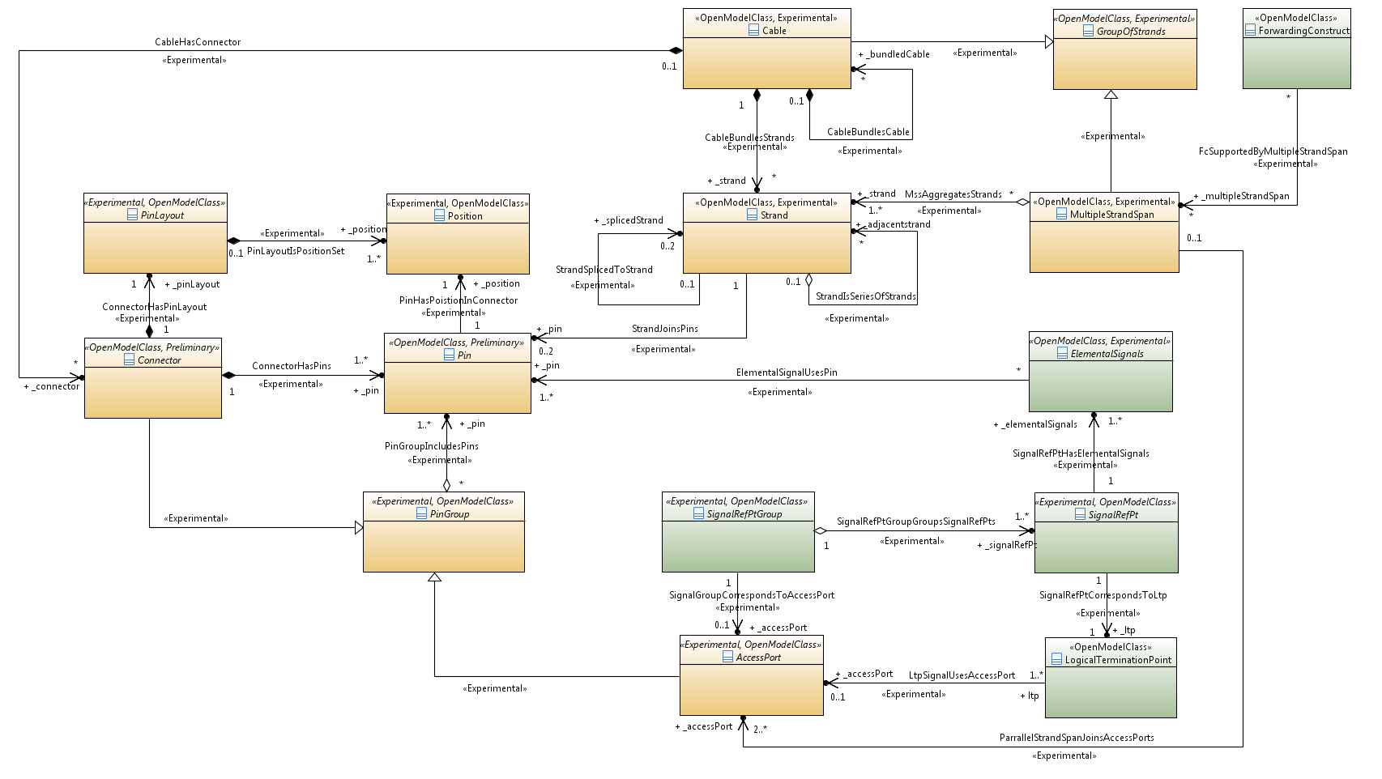
Connector, Cable, AccessPort and MultipleStrandSpan
Cable
FC
From TR-512.5
Strand
MultipleStrandSpan
Connector
Pin
PinGroup
AccessPort
LTP
Strong separation of concerns of physical from functional yields a model that deals consistently with a wide range of physical structure

Slide 11
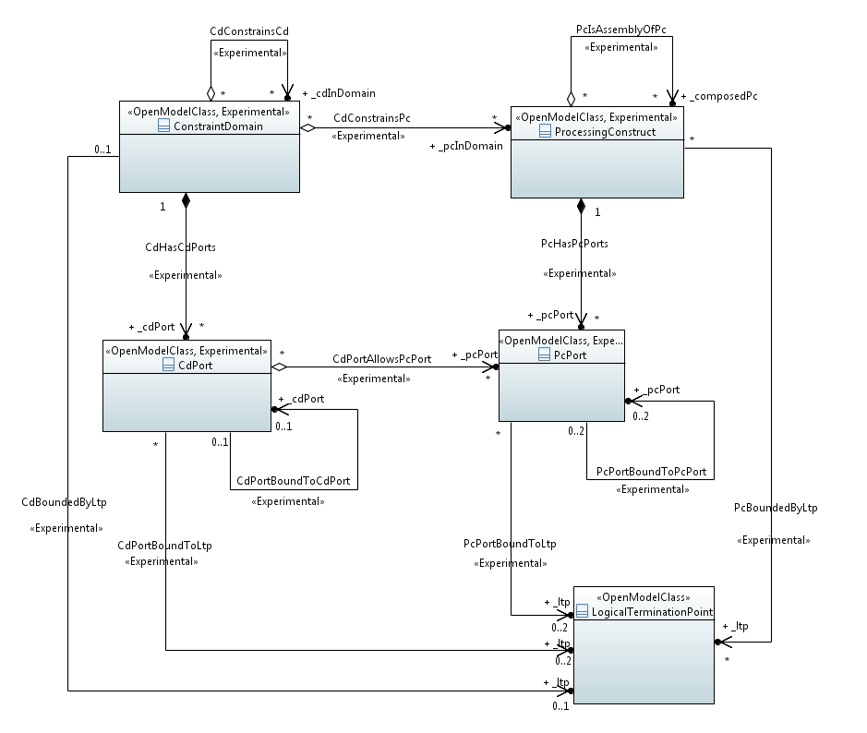
Model of generalized processing and constraint
See slide notes
From TR-512.11
ConstraintDomain
ProcessingConstruct
Follows the Component-Port and Component-System patterns
CdPort
PcPort
LTP
Model for any arbitrary functions/constraint, views of abstractions of functions/constraints, interconnection of functions to networking.
Notes:
Dealing with non-transport functions covering any functionality in abstraction
All functions are emergent and hence all functions are virtual
Supporting part of the control model
Enabling removal of the faulty concept of NE and replacement with a versatile constraint based model
Model for any arbitrary functions/constraint, views of abstractions of functions/constraints, interconnection of functions to networking and relationship of functions to the physical environment.

Slide 12
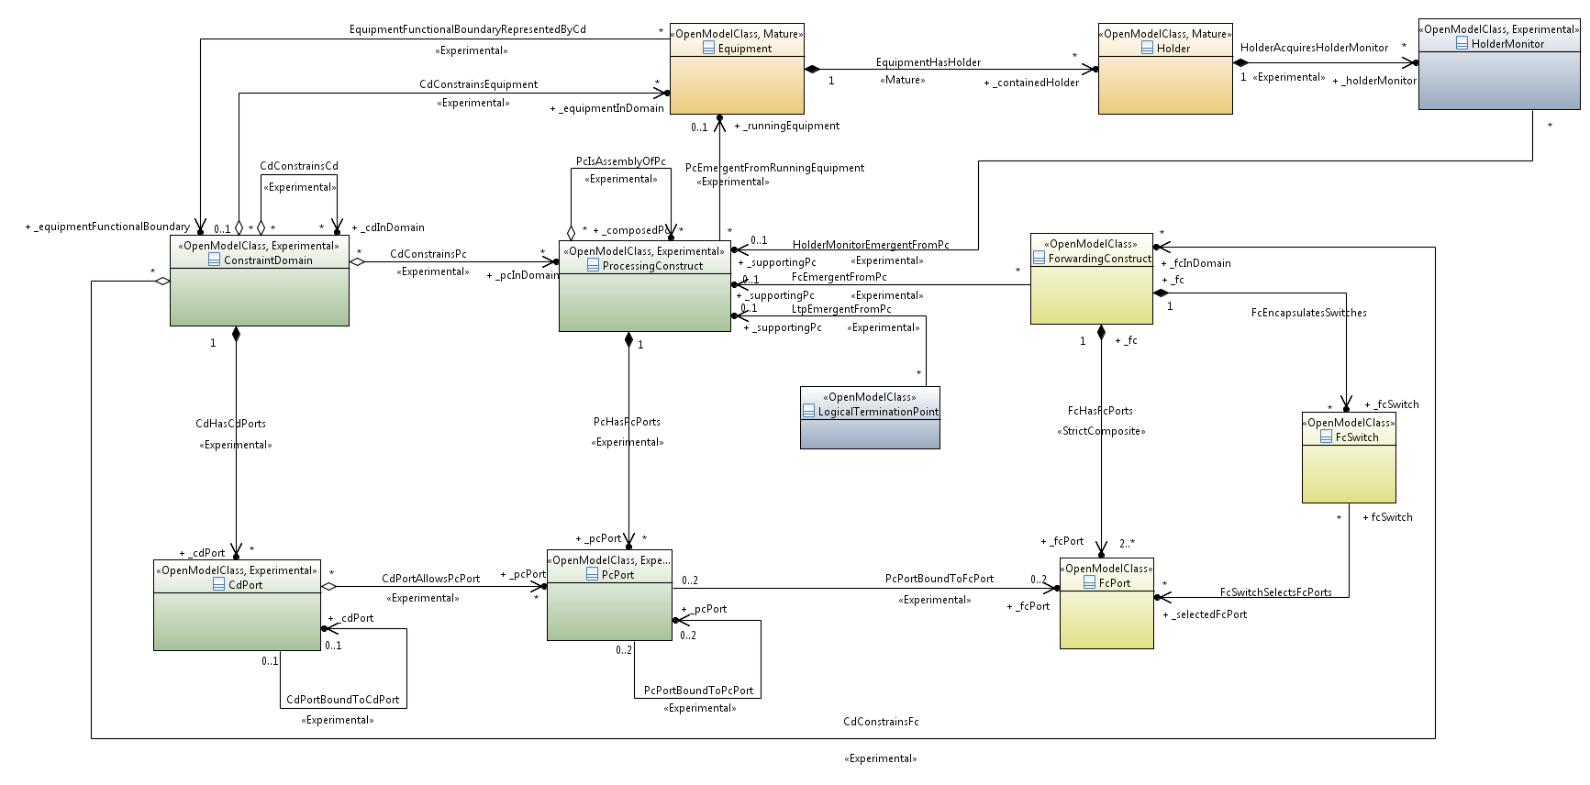
Association between physical and functional model
See slide notes
CD provides boundary around equipment to represent NE/Device/Controller etc
PC emergent from running equipment
Equipment
Holder
HolderMonitor
CD
PC
FC
CD represents Equipment functional boundary grouping PCs
LTP
Functions emergent from complex processing represented by PC
Derived from ITU-T and TMF work
From TR-512.6
Basis for model for the understanding of the physical realization of functional things (regardless of how “virtual” they are).
Notes:
Achieved via the generalized processing model
Recognizes that all behaviour is emergent and hence all functions are virtual
Strongly separates concerns of true physical from true functional
Corrects issues with “equipment” protection recognising that:
It is not the physical thing that is protected
A single physical unit may support several functions where each is involved in a different form of resilience
Basis for model for the understanding of the physical realization of functional things (regardless of how “virtual” they are)

Slide 13
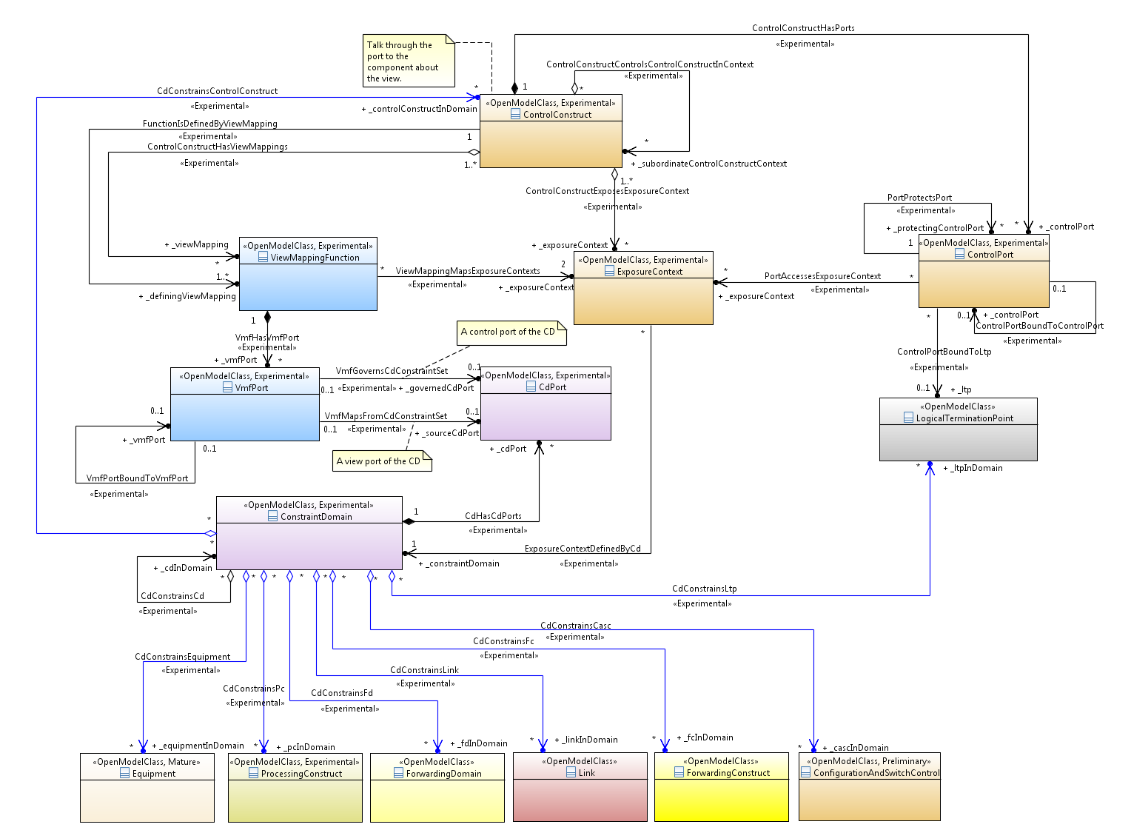
Model of control access and view
See slide notes
ControlConstruct provides access via its ports to enable observation/control. ControlPort provides the messaging/signalling
From TR-512.8
ControlConstruct
ViewMapping provides the relationship views defined by CD that are offered through different ExposureContexts
ViewMapping
ControlPort
ExposureContext
The ControlPort is bound to LTP allowing control messages to enter the network
CdPort
LTP
CD
ExposureContext provides definition of what is exposed through a ControlPort using ConstraintDonain (and hence including ControlConstruct)
CD groups/constrains any structures including ControlConstruct
Equipment
PC
FD
Link
FC
CASC
Model for the control functions in the network, for control of those control functions, and modelling of Control itself, for control of the Controller.
Notes:
Focussing on:
Generalized control (see above)
Configuration and Switch control (see next slide)
Initially dealing with protection and restoration schemes
Progressing from specific control to model of general control
Model for the control functions in the network, for control of those control functions, and modelling of Controller itself, for control of the Controller.

Slide 14
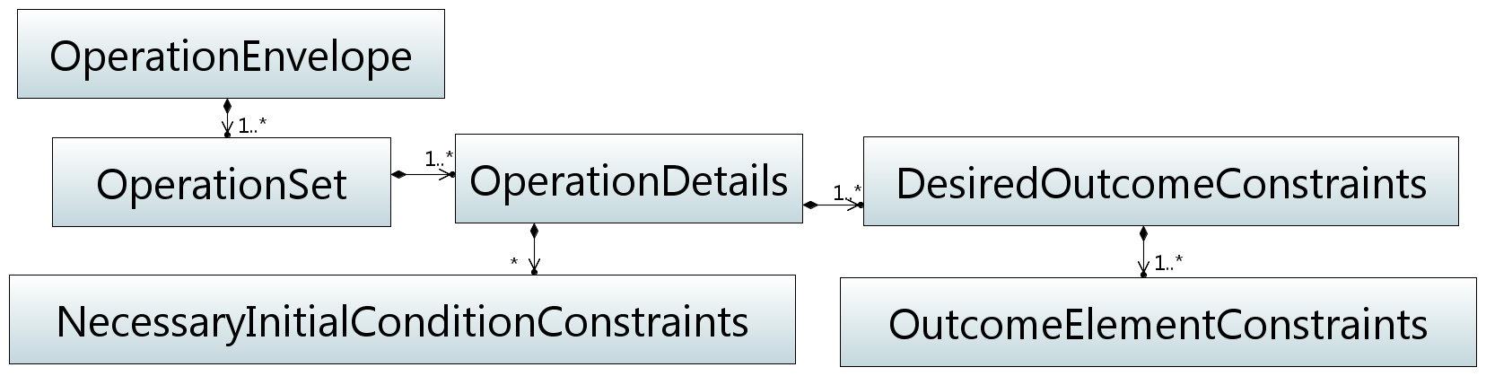
Model of Interaction patterns
From TR-512.10
Simplified view
It is envisaged that a single compositional structure can describe all degrees of interaction from simple CRUD to complex multi-task constraint delegation
This single structure is designed such that 1of1 composed parts are folded into the parent on a case by case basis
This yields a message that is compact for a simple case but sophisticated for a complex case
A basic controller could offer a limited range of operational capability and provide a schema that is a sub-set of the full pattern (explicitly explaining what it can do (in terms of operations pattern schema) – not what it can’t)
An advanced controller could offer the full range
The advanced controller could communicate with the basic controlled without adjusting its full schema definition as it limits the usage to the narrower capability of the basic controller
As an analogy consider human language grammar where an adult talks to a child

Slide 15
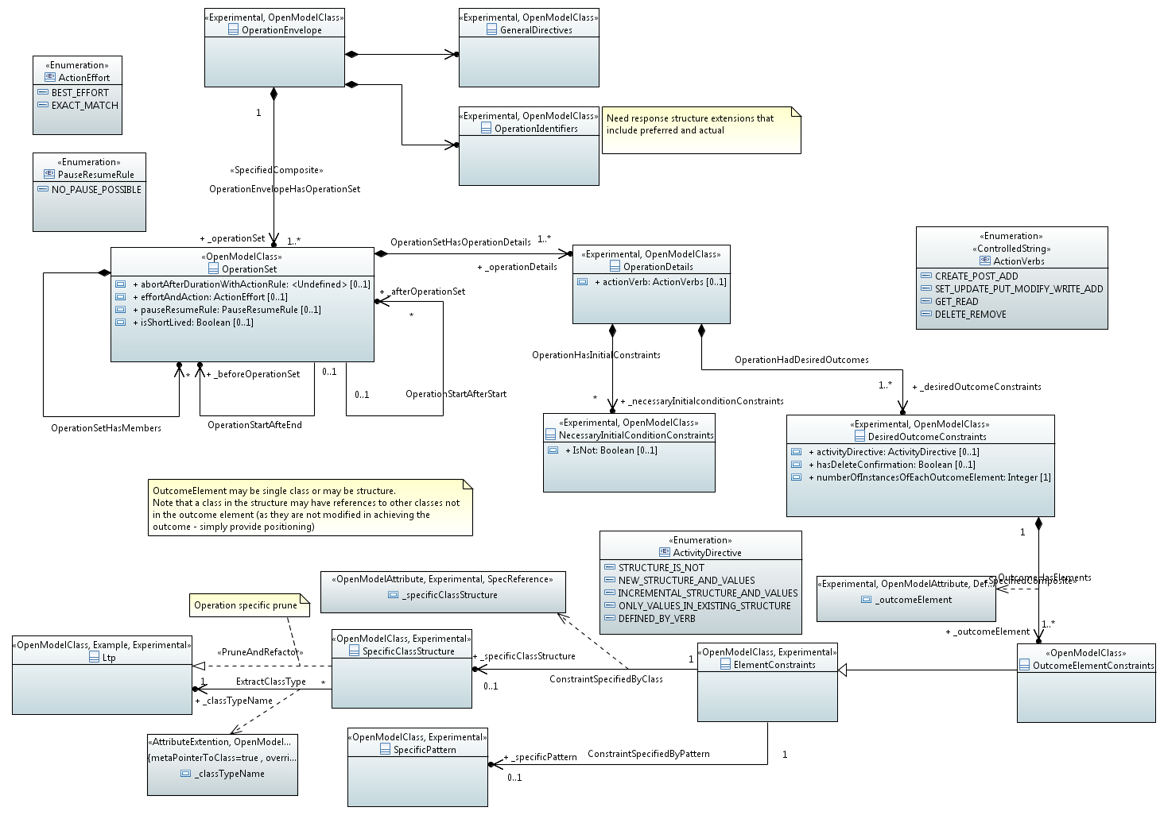
Model of Interaction patterns
OperationEnvelope
From TR-512.10
Complex view
OperationSet
OperationDetails
NecessaryInitialConditionConstraints
DesiredOutcomeConstraints
OutcomeElementConstraints

Slide 16
Interaction patterns “Foldaway complexity”
Is a create with no specific directives
X
Envelope has one set
Set has one operation
Set has no start/finish dependencies
Merge
Operation has no relevant abort behavior
Activity Directive is DEFINED_BY_VERB (default)
Merge
Operation is EXACT_MATCH effort (default)
Has delete confirmation (default)
Merge
X
X
X
Has one outcome instance
Operation is short lived (default) (pause/resume not possible)
X
Operation is not idempotent
Merge
Merge
Merge
X
Operation is for an LTP
Has one specific class outcome constraint
Notes:
3.4.14/TR-512.10 Resulting structure
The above merging results in a single level operation structure with CREATE_POST_ADD as the operation verb and with contents of an LTP structure with absolute values for each relevant writeable attribute. This is essentially the same structure complexity as a Create in a CRUD system, but it is fully conformant with the grammar of the far more sophisticated Outcome-Oriented form. The sophisticated structure is unnecessary for the basic CRUD style operation. The structure would be viewed by a CRUD designer as massive unnecessary complexity if imposed on the simple cases. The mechanism set out by example above "folds away" the complexity.
A basic application could simply operate with the CRUD form whilst interworking with a more sophisticated application that downgrades its operation based upon the structures it receives (and the specification of capability presented by the basic application).
If the basic application is upgraded to a more sophisticated form there is no need to recompile the interface as the more sophisticated form will still be a simple folded sub-set of the full interface representation.

Slide 17
Other further key coverage in TR-512 V1.4
Replacement of the NE and the SDN Controller with a uniform model of ControlConstruct, ExposureContext and ConstraintDomain [TR-512.8]
Model of Control of Switching etc. using the ConfigurationAndSwitchControl (CASC) [TR-512.5]
Component-System pattern and Component-Port pattern [TR-512.A.2]
Augmentation via decoration defined by machine readable specification [TR-512.7]
Modelling of Software [TR-512.12]

Slide 18
Information Model evolution

Slide 19
ONF Tooling evolution
ITU-T Technology IMs
TMF SID
ONF IM
(inc. converged network ABE)
ONF Spec Approach
NVP extension
TMF MTNM / MTOSI
Manual P&R
Tool Assisted P&R
Tool Assisted P&R
Mapping
Mapping
Manual Generation
Experience, lessons, insight
CORBA IDL &
XSD
Manual process
TMF TIP
TAPI
Tooled process
Model migration
Tooled Generation
Tooled Generation
UML Tool
OssJ
Implementation
Transformation Tooling
Java &
XSD
Yang, REST, TOSCA…
IBM RSA (Eclipse, Proprietary)
Tooled Generation
TigerStripe (Cisco, Open Source)
Time
Papyrus (Eclipse, Open Source)
Java &
XSD
IISOMI (Java Script, Open Source)
2005
2011
2017

Slide 20
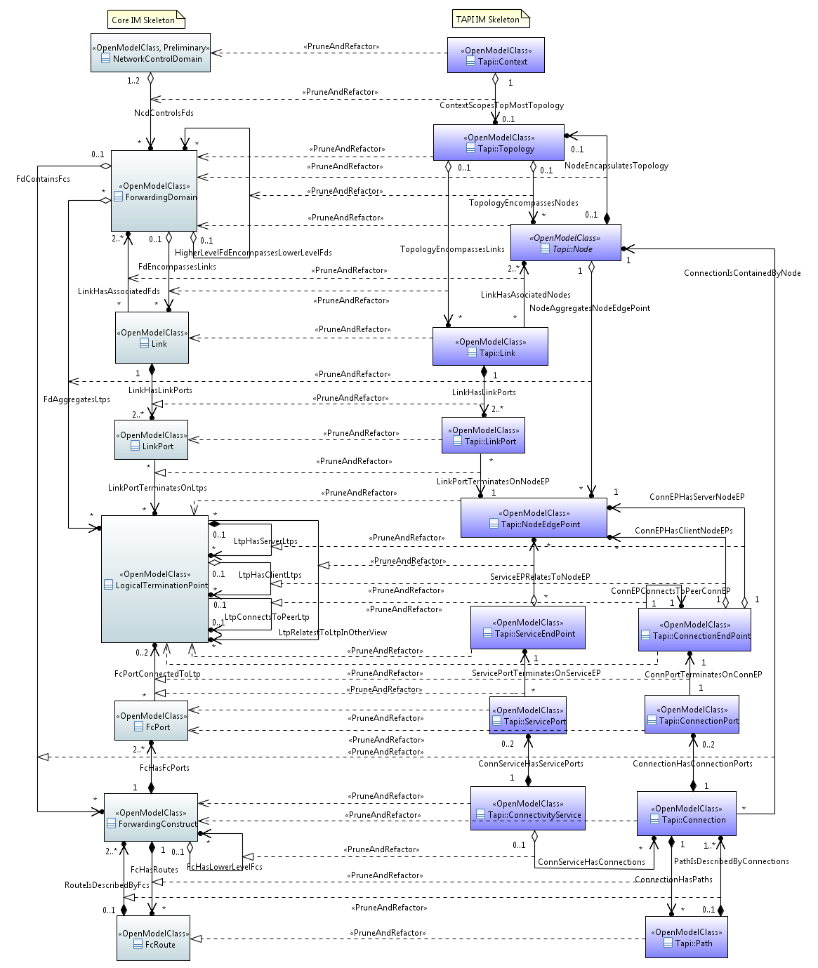
ONF Core model to TAPI and WT models
Core - TAPI
WT model is pruned from the Core model
The classes are unchanged in name and scope
Some classes/associations/attributes have been removed
TAPI model is pruned and refactored from the Core model
The figure sketches the more complex relationships
The model is pruned in a similar way to WT
Some classes from the core are split
E.g., FD becomes Node and Topology in TAPI
Some classes are cloned and narrowed
E.g., FC becomes Connection and ConnectivityService
Renaming of classes is carried out to assist adoption in the application context
Not fully aligned with current TAPI/Core

Slide 21
Ongoing work update
Continue work with other bodies
ITU-T (photonic media; publishing TR-512 as G.7711)
MEF
OASIS-TOSCA
ONAP
TMF (in the process of adopting TR-512.2, TR-512.4 and TR-512.7 in place of the TMF SID 5LR model)
TIP
ITU-T/IEEE/MEF on Ethernet, OAM etc.
TR-512 v1.5
Adopting the OAM model from TAPI
Enhancing the resilience model
Refining the Entity lifecycle
TR-512 v 2.0
Consider adding ports to the LTP
Consider restructuring the model packaging

Slide 22
Questions?
Thank you ☺

