Slide 1
Introduction to Guidelines & Tooling from ONF Open Information Model & Tooling (OIMT) project
Kam LAM (FiberHome / CICT) Nigel DAVIS (Ciena)
2019.05.04
Beijing

Slide 2
Agenda
Brief context setting
P1: ONF interface model – TAPI
P2: ONF core model – TR-512
P3: ONF interface model – TAPI
P4: Guidelines & Tooling – TR-514, -515, -531, -543, -544

Slide 3
Model Development Process (TR-513)
Common Information Model (CIM)
Interface Creation Process
Core Model ONF TR-512 / G.7711
Forwarding & Termination
Foundation
Topology
Resilience
Physical
….
View of the common IM for a particular purpose
Map
Data schema
for interface 1
Map
Interface
instance 1
Prune/refactor
Map
Interface instance 2
Technology specific models, e.g.,
G.875 OTN
G.8052 Transport ETH
Application specific models (e.g. storage)
xxx model
Guidelines
UML
Common Guidelines
Papyrus tool and GitHub
Common process
Interface specific
Interface specific
Interface specific
Model structure
Notes:
ONF TR-513 v1.2 “Common Information Model (CIM) Overview” https://www.opennetworking.org/wp-content/uploads/2014/10/TR-513_CIM_Overview_1.2.pdf

Slide 4
Model Specification Architecture
Notes:
ONF TR-513 v1.2 “Common Information Model (CIM) Overview” https://www.opennetworking.org/wp-content/uploads/2014/10/TR-513_CIM_Overview_1.2.pdf

Slide 5
OIMT IISOMI
IISOMI: Informal Inter-SDO Open Model Initiative
https://wiki.opennetworking.org/display/OIMT/IISOMI
An open source project founded by UML model designers from various SDOs like ETSI NFV, ITU-T, MEF, ONF and TM Forum
The goal is to develop guidelines and tools for a harmonized modeling infrastructure that is not specific to any SDO, technology or management protocol and can then be used by all SDOs.
The deliverables are developed in an open source community under the “Creative Commons Attribution 4.0 International Public License”.
Notes:
ONF TR-513 v1.2 “Common Information Model (CIM) Overview” https://www.opennetworking.org/wp-content/uploads/2014/10/TR-513_CIM_Overview_1.2.pdf

Slide 6
OIMT IISOMI deliverables
https://wiki.opennetworking.org/display/OIMT/IISOMI+Deliverables
IISOMI 514 UML Modeling Guidelines
Working drafts:
Draft_TR-514_UML_Modeling_Guidelines_v1.3.02.docx (including updates made during the December F2F meeting)
Draft_TR-514_UML_Modeling_Guidelines_v1.3.01.docx
Latest published version: TR-514 v1.3-info (7/2018)
IISOMI 515 Papyrus Guidelines
Working drafts:
Draft_TR-515_Papyrus_Guidelines_v1.3.01.docx
Latest published version: TR-515 v1.3-info (7/2018)
IISOMI 531 UML to YANG Mapping Guidelines
Working draft:
Draft_TR-531_UML-YANG_Mapping_Gdls_v1.1.02.docx (including updates agreed during the December F2F meeting)
Draft_TR-531_UML-YANG_Mapping_Gdls_v1.1.01.docx
Latest published version: TR-531 v1.1-info (7/2018)
IISOMI 543 UML to OpenAPI Mapping Guidelines
Latest published version: TR-543-v1.0-info (02/2018)
IISOMI 544 UML to ProtoBuf Mapping Guidelines
Latest published version: TR-544-v1.0-info (02/2018)
Notes:
ONF TR-513 v1.2 “Common Information Model (CIM) Overview” https://www.opennetworking.org/wp-content/uploads/2014/10/TR-513_CIM_Overview_1.2.pdf

Slide 7



Tooling Environment: Eclipse, Papyrus, Gendoc, GitHub
Eclipse is an IDE (Integrated Development Environment)
Papyrus is an Open Source modeling tool
A plug-in of Eclipse
Gendoc is another plug-in (XML Editor written in Java2 ) the modeling team is using for documentation
GitHub environment for cooperation
The agreed version of the tool is
Eclipse version 4.7.2 “Oxygen”
Papyrus version 3.2.0 RC4
Gendoc version 0.7.0 milestone 2

Slide 8
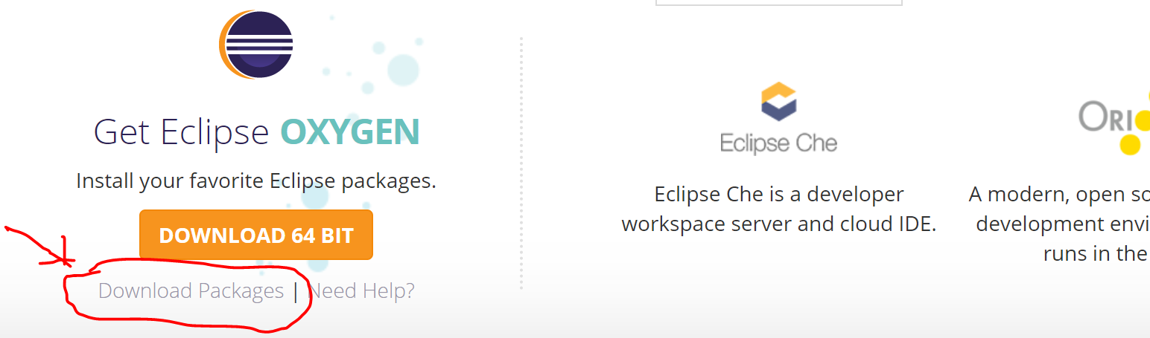
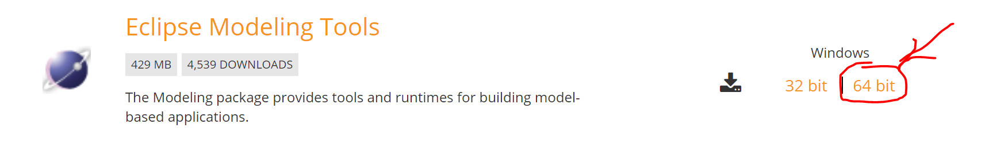

Installing Eclipse
http://www.eclipse.org/ → click “Download”
→ Click “Download Packages”
i.e., http://www.eclipse.org/downloads/eclipse-packages/
Select: Eclipse Modeling Tools 64 bit
Download, get eclipse-modeling-oxygen-2-win32-x86_64.zip
Extract the zip into a folder where you want the Eclipse application to locate in (e.g., document/model-app/oxygen.2)
Open eclipse.ini (using notepad+) to change two configuration values:
256 to 1024 for Xms & 1024 to 4096 for Xmx (so that have enough memory space for running GenDoc)
Now can launch Eclipse
But still need to install the Papyrus. See next slide

Slide 9
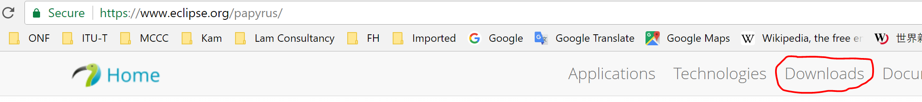
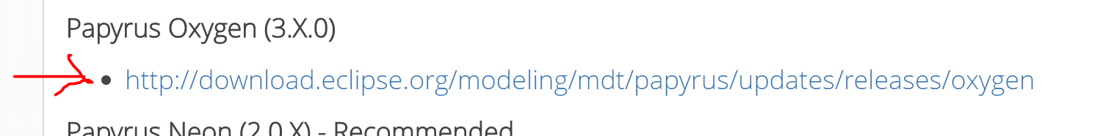
Installing Papyrus
Go to https://www.eclipse.org/papyrus/ → top right tab “Downloads”
Look for Papyrus 3.x.0 (Oxygen), copy the link (need this link later):
http://download.eclipse.org/modeling/mdt/papyrus/updates/releases/oxygen/
Launch eclipse, close the welcome screen, click help, select “Install New Software”, paste the above link into “work with”, click Add, give a name (e.g., Papyrus), ok, select the “Papyrus” little box (no need to select/install the other stuff), next, next, accept, finish
When install is done, restart eclipse, open Perspective, select Papyrus
Now can start using Papyrus for modeling, such as create a project, then create/import a model
But it is good to install “GenDoc” first, so that you can generate documentation (see next slide)

Slide 10

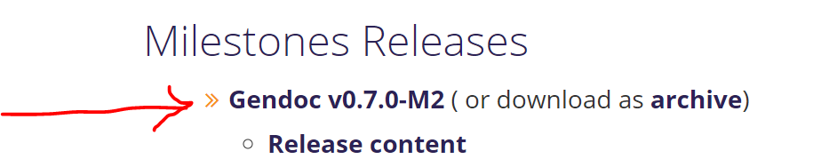
Installing Gendoc
Go to https://www.eclipse.org/gendoc/ (or in Google, search for Gendoc Eclipse Papyrus)
Click the Download tab
select Gendoc v0.7.0-M2,
Copy the URL (http://download.eclipse.org/gendoc/updates/milestones/0.7.0/M2/oxygen/)
In Eclipse, click help, select “Install New Software”, paste the above URL in the “Work With” box, click Add, select gendoc, next, next, accept, finish;
It will start to install, when done, restart.
Now get Gendoc installed
To run Gendoc:
In Papyrus project, in the Gendoc template folder, right click the template, select “Generate documentation using Gendoc”,
After done, refresh the “doc” folder to see the output document

Slide 11
Papyrus Guidelines TR-515
An OIMT IISOMI deliverable
https://wiki.opennetworking.org/display/OIMT/IISOMI+Deliverables
Document:
Working drafts:
Draft_TR-515_Papyrus_Guidelines_v1.3.01.docx
Latest published version: TR-515 v1.3-info (7/2018)

Slide 12
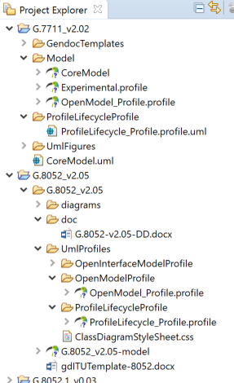
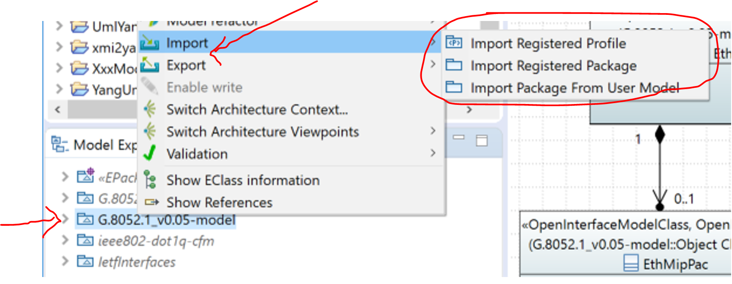
Notes about Papyrus Guidelines TR-515 (1/n)
5.2.1: Loading Eclipse and Papyrus
The downside of this approach is that you cannot up version the Papyrus or Eclipse independently.
To load Eclipse and Papyrus separately, see section 5.2.2 (or slides 8 & 9 above)
Papyrus release (3.x.x) requires a 1.8 compatible JVM
“1.8 compatible JVM”: Kam uses jre-8u131-windows-x64.exe file
Put the file “jre-8u131-windows-x64.exe” in the workspace folder
5.5: Importing project and model
Project and models
See Section 5.6 for importing other models (e.g., Primitive types, other user models, etc.) as read-only

Slide 13
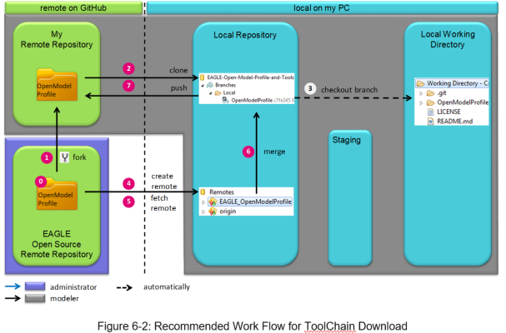
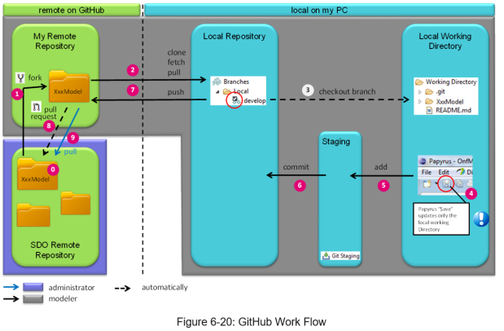
Notes about Papyrus Guidelines TR-515 (2/n)
6: Git
Git:
Wikipedia: “Git is a widely-used source code management system for software development. It is a distributed revision control system with an emphasis on speed, data integrity, and support for distributed, non-linear workflows.”
GitHub
A web-based git repository hosting service
6.2 Figure 6-2 Toolchain download and update
Fork, Clone create remote, fetch remote, merge
6.4 Figure 6-20 Workflow
Fork, Clone, “checkout”, update, add, commit, merge

Slide 14


Notes about Papyrus Guidelines TR-515 (3/n)
6.2.4 Create remote: make sure copy the link from →
6.4 “Git workflow”: Steps 1, 2, 3, 4, 5, 6, 7
6.4.3 “Model in Papyrus”: This is step 3 of Figure 6-20
Make sure “Copy project into workspace” should be unchecked, otherwise step 4, 5, 6 become irrelevant.
6.4.4 “Developing the Model”
6. 5 “Downloading a Model from github for “Read Only Use””

Slide 15
Notes about Papyrus Guidelines TR-515 (4/n)
7 Using Papyrus
Meta model Standard properties
Profiles Additional “standard” properties
User models
7.3 Model Splitting and importing
Develop the model in a collaborative manner
7.4 Create new project and model from scratch (i.e., constructing modeling environment (infrastructure))
Download infrastructure files (common datatype, Style sheets, profiles) from GitHub
Create new Xxx project and Xxx model
Copy and paste the infrastructure files into the new Xxx project
Refresh Xxx project
Apply the Open Model Profiles
Create packages
Add Style Sheet
Load Common Data Types
Now can start to play ….☺

Slide 16
Notes about Papyrus Guidelines TR-515 (5/n)
8 Gendoc
Extract diagrams, comments and details for a Data Dictionary from a Papyrus model using the Gendoc plugin
On-line tutorial: https://www.eclipse.org/gendoc/documentation/Gendoc_v0.6_tutorial.pdf
It doesn’t cover all aspects of usage, which are provided in TR-515
MS Word Template – a mix of Gendoc script, normal text, Word figures, tables, etc.
Can interleave text with figures and data dictionary content
8.1 through 8.16

Slide 17
Notes about Papyrus Guidelines TR-515 (6/n)
Papyrus usage
{xor}
Nodes/Constraint,
Context
Properties/UML: delete the default name
Properties/Specification/+/LiteralString/Value: type in xor
Properties/Appearance: unselect “Element icon”
Click and drag (the tiny outward arrow) to create a connection to the {xor} element
Copy a class and start to modify the attributes

Slide 18
Demo – Papyrus Installation and Use
A set of video clips given by the ONF OIMT co-chair Nigel Davis (Ciena) to ONAP on 2018.01.05

Slide 19
UML to YANG Mapping TR-531
An OIMT IISOMI deliverable
https://wiki.opennetworking.org/display/OIMT/IISOMI+Deliverables
Guidelines document:
Working draft:
Draft_TR-531_UML-YANG_Mapping_Gdls_v1.1.02.docx (including updates agreed during the December F2F meeting)
Draft_TR-531_UML-YANG_Mapping_Gdls_v1.1.01.docx
Latest published version: TR-531 v1.1-info (7/2018)

Slide 20
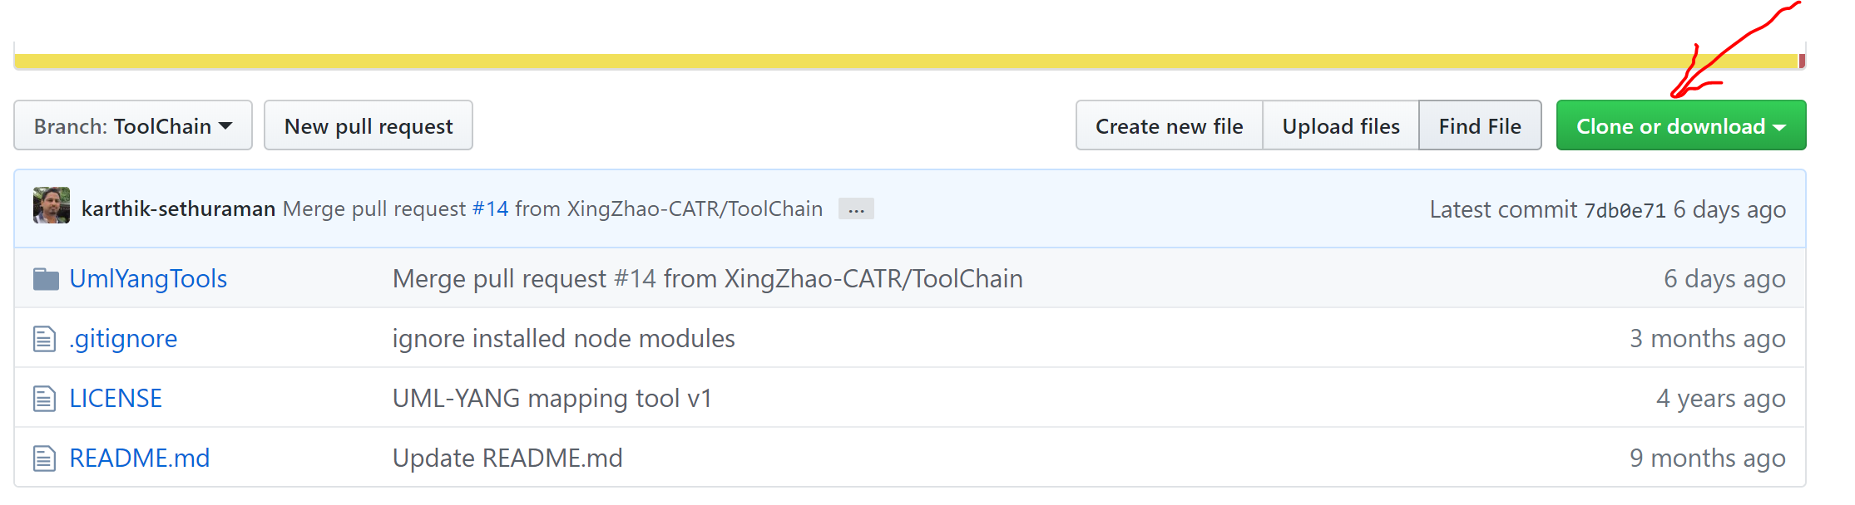

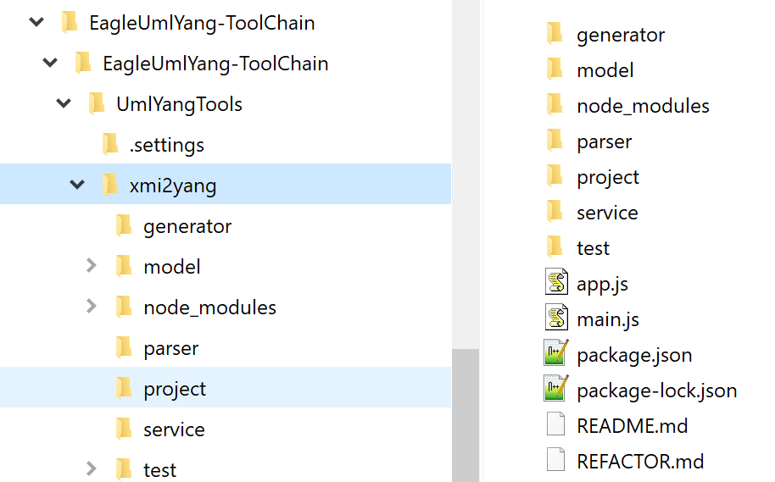
UML to YANG Mapping Tool: xmi2yang
Download the tool
At https://github.com/OpenNetworkingFoundation/EagleUmlYang
Click “Clone or download”
Select “Download zip”
Unzip the zip file “EagleUmlYang-ToolChain.zip”

Slide 21
Set up the running environment for xmi2yang
Programming language: JavaScript
Set up the running environment: node.js
Download from https://nodejs.org/en/ the node-v8.9.4-x64.exe and run it once
Also, from time to time, update the environment by running the command “npm install” in the folder xmi2yang
Select the folder …..\xmi2yang
(e.g., C:\Users\hingk\Documents\model_app\xmi2yang_2019.05.01\EagleUmlYang-ToolChain\EagleUmlYang-ToolChain\UmlYangTools\xmi2yang)
Shift & right click, select “Open the Powershell Window here” (this will bring up the command line window)
Type in the command: npm install

Slide 22
Running the tool xmi2yang
How to run:
Copy the UML file (.uml) of the UML model into the “project” sub-folder of the xmi2yang directory
Run the command “node main.js” at the xmi2yang directory
Shift & right click,
Select “Open the Powershell Window here” (this will bring up the command line window)
Type in the command: node main.js
The YANG file (.yang) will be generated in the “project” sub-folder
Validate the YANG file at http://www.yangvalidator.com/ and get also the YANG Tree.

Slide 23
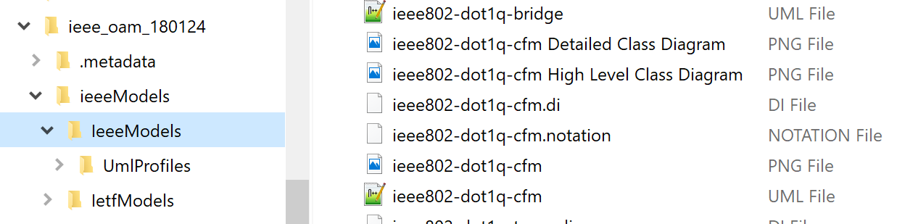
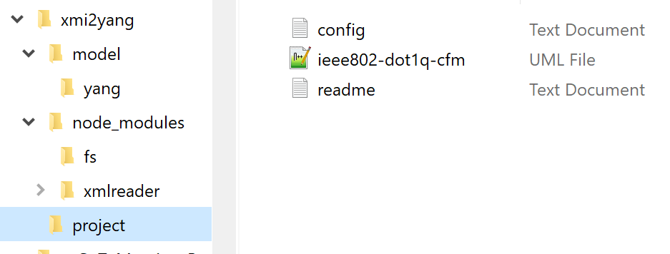
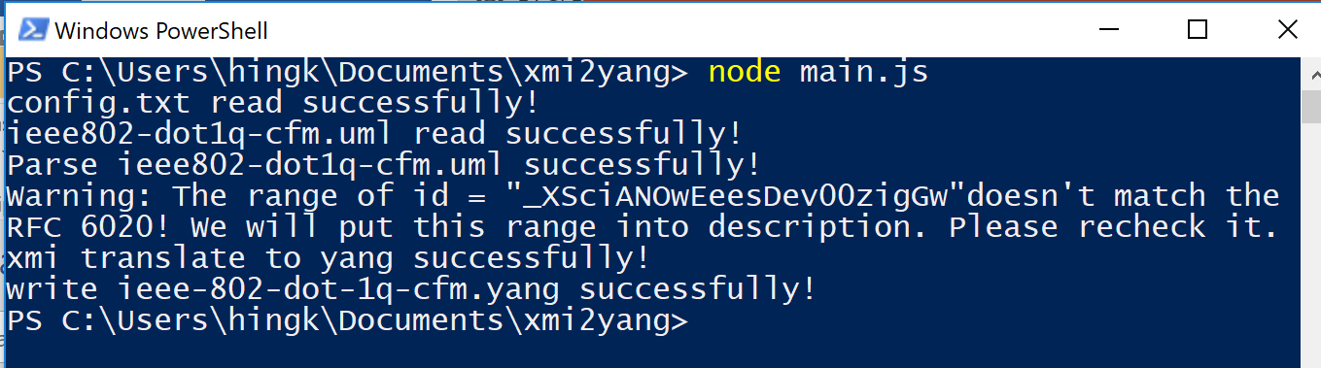
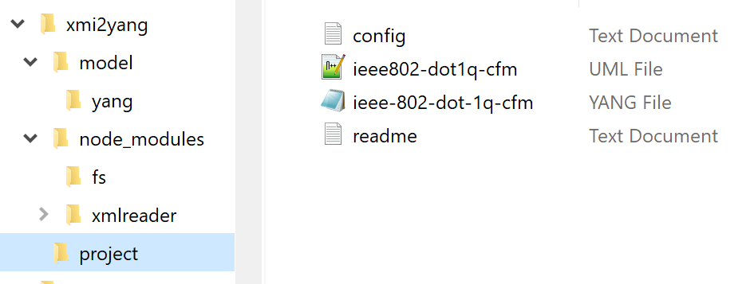
Demo - Running xmi2yang
The model
The tool
Run!
The output
Notes:
The UML-YANG mapping tool “xmi2yang” translates a UML (Unified Modeling Language) model to a YANG model defined in RFC6020. The output YANG files can be conveniently used in REST style API definition.
The mapping rules of this UML-YANG mapping tool is based on ONF TR-531 v1.0, IETF RFC 6020 and OMG Unified Modeling Language (OMG UML) Version 2.5.

Slide 24
Demo – UML to YANG translation
On site live demo

Slide 25
YANG to UML Mapping
An OIMT work item
https://github.com/OpenNetworkingFoundation/EagleUmlCommon/tree/ToolChain/YangUmlTools
Work on how a "tool" can fulfill the requirements for converting existing Yang to UML (Papyrus).
https://github.com/OpenNetworkingFoundation/EagleUmlCommon/tree/ToolChain/YangUmlTools

Slide 26
UML to OpenAPI Mapping TR-543
An OIMT IISOMI deliverable
https://wiki.opennetworking.org/display/OIMT/IISOMI+Deliverables
Guidelines document:
Latest published version: TR-543-v1.0-info (02/2018)
Tool:
https://github.com/OpenNetworkingFoundation/EagleUmlCommon/tree/ToolChain/YangJsonTools

Slide 27
UML to ProtoBuf Mapping TR-544
An OIMT IISOMI deliverable
https://wiki.opennetworking.org/display/OIMT/IISOMI+Deliverables
Guidelines document:
Latest published version: ONF TR-544 v1.0 (2/2018)
Tool:
No tool has been developed yet

Slide 28
Unified Modeling Language (UML)
A general-purpose, developmental, modeling language in the field of software engineering, that is intended to provide a standard way to visualize the design of a system.
1994-1995 created by Grady Booch, Ivar Jacobson, James Rumbaugh
1997 adopted by OMG (Object Management Group) and maintained since then
2005 also published by ISO (International Organization for Standardization as ISO/IEC 19501-1:2005
Latest release: UML version 2.5 (5/2015)

Slide 29
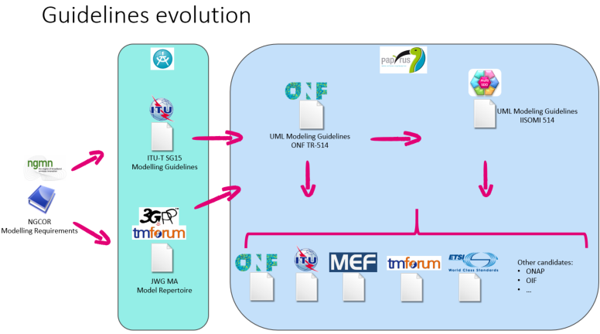
UML Modeling Guidelines TR-514
Purpose of the guidelines
UML defines a number of basic model elements (UML artifacts). Not all artifacts are necessary.
In order to assure consistent and harmonious information models, only a selected subset of these artifacts is used in the UML model guidelines in this document.
An OIMT IISOMI deliverable
https://wiki.opennetworking.org/display/OIMT/IISOMI+Deliverables
Working drafts:
Draft_TR-514_UML_Modeling_Guidelines_v1.3.02.docx (including updates made during the December F2F meeting)
Draft_TR-514_UML_Modeling_Guidelines_v1.3.01.docx
Latest published version: TR-514 v1.3-info (7/2018)

Slide 30
Questions?
Thank you ☺

Slide 31
Back up
Notes about UML Modeling Guideline TR-514

Slide 32
Notes about UML Modeling Guideline TR-514 (1/n)
Latest working draft: v1.3.02
General UML modeling requirements
UML 2.5 (Unified Modeling Language)
The model shall be management/control protocol-neutral, i.e., not reflect any middleware protocol-specific characteristics (like e.g., CORBA, HTTP, JMS).
The model shall be map-able to various protocol-specific interfaces.
It is recommended to automate this mapping supported by tools.
To ensure proper working of the mapping tools, the model designer shall only use the modeling patterns defined in these guidelines.
Traceability from each modeling construct back to requirements and use cases shall be provided whenever possible.
In the Guidelines, each basic model artifact are divided into three parts:
Short description
Graphical notation examples
Properties

Slide 33
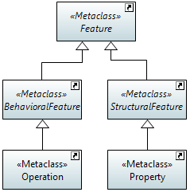
Notes about UML Modeling Guideline TR-514 (2/n)
5.1 Structural & Behavioral Features
Structural:
Static
Classes & Attributes (Properties)
Behavioral:
Dynamic
Interfaces & Operations
The decoupling of attributes and operations allows a model designer to provide individual operations (specific parameter lists) for different views/managers.

Slide 34
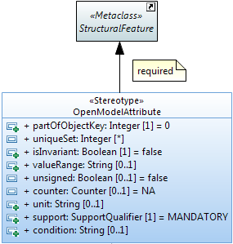
Notes about UML Modeling Guideline TR-514 (3/n)
5.2 Class
Create: Model Explorer/ObjectClass Package/right click/new child/class
Class properties: Properties/Advanced
5.3 Attribute (in Papyrus “property”)
Create: Model Explorer/Object Class/Right click/new child/property
Attribute properties: Properties/Advanced

Slide 35
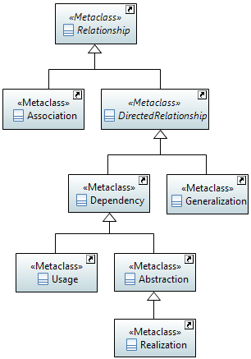
Notes about UML Modeling Guideline TR-514 (4/n)
5.4 Relationship
Create: Palette/Edges/Association
Properties: Properties/Profiles/Applied stereotype
Relationship types:
Simple association, pointer (reference) association, ….
Association
Aggregate – SharedAggregate – LifecycleAggregate – Composite (Names) - StrictComposite (part cannot move) – ExtendedCompoiste (part has no life, is abstract, the extended “whole” is augmented at runtime by the extending part)
Dependency: e.g., use, NamedBy
Abstraction (Specify): Add specification at run-time. Could have constraint (OCL)

Slide 36
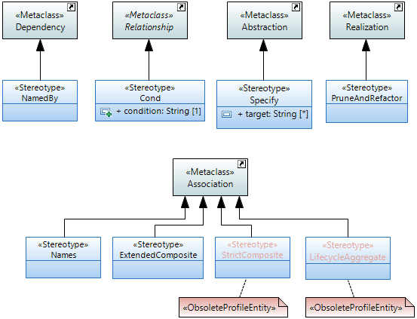
Notes about UML Modeling Guideline TR-514 (5/n)
5.4.3 Potential Annotations for Associations

Slide 37



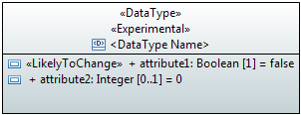
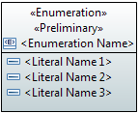

Notes about UML Modeling Guideline TR-514 (6/n)
5.9 Data Types
3 types:
(Complex) Data Types (further structured; e.g., Host which combines ipAddress and domainName)
Primitive Types (not further structured; e.g., Integer, MAC address).
Enumerations
Create: Model Explorer/ any package/ richt click/ new child/

Slide 38
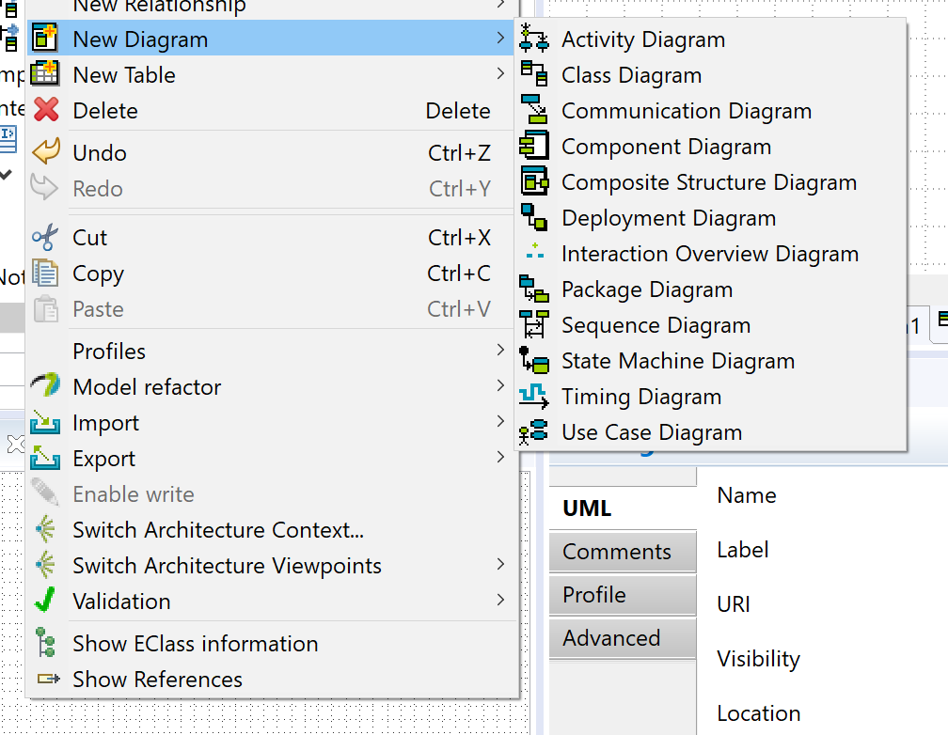
Notes about UML Modeling Guideline TR-514 (7/n)
5.5 Interface
Create: Model Explorer/Interfaces package/right click/new child/Interface
5.6 Operations
Create: Model Explorer/Interface/new child/Operation
5.7 Parameters
Create & Update: Properties/UML, add, update in/out/inout parameters
5.8 Notifications
Create Signal (Notification): Model Explorer/Notifications package/right click/new child/Signal
Create Attributes: Model Explorer/Signal/right click/new child/Property

Slide 39
Notes about UML Modeling Guideline TR-514 (8/n)
6 UML Profile Structure
The profiles are being updated based on feedback.
For example,
https://wiki.opennetworking.org/display/OIMT/IISOMI+Minutes
https://github.com/OpenNetworkingFoundation/EagleUmlCommon/pull/288

Slide 40
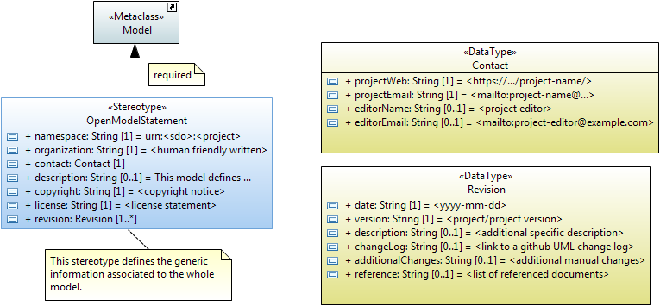
Notes about UML Modeling Guideline TR-514 (9/n)
6.2 General Information on the UML Model
OpenModelStatement Required «Stereotype»

Slide 41
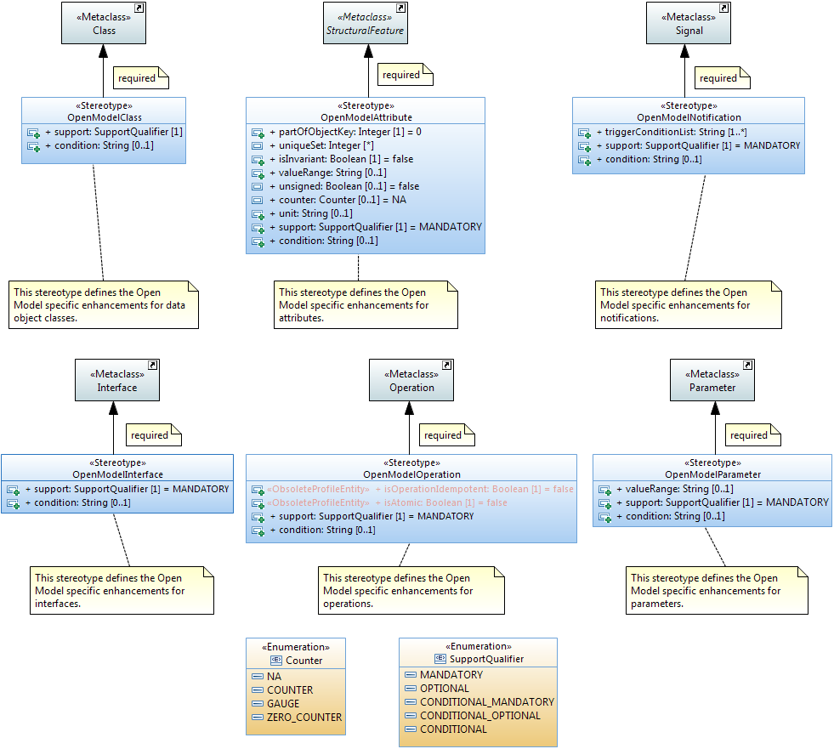
Notes about UML Modeling Guideline TR-514 (10/n)
6.3 Common Properties for individual UML Model artifacts
OpenModel Profile: Required «Stereotypes»

Slide 42
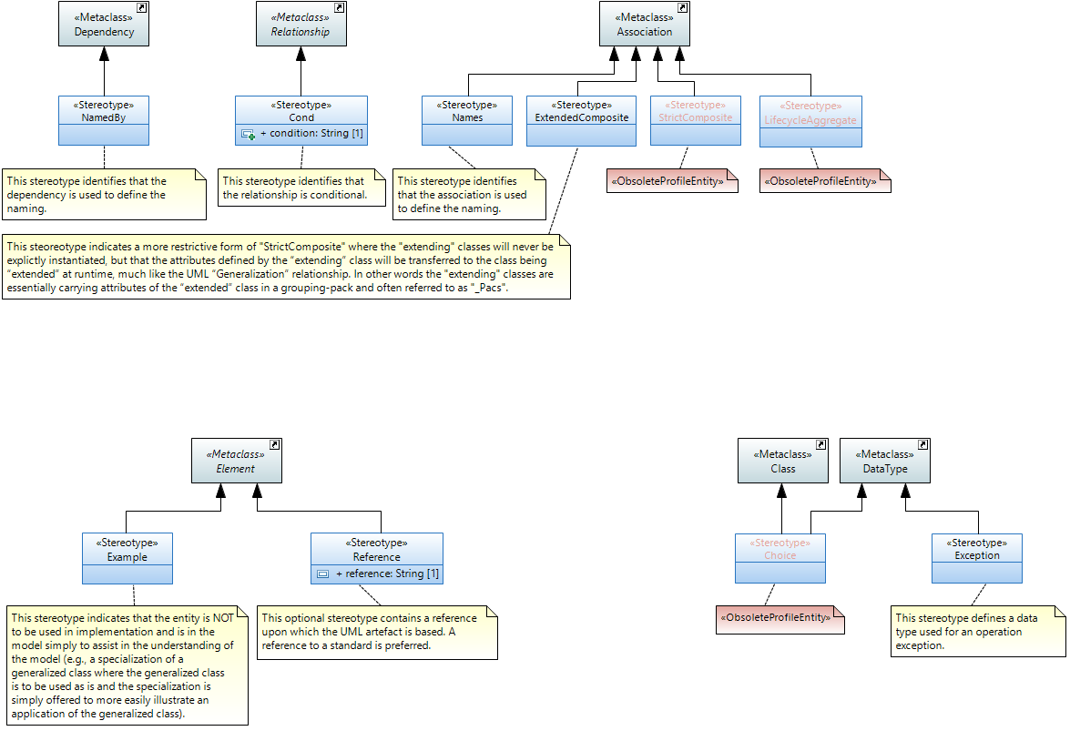
Notes about UML Modeling Guideline TR-514 (11/n)
6.3 Common Properties for individual UML Model artifacts
OpenModel Profile: Optional «Stereotypes» (1/2)

Slide 43
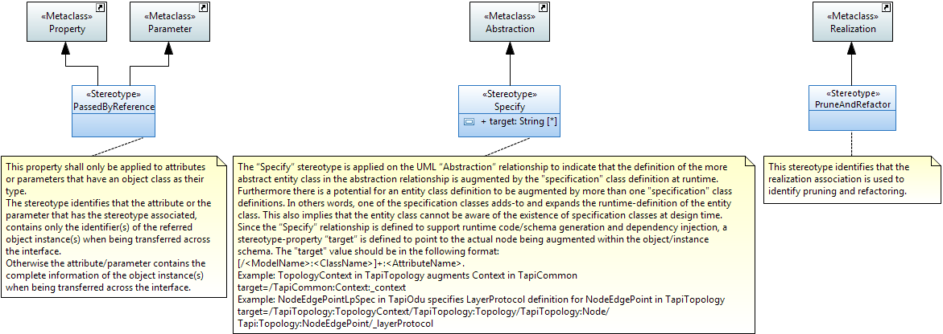
Notes about UML Modeling Guideline TR-514 (12/n)
6.3 Common Properties for individual UML Model artifacts
OpenModel Profile: Optional «Stereotypes» (2/2)

Slide 44
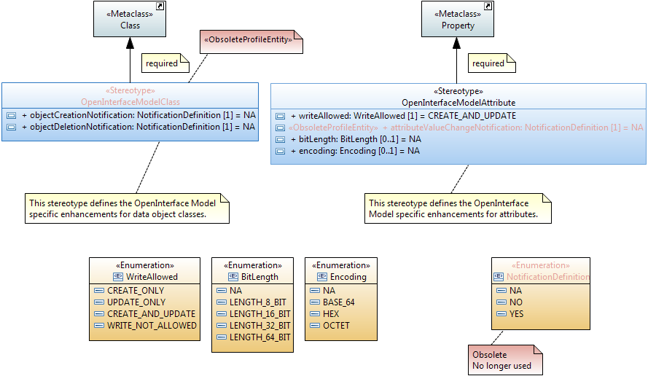
Notes about UML Modeling Guideline TR-514 (13/n)
6.4 Interface related Properties for individual UML Model artifacts
OpenInterfaceModel Profile: Required «Stereotypes»

Slide 45
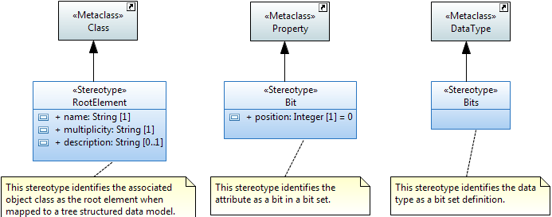
Notes about UML Modeling Guideline TR-514 (14/n)
6.4 Interface related Properties for individual UML Model artifacts
OpenInterfaceModel Profile: Optional «Stereotypes»

Slide 46
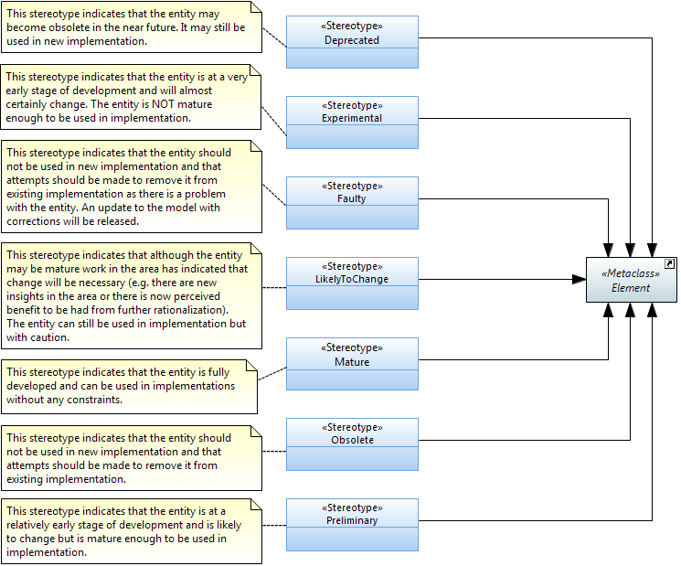
Notes about UML Modeling Guideline TR-514 (15/n)
6.5.2 LifecycleState Property
Lifecycle «Stereotypes»
All UML Model artifacts (packages, classes, attributes, interfaces, operations, parameters, data types, associations and generalizations) may be appended with one of the following lifecycle states
It is recommended that every new UML model artifact is initially annotated with the “Experimental” lifecycle stereotype.

Slide 47
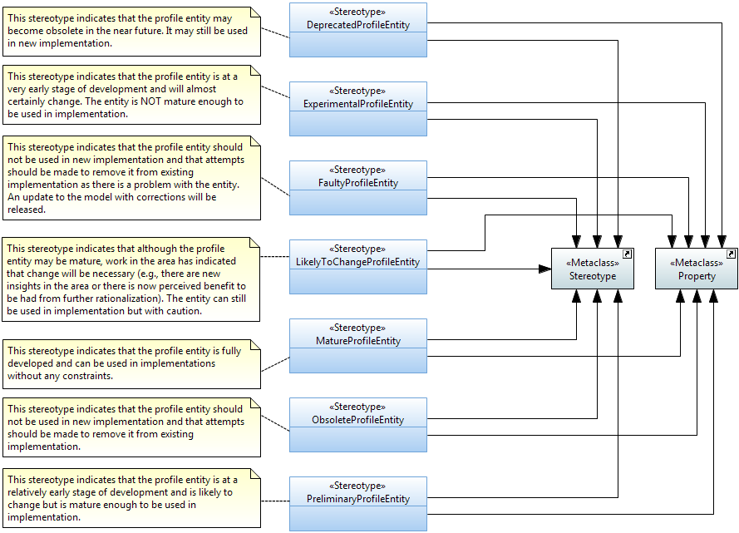
Notes about UML Modeling Guideline TR-514 (16/n)
6.5.3 Profile LifecycleState Property
Profile Lifecycle «Stereotypes»
All UML Profile artifacts (stereotypes and properties) may be appended with one of the following lifecycle states
DeprecatedProfileEntity
ExperimentalProfileEntity
FaultyProfileEntity
LikelyToChangeProfileEntity
MatureProfileEntity
ObsoleteProfileEntity
PreliminaryProfileEntity
It is recommended that every new UML profile artifact is initially annotated with the “Experimental” lifecycle stereotype.

Slide 48
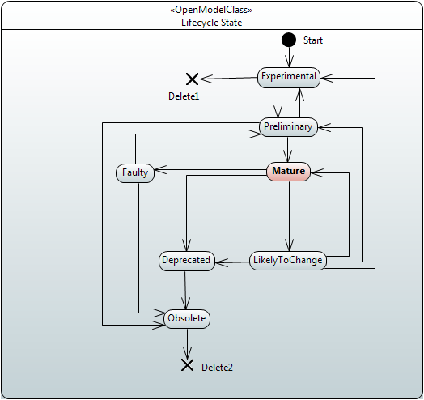
Notes about UML Modeling Guideline TR-514 (17/n)
6.5.3 Profile LifecycleState Property
Lifecycle and ProfileLifecycle LifecycleState State Machine

Slide 49
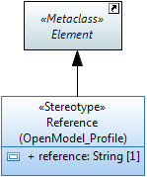
Notes about UML Modeling Guideline TR-514 (18/n)
6.5.4 “Reference” property
defined for all UML artiA reference can be facts. This is an optional property which contains a reference to the source on which the artifact is based on. A reference to a standard, if it exists, is preferrable. The following form is recommended: <SDO> <Standard> <Version>: <section>; e.g., "IEEE Std 802.1AB-2016: 8.5.9.5".

Slide 50
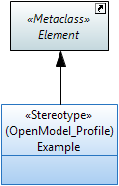
Notes about UML Modeling Guideline TR-514 (19/n)
6.5.5 “Example” property
It is defined as a stereotype and indicates that the entity is NOT to be used in implementation and is in the model simply to assist in the understanding of the model

Slide 51
END
Done! ☺

