Slide 1
ONF Core Model Introduction to models, guidelines and tooling from ONF Open Information Model & Tooling project
Nigel Davis (Ciena)
Kam Lam (FiberHome)
20181205

Slide 2
ONF API Modeling
ONF Open Information Modeling and Tooling (OIMT) Project
Core Information Model - TR-512 v1.4
Technology agnostic core modeling framework – patterns and methods
OTCC sub-Project – Transport API (TAPI)
CIM pruned and refactored for Transport SDN NBI
K. Sethuraman Presentation Wed. 2:30pm ODTN Track
OTCC sub-Project – Open Transport Info. Modeling
Models for wireline transport technologies
Ethernet, OTN, Photonic Media Models
OTCC sub-Project – Wireless Transport model
CIM-aligned models for wireless transport – TR-532
PoCs testing interoperability of TR-532 implementations
L. Ong/T. Brakle Presentation Tue 5:30pm Mobile Track
OTCC sub-Project – Device Management Interface Profile
Profile/Requirements for Netconf – TR-545
Interoperability Requirements based on PoC Testing

Slide 3
Modelling SDN
The Core model provides a standardized implementation neutral representation of things and the relationship between those things in the SDN problem space
Network functions. Model focus:
Virtualized termination/forwarding in any network
Physical Equipment supporting the network. Model focus:
Field Replaceable Units (FRUs), non-FRUs, strands etc.
Control functions supporting the network. Model focus:
Representation of functions related to closure of control loops
Presentation of views of the resources for the purpose of control
Processing functionality supporting/using the network. Model focus:
Any abstract function
Resource/System/Scheme specifications. Model focus:
Constraints, rules and specs for the of the overall systems
Software supporting the control
Files, Installed Software, Containers, VMs,
Most recent focus has been on Analogue Guided Media networks, using photonic networks as the key application.
TR-512.A.4 provides the explanation of the use of the Core Model for photonic networks.
This work has been used extensively by OTCC and Facebook TIP

Slide 4
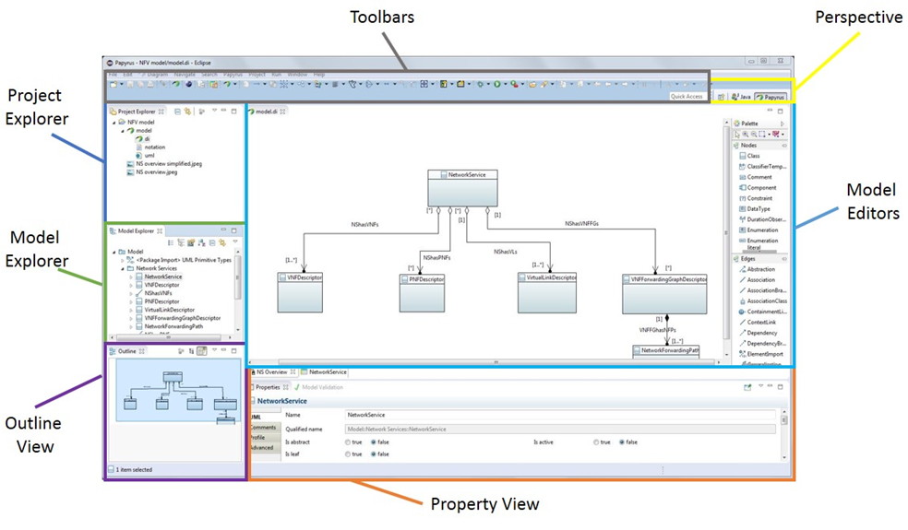
Model to create a common language
Goals:
A well defined widely applicable representation of the semantics of managed network functionality that is lightweight, has a modular architecture and is technology/technique agnostic
Reduce the formation of overlapping inconsistent implementations which hinder overall progress
Approach:
Leverage industry best-practices, patterns and tools to close the model to implementation round trip loop
Use Agile modelling methodology to construct a formal model using Papyrus UML
A graphical modeling language highlights underlying patterns
The environment provides a framework for:
Development of understanding about control of networks
Capturing a representation of the understanding
Maintaining growing insight
Promote Core Model use/extension
Use:
Derivation of Interface/database models using generators to generate consistent artefacts in JSON, Yang etc.

Slide 5

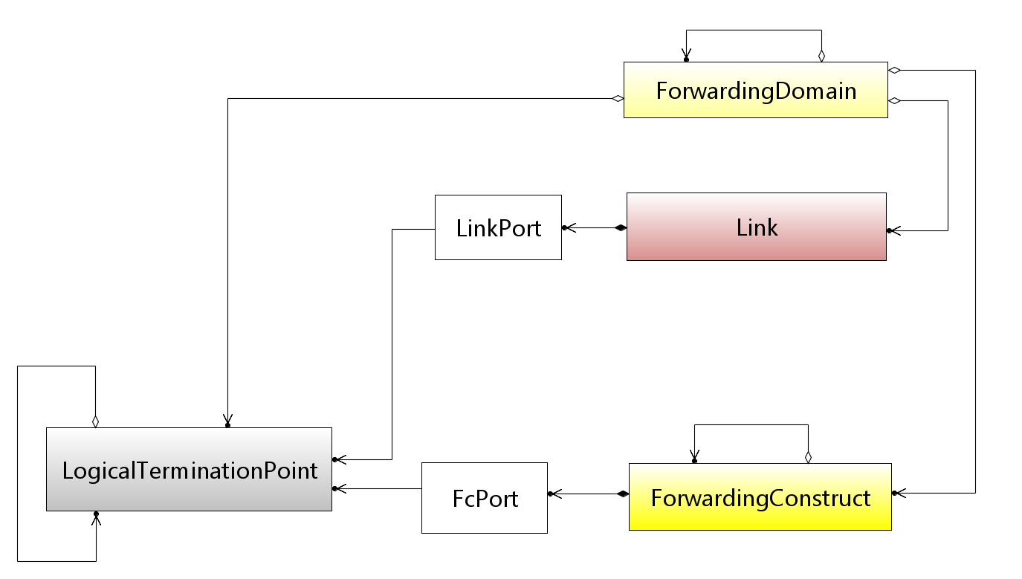
Canonical network model (virtualized/functional): Forwarding, Termination and Topology
See slide notes
Device
Network Device OR Opaque Network
Simplified view
From TR-512.2
Network
Showing layers
Derived from ITU-T and TMF work
Model for any networking, for any network technology, with any degree of virtualization, at any scale, at any abstraction and in any interrelated view.
Notes:
A general pattern for all networking focussing on transport
Any capability with the purpose of transferring information is transport
IP is transport
Essential concepts are forwarding, termination and adaptation
Pure functional, independent of physical environment but relateable at the port and as below
All forwarding/termination can use this model whether it is implemented in a traditional form or virtual/cloudified
Deals with “apparent” adjacency (Link)
Support
Stacking of layer-protocols and network layering
Navigation between views
Model for any networking for any transport network technology, with any degree of virtualization, at any scale, at any abstraction and in any interrelated view.

Slide 6
Photonic network analysis and modeling
Modelling of fundamental functions
Key (Core Model Entities)
ForwardingConstruct (FC)
Intermediate
LogicalTerminationPoint
(LTP)
Floating
Tied to physical
Modelling of Aggregated functions
Device etc. (ConstraintDomain)
Termination (in an LTP)
Modelling of Devices
Adapter (in an LTP)
C&SC
ConfigurationAndSwitchController
Modelling of Networks
From TR-512.A.4
Using the model entities to represent photonics at all scales gives a consistent model regardless of the degree of aggregation etc.

Slide 7
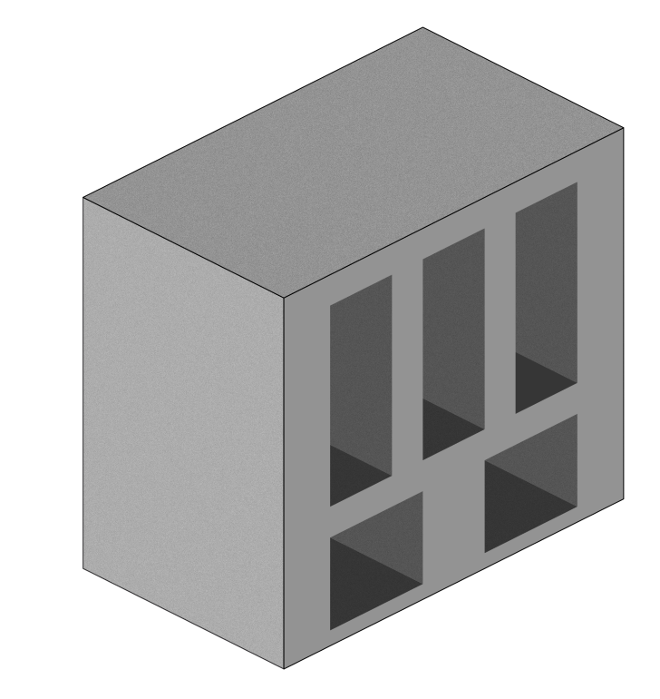
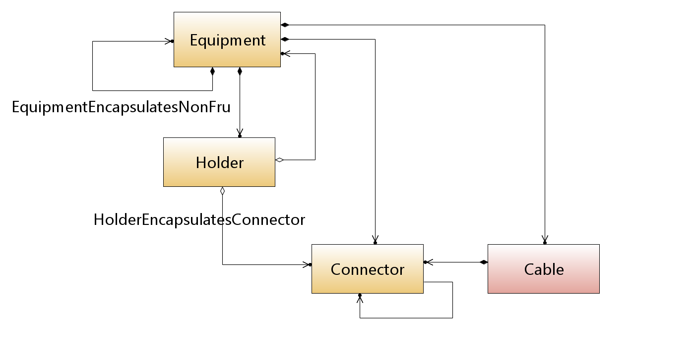
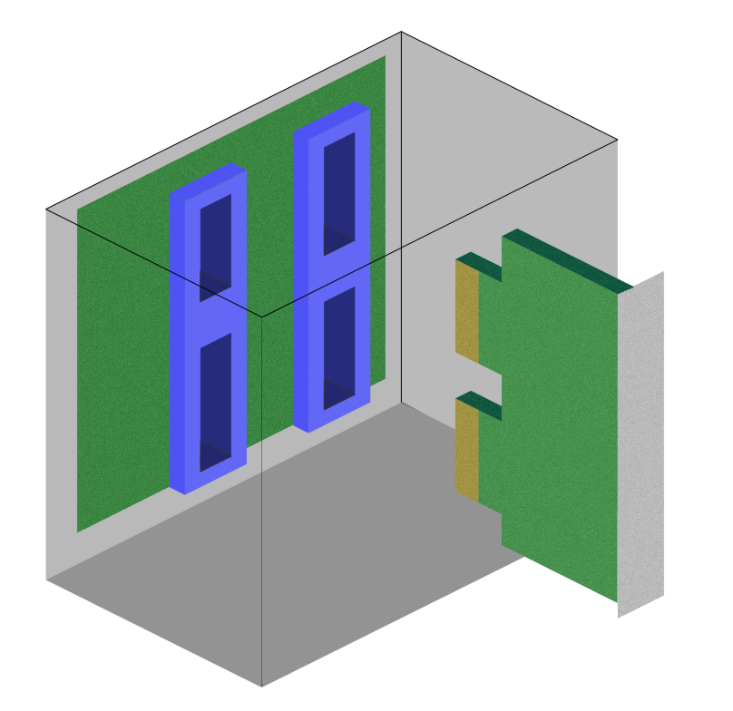
Canonical physical model
See slide notes
Represents truly physical things, i.e. things that can be measured with a ruler
From TR-512.6
Simplified view
Derived from ITU-T and TMF work
Model for any physical components that are rack/cabinet/shelf based or stand-alone in a data center or telco environment
Notes:
Represents truly physical things, i.e. things that can be measured with a ruler
Focusses on electronic equipments
Any rack based, circuit pack based solutions can use this model
Supports a stand-alone equipment
Has a representation of physical connector and abstract cable
Model for any physical components that are rack/cabinet/shelf based or stand-alone in a data center or telco environment

Slide 8
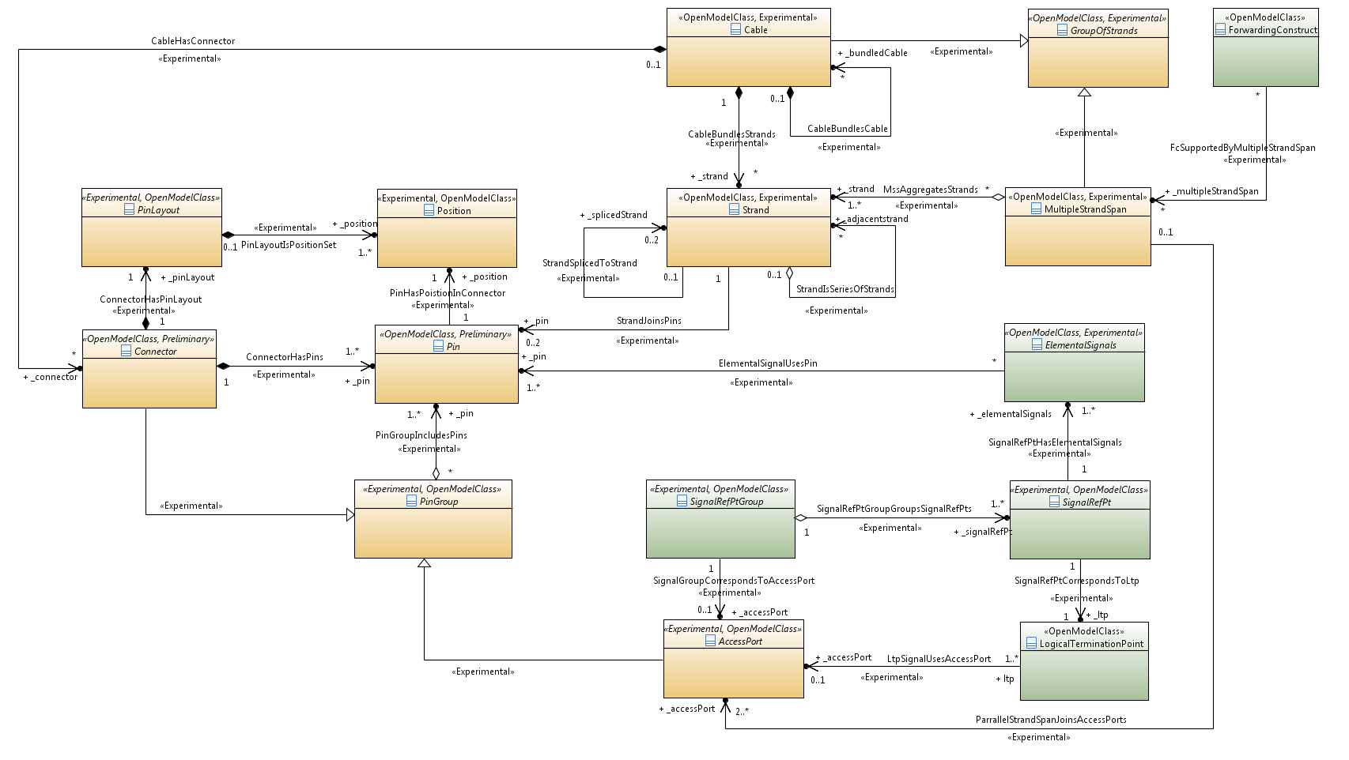
Connector, Cable, AccessPort and MultipleStrandSpan
Cable
FC
From TR-512.5
Strand
MultipleStrandSpan
Connector
Pin
PinGroup
AccessPort
LTP
Strong separation of concerns of physical from functional yields a model that deals consistently with a wide range of physical structure

Slide 9
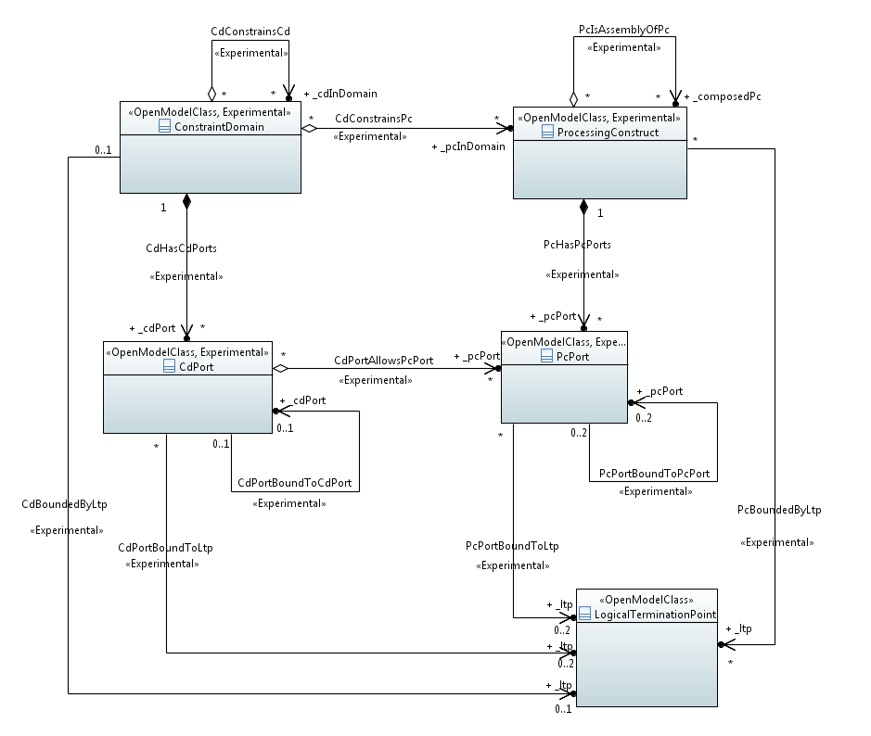
Model of generalized processing and constraint
See slide notes
From TR-512.11
ConstraintDomain
ProcessingConstruct
Follows the Component-Port and Component-System patterns
CdPort
PcPort
LTP
Model for any arbitrary functions/constraint, views of abstractions of functions/constraints, interconnection of functions to networking.
Notes:
Dealing with non-transport functions covering any functionality in abstraction
All functions are emergent and hence all functions are virtual
Supporting part of the control model
Enabling removal of the faulty concept of NE and replacement with a versatile constraint based model
Model for any arbitrary functions/constraint, views of abstractions of functions/constraints, interconnection of functions to networking and relationship of functions to the physical environment.

Slide 10
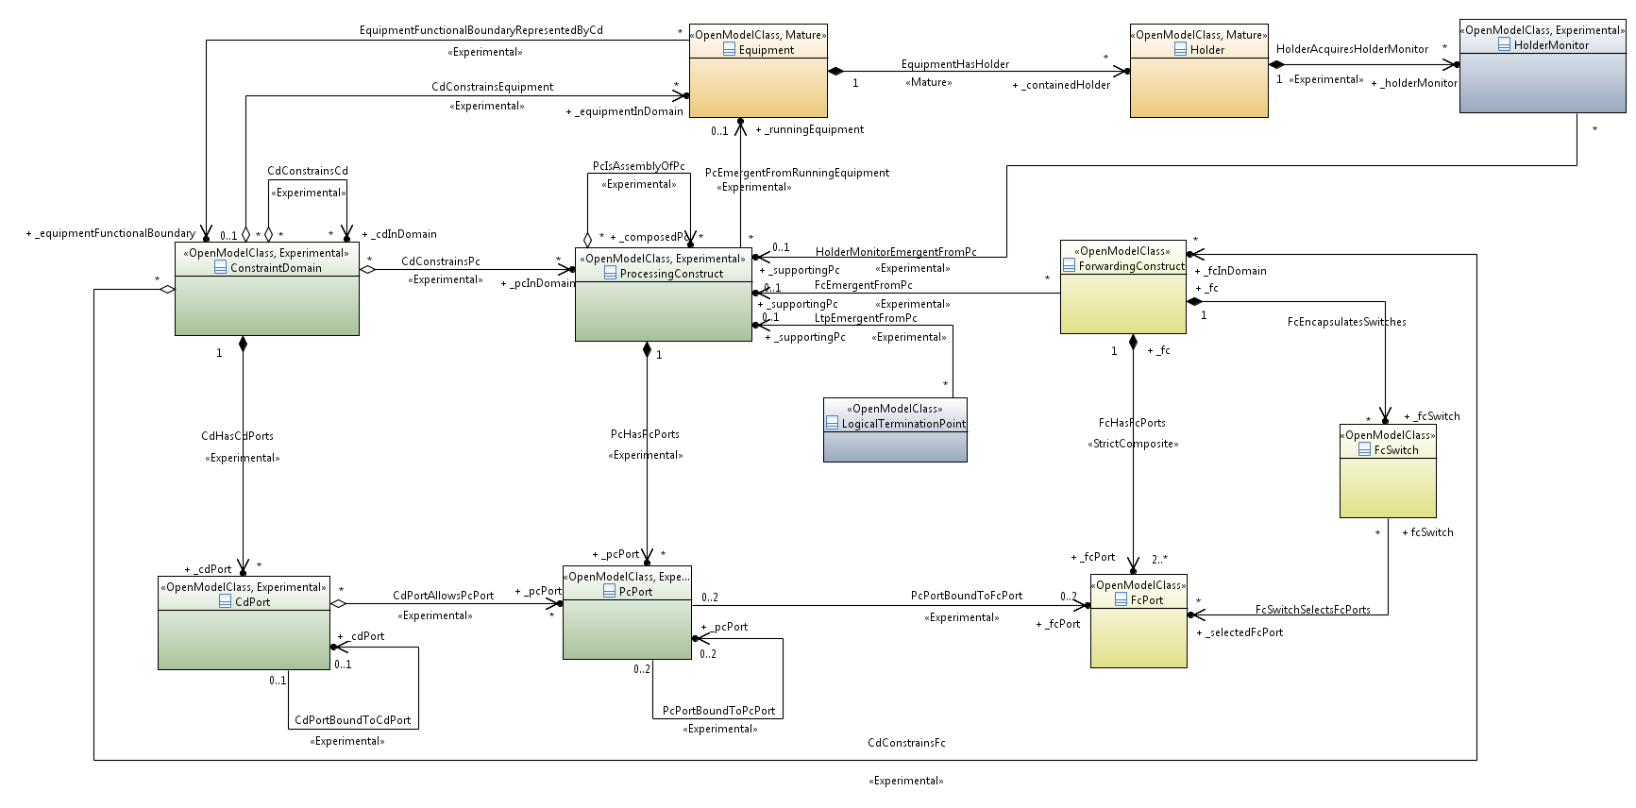
Association between physical and functional model
See slide notes
CD provides boundary around equipment to represent NE/Device/Controller etc
PC emergent from running equipment
Equipment
Holder
HolderMonitor
CD
PC
FC
CD represents Equipment functional boundary grouping PCs
LTP
Functions emergent from complex processing represented by PC
Derived from ITU-T and TMF work
From TR-512.6
Basis for model for the understanding of the physical realization of functional things (regardless of how “virtual” they are).
Notes:
Achieved via the generalized processing model
Recognizes that all behaviour is emergent and hence all functions are virtual
Strongly separates concerns of true physical from true functional
Corrects issues with “equipment” protection recognising that:
It is not the physical thing that is protected
A single physical unit may support several functions where each is involved in a different form of resilience
Basis for model for the understanding of the physical realization of functional things (regardless of how “virtual” they are)

Slide 11
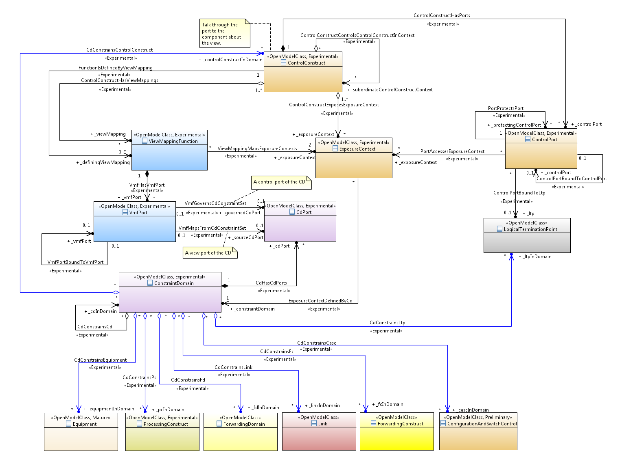
Model of control access and view
See slide notes
ControlConstruct provides access via its ports to enable observation/control. ControlPort provides the messaging/signalling
From TR-512.8
ControlConstruct
ViewMapping provides the relationship views defined by CD that are offered through different ExposureContexts
ViewMapping
ControlPort
ExposureContext
The ControlPort is bound to LTP allowing control messages to enter the network
CdPort
LTP
CD
ExposureContext provides definition of what is exposed through a ControlPort using ConstraintDonain (and hence including ControlConstruct)
CD groups/constrains any structures including ControlConstruct
Equipment
PC
FD
Link
FC
CASC
Model for the control functions in the network, for control of those control functions, and modelling of Control itself, for control of the Controller.
Notes:
Focussing on:
Generalized control (see above)
Configuration and Switch control (see next slide)
Initially dealing with protection and restoration schemes
Progressing from specific control to model of general control
Model for the control functions in the network, for control of those control functions, and modelling of Controller itself, for control of the Controller.

Slide 12
Other further key coverage in TR-512 V1.4
Replacement of the NE and the SDN Controller with a uniform model of ControlConstruct, ExposureContext and ConstraintDomain [TR-512.8]
Model of Control of Switching etc. using the ConfigurationAndSwitchController (CASCC) [TR-512.5]
Component-System pattern and Component-Port pattern [TR-512.A.2]
Augmentation via decoration defined by machine readable specification [TR-512.7]
Modelling of Software [TR-512.12]

Slide 13
Information Model evolution

Slide 14
ONF Tooling evolution
ITU-T Technology IMs
TMF SID
ONF IM
(inc. converged network ABE)
ONF Spec Approach
NVP extension
TMF MTNM / MTOSI
Manual P&R
Tool Assisted P&R
Tool Assisted P&R
Mapping
Mapping
Manual Generation
Experience, lessons, insight
CORBA IDL &
XSD
Manual process
TMF TIP
TAPI
Tooled process
Model migration
Tooled Generation
Tooled Generation
UML Tool
OssJ
Implementation
Transformation Tooling
Java &
XSD
Yang, REST, TOSCA…
IBM RSA (Eclipse, Proprietary)
Tooled Generation
TigerStripe (Cisco, Open Source)
Time
Papyrus (Eclipse, Open Source)
Java &
XSD
IISOMI (Java Script, Open Source)
2005
2011
2017

Slide 15
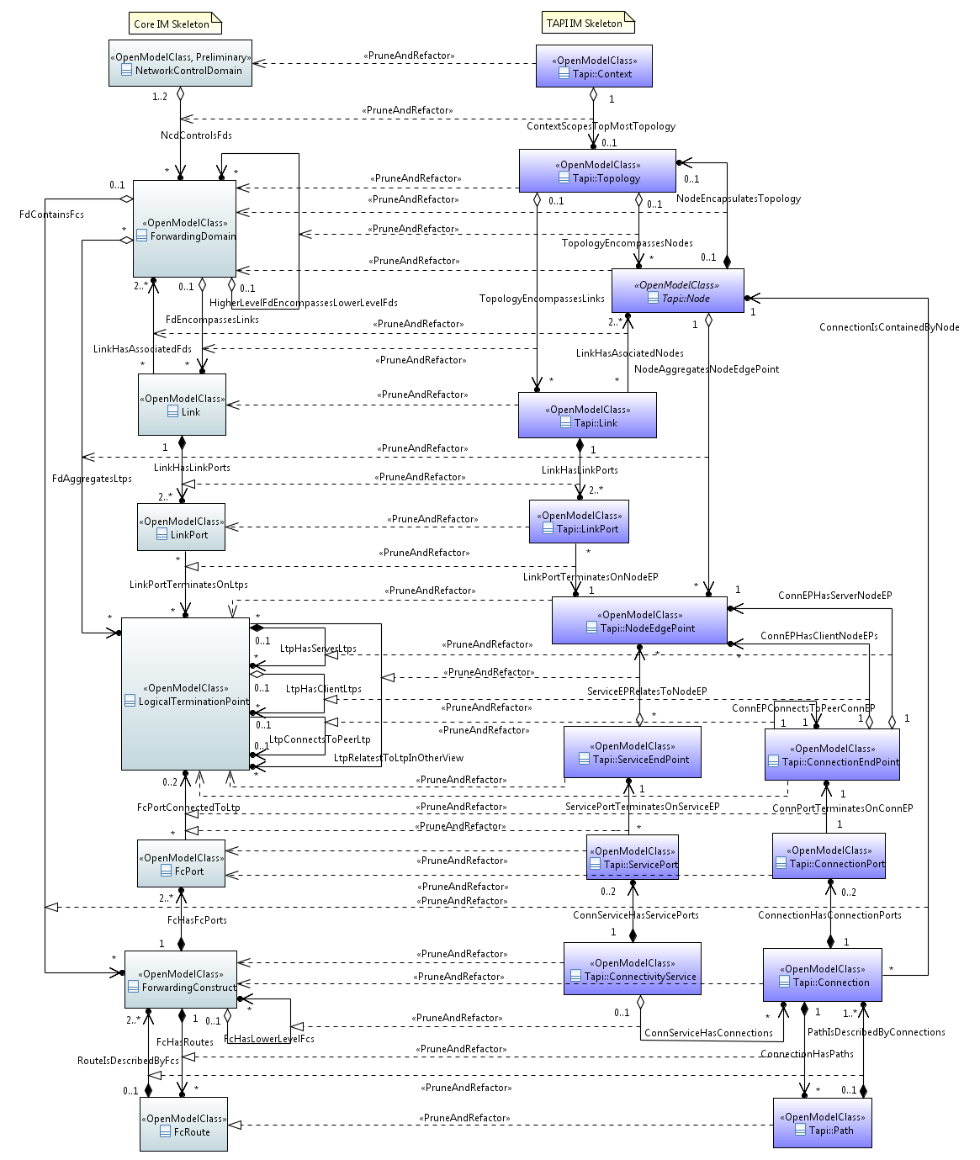
ONF Core model to TAPI and WT models
Core - TAPI
WT model is pruned from the Core model
The classes are unchanged in name and scope
Some classes/associations/attributes have been removed
TAPI model is pruned and refactored from the Core model
The figure sketches the more complex relationships
The model is pruned in a similar way to WT
Some classes from the core are split
E.g., FD becomes Node and Topology in TAPI
Some classes are cloned and narrowed
E.g., FC becomes Connection and ConnectivityService
Renaming of classes is carried out to assist adoption in the application context
Not fully aligned with current TAPI/Core

Slide 16
Ongoing work update
Continue work with other bodies
MEF
OASIS-TOSCA
ONAP
ITU-T (publish TR-512 as G.7711)
TMF (in the process of adopting TR-512.2, TR-512.4 and TR-512.7 in place of the TMF SID 5LR model)
TIP
ITU-T/IEEE/MEF on Ethernet, OAM etc.
TR-512 v1.5
Adopting the OAM model from TAPI
Enhancing the resilience model
Refining the Entity lifecycle
TR-512 v 2.0
Consider adding ports to the LTP
Consider restructuring the model packaging

Slide 17
Links….
Core model: TR-512 V1.4 (November 2018)
V1.4 can be found at https://3vf60mmveq1g8vzn48q2o71a-wpengine.netdna-ssl.com/wp-content/uploads/2018/12/TR-512_v1.4_OnfCoreIm-info.zip
See also https://www.opennetworking.org/software-defined-standards/models-apis/
TAPI: V2.1.0
https://github.com/OpenNetworkingFoundation/TAPI
Microwave model
TR-532 documents the model (see https://www.opennetworking.org/images/stories/downloads/sdn-resources/technical-reports/TR-532-Microwave-Information-Model-V1.pdf)
UML Modeling Guidelines (IISOMI 514)
Last published version → v1.3 info (at https://www.opennetworking.org/software-defined-standards/models-apis/)
Latest working draft → Draft v1.3.01 (11/2018) (at https://wiki.opennetworking.org/display/OIMT/Infrastructure+Sub-team+Guidelines)
UML Profiles and Style Sheets
Github repository: UmlProfiles (formal)
OpenModelProfile, v0.2.13
OpenInterfaceModelProfile, v0.0.8
ProfileLifecycleProfile, v0.0.4
Style sheet for class diagrams
and https://github.com/bzeuner/EAGLE-Open-Model-Profile-and-Tools/tree/ToolChain/UmlProfiles (latest)
Papyrus Guidelines (IISOMI 515)
Last published version → v1.3 info (at https://www.opennetworking.org/software-defined-standards/models-apis/)
Latest working draft → Draft v1.3.01 (11/2018) (at https://wiki.opennetworking.org/display/OIMT/Infrastructure+Sub-team+Guidelines)
Papyrus https://www.eclipse.org/papyrus/
UML to YANG Mapping Guidelines (IISOMI 531)
Last published version → v1.1 info (at https://www.opennetworking.org/software-defined-standards/models-apis/)
Latest working draft → Draft v1.2 (11/2018) (at https://wiki.opennetworking.org/display/OIMT/UML+-+YANG+Guidelines)
UML to YANG Mapping Tool
Github repository: https://github.com/OpenNetworkingFoundation/EagleUmlYang

Slide 18
Questions?
Thank you ☺

Slide 19
Information Model evolution

Slide 20
Abstract
This presentation will explain the ONF Core model TR-512, a standardized implementation neutral representation of things and the relationship between those things in the SDN problem space. The presentation will show how the model has been developed through many years of practical experience.
The presentation will work through the things explaining their relevance and application including: • Specific network functions focussing on virtualized termination and forwarding designed to represent any network • Generalized processing functionality designed to represent any abstract function • Real physical equipment specifically representing FRUs, non-FRUs, strands etc • Control functions related to presentation of views, closure of loops etc • System/scheme specifications representing the structures of systems
The presentation will explain how the model can be applied at any level of abstraction to any control/orchestration/automation layer and will work through the approach used to construct view model using TAPI as an example. The TAPI model is a Pruned and Refactored derivative of the Core model. The presentation will highlight how the TAPI model drives tooling to generate Yang and via Yang to generate Swagger definitions etc.
Some of the general principles and patterns, such as the Component-System and recursive abstraction patterns, will be exposed during the presentation.

Slide 21
Key areas
5G – No new capabilities required. All capabilities required already appear for other existing technologies from a management/control perspective
E.g., slicing is not new from a management-control perspective
Access Networks – a network is a network
Automation and Orchestration – MCC and the Control models
Containerization – Software model and ConstraintDomain
Disaggregation – Natural aspect of the model
Implementation – Tooling approach to generation of Yang etc. from models
Standardization – Direct via ONF and in collaboration with ITU-T, TMF and MEF
Virtualization – All functions are naturally virtual/emergent, strong separation of concerns of functional from physical (i.e., something that can be measured with a ruler) and support for distinct, related views of networks ensures support for virtualization

