Slide 1
TAPI as G.7702 CPI
ITU-T SG 15
Ramon Casellas for TAPI WG

Slide 2
Overview
Elaborate on the possibility of proposing TAPI as interface option for G.7702 CPI (Control Plane Interface)
Initial notification/request from Telefonica
To be presented at a TAPI meeting to
Notify about the potential contribution
Collect feedback and gauge interest
The idea is to be also proposed at TIP with a group of interested parties

Slide 3
Background
ITU-T has agreed to launch a work item for G.7702
Revision to Recommendation ITU-T G.7702 " Architecture for SDN control of transport networks “ (08/24)
Mapping of key concepts, architecture, functions or applicable interface
No new protocols or data models
Potential contribution
Appendix to G.7702 on how specific interfaces fit

Slide 4
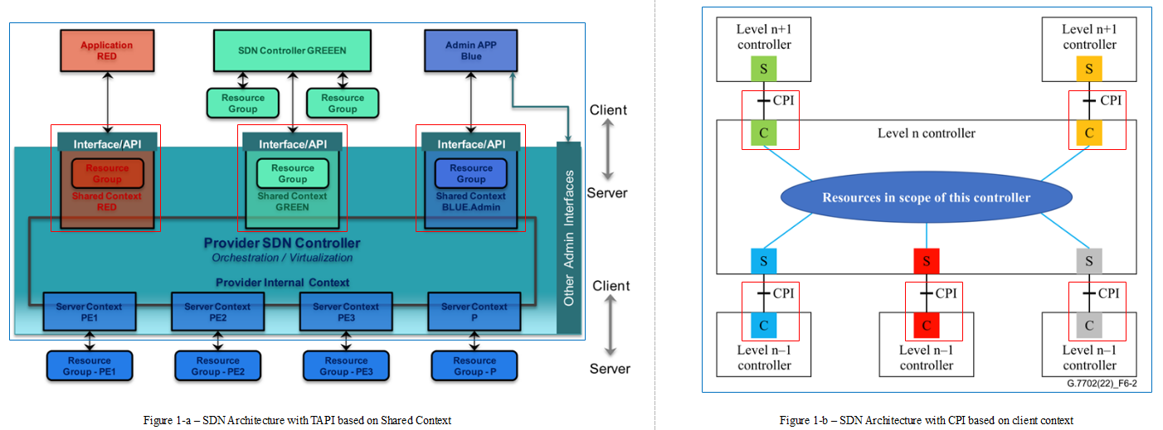
Architecture

Slide 5
Functions
The G.7702 architecture is applicable to both connection-oriented circuit and packet transport networks.
The CPI should support several categories of functional requirements, including topology, connection, path computation and resource virtualization/abstraction, performance and fault management, notification/events with MC (Management and Control)

Slide 6
Initial Scope
Map TAPI functions to entities such as
RC
LRM
Elaborate on how different concepts are mapped into TAPI entities
TAPI → CPI
Shared Context → Client Context
NEP/CEP → SNPP/SNP
Connectivity Service → Call
…

