Slide 1
TAPI modelling of ZR/ZR+ on line side
Roshan Joyce, 1FINITY INC

Slide 2
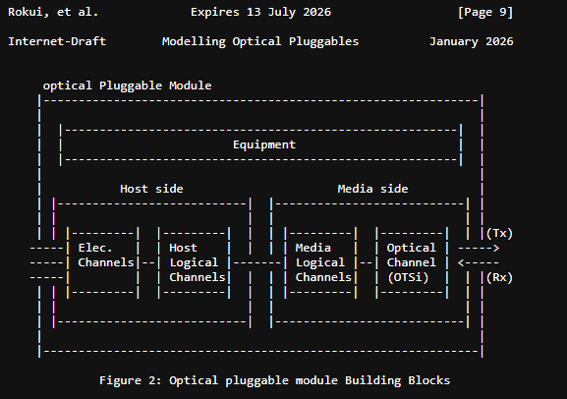
Optical Pluggable Module
On the media side:
Optical Channel (OTSi) is modelled in TAPI as OTSiMC layer-protocol-qualifier
Media Logical Channels can be modelled in TAPI using CEPs with DSR:GigE or OTN l-p-q’s, depending on the technology used
Side-note: as of now DSR:GigE layer-protocol-qualifiers are defined only up-to 400G
In TR547 v3.3, we introduced the use of OTSiMCA as a generic l-p-q that can be used to represent a layer that “assembles” one or more DSR or OTN clients into one or more OTSiMC
As of now (TR547 v3.3), this is what can be used to represent ZR/ZR+
See next slide
While retaining this, we could introduce more specific layer-protocol-qualifiers for ZR/ZR+
From:
draft-ietf-ccamp-actn-wdm-pluggable-modelling-00.txt

Slide 3
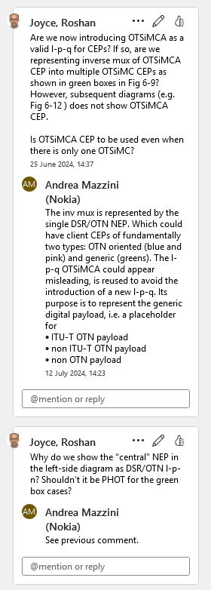
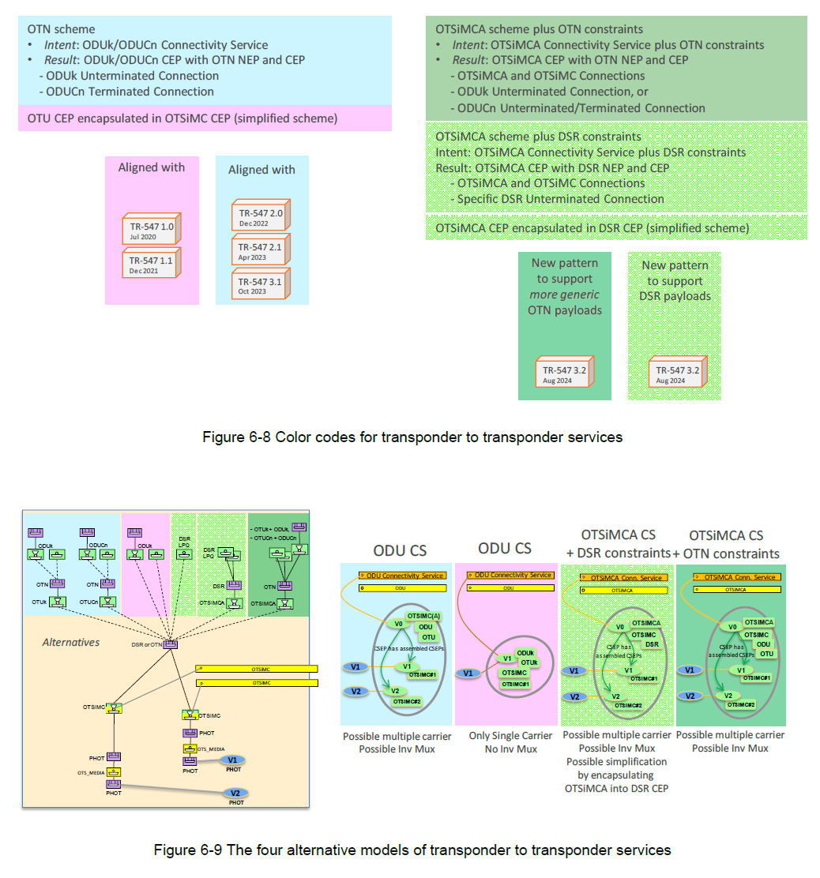
Extract from TR-547 v3.3 and discussions
I remember there was a discussion about this with AM, ND, and RC and these diagrams were accepted in TR547 v3.3
The circled portion would be applicable to ZR/ZR+ modelling in TAPI

Slide 4
Modelling enhancements
For DSR:GigE, introduce the following identities for rates up to 3200GigE:
DIGITAL_SIGNAL_TYPE_<n>00_GigE where <n>=1,2,..32
* only 1,2, and 4 exists now
Introduce a new base identity in tapi-dsr.yang
identity DIGITAL_SIGNAL_TYPE_ZR {
base DIGITAL_SIGNAL_TYPE;
description “Base for ZR/ZR+ rates";
}
And introduce identities extending this for rates up to 3200ZR:
DIGITAL_SIGNAL_TYPE_<n>00_ZR where <n>=1,2,..32
Not all of these will be useful now. Some may not be used at all.
We may also need:
DSR augments to layer-protocol-constraints of CSEPs
To specify DSR/ZR parameters while creating CS
Right now, there are no augments to layer-protocol-constraints from tapi-dsr.yang
New PM and Alarm identities/enums
New DSR containers in tapi-oam: current/history data
New DSR attribute containers/fields for ZR CEPs
Analysis in optical-pluggable-attributes-v00.xlsx
<m>00_GigE
DSR
media-side
logical channels
OR, generic OTSiMCA
<n>00_ZR
DSR
OTSiMC
optical-channel
PHOT
OTS_MEDIA
V1
V1
PHOT
PHOT
PHOT
PHOT
Line-side stack

Slide 5
OIF-400ZR 400GBASE-R
OLD SLIDE BY ANDREA
HOST / ROUTER
OIF-400ZR-02.0:
400GBASE-R, FlexO-4-DSH, and 400ZR frames have similar structures. The 400ZR frame OH area is the same as the FlexO-4-DSH, however, fewer OH fields are defined as required for 400ZR than for FlexO-4-DSH. Bonding across multiple PHYs is not supported by the 400ZR frame structure.
The 400GBASE-R is asynchronously mapped into a 400ZR container using GMP.
The chapter “8.9 400ZR Error Detection and Signaling” lists the alarms
HOST LANES
DSR
Note the use of PHOT:OTSiMCA l-p-q as a CEP contained by a DSR NEP
OTSiMCA
DSR
OTSiMC
PHOT
OTS_MEDIA
V1
PHOT
PHOT

Slide 6
Extract from TR-547 v3.3 and discussions
I remember there was a discussion about this with AM, ND, and RC and these diagrams were accepted in TR547 v3.3
The circled portion would be applicable to ZR/ZR+ modelling in TAPI

Slide 7
If we retain this approach…
It would be quite close to what Brian was trying to describe in the 01/20/2026 meeting (I believe)
My attempt to use this approach to represent (a) 4x100G into ZR400 and (b) 400G transponder using ZR400 are in the following two slides

Slide 8
4 x 100G multiplexed and carried over a ZR400 payload
Transceiver1
100G Connectivity Service
100G Connectivity Service
100G Connectivity Service
100G Connectivity Service
DSR 100G Top Connection
DSR_100G
DSR
ODU
(+OTU)
DSR
OTSiMCA Connectivity Service
MC Connectivity Service
OTSiMCA Top Connection
OTSiMC Top Connection
OTSiMCA
DSR
Things to consider:
What layer-protocol-constraints could be added to the CSEP to express that ZR400 (supporting mux) is required?
There are no layer-protocol-constraints defined in tapi-dsr.yang
Or is it sufficient to specify the required profile?
Can all relevant alarms and PMs be modelled against the OTSiMC CEP? Or, are there ZR/ZR+ specific alarms/PMs to be considered on the OTSiMCA CEP?
DSR does not define l-p-q for rates above 400G.
I think it is better to add l-p-q identities for 500G to 1200G, 1600G, and 3200G
OTSiMC
(+OTSi if O/E/O)
PHOTONIC
OTS_MEDIA
PHOTONIC

Slide 9
400G carried over a ZR400 payload
Transceiver1
400G Connectivity Service
DSR 400G Top Connection
DSR_400G
DSR
ODU
(+OTU)
DSR
OTSiMCA Connectivity Service
MC Connectivity Service
OTSiMCA Top Connection
OTSiMC Top Connection
OTSiMCA
DSR
OTSiMC
(+OTSi if O/E/O)
PHOTONIC
OTS_MEDIA
PHOTONIC

