Slide 1
Pagination Support in TR547
Analysis on Issue-651
ROSHAN JOYCE

Slide 2
Overview
Current recommendation in TR547 for retrieving list of objects
Problems and solutions in TR548
Pagination as per recent IETF drafts
Applying this to TAPI

Slide 3
GET of lists of objects - current approach in TR547
Get the list of identifiers (uuid or local-id) of the elements in the list
Get each element using its identifier
TR547 defines uses cases for such retrievals for the following lists and marks these as mandatory:
API Entry | List involved in the GET | Use Case
/tapi-common:context?fields=service-interface-point(uuid) | SIP | UC 0a
/tapi-common:context/tapi-topology:topology-context?fields=topology(uuid) | Topology | UC 0b
/tapi-common:context/tapi-topology:topology-context/topology={uuid}?fields=node(uuid) | Node | UC 0b
/tapi-common:context/tapi-topology:topology-context/topology={uuid}?fields=link(uuid) | Link | UC 0b
/tapi-common:context/tapi-topology:topology-context/topology={uuid}/node={uuid}?fields=owned-node-edge-point(uuid) | NEP | UC 0b
/tapi-common:context/tapi-connectivity:connectivity-context?fields=connectivity-service(uuid) | Connectivity-service | UC 0c
/tapi-common:context/tapi-connectivity:connectivity-context?fields=connection(uuid) | Connection | UC 0c
/tapi-common:context/tapi-connectivity:connectivity-context/connectivity-service={uuid}?fields=connection(connection-uuid) | Connections used by a given connectivity-service | UC 0c
/tapi-common:context/tapi-equipment:physical-context?fields=device(uuid) | Device | UC 4b
/tapi-common:context/tapi-equipment:physical-context?fields=physical-span(uuid) | Physical-span | UC 4b
/tapi-common:context/tapi-equipment:physical-context/device={uuid}?fields=equipment(uuid) | Equipment within a Device | UC 4b
NOTE: Similar API is missing now for retrieving list of access-port uuids from a device
/tapi-common:context?fields=profile(uuid) | Profile | UC17a
/tapi-common:context/tapi-oam:oam-context?fields=oam-service(uuid) | Oam-service | UC 17a
/tapi-common:context/tapi-oam:oam-context?fields=oam-job(uuid) | Oam-job | UC17a
/tapi-common:context/tapi-oam:oam-context?fields=meg(uuid) | MEG | UC17a
/tapi-common:context/tapi-oam:oam-context/meg={{uuid}}?fields=mep(local-id) | MEPs under a MEG | UC17a
/tapi-common:context/tapi-oam:oam-context/meg={{uuid}}?fields=mip(local-id) | MIPs under a MEG | UC17a

Slide 4
Problems with the current approach
Time taken to synchronize large network data
Individual GET for each object in lists
Fine grained back-and-forth between TAPI client and server during synchronization
As list sizes grow, synchronization time increases linearly
Recovering from network problems
Client responsibility
It needs to keep track of where in the process it failed and decide on how to recover
Reconciling changes during synchronization
Client responsibility
It needs to employ strategies such as:
Buffer/stop notifications during the synchronization and reconcile them after the synchronization.
Becomes more complex as the synchronization time increases
NOTE: These problems are effectively addressed by TR548 streaming

Slide 5
TR548 Streaming and (?) Alternatives
Time taken to synchronize large network data
Synchronization possible over multiple streams
Push based model avoids back-and-forth
Recovering from network problems
Supports recovery from network failures and re-alignment
Reconciling changes during synchronization
Changes are also available in the streams
No need for separate reconciliation
However, not all systems (clients and servers) do not support TR548 yet
Alternatives that are typically suggested:
Support for paginated GETs of lists
Support for file-based synchronization
Both are capable solutions for problem #1
However, they do not address #2 and #3
Hence, they’re not complete alternatives to TR548
File-based synchronization (IMHO) is a step backwards in time
Paginated GETs is worthy of attention now, with the appearance of draft-ietf-netconf-list-pagination
But remember this is still only a draft!

Slide 6
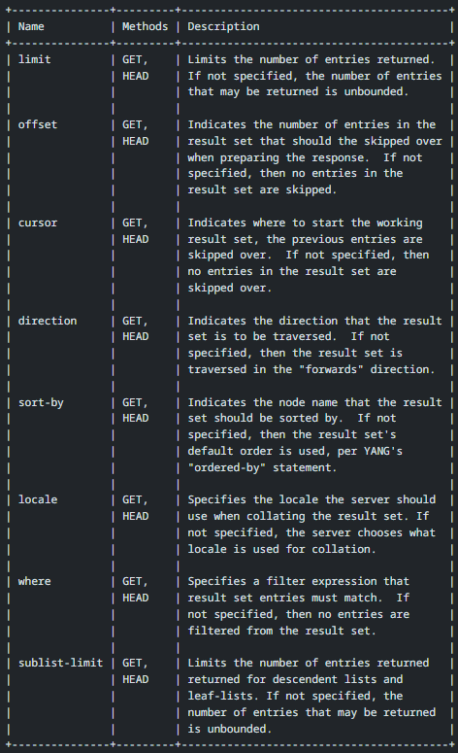
draft-ietf-netconf-list-pagination draft-ietf-netconf-list-pagination-rc
The table shows new RESTCONF query parameters introduced as part of this draft
Out of these, following are the minimum mandatory items for paging to work for TAPI RESTCONF (my interpretation)
limit (to define the size of the page requested)
offset OR cursor (to indicate the position of the page requested)
The other query parameters can be considered as optional for TAPI
See next slides
Note: “paging” through a list of items implies that there is an agreed upon sorting order between the server and the client.

Slide 7
draft-ietf-netconf-list-pagination draft-ietf-netconf-list-pagination-rc
where
Allows DB like queries against lists
This is not a focus item for TAPI now. Instead, we can focus on returning all entries in a list, page by page.
TAPI being a system-to-system API between OSS/SDTN/SDN-C systems, it may not be important to support flexible queries
sort-by, locale, direction
Allows flexible sorting of items in the response pages
We can return entries in a list, sorted based on their uuid/local-id, in ascending order
Or support these explicitly with uuid/local-id as the only supported sorting key
sublist-limit
Allows limiting the number of entries returned for descendent lists and leaf-lists.
In the TAPI model descendent lists would be:
topology ➔ node ➔nep ➔ cep
device ➔ equipment, device ➔ access-port
connectivity-service ➔ connection
meg ➔ mep, meg ➔ mip
We may need to support this query parameter (?)
Or ignore this? Because it is not considered a problem now.

Slide 8
Offset versus cursor
Offset:
Integer value identifying the position of an element in the list that is being paged over.
Cursor:
Opaque index values for the underlying system's database, e.g. a key or other information needed to efficiently access the selected result-set
For TAPI data model lists, this will be either uuid or local-id
Example:
Let’s say 1000 elements exist in the list and we’re retrieving pages of 100
Valid offset values will be 0..999
Valid cursor values will be the key values (uuid/local-id) of the 1000 elements in the list

Slide 9
draft-ietf-netconf-list-pagination: Meta Data
limit parameter support would require the following
a metadata value [RFC7952] called "remaining", a positive integer indicating the number of elements that were not included in the result-set by the "limit“ operation, or the value "unknown" in case, e.g., the server determines that counting would be prohibitively expensive.
cursor parameter support would require the following
Furthermore, a result set constrained with the "limit" query parameter includes metadata values [RFC7952] called "next" and "previous", which contains cursor values to the next and previous result-sets. These next and previous cursor values are opaque index values for the underlying system's database, e.g. a key or other information needed to efficiently access the selected result-set. These "next" and "previous" metadata values work as Hypermedia as the Engine of Application State (HATEOAS) links.
sublist-limit parameter support would require the following
a metadata value [RFC7952] called "remaining", a positive integer indicating the number of elements that were not included in the result-set by the “sublist-limit“ operation, or the value "unknown" in case, e.g., the server determines that counting would be prohibitively expensive.
RFC7952 indicate that these metadata values be added in the JSON response with a special entry in the response JSON named “@”
See example in later slide
We can consider providing the metadata values as response headers and not “polluting” the JSON response

Slide 10
Possible approach for pagination in TAPI
Keep the current list of mandatory APIs (needed for backwards compatibility)
Introduce the following optional APIs that support pagination
The APIs in red text are for sub-list items
Preserve the semantics of retrieving lists of objects in the context of their parent object
For example, NEPs will still have to be retrieved on a per-node basis, not across nodes
API Entry | List involved in the GET
/tapi-common:context/service-interface-point | SIP
/tapi-common:context/tapi-topology:topology-context/topology={uuid}/node | Node
/tapi-common:context/tapi-topology:topology-context/topology={uuid}/link | Link
/tapi-common:context/tapi-topology:topology-context/topology={uuid}/node={uuid}/owned-node-edge-point | NEP
/tapi-common:context/tapi-connectivity:connectivity-context/connectivity-service | Connectivity-service
/tapi-common:context/tapi-connectivity:connectivity-context/connection | Connection
/tapi-common:context/tapi-connectivity:connectivity-context/connectivity-service={uuid}/connection | Connections used by a given connectivity-service
/tapi-common:context/tapi-equipment:physical-context/device | Device
/tapi-common:context/tapi-equipment:physical-context/physical-span | Physical-span
/tapi-common:context/tapi-equipment:physical-context/device={uuid}/equipment | Equipment within a Device
/tapi-common:context/tapi-equipment:physical-context/device={uuid}/access-port | Access ports within a Device
/tapi-common:context/profile | Profile
/tapi-common:context/tapi-oam:oam-context/oam-service | Oam-service
/tapi-common:context/tapi-oam:oam-context/oam-job | Oam-job
/tapi-common:context/tapi-oam:oam-context/meg | MEG
/tapi-common:context/tapi-oam:oam-context/meg={{uuid}}/mep | MEPs under a MEG
/tapi-common:context/tapi-oam:oam-context/meg={{uuid}}/mip | MIPs under a MEG
/tapi-common:context/tapi-fm:fault-management-context/active-condition | Active conditions

Slide 11
Example
TAPI lists do not have an ordered-by clause. For paged GETs, we can assume ascending order sort based on the list key (uuid or local-id)
There should not be an expectation on the server to store “paging state” between GETs.
If entries get added to or removed from the list between paged GETs, the client may or may not get the information, depending on whether the affected entry’s page is already retrieved or not. Client needs to rely on reconciling based on notifications.
For paging with cursor, we can omit “previous” references from the responses. Supporting “previous” will mean that the server needs to have some memory of the previous page.
PAGING with cursor
GET /restconf/data/tapi-common:context/tapi-topology:topology-context/topology={uuid}/node ?limit=2&cursor=
{ "tapi-topology:node": [ { <node-data-1> }, { <node-data-2> } ], “@tapi-topology:node”: [ { "ietf-list-pagination:remaining": 8, "ietf-list-pagination:previous": "", "ietf-list-pagination:next": “uuid-for-node-2" } ] }
GET /restconf/data/tapi-common:context/tapi-topology:topology-context/topology={uuid}/node ?limit=2&cursor=<uuid-for-node-2>
<next page of 2 nodes>
PAGING with offset
GET /restconf/data/tapi-common:context/tapi-topology:topology-context/topology={uuid}/node ?limit=2&offset=0
{ "tapi-topology:node": [ { <node-data-1> }, { <node-data-2> } ], “@tapi-topology:node”: [ { "ietf-list-pagination:remaining": 8 } ] } GET /restconf/data/tapi-common:context/tapi-topology:topology-context/topology={uuid}/node ?limit=2&offset=2
<next page of 2 nodes>

