Slide 1
TAPI Work progress
Nigel Davis
20251014
Note all work is being carried out in my forks…
https://github.com/nigel-r-davis/TAPI
https://github.com/nigel-r-davis/TAPI-Documentation

Slide 2
Approach
There are several items ready for review
At this point they are in my fork
I plan to create several pull requests to formalize the review process
Current proposal is to identify specific reviewers
review requested within two weeks
Any objections to the planned approach??

Slide 3
Updates to 2.1.3 and 2.5.x
Need to agree
Updates to 2.1.3 will be based on 2.1.4 and go to 2.1.5
2.1.4 has a fixed OAS that are rolled into tapi-2.1.3-fixes directly
Updates to 2.5.0 will be based on 2.5.1 and go to 2.5.2
There are YANG patches in 2.5.0-fixes (from 2.5.1), should they be rolled into the formal YANG of 2.5.2 (i.e., update the YANG (backward compatible))?
There is a corrected OAS in the patches, should this replace the OAS such that there is no confusion in 2.5.2 and be compatible with the 2.1.3 approach?
Where we have YANG updates to 2.5 and 2.1.3 we should update the YANG from ONF to LF
Should we update all YANG modules or just those that are modified?

Slide 4
Protobuf file to 2.5
Ready for review
Add protobuf file to 2.5 (issue 619 work item 65)
Prepared the file and update to TR-548 in working 2.5 branch for call 20250909
Protobuf file added to 2.5.0-fixesTR-547-ND.
TR folder structure changed
TR-548 initial updates made in documentation nd fork v3.1.1
Follow-on actions
Review updates
Prepare delivery
I will create two pull requests one on documentation and one on tapi main (2.5.0-fixes) with this update applied and will update the issue and work item

Slide 5
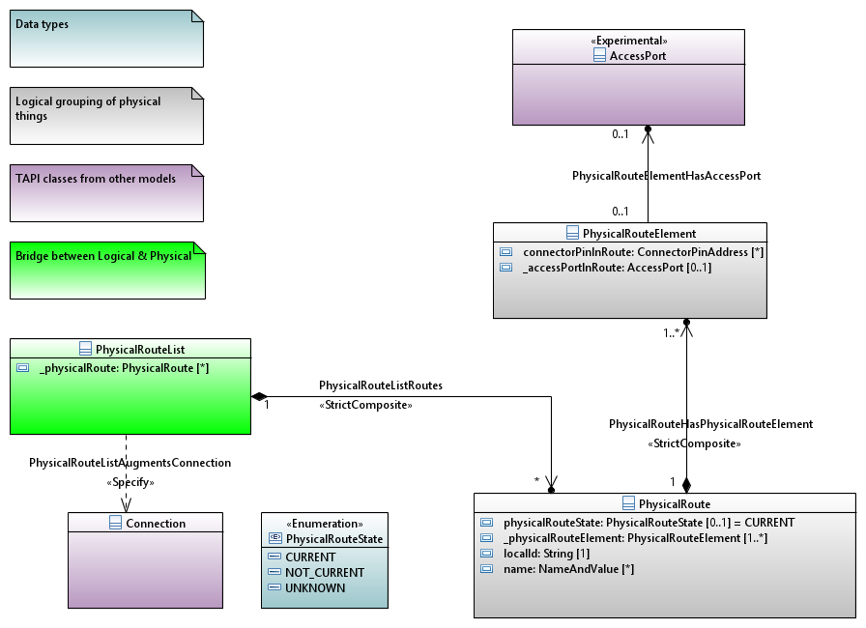
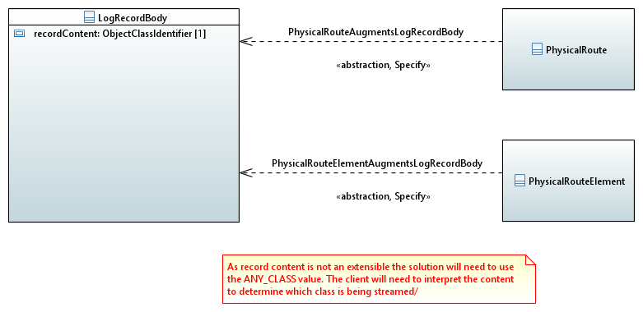
physical-route
Ready for review
physical-route to 2.1.3 (issue 628 work item 63)
UML/YANG draft generated 20250909
Available at 2.1.3-fixes-ND
Challenges in streaming and especially notification
Streaming hybrid augment proposed where ANY_CLASS is used to carry the objects
No clear solution for notification other than modifying the enum for object type
YANG v1.1 currently used. Could revert to 1.0
Draft update to TR-547 completed 20250916
Follow-on actions
Review solution
Updates to UML and YANG additions if any
Prepare delivery
I will create two pull requests one on documentation and one on tapi main (2.1.3-fixes) with this update applied and will update the issue and work item

Slide 6
String restrictions
Ready for review
String restrictions (issue 622 work item 62)
Used worked through changes in TR-547 2.6.0
This review also highlighted some conditions we have changed these should be rolled back to 2.5 too (word compare is probably the best method to find these)
30 changes were made
We appear to have missed access-port in device in 2.6.0. I have corrected this in 2.5. We can clear that up in 2.7.
I have updated for Linux Foundation etc.
I have prepared TR-547 2.5 with all string restrictions removed (at tapi-2.5.0-fixesTR-547-ND as done for 2.6, for the call 20250909
2.1.3 has also been adjusted
Folders for docs for TRs so TR-547 and TR-548 have been rearranged
Follow-on actions
Review as drafts of TR-547 v1.1.1 and v3.1.1
Publish as new release of 2.5 and 2.1.3 (rearrange folders for docs for TRs so TR-547 and TR-548)
I will create two pull requests on documentation for 2.1.3-fixes and for 2.5.0-fixes with this update applied and will update the issue and work item

Slide 7
Config false
In progress
Config false (issue 620 work item 15)
I will update the YANG from ONF to LF as per earlier agreement
I adjusted the following in 2.5.0 fixes to be require-instance false;
tapi-connectivity.yang
connection-end-point-ref
switch-control-ref
switch-ref
route-ref
tapi-common.yang
profile-ref
tapi-topology.yang
topology-ref
node-ref
TR-547 v3.1.1 does not need to be modified (there are no YANG snippets that include the area modified)
For 2.7 it may be appropriate to reverse out the modifications made between 2.5 and 2.6 (as these did not use the require-instance approach) and use the require-instance false approach for 2.7 so that it is fully aligned with 2.5
Updated 2.5 is available in my fork
Follow-on action:
Take agreed approach for 2.7
Validate 2.1.3 does not have these errors
Complete and review…

Slide 8
Spotlight and snapshot stream
See separate presentation… otcc2024.ND.002_SpotlightAndSnapshotStreams.pptx
Target review 20251007

Slide 9
Control plane model
Model of control plane using standard TAPI classes
SNPP → NEP
SNP → CEP
Connection → Connection
SNPP_Link → Link
Abstraction through new association such that control plane entities reference real entities
Works with TAPI path and path set
This may require more than one level of nesting of lower connection in top level connection… discuss

Slide 10
Proposal
OTSiMC Connectivity Service
View change
MC Connectivity Service
MC Connectivity Service
OTSiMC CP connection
PathSet
Path
Transceiver1
Path
Transceiver2
Link
Link
ODU
Link
Partition parallel
(decomposition)
Link
OTN
aggregation
Link
Link
OTU
OTN
OTSiMC Top Connection
OTSiMC
(+OTSi if O/E/O)
PHOTONIC
MC
PHOTONIC
ROADM1
ROADM2
ROADM3
OMS
OMS
Top Connection
OMS
Top Connection
PHOTONIC
OTS_MEDIA
Top Conn
OTS_MEDIA
Top Connection
(deg to deg port)
OTS_MEDIA
Top Connection
(deg to deg port)
OTS_MEDIA
Top Conn
OTS_MEDIA
PHOTONIC

Slide 11
Proposal
OTSiMC Connectivity Service
View change
MC Connectivity Service
MC Connectivity Service
OTSiMC CP connection
SNP
PathSet
Path
Transceiver1
Path
Transceiver2
Link
Link
ODU
SNPP
Link
Partition parallel
(decomposition)
Link
OTN
aggregation
Link
Link
OTU
OTN
OTSiMC Top Connection
OTSiMC
(+OTSi if O/E/O)
PHOTONIC
MC
PHOTONIC
ROADM1
ROADM2
ROADM3
OMS
OMS
Top Connection
OMS
Top Connection
PHOTONIC
OTS_MEDIA
Top Conn
OTS_MEDIA
Top Connection
(deg to deg port)
OTS_MEDIA
Top Connection
(deg to deg port)
OTS_MEDIA
Top Conn
OTS_MEDIA
PHOTONIC

Slide 12
Proposal
OTSiMC Connectivity Service
View change
MC Connectivity Service
PathSet
Path
Transceiver1
Path
Transceiver2
Link
Link
ODU
Partition parallel
(decomposition)
Link
Link
OTN
aggregation
Link
Link
OTU
OTN
OTSiMC Top Connection
OTSiMC
(+OTSi if O/E/O)
PHOTONIC
MC
PHOTONIC
ROADM1
ROADM2
ROADM3
OMS
OMS
Top Connection
OMS
Top Connection
PHOTONIC
OTS_MEDIA
Top Conn
OTS_MEDIA
Top Connection
(deg to deg port)
OTS_MEDIA
Top Connection
(deg to deg port)
OTS_MEDIA
Top Conn
OTS_MEDIA
PHOTONIC

Slide 13
Proposal
OTSiMC Connectivity Service
View change
MC Connectivity Service
PathSet
Path
Path
Transceiver1
Link
Link
Transceiver2
Partition parallel
(decomposition)
Link
Link
ODU
aggregation
Link
Link
OTN
OTU
OTSiMC Top Connection
OTN
OTSiMC lower Connection
OTSiMC
(+OTSi if O/E/O)
PHOTONIC
MC
PHOTONIC
ROADM1
ROADM2
ROADM3
OMS
OMS
Top Connection
OMS
Top Connection
PHOTONIC
OTS_MEDIA
Top Conn
OTS_MEDIA
Top Connection
(deg to deg port)
OTS_MEDIA
Top Connection
(deg to deg port)
OTS_MEDIA
Top Conn
OTS_MEDIA
PHOTONIC

Slide 14
Implications
For complex cases we can:
pull out the control plane connection as separate from the “real” connection
allow two levels of lower connection.

Slide 15
TAPI – IETF model linkage
onmi025.ND.005_BriefAnalysis-TapiIetfModelLinkage.pptx
Need to add peer relationship to cover case where TP is shared.
Need to consider connection and Link cases
Target update 20250930

Slide 16
Align PM streaming with OAM model advancements
Review the PM streaming
Review OAM in the streaming context (e.g., removal of current data)
Assess structure for gaps, conflicts etc.
Report back to team
Target 20251007
Partial analysis carried out… need to do more before reporting back

Slide 17
Streaming test plan review
onmi2025.ND.007_StreamingTestPlan-FirstDraft.docx
Deeper dive than last skim on today’s call
Document available for assessment
Comments in two weeks (20250916)
Review Ramon’s comments

