Slide 1
TAPI Work progress
Nigel Davis
20250909
Note all work is being carried out in my forks…

Slide 2
Updates to 2.1.3 and 2.5.x
Updates to 2.1.3 will be based on 2.1.4 and go to 2.1.5
2.1.4 has a fixed OAS that are rolled into tapi-2.1.3-fixes directly
Updates to 2.5.0 will be based on 2.5.1 and go to 2.5.2
There are YANG patches in 2.5.0-fixes (from 2.5.1), should they be rolled into the formal YANG of 2.5.2 (i.e., update the YANG (backward compatible))?
There is a corrected OAS in the patches, should this replace the OAS such that there is no confusion in 2.5.2 and be compatible with the 2.1.3 approach?

Slide 3
Protobuf file to 2.5
Add protobuf file to 2.5 (issue 619 work item 65)
Prepared the file and update to TR-548 in working 2.5 branch for call 20250909
Protobuf file added to 2.5.0-fixesTR-547-ND.
TR folder structure changed
TR-548 initial updates made in documentation nd fork v3.1.1
Follow-on actions
Review updates
Prepare delivery

Slide 4
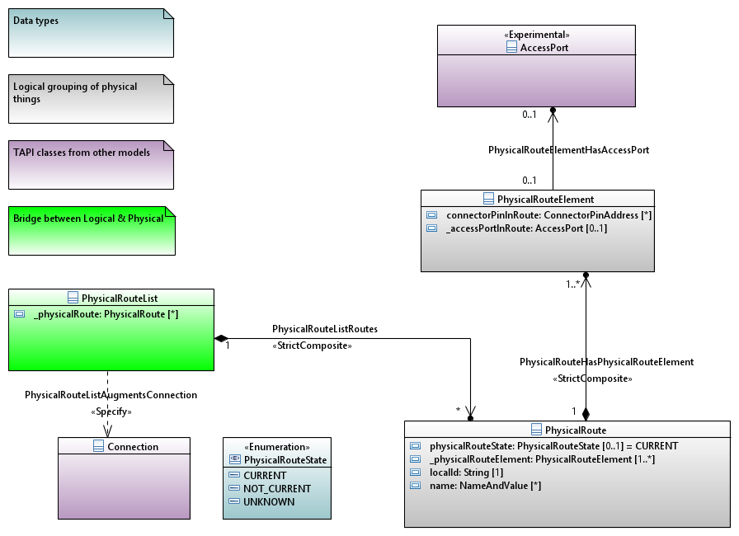
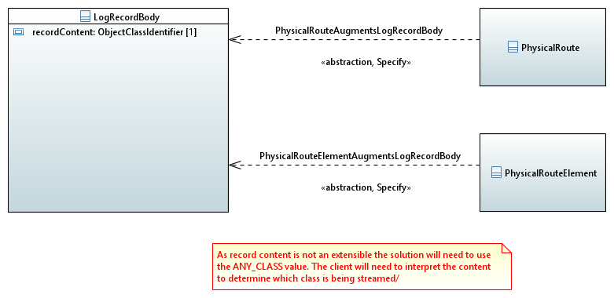
physical-route
physical-route to 2.1.3 (issue 628 work item 63)
UML/YANG draft generated 20250909
Available at 2.1.3-fixes-ND
Challenges in streaming and especially notification
Streaming hybrid augment proposed where ANY_CLASS is used to carry the objects
No clear solution for notification other than modifying the enum for object type
YANG v1.1 currently used. Could revert to 1.0
Follow-on actions
Draft update to TR-547
Updates to UML and YANG additions if any
Review solution
Prepare delivery

Slide 5
String restrictions
String restrictions (issue 622 work item 62)
Used worked through changes in TR-547 2.6.0
This review also highlighted some conditions we have changed these should be rolled back to 2.5 too (word compare is probably the best method to find these)
30 changes were made
We appear to have missed access-port in device in 2.6.0. I have corrected this in 2.5. We can clear that up in 2.7.
I have updated for Linux Foundation etc.
I have prepared TR-547 2.5 with all string restrictions removed (at tapi-2.5.0-fixesTR-547-ND as done for 2.6, for the call 20250909
2.1.3 will be adjusted for next weeks call
Follow-on actions
Review as drafts of TR-547 v1.1.1 and v3.1.1
Publish as new release of 2.5 and 2.1.3 (rearrange folders for docs for TRs so TR-547 and TR-548)

Slide 6
Config false
Config false (issue 620 work item 15)
I will update the connectivity YANG to LF standard
I adjusted the connection-end-point-ref (which was the only remaining error in 2.6.0) as proposed by Ramon (Mark all leafrefs in config groupings that point to non-config uuids as “require-instance false;”) and as below…
grouping connection-end-point-ref {
uses tapi-topology:node-edge-point-ref;
leaf connection-end-point-uuid {
type leafref {
path '/tapi-common:context/tapi-topology:topology-context/tapi-topology:topology/tapi-topology:node/tapi-topology:owned-node-edge-point/tapi-connectivity:cep-list/tapi-connectivity:connection-end-point/tapi-connectivity:uuid’;
require-instance false;
}
description "none";
}
description "none";
}
The results (as expected) was “no errors”
Follow-on action:
Review sample
Complete work for all identified problems
Review completed YANG
Review TR-547 for any changes (suspect none but may be a YANG snippet in the document)
Plan back propagation to 2.5 and 2.1.3
Complete and review…

Slide 7
Additional candidate item
Model of control plane using standard TAPI classes
SNPP → NEP
SNP → CEP
Connection → Connection
SNPP_Link → Link
Abstraction through new association such that control plane entities reference real entities
Works with TAPI path and path set
This may require more than one level of nesting of lower connection in top level connection… discuss

Slide 9
Streaming test plan review
onmi2025.ND.007_StreamingTestPlan-FirstDraft.docx
Deeper dive than last skim on today’s call
Document available for assessment
Comments in two weeks (20250916)

