Slide 1
TAPI Work progress
Nigel Davis
20251125
Note all work is being carried out in my forks…
https://github.com/nigel-r-davis/TAPI
https://github.com/nigel-r-davis/TAPI-Documentation

Slide 2
Brief plan
20251125 – complete initial pull requests
20251202 – Final pull requests
2.7 changes noted on following pages
Specific changes to conditional attributes as per issues
20251209 – Review assembled documentation
20251216 – Complete documentation
20251223 – No meeting… finalizing package
202601… - may need final check of packages prior to delivery to steering team

Slide 3
Quick discussion issue
Alarm and notification:
The releases have dedicated alarm and notification documents
The original intention was that this be a living document
Clearly now we have partitioned the releases fully, there is a 2.1.x version, a 2.5 version and a develop version
We should give clearer guidance on the use of the document
Take the latest from develop v take the one from the release
I have updated the reference in 2.1.5 to bridge between the two choices…
2.1.5
Link https://example.com/streams/tapi-notification is broken
Embedded mentions of the release changed from 2.1.3 to 2.1.x and removal of mentions of 2.3

Slide 4
Progress
2.5.0
#660 ready for final approval
2.1.3
#661 ready for final approval
#2 ready for final approval

Slide 5
To be delivered in the December timeframe
2.7
IETF-TAPI model linkage (CEP/NEP to RFC8345 TP)
To be completed for next week’s meeting via pull request
2.7 and 2.5
Config false issues and development of YANG profiling methods
2.5 completed. Need to roll forward to 2.7 for next week.
2.7, 2.5 and 2.1.x
String restrictions in earlier releases conflict with INVENTORY_ID
2.5 and 2.1.3 corrected. Need to apply changes for 2.7 for next week.
Specific properties identified as mandatory that should be conditional as highlighted in several Jiras
To be done
Previous releases
Add physical route to 2.1.3 - done
Protobuf file should be back propagated to 2.5 – done
General – we are essentially doing this live…
Process for applying fixes to previous releases and announcing fixes

Slide 6
Also in December release
2.7
Protobuf fix identified as required during 2.5 fixes work
2.5 and 2.1.5
All YANG updated to LF
TR-548 of 2.1.5 updated to LF

Slide 7
Minimal delivery
2.7
Spotlight/snapshot stream - PRELIMINARY
propose a snapshot stream sketch in TR-548 and additional property values to tapi-oam
Align PM streaming with OAM model advancements - PRELIMINARY
2.7 and previous releases
Conditional/mandatory issues
All properties conditional – do some this release defer remainder to 2.8
Correction to mandatory attributes – cover specific attributes
Attribute Type for Switch Control needs to be corrected to conditional – fix this
Link creation and modification via a service
Explain how service creation can be used to create a link (this is stretch)

Slide 8
Additional work item for 2.8
Use of TAPI for ASON/ASTN control plane
Sketches in place
Work with ITU-T team

Slide 9
Validate state
LLDP snooping – BJ
OTN Trail Trace – BJ
ODU UUID Missing in UC2b – KK
Creation of interdomain links – KK
TAPI notification API clarification – KK
target-object-dri in event object notification to be conditional – KK

Slide 10
Not being delivered
Move to TAPI 2.8 and/or beyond
Improved service/connection lifecycle
Need to provide clarification on this and validate it fits the operator requirement
Where to report what (state should be separate stream/notification v delta stream/notification )
Need to make proposal early in 2.8 timeframe
Use streaming strategy for notification reporting (existing issue)
Need to make proposal early in 2.8 timeframe
Power along a connection
Validate requirement with operators
Connectivity Service and path computation service advancements (multiple alternatives, deep computations, rebalancing, including preparation for specific work beyond 2.7
Complex and requires extensive exploratory work
TAPI availability mechanism
Aim to define and describe in 2.8

Slide 11
From previous version

Slide 12
Approach
I have created pull requests for the changes I have made
We should allocate reviewers and target review responses in 2 weeks
I will continue to use this approach

Slide 13
Updates to 2.1.3 and 2.5.x
Confirm agreement
Updates to 2.1.3 will be based on 2.1.4 and go to 2.1.5
2.1.4 has a fixed OAS that are rolled into tapi-2.1.3-fixes directly
Updates to 2.5.0 will be based on 2.5.1 and go to 2.5.2
There are YANG patches in 2.5.0-fixes (from 2.5.1), should they be rolled into the formal YANG of 2.5.2 (i.e., update the YANG (backward compatible))?
There is a corrected OAS in the patches, should this replace the OAS such that there is no confusion in 2.5.2 and be compatible with the 2.1.3 approach?
Where we have YANG updates to 2.5 and 2.1.3 we should update the YANG from ONF to LF
Should we update all YANG modules or just those that are modified?
Agreed (20251014): We should provide a complete release and should update all YANG to be LF.

Slide 14
Protobuf file to 2.5
Ready for review
Add protobuf file to 2.5 (issue 619 work item 65)
Prepared the file and update to TR-548 in working 2.5 branch for call 20250909
Protobuf file added to 2.5.0-fixesTR-547-ND.
TR folder structure changed
TR-548 initial updates made in documentation nd fork v3.1.1
Follow-on actions
Review updates
Prepare delivery
I have created pull requests

Slide 15
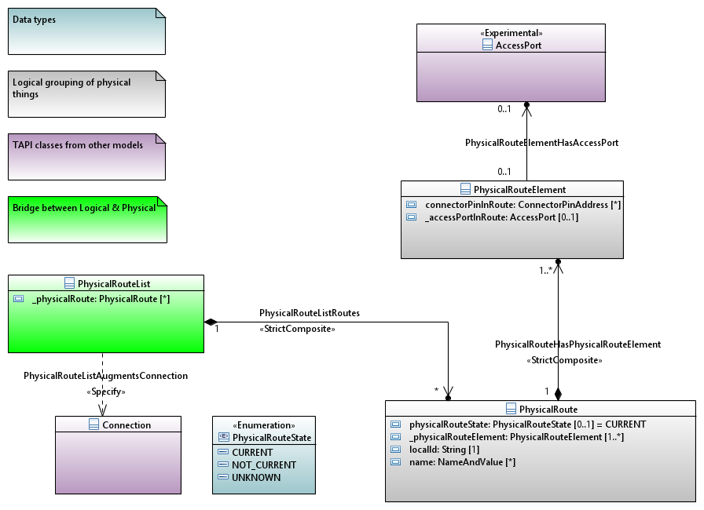
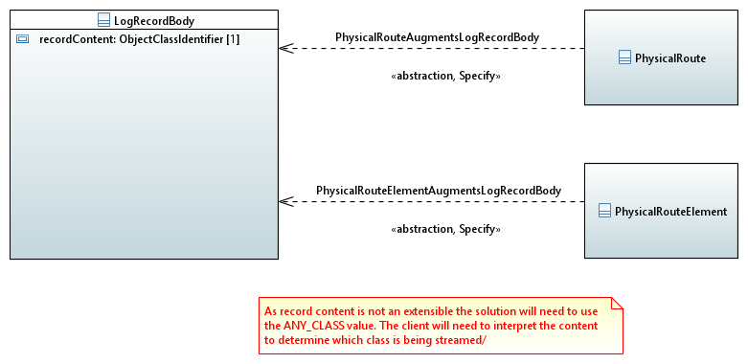
physical-route
Ready for review
physical-route to 2.1.3 (issue 628 work item 63)
UML/YANG draft generated 20250909
Available at 2.1.3-fixes-ND
Challenges in streaming and especially notification
Streaming hybrid augment proposed where ANY_CLASS is used to carry the objects
No clear solution for notification other than modifying the enum for object type
YANG v1.1 currently used. Could revert to 1.0
Draft update to TR-547 completed 20250916
Follow-on actions
Review solution
Updates to UML and YANG additions if any
Prepare delivery
I have created pull requests

Slide 16
String restrictions
Ready for review
String restrictions (issue 622 work item 62)
Used worked through changes in TR-547 2.6.0
This review also highlighted some conditions we have changed these should be rolled back to 2.5 too (word compare is probably the best method to find these)
30 changes were made
We appear to have missed access-port in device in 2.6.0. I have corrected this in 2.5. We can clear that up in 2.7.
I have updated for Linux Foundation etc.
I have prepared TR-547 2.5 with all string restrictions removed (at tapi-2.5.0-fixesTR-547-ND as done for 2.6, for the call 20250909
2.1.3 has also been adjusted
Folders for docs for TRs so TR-547 and TR-548 have been rearranged
Follow-on actions
Review as drafts of TR-547 v1.1.1 and v3.1.1
Publish as new release of 2.5 and 2.1.3 (rearrange folders for docs for TRs so TR-547 and TR-548)
I have created pull requests

Slide 17
Config false
In progress
Config false (issue 620 work item 15)
I will update the YANG from ONF to LF as per earlier agreement
I adjusted the following in 2.5.0 fixes to be require-instance false;
tapi-connectivity.yang
connection-end-point-ref
switch-control-ref
switch-ref
route-ref
tapi-common.yang
profile-ref
tapi-topology.yang
topology-ref
node-ref
TR-547 v3.1.1 does not need to be modified (there are no YANG snippets that include the area modified)
For 2.7 it may be appropriate to reverse out the modifications made between 2.5 and 2.6 (as these did not use the require-instance approach) and use the require-instance false approach for 2.7 so that it is fully aligned with 2.5
Updated 2.5 is available in my fork
Follow-on action:
Take agreed approach for 2.7
Validate 2.1.3 does not have these errors
Complete and review…
Agreed (20251014): I should reverse out changes made in 2.6 and then apply the formal changes made for 2.5 fixes to 2.7. I will wait for this to be reviewed prior to taking this action.

Slide 18
Streaming test plan review
onmi2025.ND.007_StreamingTestPlan-FirstDraft.docx
Ramon’s comments reviewed 20251014
Update document submitted to repository
Need to highlight to TIP

Slide 19
Spotlight and snapshot stream
See separate presentation… otcc2024.ND.002_SpotlightAndSnapshotStreams.pptx
Target review 20251021

Slide 20
Control plane model
Model of control plane using standard TAPI classes
SNPP → NEP
SNP → CEP
Connection → Connection
SNPP_Link → Link
Abstraction through new association such that control plane entities reference real entities
Works with TAPI path and path set
This may require more than one level of nesting of lower connection in top level connection… discuss
For complex cases we can:
pull out the control plane connection as separate from the “real” connection
allow two levels of lower connection.

Slide 21
Proposal
Call
View change
OTSiMC Connectivity Service
MC Connectivity Service
MC Connectivity Service
Connection
OTSiMC CP connection
Connection
SNP
PathSet
Path
Transceiver1
SNPPLink
Path
Transceiver2
Link
Link
ODU
SNPP
Link
Partition parallel
(decomposition)
Link
OTN
aggregation
Link
Link
OTU
OTN
OTSiMC Top Connection
OTSiMC
(+OTSi if O/E/O)
PHOTONIC
MC
PHOTONIC
ROADM1
ROADM2
ROADM3
OMS
OMS
Top Connection
OMS
Top Connection
PHOTONIC
OTS_MEDIA
Top Conn
OTS_MEDIA
Top Connection
(deg to deg port)
OTS_MEDIA
Top Connection
(deg to deg port)
OTS_MEDIA
Top Conn
OTS_MEDIA
PHOTONIC

Slide 22
Proposal
Call
View change
OTSiMC Connectivity Service
MC Connectivity Service
MC Connectivity Service
Connection
OTSiMC CP connection
Connection
SNP
PathSet
Path
Transceiver1
SNPPLink
Path
Transceiver2
Link
Link
ODU
SNPP
Link
Partition parallel
(decomposition)
Link
OTN
aggregation
Link
Link
OTU
OTN
OTSiMC Top Connection
OTSiMC
(+OTSi if O/E/O)
PHOTONIC
MC
PHOTONIC
ROADM1
ROADM2
ROADM3
OMS
OMS
Top Connection
OMS
Top Connection
PHOTONIC
OTS_MEDIA
Top Conn
OTS_MEDIA
Top Connection
(deg to deg port)
OTS_MEDIA
Top Connection
(deg to deg port)
OTS_MEDIA
Top Conn
OTS_MEDIA
PHOTONIC

Slide 23
Proposal
OTSiMC Connectivity Service
View change
MC Connectivity Service
MC Connectivity Service
OTSiMC CP connection
SNP
PathSet
Path
Transceiver1
Path
Transceiver2
Link
Link
ODU
SNPP
Link
Partition parallel
(decomposition)
Link
OTN
aggregation
Link
Link
OTU
OTN
OTSiMC Top Connection
OTSiMC
(+OTSi if O/E/O)
PHOTONIC
MC
PHOTONIC
ROADM1
ROADM2
ROADM3
OMS
OMS
Top Connection
OMS
Top Connection
PHOTONIC
OTS_MEDIA
Top Conn
OTS_MEDIA
Top Connection
(deg to deg port)
OTS_MEDIA
Top Connection
(deg to deg port)
OTS_MEDIA
Top Conn
OTS_MEDIA
PHOTONIC

Slide 24
Proposal
OTSiMC Connectivity Service
View change
MC Connectivity Service
PathSet
Path
Transceiver1
Path
Transceiver2
Link
Link
ODU
Partition parallel
(decomposition)
Link
Link
OTN
aggregation
Link
Link
OTU
OTN
OTSiMC Top Connection
OTSiMC
(+OTSi if O/E/O)
PHOTONIC
MC
PHOTONIC
ROADM1
ROADM2
ROADM3
OMS
OMS
Top Connection
OMS
Top Connection
PHOTONIC
OTS_MEDIA
Top Conn
OTS_MEDIA
Top Connection
(deg to deg port)
OTS_MEDIA
Top Connection
(deg to deg port)
OTS_MEDIA
Top Conn
OTS_MEDIA
PHOTONIC

Slide 25
Proposal
OTSiMC Connectivity Service
View change
MC Connectivity Service
PathSet
Path
Path
Transceiver1
Link
Link
Transceiver2
Partition parallel
(decomposition)
Link
Link
ODU
aggregation
Link
Link
OTN
OTU
OTSiMC Top Connection
OTN
OTSiMC lower Connection
OTSiMC
(+OTSi if O/E/O)
PHOTONIC
MC
PHOTONIC
ROADM1
ROADM2
ROADM3
OMS
OMS
Top Connection
OMS
Top Connection
PHOTONIC
OTS_MEDIA
Top Conn
OTS_MEDIA
Top Connection
(deg to deg port)
OTS_MEDIA
Top Connection
(deg to deg port)
OTS_MEDIA
Top Conn
OTS_MEDIA
PHOTONIC

Slide 26
TAPI – IETF model linkage
onmi025.ND.005_BriefAnalysis-TapiIetfModelLinkage.pptx
Need to add peer relationship to cover case where TP is shared.
Need to consider connection and Link cases
Target update 20250930

Slide 27
Align PM streaming with OAM model advancements
Review the PM streaming
Review OAM in the streaming context (e.g., deprecation of current data)
The properties form current data and history data have been used as a basis for the streaming properties.
There is no direct linkage to current data and history data
Current data was deprecated as it contained history data and had high rate of change properties (complicating notification and get methods)
Note that the snapshot stream will be used to acquire current data during accumulation
Assess structure for gaps, conflicts etc.
Streaming description in TR-547 uses some out-of-date terminology
E.g., oam-job in some cases as opposed to oam-job-service
I will review fully and correct all discrepancies
Report back to team
Target 20251118
Partial analysis carried out… need to do more before reporting back

