Slide 1
Ivy Hackathon
Nigel Davis (Ciena)
20260603

Slide 2
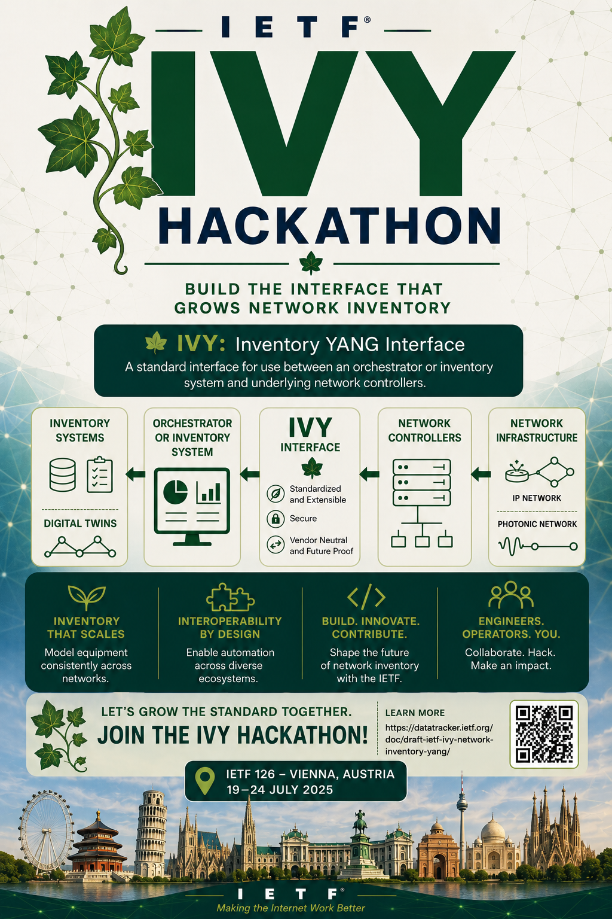
Overview
Hackathon architecture
Ivy model
Objectives of Hackathon
Sketch of possible arrangements
Prior to Hackathon
Vision
What will not be explored

Slide 3
Hackathon Architecture
Note that this follows on from the successful
IETF125 Hackathon demonstration of IVY
Configuration:
A controller from one vendor plays the role of inventory system (inventory role)
Several controllers from different vendors are connected to the inventory controller (controller role)
Each controller role provides a view of network elements and their physical inventory
Multiple vendors engage in various orientations
Interconnect in various configurations
Any appropriate vendor system can take the inventory role
The Use Case will be alignment via GET (notification will not be exercised at this stage)
May be:
Controller
Orchestrator
Inventory system
Inventory role
Display of inventory
ivy
Compare Content
Controller role
Controller role
Display of inventory
Network
Network
Network may be:
An image in the controller
A simulation
Real hardware
Ideally network elements would be a mix of IP, Ethernet, OTN and optical where there were various NEs of different mixes of capabilities. This should have no impact on the ivy interface capability

Slide 4
Ivy model
module: ietf-network-inventory
+--ro network-inventory
+--ro network-elements
+--ro network-element* [ne-id]
+--ro ne-id string
+--ro ne-type? identityref
+--ro uuid? yang:uuid
+--ro name? string
+--ro alias? string
+--ro description? string
+--ro software-rev* [name]
| +--ro name string
| +--ro revision? string
| +--ro patch* [revision]
| +--ro revision string
+--ro mfg-name? string
+--ro product-name? string
+--ro product-rev? string
+--ro components
+--ro component* [component-id]
+--ro component-id string
+--ro class union
+--ro uuid? yang:uuid
+--ro name? string
+--ro alias? string
+--ro description? string
+--ro software-rev* [name]
| +--ro name string
| +--ro revision? string
| +--ro patch* [revision]
| +--ro revision string
+--ro mfg-name? string
+--ro product-name? string
+--ro hardware-rev? string
+--ro mfg-date? yang:date-and-time
+--ro part-number? string
+--ro serial-number? string
+--ro asset-id? string
+--ro is-fru? boolean
+--ro uri* inet:uri
+--ro parent*
| -> ../../component/component-id
+--ro parent-rel-pos? string
+--ro is-main? boolean
Useful links
IETF | IETF 126 Hackathon
IETF 126 Hackathon | IETF Community Wiki (see YANG Data Model for Network Inventory (IVY) – 2)
Network Inventory YANG (ivy)
draft-ietf-ivy-network-inventory-yang-18 - A Base YANG Data Model for Network Inventory
ietf-ivy-wg/network-inventory-yang
The key structure is component
Component represents equipment, holder, pluggable etc.
Most properties are clear in meaning
For holder, most properties are not required
Compared to TAPI
The model does not support expectation/actual split
There is not access-port or physical-span
Need to do a property by property comparison of tapi-equipment to determine precisely what is missing

Slide 5
Objectives of Hackathon
This is a validation of the use of ivy equipment.
The activity will NOT cover Topology models, Service models, IP capabilities, Photonic capabilities… Etc.
Demonstrate that systems can connect
Prove this prior to the actual hackathon to save wasted time
Demonstrate ivy can convey inventory
Partly exercise this prior to actual hackathon, again to save wasting time
Exercise inventory detail
Get all inventory then display
Explore for missing detail
Compare display on inventory role with display on controller role devices
Add properties to model and convey new data
Compare with TAPI and add further properties where obvious
Highlight discrepancies
Consult operators on relevance of shortfalls
Propose additions to IVY as appropriate

Slide 6
Sketch of possible arrangements
Vendor W brings a controller that can perform both roles
Vendor X brings two distinct controllers one for inventory role and one for controller role
Vendor Y only brings an inventory solution
Vendor Z brings a controller that supports the controller role
 | Controller role | Inventory role
Config 1 | W, Xc, Z | W
Config 2 | W, Xc, Z | Xi
Config 3 | W, Xc, Z | Y
One or more vendors may also have a TAPI equipment capability
Single vendor or multi-vendor interconnect may be achievable
Comparison of information transferred by TAPI may be of value

Slide 7
Prior to hackathon
In ivy
Agree use cases as described in these slides
Agree interaction formats etc.
Participants
Determine which systems will be used
Identify design resources to be on site
Develop/refine NBI and SBI as appropriate
Validate interconnect with other vendors via various pairwise interactions
Simply connect
Try a get

Slide 8
Vision
Currently the IVY model provides less than TAPI and TAPI uses some more compact modelling patterns
Through the Hackathon and via consultation with operators, add to IVY to cover gaps such that IVY covers all relevant capabilities of TAPI
Refine the IVY model to align with TAPI patterns where agreed
Demonstrate equivalence in parallel TAPI/IVY interfacing
Build prototype TAPI with IVY equipment
Demonstrate migration opportunity (using CoPilot/LLMs to assist in code and documentation)
Define value-justified steps (vendors and operators)
Coordinate migration from TAPI Equipment to IVY Equipment across the industry
Consider OC advancements in a similar way

Slide 9
What will not be explored
Topology models and interconnect between systems exposing topology
Service models
IP capabilities
Photonic capabilities

Slide 10
Questions?

