Slide 1
Various topics for discussion
Nigel Davis
20250429

Slide 2
Tidy up of repository
Working with TAPI, TAPI-Documentation and TAPI-Activities
Have added branches to make TAPI and TAPI-Documentation consistent
The both now have tapi-2.1.3-fixes, tapi-2.5.0-fixes, tapi-2.6.0-fixes branches
Note that TAPI has a typo in the branch name 2_5_0. I will try to fix this.
TAPI has develop and TAPI-Documentation has main as default branch
Names unnecessarily different, but will leave for now
TAPI has additional branches
develop_v2_1 and tapi_2.1 that I need to explore (with the aim to delete)
tapi-team-activities which I think we can delete
I have analysed most and can find locations in other repositories

Slide 3
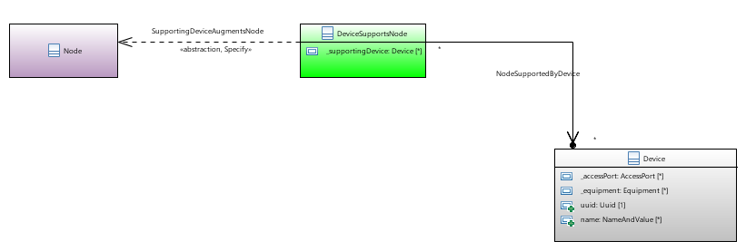
Node-device relationship (item 46 in FeaturesAndWorkFor2.7.xlsx)
Issue Validate that the node-device relationship provides the opportunity for n:m.
Looks OK

Slide 4
Priorities
See FeaturesAndWorkFor2.7.xlsx (updated)

Slide 5
Physical Route in 2.1.3+
Have constructed YANG augment
Next will explore use case augment to TR-547
Aim is to make the change purely incremental and external to existing TR-547
Aim to provide in tapi-2.1.3-fixes as a full build with additional files
Not clear on numbering as 2.1.4 already exists (with OAS corrections – I need to ensure these are also in the new 2.1.x)
Looking for guidance on numbering from TIP

Slide 6
Update in Link creation etc.
In the process of constructing appropriate YANG and UML
Adding constraints to the connectivity-service request for the link
Will provide input within the next two weeks

Slide 7
Config false issue in 2.5.0
Using a service approach as opposed to direct writes
Need to take the model back to config false
Deprecate the config true aspect via the RIA
Generate a parallel Topology module with config false
Need to explore connectivity issue in detail
Expect it is due to a mingle of config true and false in connectivity
May lead to the need to replicate structures??
May need to extract all services into a separate set of modules
Backward compatibility concern – the key is that the JSON needs to be the same (the YANG can be different)

Slide 8
2.1.3 additions and adjustments
Issues identified so far
Candidate additions
MC width parameter

