Slide 1
TAPI Connectivity Service Computation Service ☺
Nigel Davis (Ciena)
Extracted from otcc2020.ND.005_TAPI-VariousRefinements.pptx and then enhanced

Slide 2
Introduction
Two aspects to this proposal
PathComputationService
ConnectivityServiceComputationService
PathComputationService
What it isn’t
What it is intended to be
Enhancements proposed to make it more of what it is intended to be
ConnectivityServiceComputationService
Now that PathComputationService is clearly not this, then what do we need
How might the current model be enhanced to provide the capability

Slide 3
TapiPathComputation
There appear to be various issues with the current structure
The term “path” is confusing from an ITU-T perspective
“path” in TAPI is an ordered list of Links
The documentation says TE links… we need to remove TE!
Some of the constraints etc. do not appear to make sense for the construction of an ordered list of Links
Some of the entity names are extremely misleading
The PathComputationService is actually a set of precomputed LinkLists and not a service of any form and essentially not, once formed, relevantly “path computation”
Etc.
The next slide shows the current model and the slide after shows some proposals for change
There is also a need for a ConnectivityServiceComputationService

Slide 4
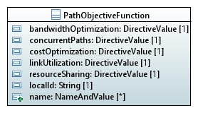

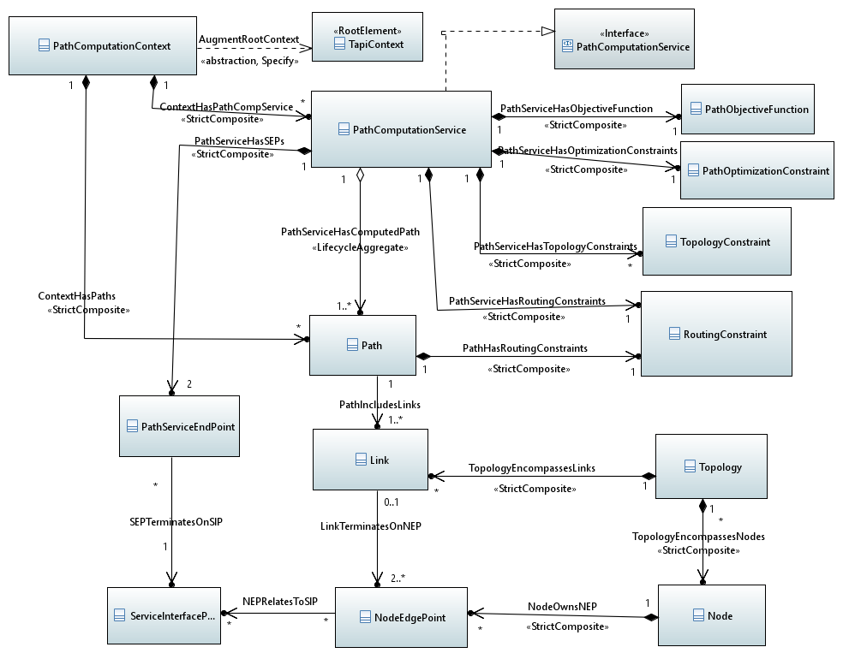

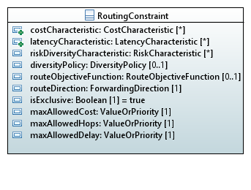
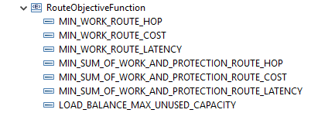
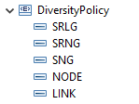
TapiPathComputation – Current structure
Various elements of these seem inappropriate or poorly defined considering the purpose
A Path can belong to more than one PCS
A link is multi-pointed
A link can be in more than one path

Slide 5
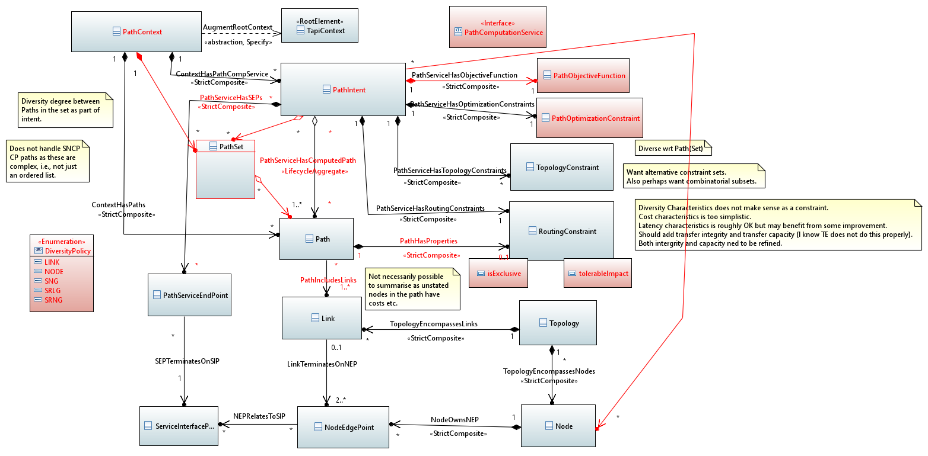
TapiPathComputation – Proposed Adjustments
A Path is a Link Chain to enable building of many co-routed ConnectivityServices
Predefined PathSets
Set provides alternative Link Chains
Different PathSets may be used for different services
PathSets may be constructed for future cases that require different routing to current
PathSets are not provisioned
A PathIntent may be
An intended use of a PathSet such that SIPs are specified (PathIntent has PathServiceEndPoints)
A SIP may have many PathIntents because some are for now (in the same PathSet) and some are for future
A preplanned route potentially available to many SIPs associated with the same Node (PathIntent to Node)
May want set of sets for a specific PathIntent (e.g., where there will be a need for a pair of diverse ConnectiviyServices)
The PathSets, PathIntents and Paths are maintained by the Controller as candidate constraints for use when creating ConnectivityService
I have changed some names to make more sense. We do not need to change the names.
Red fill means questionable or insufficient
Red line is new
Red text indicates proposed change (independent of new stuff)

Slide 6
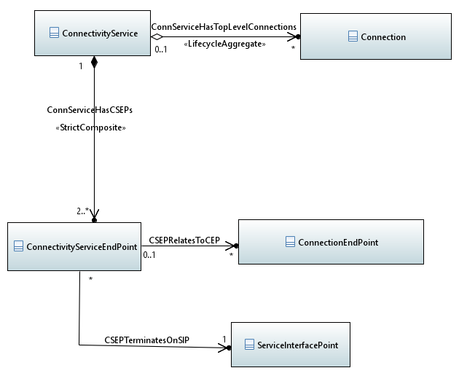
ConnectivityServiceComputationService
For want of a better name ☺… fortunately we can just use ConnectivityService with the right state combinations ☺)
Allows a PCE to provide a number of full definitions for a requested ConnectivityService with defined SIPs in terms of existing and potential
Connections
CEPs
NEPS
Links
Nodes
Topologies
Most classes seem to have LifecycleState (indirectly) other than Topology
Lifecycle state of PLANNED could be used but this seems to be a distortion of its purpose
So PREPLANNED or CANDIDATE may be necessary
We can’t use POTENTIAL as we have that for another purpose
There may be other changes to Lifecycle state (and this plays into long lived operations and late failures)
A ConnectivityService can have many alternative Connections (with different costs etc.)
Whilst the model multiplicity allows for this there would be confusion between cases where multiple Connections were required together rto support a ConnectivityService and there were alternatives of these multiple Connections
It would seem that ConnectivityServices with a time dimension to the Connection support may also benefit from an optional additional level of indirection
AlternativeConnection “between” ConnenctivityService and Connection with properties indicating whether the referenced set is alternative candidates or timeSelected and allowing for a candidate sets of connections and an alternative candidate set of time selected connection sets
One class with the appropriate complex attributes appears sufficient where there is an opportunity for multiple instances of the class
The same treatment as for ConnectivityService would seem to be necessary for CSEP wrt CEP and SIP
It is necessary to allow for recomputation of an existing ConnectivityService and then a “roll” and this may also benefit from the intermediate classes
For regrooming a network there would be a case for the simultaneous computation of a (large) number of ConnectivityServices
The computation could be standalone and stateless (a set of computation results are offered and forgotten) for one or more new ConnectivityServices (transactional for the computation)
The computation could be standalone and stateless of a proposal for modification of a connectivity service given a set of constraiints where a put/patch of the ConnectivityService with new constraints is made with a “candidate” flag and a new Connection(s) (potentially reusing bits of the old Connections(s) is returned
The computation could be part of the ongoing control of existing connectivity where there is limited state during the task
The case where there is a large number of ConnectivityService and where there is a stage process suggests the need for a Task and it is suggested that the Core model Task is applicable as a basis for this

Slide 7
Proposal for remainder of slot
Sketch various cases
Sketch model enhancements
Validate essence of proposal
Discuss next steps

