Slide 1
TAPI Work progress
Nigel Davis
20250930
Note all work is being carried out in my forks…
https://github.com/nigel-r-davis/TAPI
https://github.com/nigel-r-davis/TAPI-Documentation

Slide 2
Updates to 2.1.3 and 2.5.x
Need to agree
Updates to 2.1.3 will be based on 2.1.4 and go to 2.1.5
2.1.4 has a fixed OAS that are rolled into tapi-2.1.3-fixes directly
Updates to 2.5.0 will be based on 2.5.1 and go to 2.5.2
There are YANG patches in 2.5.0-fixes (from 2.5.1), should they be rolled into the formal YANG of 2.5.2 (i.e., update the YANG (backward compatible))?
There is a corrected OAS in the patches, should this replace the OAS such that there is no confusion in 2.5.2 and be compatible with the 2.1.3 approach?

Slide 3
Protobuf file to 2.5
Ready for review
Add protobuf file to 2.5 (issue 619 work item 65)
Prepared the file and update to TR-548 in working 2.5 branch for call 20250909
Protobuf file added to 2.5.0-fixesTR-547-ND.
TR folder structure changed
TR-548 initial updates made in documentation nd fork v3.1.1
Follow-on actions
Review updates
Prepare delivery

Slide 4
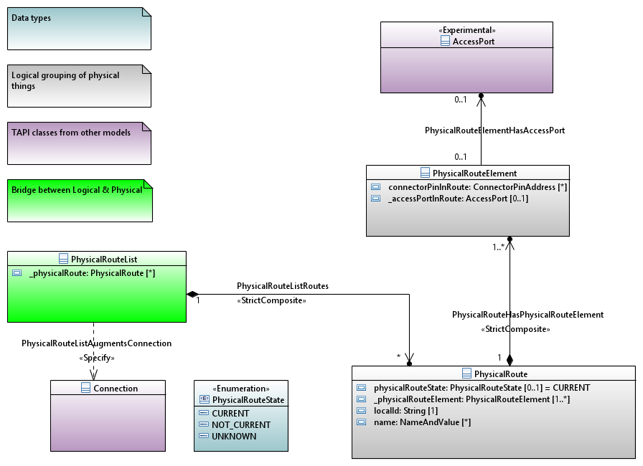
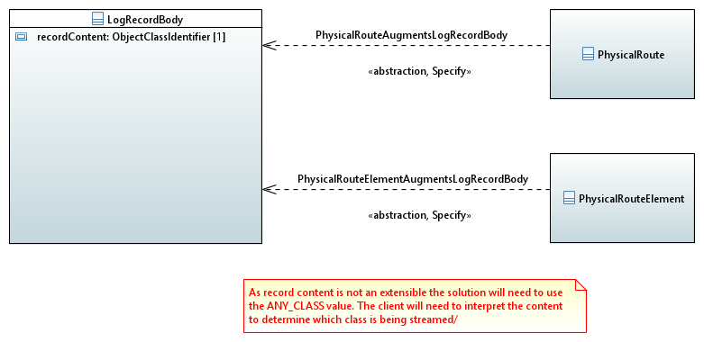
physical-route
Ready for review
physical-route to 2.1.3 (issue 628 work item 63)
UML/YANG draft generated 20250909
Available at 2.1.3-fixes-ND
Challenges in streaming and especially notification
Streaming hybrid augment proposed where ANY_CLASS is used to carry the objects
No clear solution for notification other than modifying the enum for object type
YANG v1.1 currently used. Could revert to 1.0
Draft update to TR-547 completed 20250916
Follow-on actions
Review solution
Updates to UML and YANG additions if any
Prepare delivery

Slide 5
String restrictions
Ready for review
String restrictions (issue 622 work item 62)
Used worked through changes in TR-547 2.6.0
This review also highlighted some conditions we have changed these should be rolled back to 2.5 too (word compare is probably the best method to find these)
30 changes were made
We appear to have missed access-port in device in 2.6.0. I have corrected this in 2.5. We can clear that up in 2.7.
I have updated for Linux Foundation etc.
I have prepared TR-547 2.5 with all string restrictions removed (at tapi-2.5.0-fixesTR-547-ND as done for 2.6, for the call 20250909
2.1.3 has also been adjusted
Folders for docs for TRs so TR-547 and TR-548 have been rearranged
Follow-on actions
Review as drafts of TR-547 v1.1.1 and v3.1.1
Publish as new release of 2.5 and 2.1.3 (rearrange folders for docs for TRs so TR-547 and TR-548)

Slide 6
Config false
In progress
Config false (issue 620 work item 15)
I will update the connectivity YANG to LF standard
I adjusted the connection-end-point-ref (which was the only remaining error in 2.6.0) as proposed by Ramon (Mark all leafrefs in config groupings that point to non-config uuids as “require-instance false;”) and as below…
grouping connection-end-point-ref {
uses tapi-topology:node-edge-point-ref;
leaf connection-end-point-uuid {
type leafref {
path '/tapi-common:context/tapi-topology:topology-context/tapi-topology:topology/tapi-topology:node/tapi-topology:owned-node-edge-point/tapi-connectivity:cep-list/tapi-connectivity:connection-end-point/tapi-connectivity:uuid’;
require-instance false;
}
description "none";
}
description "none";
}
The results (as expected) was “no errors”
Follow-on action:
Review sample
Complete work for all identified problems
Review completed YANG
Review TR-547 for any changes (suspect none but may be a YANG snippet in the document)
Plan back propagation to 2.5 and 2.1.3
Complete and review…
Will progress for 20251007 with the aim to have fixes in place for 2.5.

Slide 7
Spotlight and snapshot stream
See separate presentation… otcc2024.ND.002_SpotlightAndSnapshotStreams.pptx
Target review 20251007

Slide 8
Control plane model
Model of control plane using standard TAPI classes
SNPP → NEP
SNP → CEP
Connection → Connection
SNPP_Link → Link
Abstraction through new association such that control plane entities reference real entities
Works with TAPI path and path set
This may require more than one level of nesting of lower connection in top level connection… discuss

Slide 9
Proposal
OTSiMC Connectivity Service
View change
MC Connectivity Service
MC Connectivity Service
OTSiMC CP connection
PathSet
Path
Transceiver1
Path
Transceiver2
Link
Link
ODU
Link
Partition parallel
(decomposition)
Link
OTN
aggregation
Link
Link
OTU
OTN
OTSiMC Top Connection
OTSiMC
(+OTSi if O/E/O)
PHOTONIC
MC
PHOTONIC
ROADM1
ROADM2
ROADM3
OMS
OMS
Top Connection
OMS
Top Connection
PHOTONIC
OTS_MEDIA
Top Conn
OTS_MEDIA
Top Connection
(deg to deg port)
OTS_MEDIA
Top Connection
(deg to deg port)
OTS_MEDIA
Top Conn
OTS_MEDIA
PHOTONIC

Slide 10
Proposal
OTSiMC Connectivity Service
View change
MC Connectivity Service
MC Connectivity Service
OTSiMC CP connection
SNP
PathSet
Path
Transceiver1
Path
Transceiver2
Link
Link
ODU
SNPP
Link
Partition parallel
(decomposition)
Link
OTN
aggregation
Link
Link
OTU
OTN
OTSiMC Top Connection
OTSiMC
(+OTSi if O/E/O)
PHOTONIC
MC
PHOTONIC
ROADM1
ROADM2
ROADM3
OMS
OMS
Top Connection
OMS
Top Connection
PHOTONIC
OTS_MEDIA
Top Conn
OTS_MEDIA
Top Connection
(deg to deg port)
OTS_MEDIA
Top Connection
(deg to deg port)
OTS_MEDIA
Top Conn
OTS_MEDIA
PHOTONIC

Slide 11
Proposal
OTSiMC Connectivity Service
View change
MC Connectivity Service
PathSet
Path
Transceiver1
Path
Transceiver2
Link
Link
ODU
Partition parallel
(decomposition)
Link
Link
OTN
aggregation
Link
Link
OTU
OTN
OTSiMC Top Connection
OTSiMC
(+OTSi if O/E/O)
PHOTONIC
MC
PHOTONIC
ROADM1
ROADM2
ROADM3
OMS
OMS
Top Connection
OMS
Top Connection
PHOTONIC
OTS_MEDIA
Top Conn
OTS_MEDIA
Top Connection
(deg to deg port)
OTS_MEDIA
Top Connection
(deg to deg port)
OTS_MEDIA
Top Conn
OTS_MEDIA
PHOTONIC

Slide 12
Proposal
OTSiMC Connectivity Service
View change
MC Connectivity Service
PathSet
Path
Path
Transceiver1
Link
Link
Transceiver2
Partition parallel
(decomposition)
Link
Link
ODU
aggregation
Link
Link
OTN
OTU
OTSiMC Top Connection
OTN
OTSiMC lower Connection
OTSiMC
(+OTSi if O/E/O)
PHOTONIC
MC
PHOTONIC
ROADM1
ROADM2
ROADM3
OMS
OMS
Top Connection
OMS
Top Connection
PHOTONIC
OTS_MEDIA
Top Conn
OTS_MEDIA
Top Connection
(deg to deg port)
OTS_MEDIA
Top Connection
(deg to deg port)
OTS_MEDIA
Top Conn
OTS_MEDIA
PHOTONIC

Slide 13
Implications
For complex cases we can:
pull out the control plane connection as separate from the “real” connection
allow two levels of lower connection.

Slide 14
TAPI – IETF model linkage
onmi025.ND.005_BriefAnalysis-TapiIetfModelLinkage.pptx
Need to add peer relationship to cover case where TP is shared.
Need to consider connection and Link cases
Target update 20250930

Slide 15
Align PM streaming with OAM model advancements
Review the PM streaming
Review OAM in the streaming context (e.g., removal of current data)
Assess structure for gaps, conflicts etc.
Report back to team
Target 20251007
Partial analysis carried out… need to do more before reporting back

Slide 16
Streaming test plan review
onmi2025.ND.007_StreamingTestPlan-FirstDraft.docx
Deeper dive than last skim on today’s call
Document available for assessment
Comments in two weeks (20250916)
Review Ramon’s comments

