Slide 1
Conveying optical impairment and power capability information on inter-domain OMS/OTS Links
1FINITY INC

Slide 2
Inter-domain Links 1 – Hierarchical Controllers
Orchestrator
Note: in this diagram, L1 and L2 are inter-domain links.
The CS-1 in green domain is supporting a pass-through of the wavelength. It is part of an e2e service that passes through the 2 inter-domain links. There would also be simpler cases where one of the end-points of the e2e service is in the green domain itself.
TAPI
Top Controller
TAPI
Domain Controller
RDM
RDM
RDM
A1’
A1
RDM
RDM
Z1
Z1’
RDM
RDM
RDM
xPDR
CS-1
xPDR
L1
L2
xPDR

Slide 3
Inter-domain Links 2 – Same level controllers
Orchestrator
Note: in this diagram, L1 and L2 are inter-domain links.
The CS-1 in green domain is supporting a pass-through of the wavelength. It is part of an e2e service that passes through the 2 inter-domain links. There would also be simpler cases where one of the end-points of the e2e service is in the green domain itself.
TAPI
TAPI
Controller-1
Controller-2
RDM
RDM
RDM
A1’
A1
RDM
RDM
Z1
Z1’
RDM
RDM
RDM
xPDR
CS-1
xPDR
L1
L2
xPDR

Slide 4
Requirements for Optical Power Control
As part of provisioning CS-1, the Green Controller needs to perform OPC on its path segment
In order to set the power on the channels in the inter-domain links, the controller needs to know:
Optical loss expected on the inter-domain links in the Tx direction
Acceptable Rx power range for the channel at the other-end of the inter-domain link
Other parameters (?)
Can these be passed as layer-protocol-constraints on the respective CSEPs of CS-1?
See the next slides

Slide 5
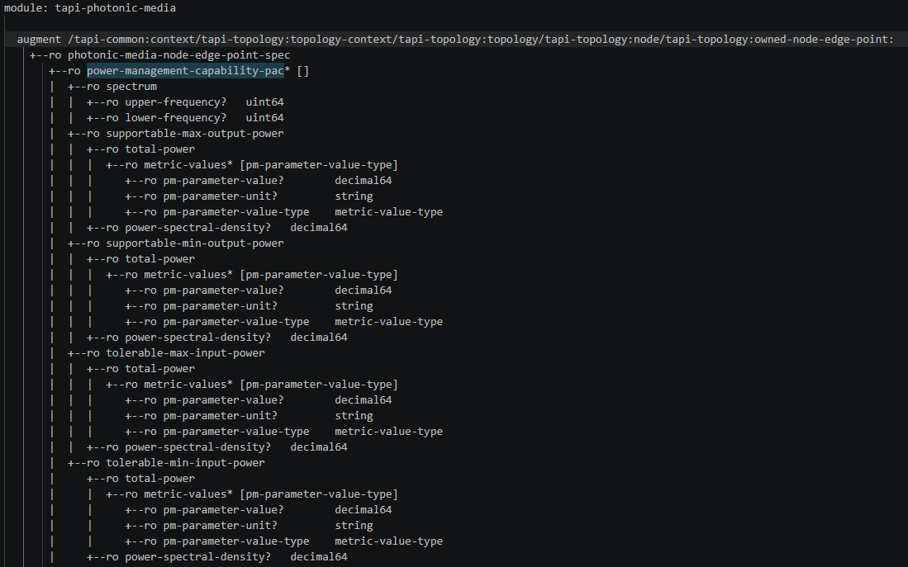
Power Management Capability PAC
This is available on photonic-media NEP and SIP objects
RO values that a controller can expose to its NBI TAPI clients. For example,
Green controller can expose this for A1 and Z1 on the green ROADMs
Blue controller can expose this for A1’ and Z1’ on the blue ROADMs

Slide 6
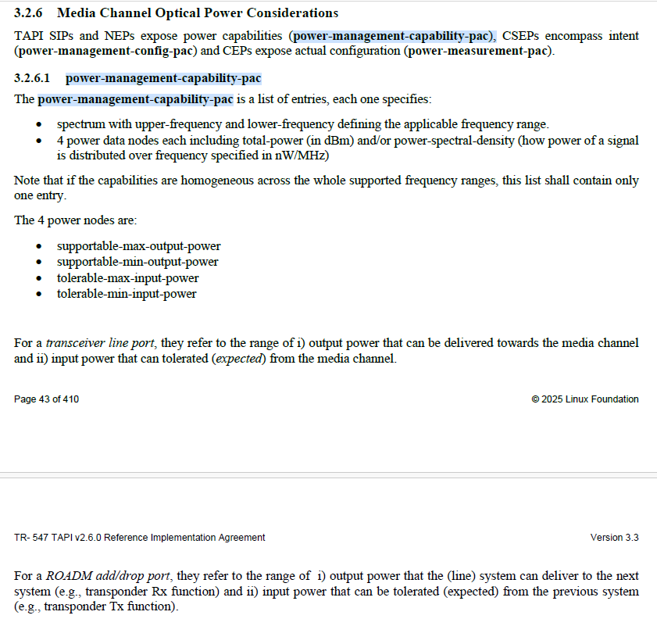
Power Management Capability PAC – TR547
TR547 defines these for Transceiver line ports and ROADM add/drop ports.
We need to clarify their applicability and meaning for ROADM degree ports that can act as inter-domain links.
For example, the meaning on:
OTS_MEDIA NEP
OMS NEP
MC NEP
OTSiMC NEP
From an OPC perspective, the “tolerable-max-input-power” and “tolerable-min-input-power” are needed on a per-channel basis.
Can these be reported on the MC NEP?
TAPI Client (the Orchestrator or the Top Controller) can read this and use it when creating a connectivity-service with end-points on inter-domain links. For example, in slide-3:
Orchestrator can read “tolerable-max-input-power” and “tolerable-min-input-power” from MC NEPs on A1’ and Z1’ (exposed by the Blue Controller)
And pass them to the Green Controller on A1 and Z1 CSEPs.
How are they passed? See next slide.

Slide 7
Power Management Config PAC
augment /tapi-common:context/tapi-connectivity:connectivity-context/tapi-connectivity:connectivity-service/tapi-connectivity:end-point/tapi-connectivity:layer-protocol-constraint:
+--rw (otsi-)mcg-connectivity-service-end-point-spec
+--rw number-of-otsi-mc? uint64
+--rw otsi-mc-bandwidth-config-pac* [local-id]
| +--rw spectrum-bandwidth? uint64
| +--rw center-frequency-offset? uint64
| +--rw center-frequency-constraint
| | +--rw adjustment-granularity? adjustment-granularity
| | +--rw grid-type? grid-type
| +--rw edge-frequency-constraint
| | +--rw adjustment-granularity? adjustment-granularity
| | +--rw grid-type? grid-type
| +--rw non-adjacent-spectrum? uint64
| +--rw power-management-config-pac
| | +--rw max-output-power
| | | +--rw total-power
| | | | +--rw metric-values* [pm-parameter-value-type]
| | | | +--rw pm-parameter-value? decimal64
| | | | +--rw pm-parameter-unit? string
| | | | +--rw pm-parameter-value-type metric-value-type
| | | +--ro power-spectral-density? decimal64
| | +--rw min-output-power
| | | +--rw total-power
| | | | +--rw metric-values* [pm-parameter-value-type]
| | | | +--rw pm-parameter-value? decimal64
| | | | +--rw pm-parameter-unit? string
| | | | +--rw pm-parameter-value-type metric-value-type
| | | +--ro power-spectral-density? decimal64
| | +--rw max-input-power
| | | +--rw total-power
| | | | +--rw metric-values* [pm-parameter-value-type]
| | | | +--rw pm-parameter-value? decimal64
| | | | +--rw pm-parameter-unit? string
| | | | +--rw pm-parameter-value-type metric-value-type
| | | +--ro power-spectral-density? decimal64
| | +--rw min-input-power
| | +--rw total-power
| | | +--rw metric-values* [pm-parameter-value-type]
| | | +--rw pm-parameter-value? decimal64
| | | +--rw pm-parameter-unit? string
| | | +--rw pm-parameter-value-type metric-value-type
| | +--ro power-spectral-density? decimal64
For CS-1 payload:
For CSEP on A1, add a layer-protocol-constraint for MC or OTSiMC l-p-q and provide mcg-connectivity-service-end-point-spec (or otsi-mcg-connectivity-service-end-point-spec). In this, add power-management-config-pac with
max-output-power as the value of tolerable-max-input-power from A1’
min-output-power as the value of tolerable-min-input-power from A1’
For CSEP on Z1, add a layer-protocol-constraint for MC or OTSiMC l-p-q and provide mcg-connectivity-service-end-point-spec (or otsi-mcg-connectivity-service-end-point-spec). In this, add power-management-config-pac with
max-output-power as the value to tolerable-max-input-power from Z1’
min-output-power as the value of tolerable-min-input-power from Z1’

Slide 8
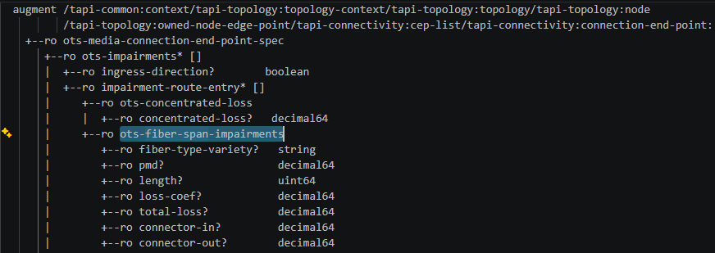
OTS Fiber Span Impairments
This is available in the model, on OTS_MEDIA CEP objects as RO values that a controller can expose to its NBI TAPI clients.
Green controller can expose this for A1 and Z1 on the green ROADMs
Blue controller can expose this for A1’ and Z1’ on the blue ROADMs
However, a Controller may not “know” these values (or be able to “measure” these values) on the end-points of inter-domain links. Hence the controllers may not report these to the Orchestrator. Orchestrator may need to go with planned/designed fiber-span-impairments.
We may need an ability to specify some fields of ots-fiber-span-impairments for an inter-domain link, in a CSEP. So that the controller can decide the right power level to be set in the connection.
The extension needed in TAPI would be to allow a CSEP to be augmented with a layer-protocol-constraint that includes a subset of this with RW fields
E.g. When the Green Controller is asked to create CS-1, it needs to be told about the impairment-route-entry fields for the A1➔A1’ and Z1➔Z1’ links.
Only total-loss may be sufficient (?)
Something like this where layer-protocol-qualifier is OTS_MEDIA (?)
| | +--rw layer-protocol-constraint* [local-id]
| | | +--rw layer-protocol-name? tapi-common:layer-protocol-name
| | | +--rw layer-protocol-qualifier? tapi-common:layer-protocol-qualifier
| | | +--rw local-id string
| | | +--rw name* [value-name]
| | | +--rw value-name string
| | | +--rw value? string
| | | +--rw ots-media-connectivity-service-end-point-spec
| | | +--rw total-loss decimal64

