Slide 1
TAPI Photonic Model Summary
Andrea Mazzini, Nokia
September 12, 2023

Slide 2
References
ITU-T G.807 (2020) Amd .1 (01/2021)
Generic functional architecture of the optical media network
ITU-T G.874 (2020) Amd . 1 (11/2022)
Management aspects of optical transport network elements
ITU-T G.875 (06/2020)
Optical transport network: Protocol-neutral management information model for the network element view
ITU-T G.876 (08/2021)
Management requirements and information model for the optical media network
ONF TAPI Model
2.4.1 (April 2023), 2.1.3 (June 2020)
ONF TAPI Reference Implementation Agreement (RIA)
TR-547 2.1 (April 2023), 1.1 (December 2021)

Slide 3
Definitions
G.807 (Generic functional architecture of the optical media network) | TAPI 2.4.1 (Management entities) | TAPI 2.1.3 (Management entities)
media channel: A media association that represents both the topology (i.e., the path through the media) and the resource (i.e., frequency slot or effective frequency slot) that it occupies. A media channel supports zero or more OTSi. | Resource: Media Channel (McConnectionEndPointSpec) | Resource: Media Channel (MediaChannelConnectionEndPointSpec)
media channel group (MCG): A unidirectional point‑to‑point management/control abstraction that represents a set of one or more media channels that are co-routed. A media channel group (MCG) is bounded by a pair of media ports. | Service: Media Channel Group (McgConnectivityServiceEndPointSpec) | Service: Media Channel Group (McaConnectivityServiceEndPointSpec)
media channel assembly (MCA): A media channel group (MCG) and its non-associated overhead. Currently defined for OMS and OTS. | Not supported | Not supported
network media channel (NMC): A network media channel (NMC) is a type of media channel that results from the serial concatenation of all the media channels between the media port on a modulator and the media port on a demodulator. A NMC supports zero or one OTSi. | Resource: OTSi Media Channel (OtsiMcConnectionEndPointSpec) | Resource: Media Channel (MediaChannelConnectionEndPointSpec) Same constructs for both MC and NMC.
network media channel group (NMCG): A type of MCG that represents the set of NMCs that support the transfer of a single OTSiG. This construct allows management of a NMCG as a single entity. | Service: OTSi Media Channel Group (OtsiMcgConnectivityServiceEndPointSpec) | Service: Media Channel Group (McaConnectivityServiceEndPointSpec) Same constructs for both MC and NMC.
optical parameter monitor-x (OPM-x): A function that monitors a specific optical parameter (e.g., optical power) of the signals present in a media channel. To identify a specific parameter "x" is replaced by a unique string. | Resource: All photonic media Connection End Points | Resource: All photonic media Connection End Points
OSC: The OSC supports the transfer of the non associated overhead information for the OTSiA, OMS OSME and the OTS OSME. (OSME: Optical Signal Maintenance Entity) | Service: Threshold configuration supported. Resource: OSC (OscParams of OtsMediaConnectionEndPointSpec) | Not supported
optical tributary signal group (OTSiG): The set of optical tributary signals (OTSi) that supports a single digital client. | See OTSiA | See OTSiA
optical tributary signal assembly (OTSiA): The optical tributary signal group (OTSiG) together with the non-associated optical tributary signal group overhead (OTSiG-O). | Service: OTSiA (OtsiaConnectivityServiceEndPointSpec) | Service: OTSiA (OtsiaConnectivityServiceEndPointSpec)
optical tributary signal group overhead (OTSiG-O): The non-associated overhead for an OTSiG. | Not supported | Not supported

Slide 4
Definitions
G.807 (Generic functional architecture of the optical media network) | TAPI 2.4.1 (Management entities) | TAPI 2.1.3 (Management entities)
OTS media channel group (OTS MCG): The topological relationship between the output media port of one amplifier and the input media port of the next amplifier. | Resource: OTS Media Channel (OtsMediaConnectionEndPointSpec) | Resource: OTS Media Channel (OtsConnectionEndPointSpec) Same constructs for both OMS and OTS.
OTS media channel assembly (OTS MCA): An OTS media channel group (OTS MCG) and its non-associated overhead (OTS-O). | Not supported | Not supported
OMS media channel group (OMS MCG): The topological relationship between the media port on a filter or coupler where a set of media channels are aggregated and the media port on a filter or coupler where one or more media channel is added to or removed from that aggregate. All of the media channels that are represented by the OMS MCG must be carried over the same serial concatenation of OTS MCGs and amplifiers. | Resource: OMS Media Channel (OmsConnectionEndPointSpec) | Resource: OTS Media Channel (OtsConnectionEndPointSpec) Same constructs for both OMS and OTS.
OMS media channel assembly (OMS MCA): An OMS media channel group (OMS MCG) and its non-associated overhead (OMS-O). | Not supported | Not supported
G.959.1 (Optical transport network physical layer interfaces) | TAPI 2.4.1 (Management entities) | TAPI 2.1.3 (Management entities)
Optical tributary signal (OTSi): Optical signal that is placed within a network media channel for transport across the optical network. This may consist of a single modulated optical carrier or a group of modulated optical carriers or subcarriers. | Service: OTSi (OtsiConfigPac of OtsiaConnectivityServiceEndPointSpec) Resource: OTSi Media Channel, terminated (OtsiMcConnectionEndPointSpec + OtsiTerminationPac) | Service: OTSi (OtsiTerminationConfigPac of OtsiaConnectivityServiceEndPointSpec) Resource: OTSi (OtsiConnectionEndPointSpec)

Slide 5
MC, OTSiMC, OTSi
OTSiMC Central Frequency
OTSi Central Frequency
OTSi – 1
OTSi – 1
OTSi Lower Frequency
OTSi Upper Frequency
OTSiMC Lower Frequency
OTSiMC Upper Frequency
OTSiMC Bandwidth
Central Frequencies
OTSi – 1
OTSi – 1
OTSi – 2
MC Lower Frequency
MC Upper Frequency
OTSiMC
MC Bandwidth
MC

Slide 6
Basic concepts
OTSiMCG Service in OLS domain to configure the spectrum with more precise signal (OTSiA) provisioning
How the spectrum is organized to support a given signal pattern.
MCG Service could be useful in OLS domain to find and reserve spectrum for future OTSiA provisioning.
An OTSiMCG Service could or could not be provisioned within a MC Connection.
OTSiMCG and MCG Services can be provisioned as only bandwidth, or declarative, exact spectrum.
MCG Service is optional.

Slide 7
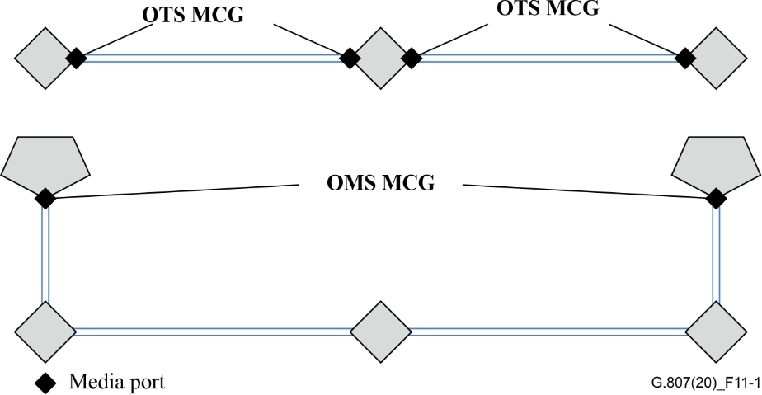
Figures - backup
Figure 7-5 – OTS and OMS MCGs with discrete remote optical amplifiers

Slide 8
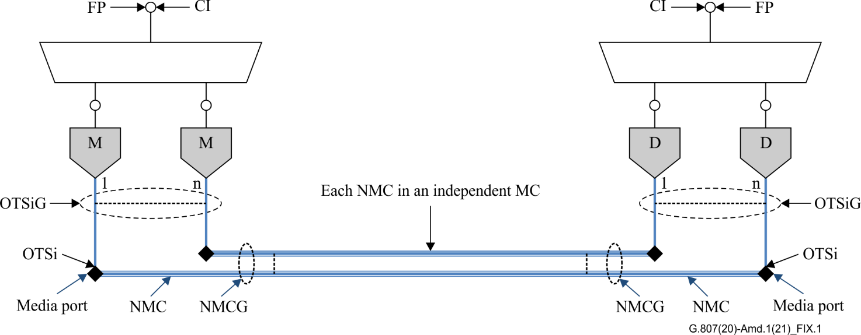
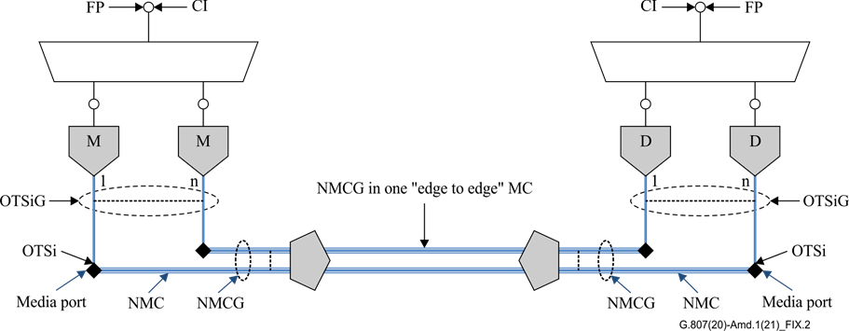
Figures - backup
Figure IX.1 – Independent media channels for each NMC
Figure IX.2 – Edge to edge media channel with a single NMCG

Slide 9
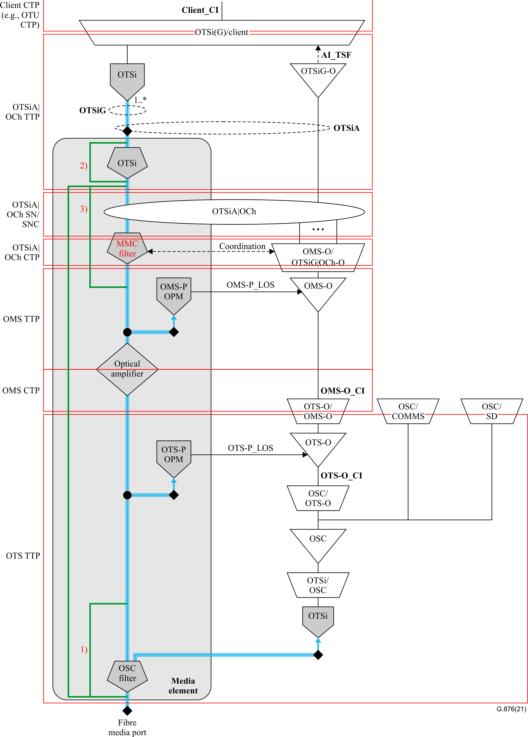
Figures - backup
Figure 7-1 – Overview of the object class mapping to a media element and
OTN atomic functions
The media channels used to guide the optical signals through the media element are either preconfigured or configured during OTSiA connection setup.

Slide 10
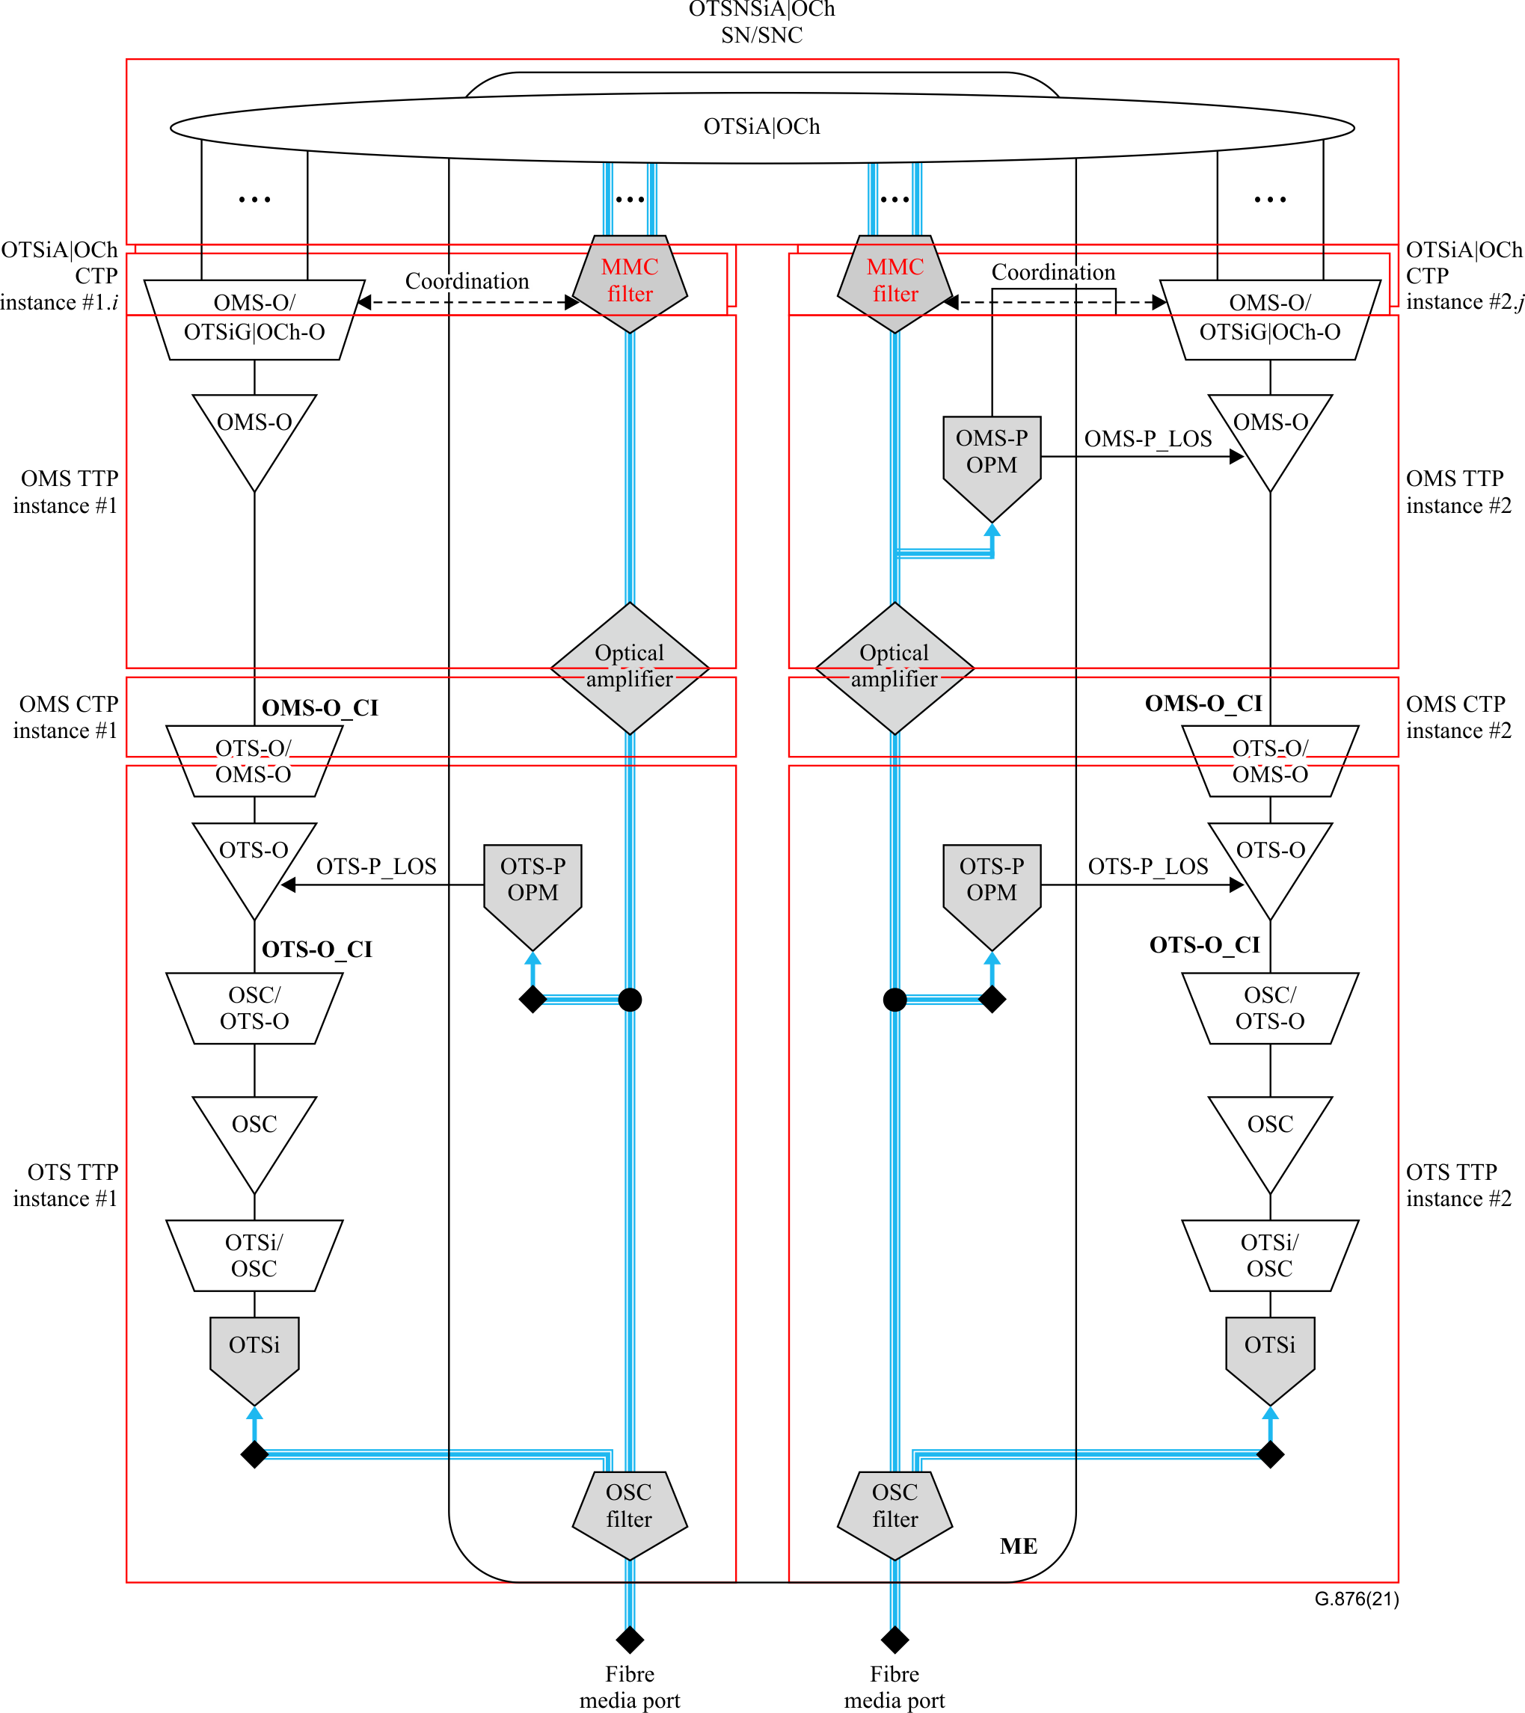
Figures - backup
Figure III.3 – Functional model of a transit ROADM

Slide 11
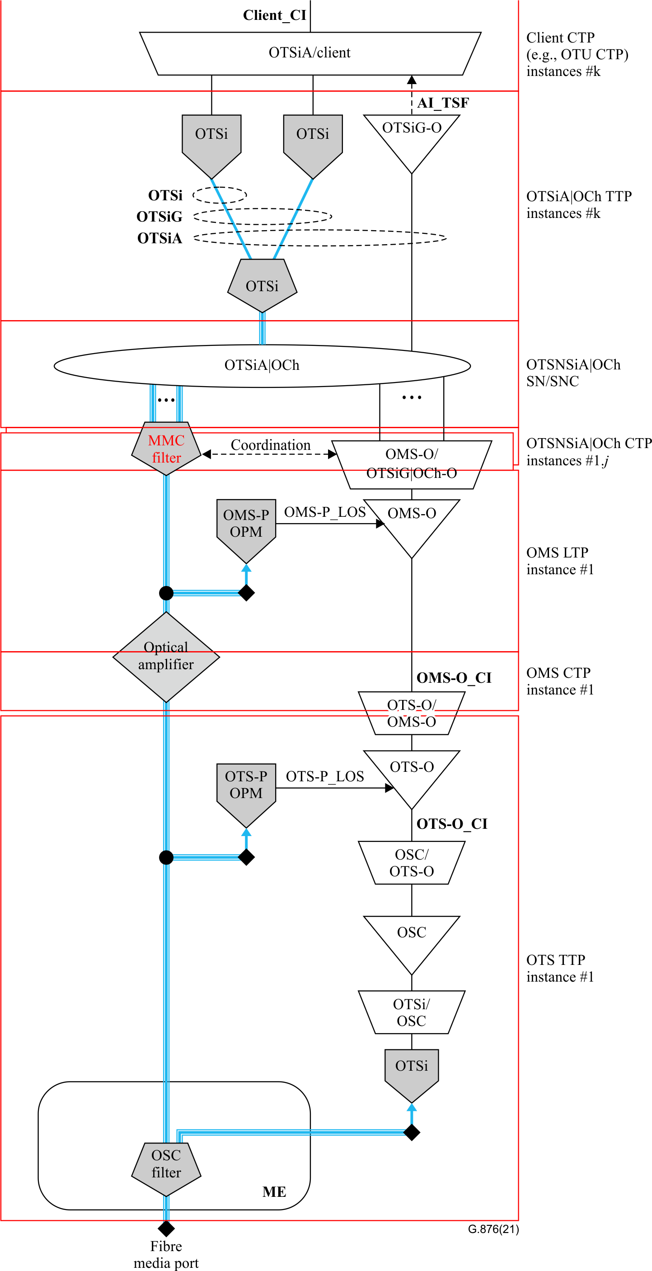
Figures - backup
Figure III.5 – Functional model of an edge ROADM

Slide 12
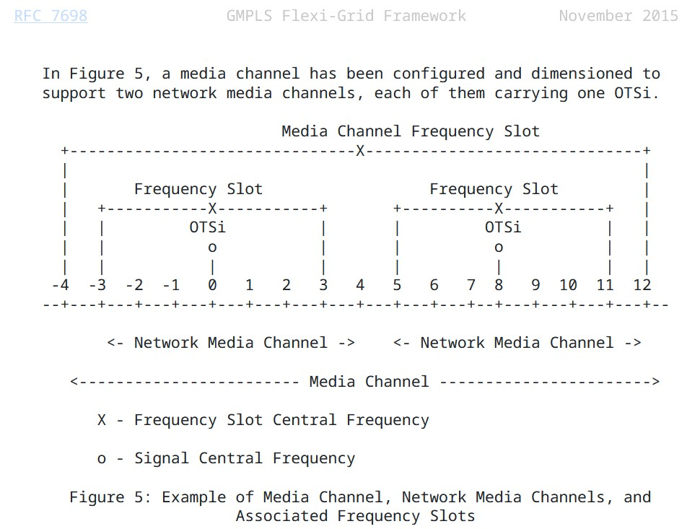
IETF RFC 7698 Framework and Requirements for GMPLS-Based Control of Flexi-Grid Dense Wavelength Division Multiplexing (DWDM) Networks

