Slide 1
Spotlight (and snapshot) streams
Nigel Davis (Ciena)
20240507

Slide 2
Overview
Level set on problem space
Engineering considerations
Examine measurement “policies”
Adjusting fidelity/detail
Consider
Several spotlight methods
Spotlight realization (high level view)
Model and data structure
Other areas for assessment

Slide 3
Challenges reporting system state
Quality of detector
Fidelity and precision
Range
Reliability
Granularity
At a fine-grained detail, all measures are analogue
At an even finer-grained detail, all analogue measures are actually quantized
At the finest of granularity, there is uncertainty and superposition
Forms
Continuous value
Infinite number of infinitesimal changes
Delta event
Infinite number of events most of which are not relevant
Persistent state
Intermittency of state
System engineering limits
Cost-value analysis dictates fidelity of view possible and appropriate
Determining what is valuable
Some things are obvious, but there are many measures on the boundary
There is an infinite amount of noise

Slide 4
Engineering for purpose
System has many events
Not possible to detect and report all events in any reasonably scale system
What can be detected and reported is many many orders of magnitude lower than what is occurring
Analysis to derive meaningful and useful insight from the detections consumes resources
Engineer the total system to hit the optimum cost/insight/value balance

Slide 5
Measurement
Upfront indications
Clearly vital for many functions and hence use of resources
Always measured, recorded in a history and presented to various systems including the user
Uses normal streaming techniques
Background recoverable history
Measured but simply recorded in the history (probably compressed)
Valuable enough to stream but cost of resources used kept to a minimum
Uses normal streaming techniques
Live measurement occasionally useful
Extremely detailed measurements that would overload the solution at the cost-effective level of deployment
Note that with a cloud-based deployment, additional resources could be applied to the occasional need
Uses a spotlight method (including a snapshot)
Aimed at an aspect of the system where the rate of change is usually too high to handle continuous alignment (cost effectively)
The align and notify mechanism is activated for one of more “on demand” properties for a defined period of time
A list of instance properties or class properties can be provided to start the process and to stop the process
Initial alignment can be achieved via “fake” notification of change from a default value
The notifications, once activated, can be dealt with as part of the normal notification stream

Slide 6
Spotlight method
Fundamentally, the spotlight and snapshot method enable flow of information on measurements not usually available to the client
Degrees:
Polling: The measurement can be read on the device, but the device does not stream. The controller polls on an appropriate basis to enable the streaming to the client. All intermediate functions in the controller are enabled to allow the measurement to be absorbed and propagated
Activation: The measurement function is activated in the device and all intermediate functions in the controller enabled to allow the measurement to be absorbed and propagated
Attention: The stream of measurements available from the device, that were being ignored, are absorbed and propagated
Enabled: The stream of measurements available within the controller, being logged etc., are streamed to the clients
Abstraction: Streams of several measurements available within the controller are combined to form a composite that is then streamed to the client
Spotlight and Snapshot
Spotlight: Sourcing a stream of measurement values, where the measurements abide by a defined policy, until explicitly deactivated
Long lived job with in-flight controls
Snapshot: Sourcing a single measurement value and then being deactivated automatically
Instantaneous job that will auto-delete
Synchronized Snapshot: Sourcing single measurements from multiple detectors simultaneously (at the same time or on some other trigger)
Short lived job with in-flight controls that will auto-delete on completion
Synchronized Spotlight: Sourcing repeated measurements from multiple detectors simultaneously (at the same time or on some other trigger)
Long lived job with in-flight controls

Slide 7
Entities and structures
Model to be developed in detail
Oam job (2.6 variant)
Control measurement and reporting (as per animation)
Short lived job for snapshot
Stream content
Format – use gnmi stream structure but allow coding in JSON

Slide 8
Animations of various methods

Slide 9
Other areas for assessment
Engineering and cost considerations
Timed measurements
Baseline measurement
Delta measurements
On change measurements
Measurement policy and policy dynamics on overload
Deployable probes
Adaptive content and workflow

Slide 10
Model Considerations

Slide 11
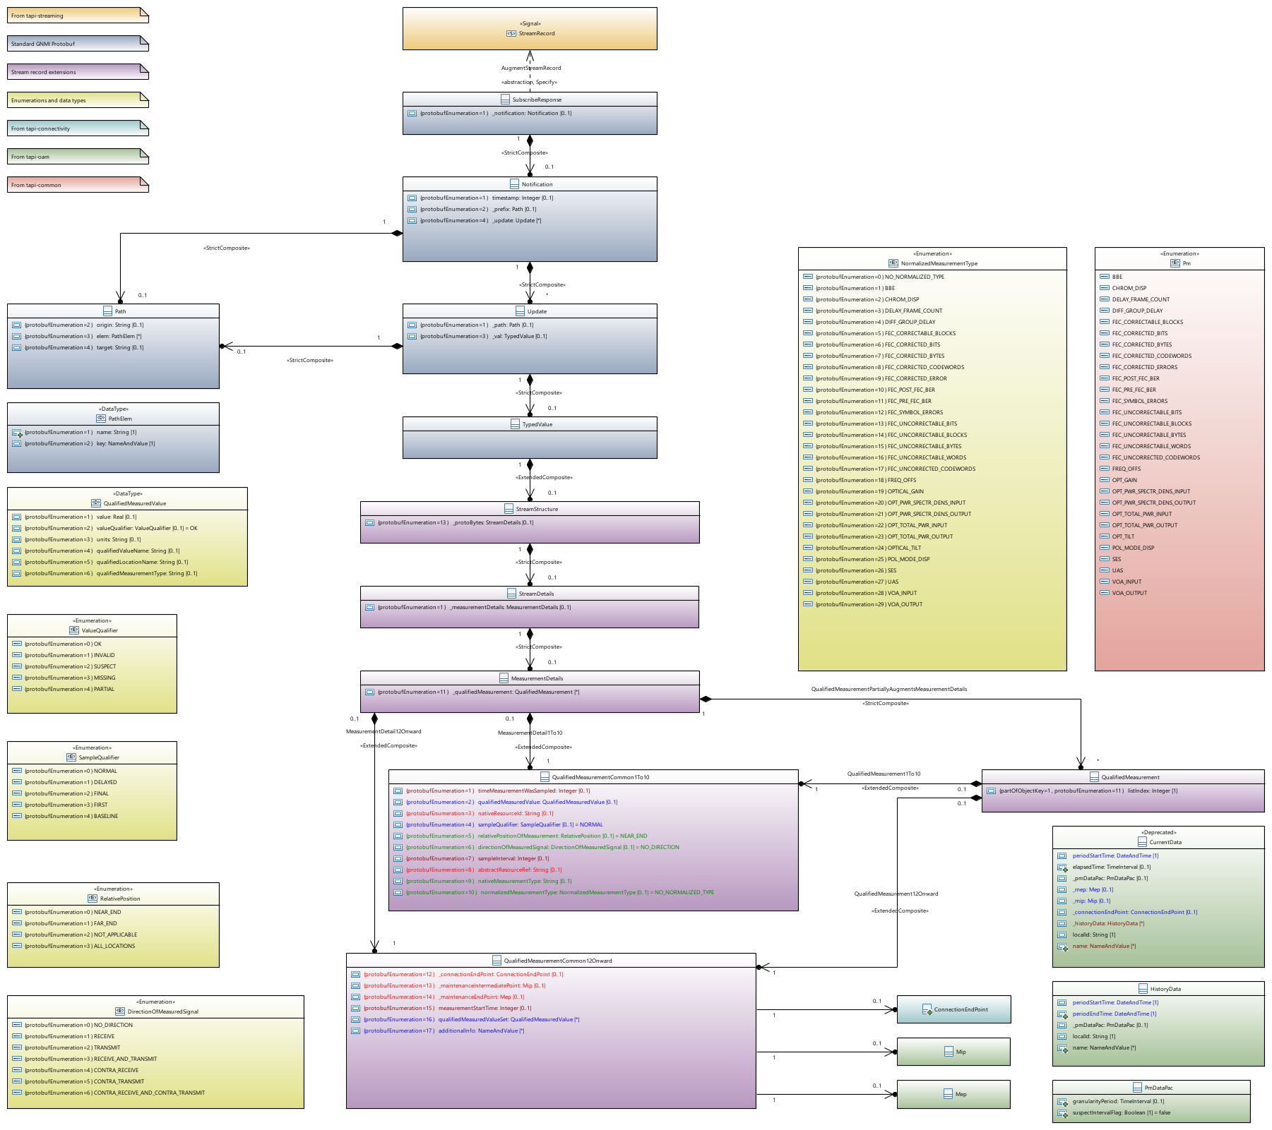
Spotlight stream
oam-jobs control/indicate what will be streamed
Model should be the same as that for gNMI/protobuf
Model content could be coded in JSON but efficiency considerations point to protobuf
An abstract resource reference mechanism improves provider throughput

Slide 12
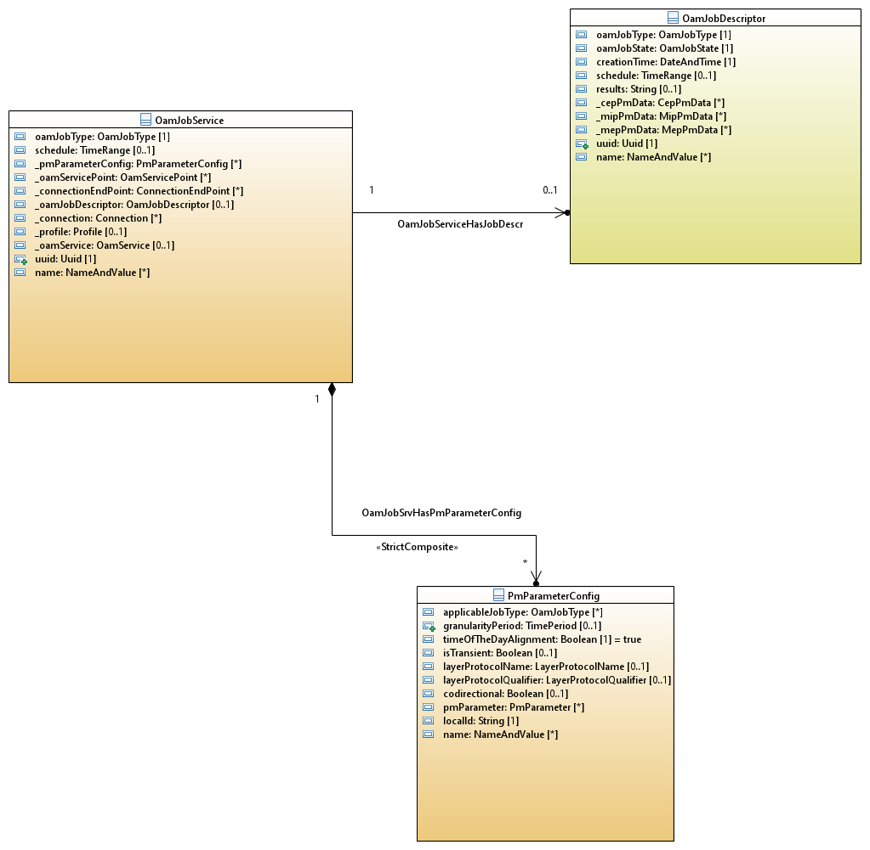


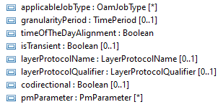
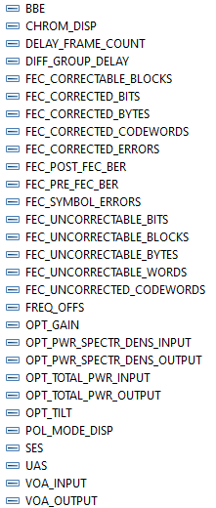
Snapshot stream
JSON or protobuf?
Same model as gnm/protobuf stream
Short live oam-job
Need to review oam-job model

Slide 13
Outstanding
How to model a property in an entity that can be acquired via snapshot/spotlight but that should not be read on get and should not be notified/streamed normally

Slide 14
Thank you!

