Slide 1
Brief Overview of TAPI PM via GNMI Stream
Use of GNMI streaming with protobuf encoding to optimise the transfer of measurement data including performance metrics, power values, counter values, statistical data etc.
Nigel Davis
20230328

Slide 2
Content
Purpose: Expose initial design of GNMI Protobuf stream structure.
Solution architecture
Identification
Model sketch, Yang and TAPI Protobuf sketch
Standard Protobuf
Requirements and Use Cases sketch
Some challenges

Slide 3
Solution Architecture
High-Level
Controller
Note that the term Orchestrator is not use as it tends to suggest a minimalistic light touch whereas there is a need for a broad and deep understanding of the network detail across the entire network.
In this solution the High-Level Controller takes a detailed view of tasks such as network rebalancing and multi-layer analysis of problem. It delegates coordination of provisioning, some restoration and information density improvements to the Lower Controller.
The High-Level Controller is assumed to not be a monolith but is instead a system of many components (where TAPI may be used between components).
Network PM
Analysis
PM
TAPI
Note that the term Domain Controller is not use as Domain is ambiguous and use of the term can lead to inappropriate demarcation of the problem space.
In this solution the Lower Controller is allocated responsibilities as note above.
For measurement data the Lower Controller collects, cleans, normalizes and consolidates measurement data from a set of network devices and control plane elements.
Lower
Controller
In an ideal formation of this architecture, the High-Level Controller and Lower Controller are actually parts of the same single control fabric where both are collections of components from the overall Control System where components interact using standard interfaces such as TAPI.

Slide 4
Referencing resources
Directory
UUID ← Ref
UUID ← foreign id
Measurement
Resource foreign id
Resources
Resource
UUID
Measurement
Resource UUID
OR
OR
Resource
UUID
Abstract Resource Ref list
Measurement
Abstract Resource Ref
Large volumes of data
Deeper mediation
Mediation
Minimal mediation/normalization to maximize “performance”
Resource data with local ids and properties
Performance data with some properties
Device

Slide 5
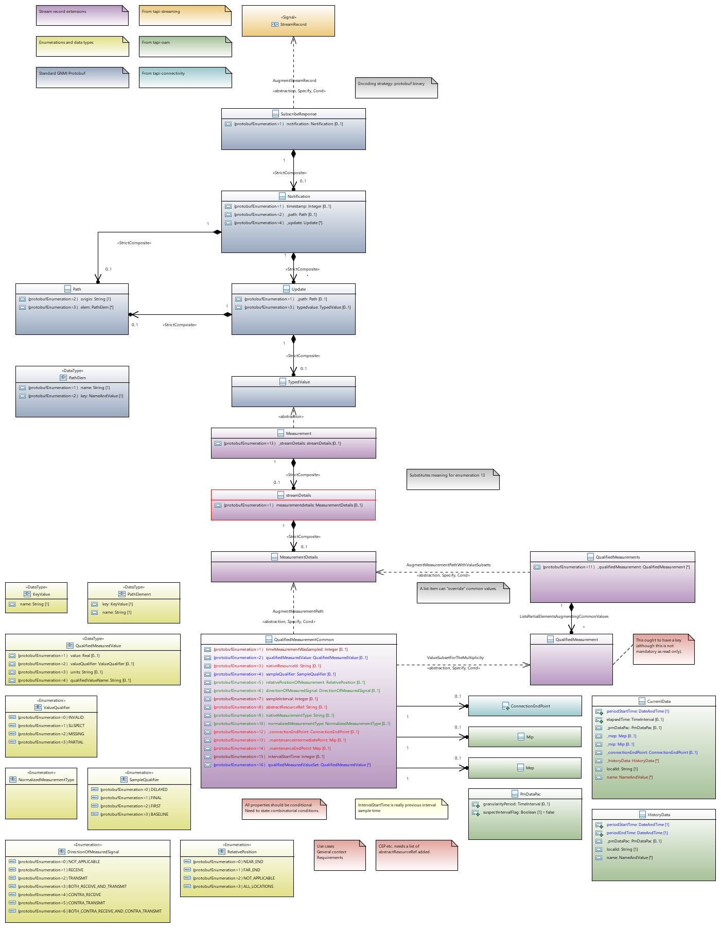
Model, Yang and Protobuf
Zoom to 400% to view detail
Actions:
Consider adjustments to UML/YANG model
Replace ValueSubsetForTheMultiplicity augmentation with a composition
Investigate how augment standard GNMI YANG typed value
The standard approach may be some kind of substitute (as opposed to augmentation)
Consider capability

Slide 6
Standard Protobuf notification structure
message SubscribeResponse {
oneof response {
Notification update = 1; // Changed or sampled value for a path.
// Indicate target has sent all values associated with the subscription
// at least once.
bool sync_response = 3;
// Deprecated in favour of google.golang.org/genproto/googleapis/rpc/status
Error error = 4 [deprecated = true];
}
// Extension messages associated with the SubscribeResponse. See the
// gNMI extension specification for further definition.
repeated gnmi_ext.Extension extension = 5;
}
message Notification {
int64 timestamp = 1; // Timestamp in nanoseconds since Epoch.
Path prefix = 2; // Prefix used for paths in the message.
repeated Update update = 4; // Data elements that have changed values.
repeated Path delete = 5; // Data elements that have been deleted.
// This notification contains a set of paths that are always updated together
// referenced by a globally unique prefix.
bool atomic = 6;
// Reserved field numbers and identifiers.
reserved "alias";
reserved 3;
}
message Update {
Path path = 1; // The path (key) for the update.
Value value = 2 [deprecated = true]; // The value (value) for the update.
TypedValue val = 3; // The explicitly typed update value.
uint32 duplicates = 4; // Number of coalesced duplicates.
}
// Path encodes a data tree path as a series of repeated strings, with
// each element of the path representing a data tree node name and the
// associated attributes.
// Reference: gNMI Specification Section 2.2.2.
message Path {
// Elements of the path are no longer encoded as a string, but rather within
// the elem field as a PathElem message.
repeated string element = 1 [deprecated = true];
string origin = 2; // Label to disambiguate path.
repeated PathElem elem = 3; // Elements of the path.
string target = 4; // The name of the target (Sec. 2.2.2.1)
}
// PathElem encodes an element of a gNMI path, along with any attributes (keys)
// that may be associated with it.
// Reference: gNMI Specification Section 2.2.2.
message PathElem {
string name = 1; // The name of the element in the path.
map<string, string> key = 2; // Map of key (attribute) name to value.
}
message TypedValue {
// One of the fields within the val oneof is populated with the value
// of the update. The type of the value being included in the Update
// determines which field should be populated. In the case that the
// encoding is a particular form of the base protobuf type, a specific
// field is used to store the value (e.g., json_val).
oneof value {
string string_val = 1; // String value.
int64 int_val = 2; // Integer value.
uint64 uint_val = 3; // Unsigned integer value.
bool bool_val = 4; // Bool value.
bytes bytes_val = 5; // Arbitrary byte sequence value.
float float_val = 6 [deprecated = true]; // Deprecated - use double_val.
double double_val = 14; // Floating point value.
Decimal64 decimal_val = 7
[deprecated = true]; // Deprecated - use double_val.
ScalarArray leaflist_val = 8; // Mixed type scalar array value.
google.protobuf.Any any_val = 9; // protobuf.Any encoded bytes.
bytes json_val = 10; // JSON-encoded text.
bytes json_ietf_val = 11; // JSON-encoded text per RFC7951.
string ascii_val = 12; // Arbitrary ASCII text.
// Protobuf binary encoded bytes. The message type is not included.
// See the specification at
// github.com/openconfig/reference/blob/master/rpc/gnmi/protobuf-vals.md
// for a complete specification. [Experimental]
bytes proto_bytes = 13;
}

Slide 7
Requirements and Use Cases
Requirements
To enable a client to receive an efficient stream of measurements for analysis
To enable a client to recover from short comms failures with no loss of measurement data
To minimise the per record computation required for the provider to deliver the stream
Use Cases
Provider prepares the stream
Provider maintains the stream
New measurement point enabled
Measurement point disabled
Measurement data missing
Measurement data delayed
Measurement data appears invalid
Client subscribes to the measurement stream for all measurements
With no suppression
With same value suppression
Client reconnects after a short comms failure
Client analysis examples
Trend analysis
Problem location and recovery
Excessive errors
Revenue not as expected
Etc.

Slide 8
Recovery from short comms fail
Architectural implications
Provider buffer
Engineering the client
GNMI challenges
Does not support “subscribe from where I was” so will need to add

Slide 9
Protobuf analysed… initial sketch
Textual form of protobuf instance
time_measurement_was_sampled: 1680004800000
measured_value {
value: 1.0
}
native_resource_id: "Port-1-1"
relative_position_of_measurement: NOT_APPLICABLE
direction_of_measured_signal: TRANSMIT
abstract_resource_ref: "Port-1-1"
native_measurement_type: "otufar-end-unavailable-seconds"
In hex
08 80 BC DB C0 F2 30 12 09 09 00 00 00 00 00 00 F0 3F
1A 08 50 6F 72 74 2D 31 2D 31
28 02
30 02
42 08 50 6F 72 74 2D 31 2D 31
4A 1E 6F 74 75 66 61 72 2D 65 6E 64 2D 75 6E 61 76 61 69 6C 61 62 6C 65 2D 73 65 63 6F 6E 64 73
74 bytes
In mix of hex/ASCII
08 80 BC DB C0 F2 30 12 09 09 00 00 00 00 00 00 F0 3F
1A {8 char} Port-1-1
28 NOT_APPLICABLE
30 TRANSMIT
42 {8 char} Port-1-1
4A {30 char} otufar-end-unavailable-seconds

