Slide 1
Pruning and Refactoring guidelines
20160121
ONF2016.023

Slide 2
Contents
Rationale for Pruning and Refactoring
Current text form TR513 highlighting issues and corrections
Forming the operations
Pruning
Refactoring
Linking the views
Dealing with model upgrades
Pruning and Refactoring process in detail
Summary of rules
Tooling to support Pruning and Refactoring
Per-operation schema
Separate considerations
Pruning and Refactoring with specification model for technology specifics
Extending the model with experimental and vendor specifics

Slide 3
Rationale
The ONF-CIM provides Canonical models for domains of interest relevant to ONF
For any particular purpose, a view of the domains will be required
A view model must abide by the Canonical models but will be a subset of the models covering a narrower scope and capability set
Pruning is the process used to derive a model with the appropriate narrower scope for the view
As the view is narrower it could benefit from restructuring
A view may also benefit from relabeling to make it compatible with the viewers terminology
This may also include sub-classing (to apply different labels to different cases of a single core model class)
Refactoring is the process used to restructure and re-label things in the model
The primary purpose of a view is for presentation over an interface to enable interoperable interaction between controllers and other devices
The view will be oriented towards a relevant presentation and the preferred encoding of that presentation
The pruning and refactoring process is also used to select specific technology attributes per case of device/port type and as a consequence
This yields per case specifications that can be used to modulate the schema of the view interface

Slide 4
Current TR513 text highlighting issues Pruning and Refactoring
Pruning can remove objects/packages/attributes/associations that are not required. Some guidelines for pruning:
Select the required object classes from the common IM ← Select the entire model segment inc associations
All mandatory (non-optional) attributes and packages must be included ← Need to think about this more – Suggest not true…
Select the required conditional packages and optional attributes
Where appropriate, conditional packages and optional attributes in the common IM may be declared mandatory in the purpose specific IM
Remove any optional associations that are not required
Where appropriate, convert attributes defined as read/write in the CIM to read only in the purpose specific IM
Narrowing capability, e.g., remove the right to create/delete some or all object instances by making role attributes read only
Narrowing multiplicity. For example, from [0..*] to [1].
Note that enlarging multiplicity is not allowed. The CIM should be updated if semantics are missing.
Constraining attribute definitions
Reducing legal value ranges
Defining which (if any) attributes should be read only (for all users)
Defining constraints between attributes
Refactoring should be done as little as possible. For example, where the refactored view benefits from compressing the class model, or where there is some prior terminology and structure that is in force in the area of application and there is no opportunity to change that (at this point). Some guidelines for refactoring:
Collapsing of classes when reducing multiplicity (for example from [1..*] to [1])
When this results in a composition association of multiplicity [1] between a subordinate and superior object class, they can be combined into a single object class by moving the attributes of the superior class into the subordinate class
Splitting of a class along a view boundary where the two parts are related by a specific multiplicity.
Where beneficial, reducing the depth of the inheritance (i.e. combining object classes by moving the attributes of the super class into the subclass)
Adding reverse association navigability or reversing the association navigability (if useful for the client)
In the ONF CIM, there is only support for one way navigation.
In many places in the ONF CIM, there is only support for navigation from a subordinate object class to a superior object class. This allows new subordinate object classes to be added without any impact on the superior object class. In a purpose specific implementation it is frequently useful to be able to navigate the relationship between superior and subordinate object classes in both directions.
Use the Realization association with a specific stereotype <> to maintain the traceability from the pruned/refactored model to the CIM.

Slide 5
Current TR513 text highlighting issues Data Schema
A Data Schema (DS) is developed in the context of either a specific protocol that is used to implement a purpose specific interface or, a programming language that is used to invoke a purpose specific API. Note that it is possible to map directly from the purpose specific information model to interface encoding. Data schemas should be developed by the relevant technology/application or interface project team. The DS is constructed by mapping the purpose specific information model into the DS together with the operations patterns from the ONF-CIM to provide the interface protocol specific operations and notifications. The operations should include data structures taken directly from the purpose specific information model view with no further adjustment. The development of the DS should consider the following:
The operations should act on the information in a way consistent with the modeled object lifecycle interdependency rules as defined in the ONF-CIM
Instance lifecycle dependencies should ensure sensible interface operation structuring and interface flow rules
Some form of Transaction should be used over the interface to account for instance lifecycle dependencies of the model
The operations should abide by the attribute properties
Read only attributes (except those which are defined as “isInvariant”) should not be included in data related to creation of an object (e.g. not in createData) or in a specification of a desired object structure outcome.
Attributes defined as “isInvariant” (and NOT read only) should be provided in create data
If there is a default then the attribute need not be provided if the required value is the default
Attributes that are not read only and are not “inInvariant” should be provided in create data
If there is a default then the attribute need not be provided if the required value is the default
Attributes that are not read only and are not “inInvariant” may be modified through the life of the entity
Use of attribute value ranges, etc. to allow “effort” statement, optionality and negotiation to be supported by the interface

Slide 6
Forming the operations in a view
Intention is to form a CIM package to capture all relevant common operation patterns
Note that there are intentionally NO operations in the object classes of the CIM
Create/modify/delete relevance and structure
Legality identified by properties of the core model
Global class can be created/deleted
Local class can be created/deleted in context of parent assuming that the multiplicity is [n..m] where m > n
Create data is defined by a combination of
Not “read only”
Other attribute properties
Modify data is defined by a combination of
Not “read only”
Not “invariant”
Other attribute properties
Aspects to be documents
Create-Set-Delete interdependencies and complex transactional operations
Directives, entry conditions and outcomes
Special actions
Add appropriate attributes/entities to the core
Note that a “kick” action has been identified. The cases need to be identified in the model
Get/Query
Conveying expectation via constraints
Identification – what is a reference?
Thing
UUID (direct)
LocalId in context via an address
Name in context via an address
Scope via other properties
In context via address
LocalIds in context of next level of address
Name in context of next level of address
UUID to provide outer context
Scope via other properties

Slide 7
Forming the operations in a view
Interaction patterns
Flaws in CRUD
Transactional integrity
Long lived controller activities

Slide 8
Pruning
Pruning is the process of reducing capability to match that required in the view
Removal of model entities (classes, attributes etc)
A view will cover a narrow subset of the overall problem so many things will not be relevant
Reduction of ranged including multiplicity
A view may be constrained to in terms of ranges of possibilities
Reduction of flexibility and independence
A view may not allow control of change or may force certain change combinations to be lock-step
Enforcing order
A view may enforce the order of activities but this order must abide by the core definitions (e.g. an FcPort cannot exist without an FC and an FC must have 2 or more FcPorts so a creation of an FC must include the creation of 2 FcPorts)

Slide 9
Refactoring
Refactoring is the reorganization of the parts of the model whilst still abiding by the constraints of the model. Refactoring should only be used where specifically beneficial and within constraints of the core
Collapsing for simplification
One class folds into another where …… for example from [1..*] to [1]….
When this results in a composition association of multiplicity [1] between a subordinate and superior object class, they can be combined into a single object class by moving the attributes of the superior class into the subordinate class
Splitting of a class along a view boundary where the two parts are related by a specific multiplicity of 0..1
Reducing the depth of the inheritance (i.e. combining object classes by moving the attributes of the super class into the subclass)
Segregating named cases via “subclassing”
Note that the entities in the view derived from a single entity in the core may be formed via inheritance in the view but need not be
Changing navigability
Adding reverse association navigability
Swapping the navigability
In many places in the ONF CIM, there is only support for navigation from a subordinate object class to a superior object class. This allows new subordinate object classes to be added without any impact on the superior object class. In a purpose specific implementation it is frequently useful to be able to navigate the relationship between superior and subordinate object classes in both directions.

Slide 10
Linking the view to the core
The Stereotype
Realization association with the <<PruneAndRefactor>> Stereotype
Rule
For the tooled approach it is intended that the PruneAndRefactor association carries a rule statement explaining the pruning
Maintenance (to be covered after discussion)
Core change
View change

Slide 11
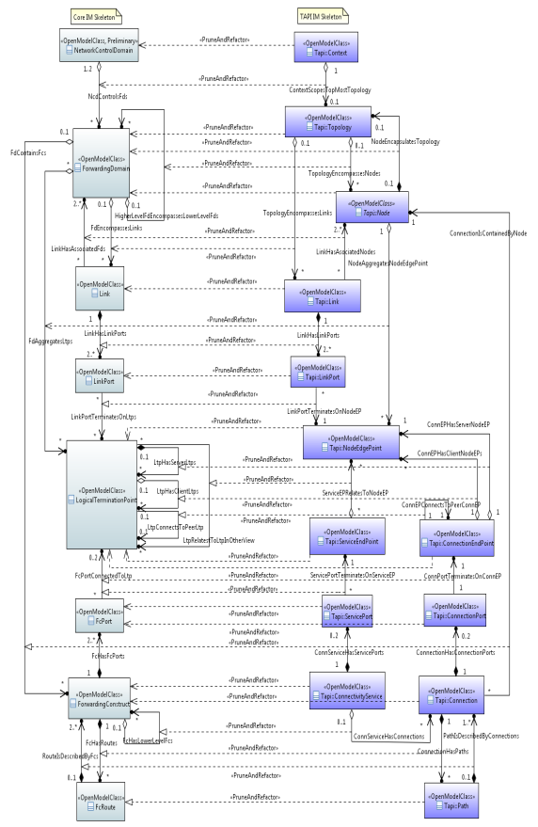
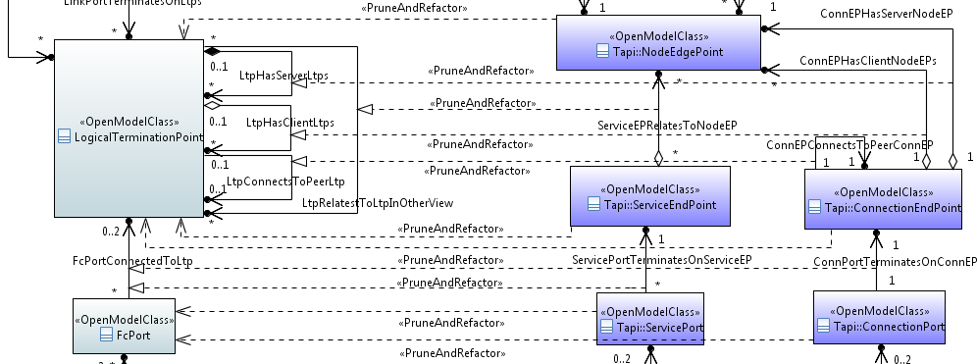
Transforming the Core Model into the Tapi (Transport API) Model
TAPI model is derived from the CIM by Pruning and Refactoring
Rules are being developed as the work progresses
Tapi use the same approach as the core so the LogicalTerminationPoint (LTP) derivatives are generally applicable
Conditional composition is used to extend LTP to cover any case
Specification classes (not shown) are used to explain the capabilities of a particular case
As illustrated by Tapi, for a specific view LTP may need to be specialized to match current terminology
The LTP brings all necessary attributes and the derivation process (Pruning and Refactoring) narrows content and adjust names

Slide 12
Building the model and evolving
Rough
Start-up
Create project in Papyrus
Import Core etc (note that import does not copy)
Carry out process as described
Dealing with core upgrades
The core model name and place does not change through version changes and hence simple replacement of the old model with the new model will maintain linkages from the view
Stereotype change on entity in the core
Deleted entity in the core
Added entity in the core
Tooling
Highlights all modifications and propose changes to the view. This depends upon the view selection
If the entity is in the view and has changed then the view may need updating
If the entity is not in the view and is new then it may need adding
If the entity is not in the view and it has been deleted it would appear to have no impact
If the entity is not in the view and it has been upgraded from experimental to preliminary or preliminary/experimental to approved then it may need to be included in the view
etc

Slide 13
Process (1)
Clone entire model of interest
Take all classes etc (including all classes in inheritance tree)
Tooled approach:
Creates PruneAndRefactor associations from clone to original for all attributes, classes, associations etc
Association has null PruneAndRefactor rule
Prune classes to create structure of view model
Irrelevant Class: Some classes are outside the scope of the view not needing to be conveyed or referenced
Remove classes and their associations where the class is not relevant
Tooled approach:
Move the PruneAndRefactor association of the class to be removed to a dummy “removed” class
Note that we may want to create a submodel unit for the view minus the “removed” class prior to Yang mapping etc
For each attribute of the class to be removed move the PruneAndRefactor association to a dummy “removed” attribute in the dummy “removed” class
Remove the class to be removed
“Association End” Class: Some classes are only relevant to preserve association ends (simply required for reference).
Remove all attributes from the association end classes (leave name and identifier attributes in an “empty“class)
Note that an instance may be referenced via an id, name, address or some other filter referencing a contextually unique instance (we need to determine how to convey this)
Tooled approach:
For each attribute removed move the PruneAndRefactor association to a dummy “removed” attribute in the dummy “removed” class
Note: This will eventually result in an attribute in the schema that has a ref value in it where the referenced thing is NOT in the schema. The reference will only be navigable in the application that has a view of instances in this data schema and instances in the data schema from another interface where the pruned class is defined
An alternative to the “empty” class is to simply convert that attribute type from class to “reference” which would then be encoded as a NVP List or similar
Manual approach
Add PruneAndRefactor associations to all classes in the view model (including “Association End” Classes)

Slide 14
Process (2)
Prune associations
Irrelevant Associations: Some associations between classes in a view are not relevant in the view
Remove associations not relevant
Tooled approach:
Move the PruneAndRefactor association of the association to be removed to a dummy “removed” class
The association is considered as a class in this context
For each attribute of the association to be removed move the PruneAndRefactor association to a dummy “removed” attribute in the dummy “removed” class
Remove the association to be removed
Reduced multiplicity: Some associations between classes in a view have a narrower range of multiplicity in the view
Reduce the end role multiplicity as follows
General case [p..n] → [q..m] (where q >= p and m <= n and where q <= m)
E.g * → 0..n (where n is an explicit numeral), 1..*, 1..n, 1
Where q=m there is no opportunity to modify the multiplicity, where q=m=1 there is an opportunity to fold the classes during refactoring
Reduced flexibility: An association end with owner as classifier (i.e. appears in the class associated) may not be adjustable in the view
Reduce the end role attribute in the class to
ReadOnly (UML property) if it is not settable by the controller but can be read from the controlled system
IsInvariant (stereotype property) if it is settable on creation by the controller but not adjustable by the controller or the controlled system through the life of the entity
ReadOnly and IsInvariant if it is set by the controlled system on creation and does not change through the life of the entity
Adjusted Aggregation (strengthening the dependency)
None → Shared
None → Composite
Shared → Composite

Slide 15
Process (3)
Prune data types
Irrelevant DataTypes: Some DataTypes are outside the scope of the view not needing to be conveyed or referenced
Remove DataTypes that are not relevant
Tooled approach:
Move the PruneAndRefactor association of the DataType to be removed to a dummy “removed” class
The DataType is considered as a class in this context
For each attribute of the DataType to be removed move the PruneAndRefactor association to a dummy “removed” attribute in the dummy “removed” class
Remove the DataType to be removed
Manual approach
Add PruneAndRefactor associations to all DataTypes in the view model
Specific valid pruning depends upon DataType
See next

Slide 16
Name and Value pruning example
0/1..* List multiplicity goes to 1..1 (or 0..1)
Attribute (named) with Named Value List goes to Attribute (named) with Named Value
Subsume name of value into name of attribute
Attribute (named) with value

Slide 17
Process (4)
Prune attributes (associations, DataTypes and classes)
Multiplicity: May be reduced as follows
General case [p..n] → [q..m] (where q >= p and m <= n and where q <= m)
E.g * → 0..n (where n is an explicit numeral), 1..*, 1..n, 1
Where q=m there is no opportunity to modify the multiplicity, where q=m=1 there is an opportunity to fold the classes during refactoring
Type: Any changes to type appear to be refactoring not pruning
Type range: May be reduced (e.g. enumeration literal list, integer range, string legal values, string size)
Default: May be added (this is very much related to an interface context and hence is not specified in the Core)
Read/Write: May be reduced to read only
Unique: Not sure what we should allow here. Making something unique, that was not, feels like a narrowing in a way but…
Ordered: Not sure what we should allow here. I feel that this is not “prunable”
Invariant: May be reduced from not invariant to invariant
Support:
Condition: May be made more complex based upon case rules refining and narrowing condition
Inter-attribute constraints: Adding constraints is allowed (as this appears to be a narrowing of behaviour)

Slide 18
Process (5)
Pruning constraints
TBD

Slide 19
Process (6)
Refactor classes
Merge into class
Where there is a composition association
Mandatory to a single instance (i.e. [1])
Simply fold in the attributes and associations of the child into the parent
Optional to a single instance (i.e. [0..1])
Where the child has one attribute only`
Make the attribute optional and then fold it into the parent
Where the child has several attributes
That are all [0..1]
Where two or more attributes are [1]
Complexity here is that the rule on the mandatory attributes must be the same as the rule on the original class
Where the child has associations
etc
Mandatory to multiple instances (i.e. [n])
Optional to multiple instances (i.e. [n..m)
Split
Only allowed to partition into two parts where the parts are joined by a single composition (with NO other associations between the parts of single instance of the original) and where the composition is [1] or [0..1]
Attributes and associations not pruned must be in one part or the other (and not both)
Fold inheritance hierarchy
Merge class into association
Changing name
“Replicating” class (different name per class) and corresponding associations
May subsequently further prune and refactor the resultant classes
Note that it does not appear to make sense to merge via aggregation

Slide 20
Process (7)
Refactor associations
Navigability reversal
Two way navigability
Note that changing to not navigabile is essentially a prune
Note that duplicating associations in the interface schema seems not relevant as the two way navigable association becomes separate attributes (one in the each class at either end) so it is essentially split

Slide 21
Process (8)
Refactor data types

Slide 22
Process (9)
Refactor attributes

Slide 23
Process (10): Entity nameing in general
May change name to reflect local terminology
Don’t use :: use “_”

Slide 24
Further considerations
Per-operations schema (modulation)
Tooling detail
Rules

Slide 25
Related material

Slide 26
Approach
First make technology model available in the repository
Highlight the essential association between elements of the spec and the elements of the model considering the potential challenges
Sub-layering approach
Models from bodies that do not split termination aspects (TTP/CTP for example)
Preferable that the model offers extension opportunities but this can be done by reverse association
Take model PER CASE and prune each _Pac (substructure) including the extensions into specific new classes (PrunedRanged_Pac)
Each has a name related to the origin
Each has ONLY aspects relevant for the case with ranges relevant to the case defined as modified data types and as necessary with OCL
Dependencies between items should be modelled explicitly including between attribute values etc – this should also be in the technology model and extensions
The spec instance is hence a essentially a “class model” identifying all layering and attributes for a particular case of port etc
It may reuse other class model fragments as necessary
Now in another pack

Slide 27
Basic flow
ONF
Import existing technology model
Extend technology model if necessary using appropriate reverse pointers
Relate parts of model to spec classes via prune/refactor associations (with rules) making attributes available to the vendor
Vendor
Preparation
Clone spec classes and technology model into local model
Extend technology model and extend ONF extensions as necessary (as per ONF method)
Note that this does not seem to be spec model change proof… need to explore
Note that extension rules should be abided by
Relate extension parts to spec classes
Specification per case
Clone spec classes into specialized classes for each specific case to be described
Refine prune/refactor associations to draw in necessary attributes for the case
Produce per case specs
Instantiation
LTP instance references specific specification
LTP instance has attributes as described in specification
Notes:
Spec is a class model with specialized classes to constrain each specific case
Instantiation uses generalized classes that are flexibly composed abiding by the spec
Now in another pack

Slide 28
Core Classes
Implementation
Technology Classes
Prune/refactor
LTP/LP
LTP/LP Spec
LTP/LP Spec instances
Tech specific
instantiate
Prune/refactor
Prune/refactor
instantiate
Tech extensions
instantiate
Indirectly
instantiate
Class structures
Now in another pack
Instance structures
LTP/LP instances
Indirectly
instantiate
Tech specific instance
Tech extensions instance

Slide 29
Principles
Use a composition approach to extend the model (as opposed to inheritance)
Composition is by conditional packages
Packages can be grouped and structured to improve readability
Ensure that the model entities provide data and stereotypes etc to drive the operations (developed at a later stage)
Follow the protection modelling approach of the core model (an SNCP style rather than a protection group style)
Now in another pack

Slide 30
Develop technology model
Technology experts
Structure as per technology model focussing on the specific layering of the technology
Use an approach:
That separates degrees of termination, adaptation and connectivity
All aspects will be flattened in the implementation
Identify relevant optionality and what the rationale for support is
Now in another pack

