Slide 1

BACKEND
PROGAMMING

Slide 2
Flow…
• What is Backend Development?
• Skill sets required to become a Backend Developer
• Roles and responsibilities of Backend Developer

Slide 3
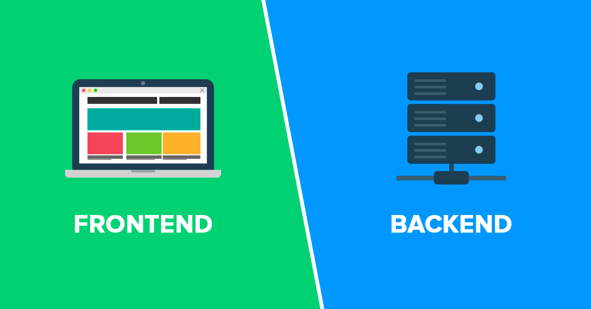
In a web application

Slide 4
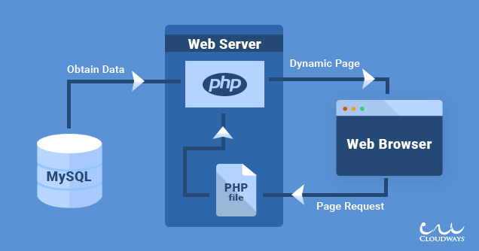

Slide 5
What is Backend Development?
Server-side development
Focuses on databases
Ex:
Store data
Retrive data
Security of data access
Etc.

Slide 6
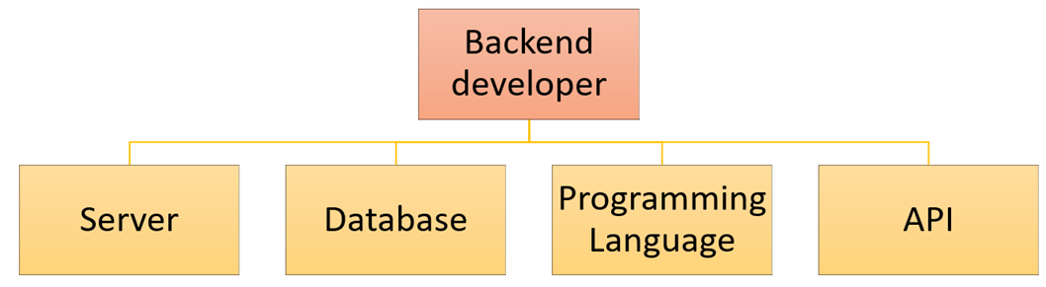
Skill sets required to become a Backend Developer

Slide 7

Skill sets required to become a Backend Developer
Skill sets required to become a Backend Developer
- Server side
Backend engineer should know at least one server-side programming languages their framework like
JavaScript
Node.is
Express
Java(not same as java)
Spring
Python
Flask
C#
ASP.NET MVC
ASP.NET core
PHP
Laravel

Slide 8
Skill sets required to become a Backend Developer
Database
Knowledge of various DBMS technology
MySQL
MongoDB
Oracle
DBMS
SQL Server
Etc.

Slide 9
Version Control Software
Git
Subversion

Slide 10

What's the best place to start?
Learn basic front end development
HTML
CSS
JavaScript

Slide 11
Roles and responsibilities of Backend Developer
Understand the goals of the application and come up with effective solutions
Storing data and also ensuring that it is
displayed to that user who are supposed to have access to it
Responsible to organize the logic of the system which runs across various devices

Slide 12

Q/A

