Slide 1

Laravel
tutorial

Slide 2

Agent
Basic Routing
Basic Routing & Named Routes
Route Groups & Route Prefixes
Middleware
Route Parameters & Dependency Injection
Named Routes
Cross-Origin Resource Sharing (CORS)

Slide 3
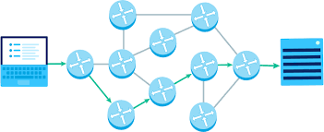
Routing
Routing is the process of path selection in any project Resources

Slide 4
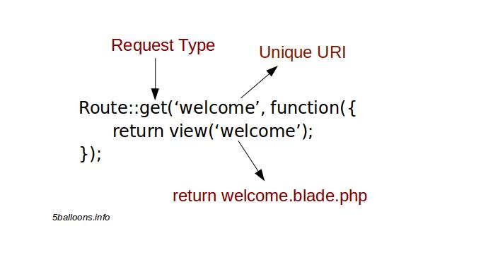

Slide 5
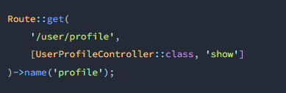

Slide 6

Cross-Origin Resource Sharing

Slide 7
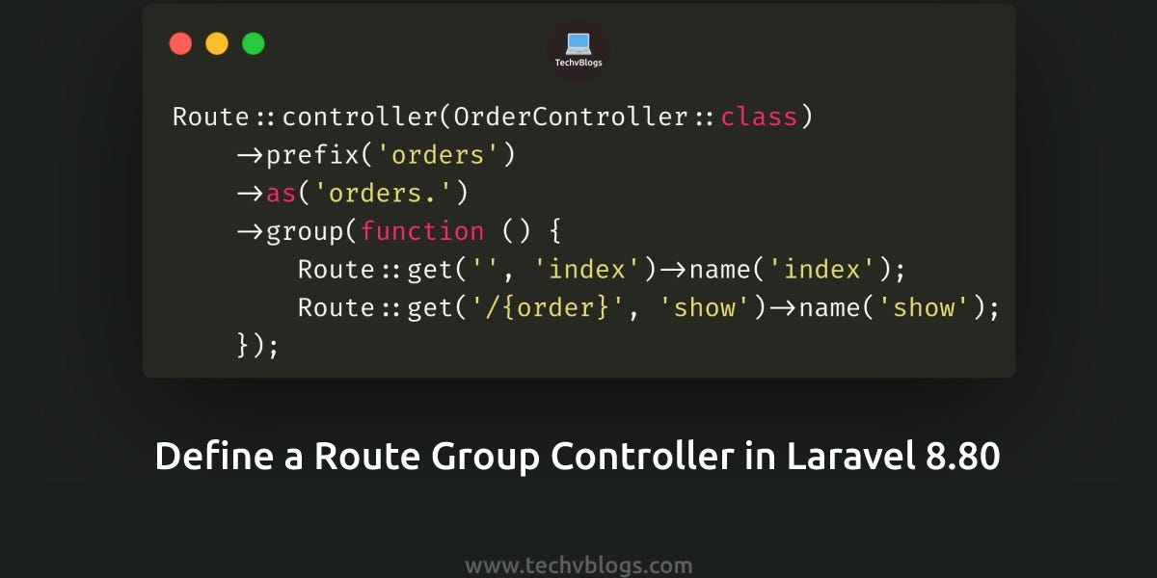

Slide 8
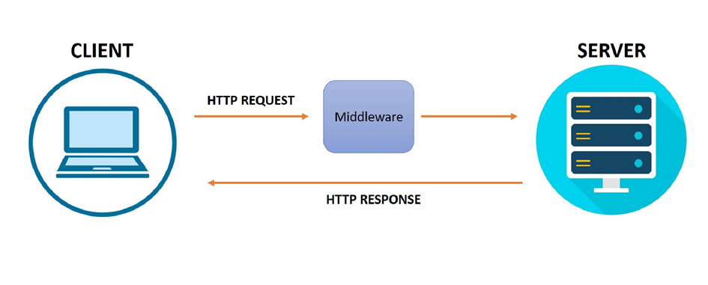
Middleware

Slide 9
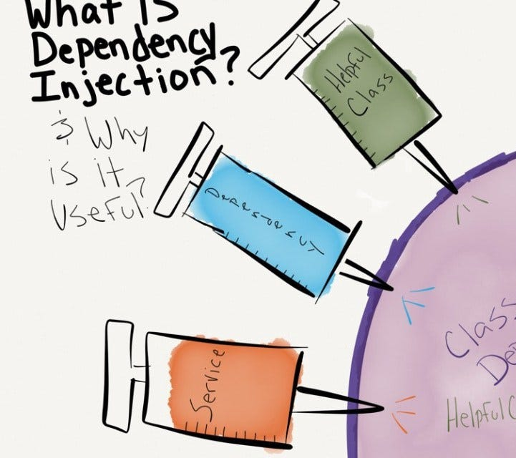
Dependency Injection

