Slide 1


Slide 2
Definition of Technical SEO
Importance of Technical SEO
Benefits of Technical SEO

Slide 3
Technical SEO Elements:
Website Architecture
XML Sitemap
Canonicalization
HTTP status codes
Cards Markup tag
Mobile-friendliness
Definition of Robots.txt
Page Speed

Slide 4
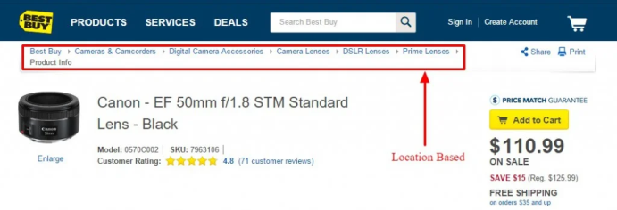
Website Architecture
Provide access to most of your website’s pages in 3-4 clicks.
Use breadcrumbs.
Create a simple top-level navigation menu.
Keep your URLs simple and user-friendly.

Slide 5
XML Sitemap
A sitemap is a file where you provide information about the pages, videos, and other files on your site, and the relationships between them. Search engines like Google read this file to crawl your site more efficiently. A sitemap tells Google which pages and files you think are important in your site, and also provides valuable information about these files. For example, when the page was last updated and any alternate language versions of the page.

Slide 6
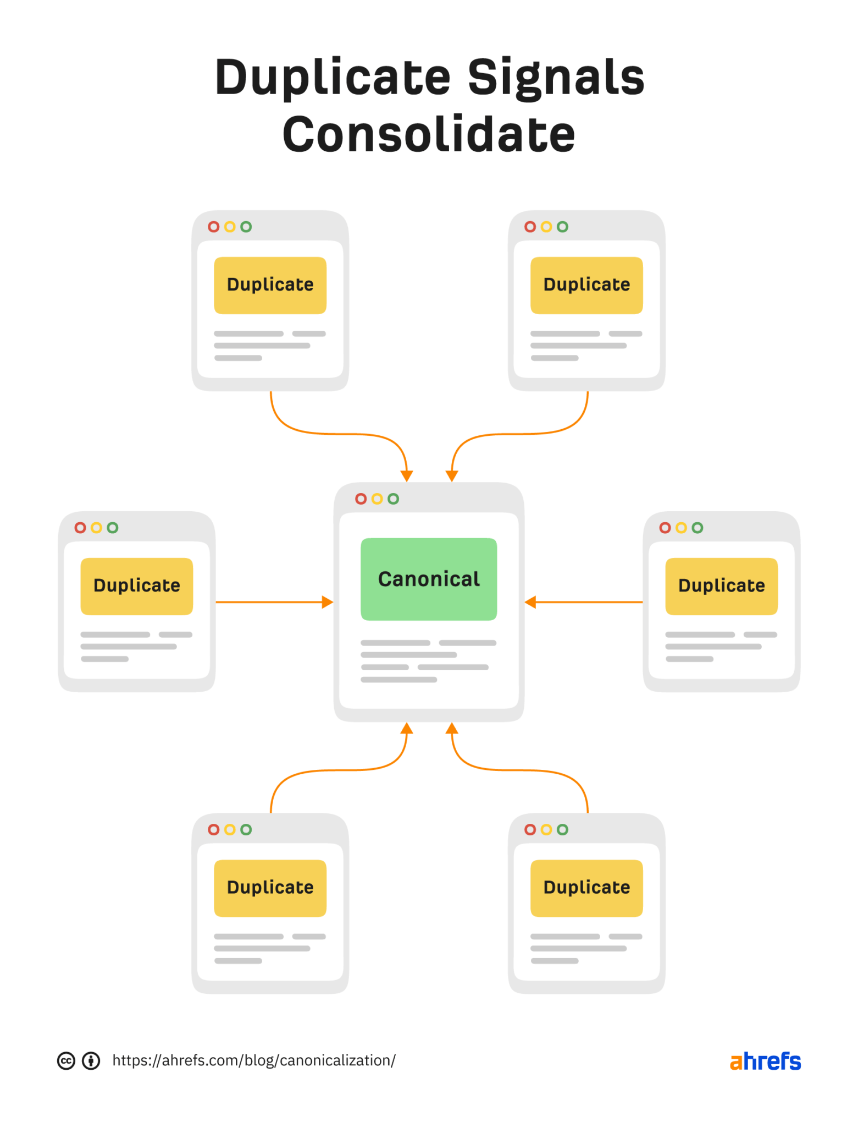
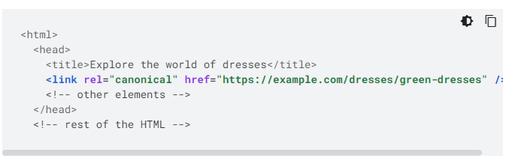
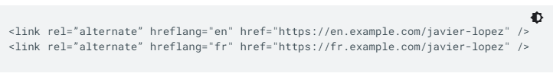
Canonicalization

Slide 7
Mobile-friendliness
Definition of Mobile Friendliness
Importance of Mobile Friendliness
How to check mobile friendliness

Slide 8
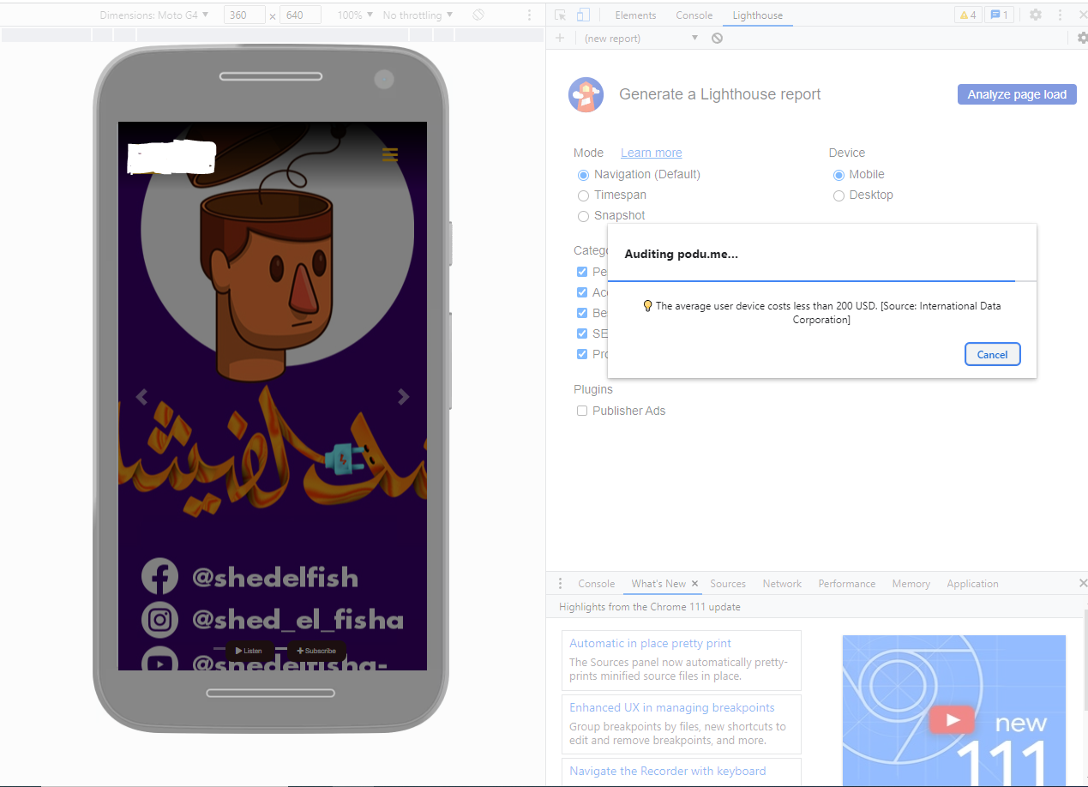
Mobile-friendliness

Slide 9
Mobile-friendliness
https://yellowlab.tools/
https://pagespeed.web.dev/

Slide 10
Robots
Definition of Robots.txt
How to create Robots.txt (https://lol.com/robots.txt)
Benefits of Robots.txt

Slide 11
Definition of Robots.txt
A robots.txt file tells search engine crawlers which URLs the crawler can access on your site. This is used mainly to avoid overloading your site with requests; it is not a mechanism for keeping a web page out of Google. To keep a web page out of Google, block indexing with noindex or password-protect the page.
If your web page is blocked with a robots.txt file, its URL can still appear in search results, but the search result will not have a description. Image files, video files, PDFs, and other non-HTML files will be excluded. If you see this search result for your page and want to fix it, remove the robots.txt entry blocking the page. If you want to hide the page completely from Search,

Slide 12
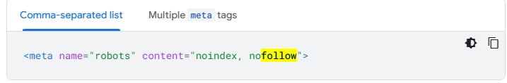
Robots meta tag
noindex | Do not show this page, media, or resource in search results. If you don't specify this rule, the page, media, or resource may be indexed and shown in search results.
nofollow | Do not follow the links on this page. If you don't specify this rule, Google may use the links on the page to discover those linked pages. Learn more about nofollow.

Slide 13
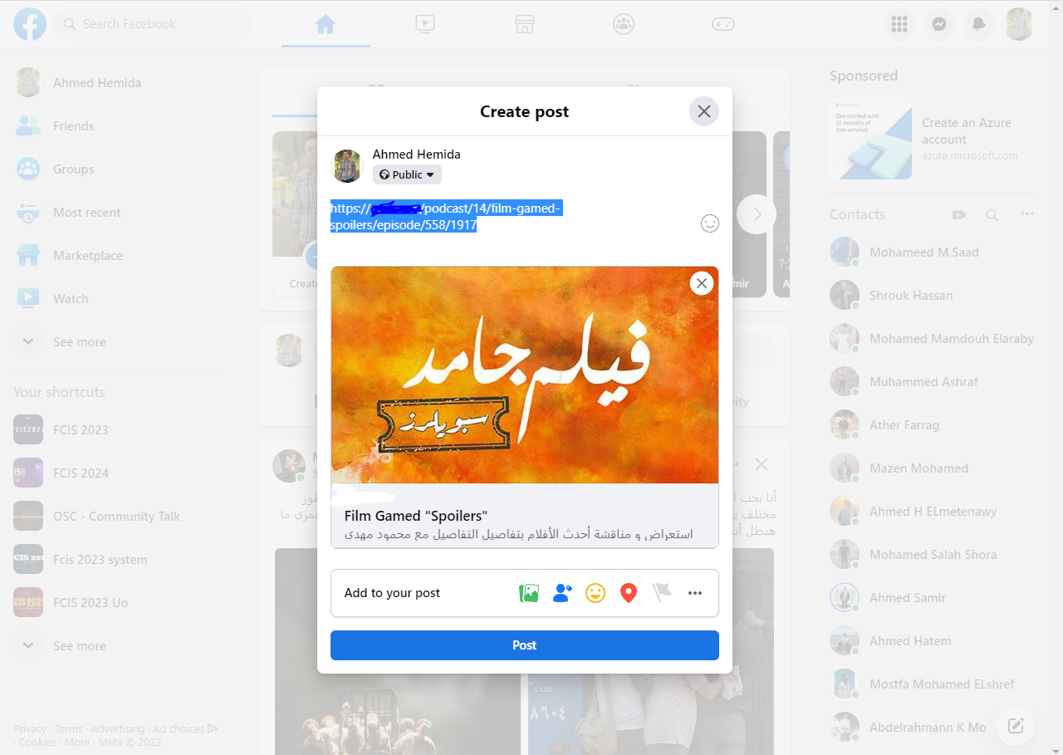
Cards Markup Tag

Slide 14
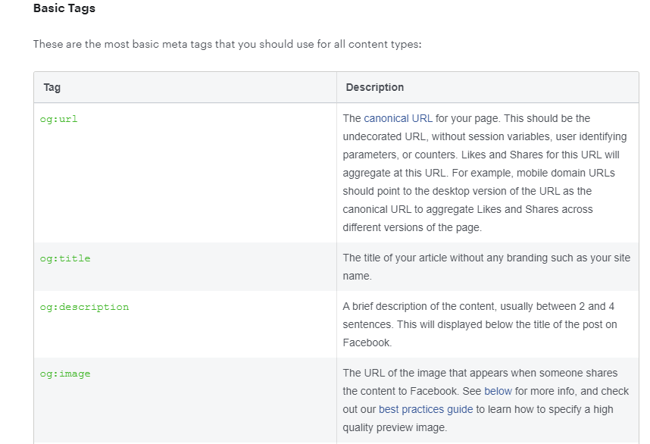
Facebook Cards Markup Tag

Slide 15
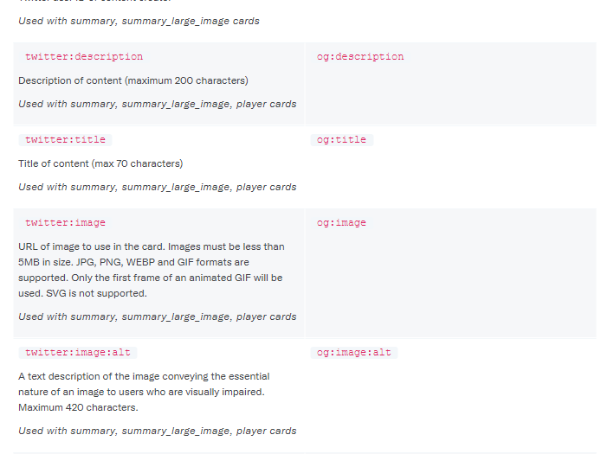
Twitter Cards Markup Tag

Slide 16
Cards Markup Tag
https://developer.twitter.com/en/docs/twitter-for-websites/cards/guides/getting-started
https://developers.facebook.com/docs/sharing/webmasters/
social media meta tags test : https://www.opengraph.xyz/

Slide 17
Page Speed

Slide 18
Page Speed
Css Preload (Now)
<link rel="preload" href="bg-image-wide.png" as="image" media="(min-width: 601px)" />
Js async
<script async src="https://lol.me/js/slider.js"></script>
Img loading="lazy"

Slide 19
Next topic is Web Accessibility

Slide 20
Thank You

