Slide 1
Face 2 Face Meeting
Darmstadt@ESOC
Oct 10th 2019
The Open Source Tooling Group 2019
https://oss-compliance-tooling.org/

Slide 2
Welcome
Note that this meeting is held under chatham house rule
  Do not disclose source of information
  https://www.chathamhouse.org/chatham-house-rule
  Therefore we do not record
  You can waive it by adding your sides to the minutes
Introduction of participants

Slide 3
Action Items from Last Time
Oliver | volunteers to provide a website | Done, https://oss-compliance-tooling.org/
Oliver | Review SPDX Spec for updating the data model terms | Ongoing
Marcel | Good practise / example process documentation | See Slot today
Marcel | BMPN notation of sequence diagrams | Ongoing
Michael P | make big picture terminology OpenChain compliant | Interesting discussion at issue #61
Peter and Andreas | volunteer to review the existing material: "unanimous understanding" after it has been updated | Material was not ready: Proposal is to join the next meeting

Slide 4
Agenda
09:00 | Informal: Meet and Greet | all
09:15 | Welcome | Peter, Michael J and all
09:30 | Presentations on Integration (15 min each) Lars G: SW360Antenna and SW360 Kalle S: O.R.T. and Sw360 More News from the OSS projects (45 min) | persons from the project, write questions on the board
11:00 | Q&A on Tooling | all
12:00 | Lunch | all
13:00 | Walk through ESOC | Colleagues from ESOC
13:30 | How many tools are there? | Michael J
14:30 | Use Cases | Marcel K
15:00 | Coffee Break | all
15:15 | Double Open Updates, Finos and OSS Compliance Tooling and more news from related efforts | Martin vW, Aaron W. et al.
16:15 | Wrap up and Closing: Next steps, Next meeting | Peter E., Michael J.
16:30 | End

Slide 5
Integration Demos
More News from the Tools
Q&A

Slide 6
Integration Demos
More News from the Tools
Q&A

Slide 7
FOSSology Since July 2019
Version 3.6 (Sept 2019)
  OJO: license scanner specifically for SPDX-License-Id
  Will be good for rules in future
  Enhancements to the REST API
  Updating SPDX License List
  Copyright correction handling

Slide 8
FOSSology New Subproject
FOSSologyML
  Machine learning to detect and classify licenses
  Using FOSSology database of decisions („Concluded License“)
Approach uses staged classifiers
Conclusion
  Works well for popular licenses
  For 50% of the SPDX License List not enough training data

Slide 9
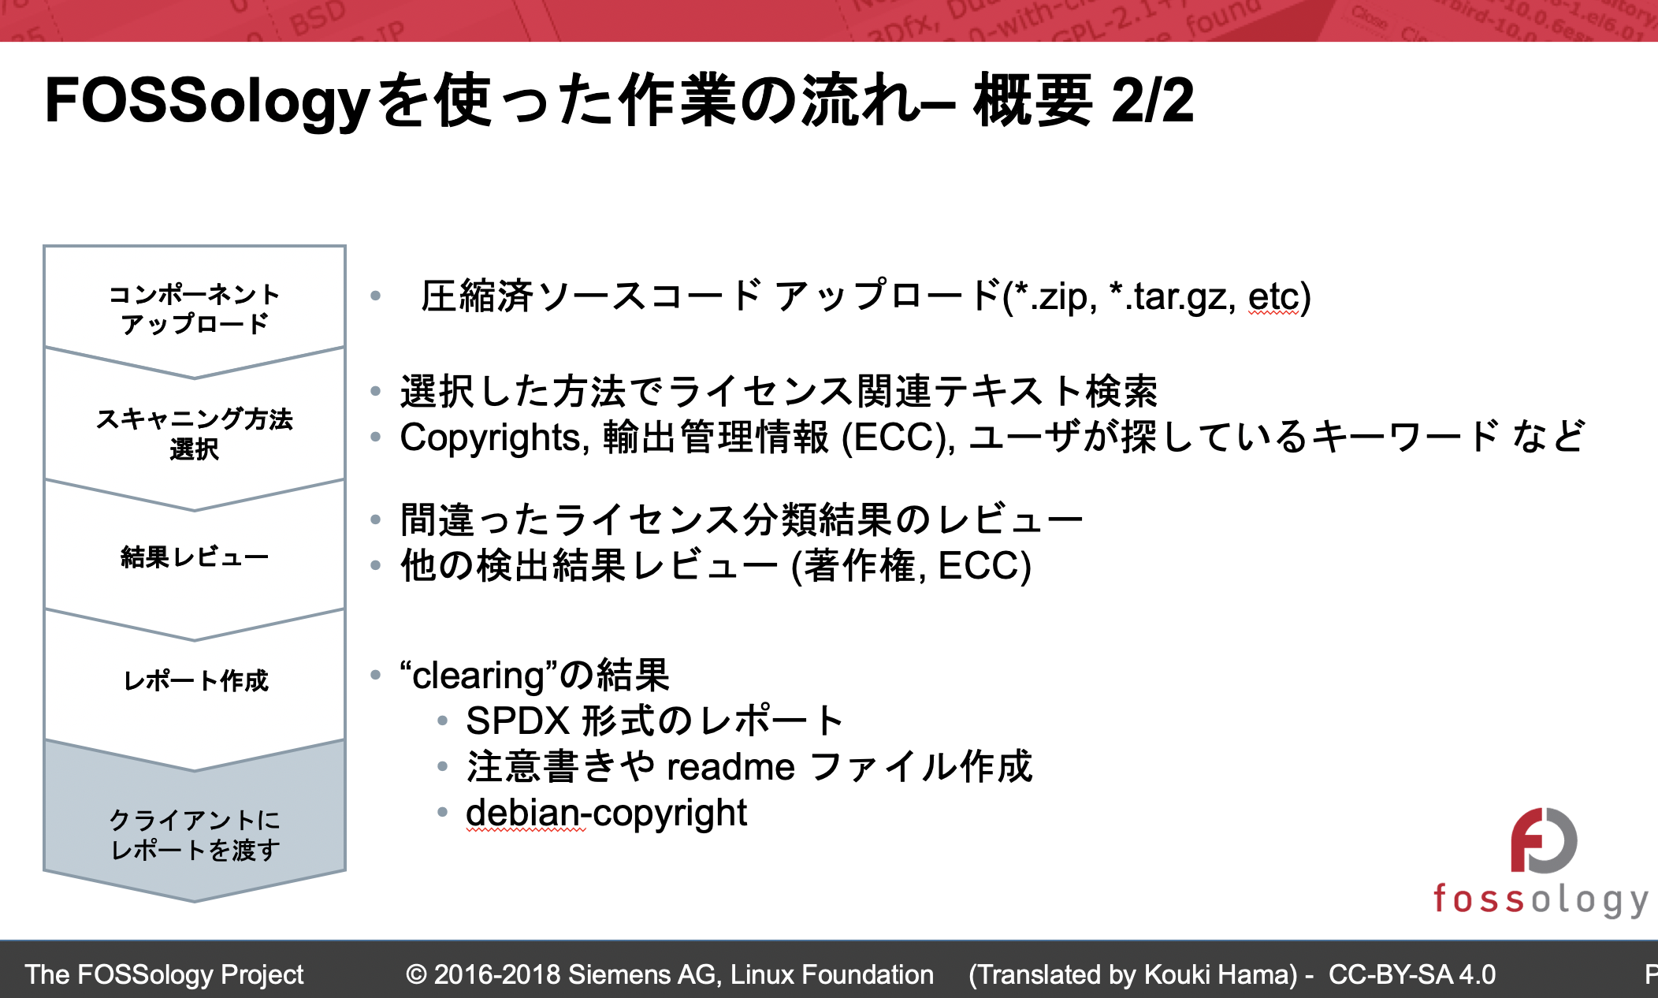
FOSSology – Community News
GSOC Runs Finished
  It was about
  ClearlyDefined,
  SoftwareHeritage,
  Atarashi
  See reporting here:
  Now integration
TOSHIBA: Japanese Slide Set
One Day Training:
https://github.com/
fossology/FOSSologySlides

Slide 10
SW360 Releases
A number of releases
  4.0.1 – last release using Liferay 6
  5.0.0 – first release using Liferay 7.2
  5.1.0 – you should use this one!
  6.0.0 – planned, new integration of REST-based FOSSology

Slide 11
SW360 Features and Fixes
Liferay 7.2 Migration
  20.000 LOC changed, 600 files touched, really big change
Continuous improvements on the REST API
  Resulting from feedback of productive use
Improved options for generation of disclosure documents
A lot of minor corrections
Ongoing work: Internationalisation

Slide 12
Integration Demos
More News from the Tools
Q&A

Slide 13
Lunch

Slide 14
ESOC Walk

Slide 15
How Many Tools are There?
(Update on the Landscape)

Slide 16
OSS Tools Landscape
Collecting relevant items in the area of open source projects
Have been presented already
Coordinates:
  https://github.com/Open-Source-Compliance/Sharing-creates-value/tree/master/Tooling-Landscape/Unanimous-Understanding
Also Glossary is available:
  https://github.com/Open-Source-Compliance/Sharing-creates-value/blob/master/Tooling-Landscape/Unanimous-Understanding/OSS-Tooling-Landscape-Glossary.md

Slide 17
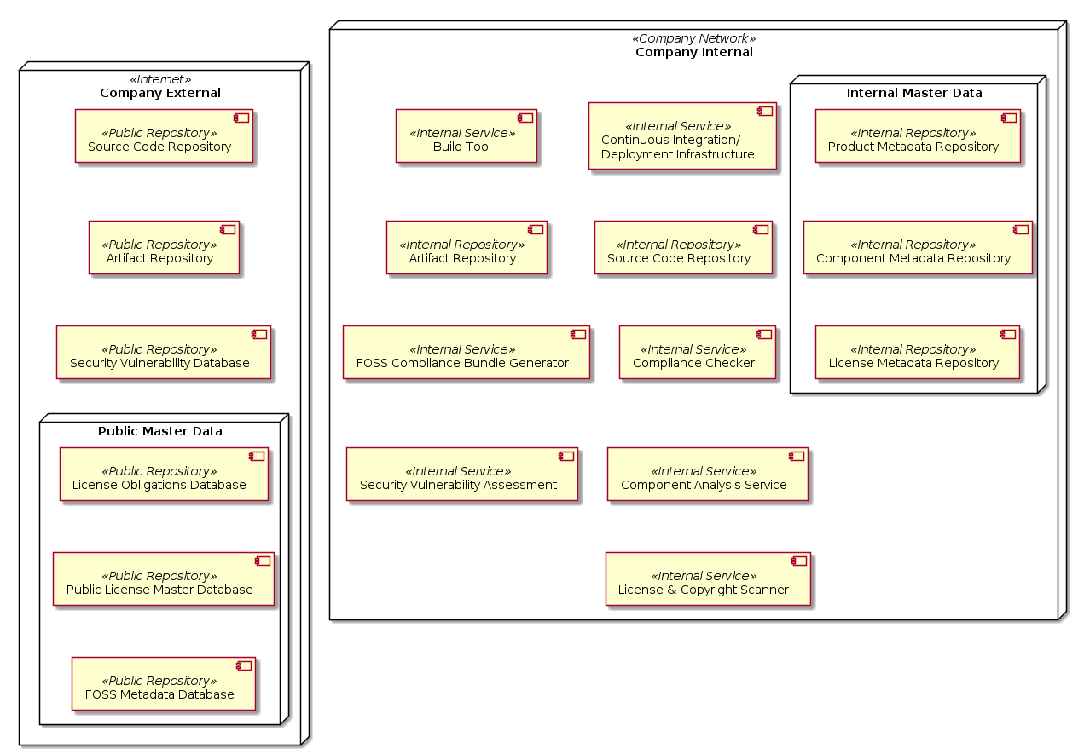
OSS Tools Landscape – UML Big Picture

Slide 18
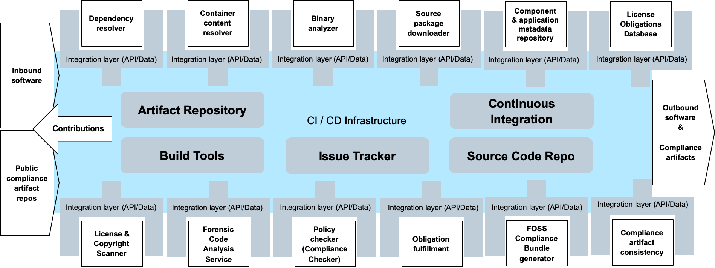
OSS Tools Landscape – Conceptual Big Picture

Slide 19
OSS Tools Landscape
Now: Constantly new tools appearing
ACT
SPDX Tools
FOSSology
Tern
QMSTR
Eclipse
SW360
Antenna
OSI
ClearlyDefined
O.R.T.
AboutCode
ScanCode
Vulas

Slide 20
OSS Tools Landscape
AboutCode Manager
amzn/askalono
Apache Rat
Apache Tentacles
Apache Whisker
Bang
carloe/LicenseGenerator-iOS
CLA Assistant
ClearlyDefined
CLIPol
Comcast/php-legal-licenses
Conan
Cregit
Debian licensecheck
Deltacode
Eclipse SW360
Eclipse SW360Antenna
FOSSology
fossology/atarashi
janitor.git
jaredsburrows/gradle-license-plugin
LDBCollector
license-compatibility-checker
Licensee.js
mono0926/LicensePlist
mwittig/npm-license-crawler
Ninka
O.R.T.
Open Source License Checker (OSLC)
OSADL License Checklist
OSS Attribution Builder
OSSPolice
QMSTR
Reuse Software
ScanCode toolkit
Slic
Software Heritage
SPDX Maven Plugin
SPDX Tools
SPDX Tools
Tern
TraceCode Toolkit
TripleCheck Reporter
Vulas
Yocto+SPDX
Main sources:
https://github.com/doubleopen-project/doubleopen-publications/blob/master/publication.md
https://spdx.org/ToolsCommunity
https://github.com/Open-Source-Compliance/Sharing-creates-value/blob/master/docs/Tooling-Landscape/OSS-Based-License-Compliance-Tools.md
https://awesomeopensource.com/projects/license

Slide 21
Use Cases

Slide 22
Coffee Break

Slide 23
News from Related Efforts
Double Open
FINOS

Slide 24
More Events and Efforts
EclipseCon Europe 2019 next week
Open Source Summit EU 2019 the week after
Open Source Compliance and Governance on 21st of Oct 02:00p.m - 05:30 p. (Unconference Event)
Ensuring Open Source Compliance using Eclipse Foundation Technology (Lars) on 22nd of Oct at 04:15 p.m.
News and Status of the FOSSology project (Maximilian, Michael) on Monday at 11:30: https://sched.co/TLCA
Compliance Puzzle, Building a OSS Compliance Toolchain with Open Source Technologies (Lars) on Monday at 15:00 https://sched.co/TLKU
REUSE: Make Licensing Easy for Everyone - (Max Mehl) on Monday 16:00 https://sched.co/TLKg
License Compliance Validation of Software Deliveries Using the Quartermaster Toolchain - (Mirko) at 17:00 https://sched.co/TLJi
OSS Review Toolkit: Using FOSS Tools for FOSS Reviews in CI/CD World (Thomas) on Wednesday at 15:00: https://sched.co/TOs6
Automating OSS Compliance with Fossology, SW360 and SPDX (Anupam) on Wednesday at 17:00: https://sched.co/TOwM
Automating Compliance with SPDX on Thursday at 08:00 https://sched.co/VuH5
FOSSology Hand-On Workshop (FOSSology team) on Thursday at 13:00: https://sched.co/Tgoy

Slide 25
Wrap Up

Slide 26
Wrap Up
Review of the Action Items
  Action items so far and persons caring for them
Next meeting
  Volunteers for hosting
  2 weeks for doodle
  Mind other events
    Conferences and other meeting of license compliance

Slide 27
Links / Communication
Where to communicate what?
Github:
https://github.com/Open-Source-Compliance/Sharing-creates-value
Slack:
https://join.slack.com/t/ossbasedcompl-bhx9742/shared_invite/enQtNzA5OTc3OTAwMjExLWNhYWVkZDk2Y2RlNDI4ODI2NzQyNDU5ZWE4ODRmZWI1ZmM1MzA4ZTc2MTdkZGFhMzc2NmUyODRhNDZjNWI5Njc
Mailing List:
Subscription page: https://groups.io/g/oss-based-compliance-tooling
Email address: oss-based-compliance-tooling@groups.io

