Slide 1
Sharing OSM Test Dummies – update 2024-05
The OpenChain reference tooling work group 2024

Slide 2
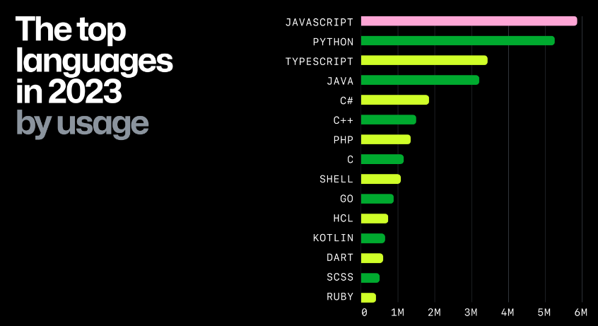
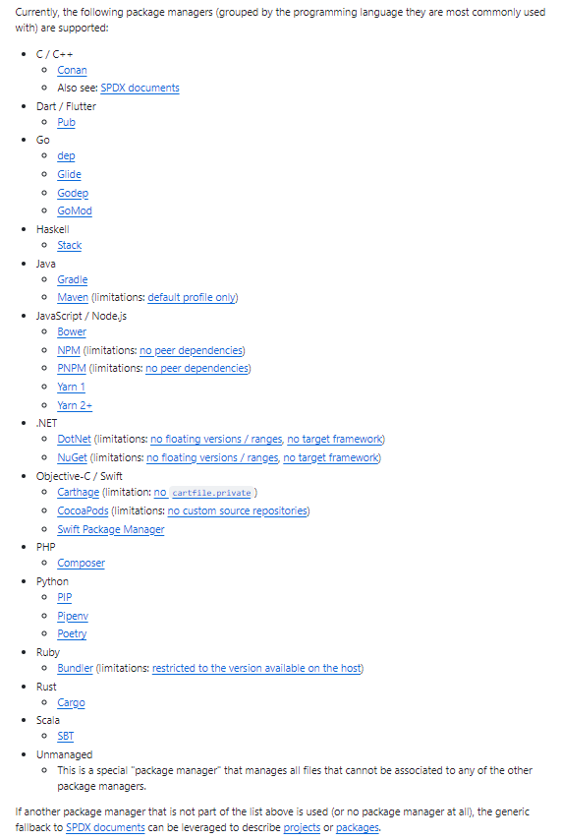
Current Situation
Recap
Heterogonous environment with a multitude of programming languages and package managers (and their versions)
From Octoverse report; Source: https://github.blog/2023-11-08-the-state-of-open-source-and-ai/
Source: https://github.com/oss-review-toolkit/ort#analyzer

Slide 3
Need and idea
Recap
Need
A reproducible quality for the Software Composition Analysis and the handling of findings needs to be ensured.
In order to be able to test different infrastructure setups (with different tools) „test-sets“ are necessary
Idea / Proposal
Identify „Hello World+“ (+ = using dependencies) example repositories in the respective communities (ideally maintained by the stewards of the respective technology, e.g. maven-example by the Maven-community etc.)
e.g. https://github.com/golang/example
Fork the example repository to Sharing_creates_value as a „dummy“
E.g. tbd
Establish branches to enrich the „dummy“ with test-cases of interest and provide a description of the „expected behaviour“ if analyzed by an Open Source Management tool (e.g. ORT, Fossology,…)
Adding a vulnerably go-component from https://pkg.go.dev/vuln/ in Cargo.lock => expect security vulnerability alert
Use the dummies for testing and share test-cases as new branches in the respective repositories
E.g. run ORT with vulnerableCode integration via Advisor on the dummy repository
Benefit
Tool communities could use the Dummies to test against them => „golden repositories“ (in relation to „golden files“ e.g. https://medium.com/@jarifibrahim/golden-files-why-you-should-use-them-47087ec994bf )
Establish standardized processing independent from the technology

Slide 4
Some potential sources for forking
Recap
C - https://github.com/mrsarm/helloworld-c , https://github.com/jithin-renji/Nuke
GO - https://github.com/golang/example , https://github.com/go-training/helloworld
Python - https://github.com/dbarnett/python-helloworld
Java - https://github.com/DEV3L/java-mvn-hello-world-web-app
C# - https://github.com/richk1/HelloWorldRUI
JavaScript - https://github.com/richk1/HelloWorldRUI
Rust - https://github.com/aalmiray/helloworld-rust , https://github.com/rust-lang/rust
SPDX - https://github.com/david-a-wheeler/spdx-tutorial , https://github.com/spdx/spdx-examples
Ideally the upstream is maintained by the „stewards“ of the respective language (e.g. https://github.com/rust-lang/rust; https://github.com/golang/example ) to ensure that the „raw“ dummies (w/o modification) are in line with the build standards and avoid discussions/irritations.

Slide 5
Update on outreach
Idea presented and discussed in Philippe‘s FOSDEM Fringe event
Idea mentionned in Eclipse Apoapsis presentations in FOSDEM, FOSSNorth, …
RfPs for PyCon, DroidCon,… to reach out for potential „upstream“ sources for dummies
Ideally the upstream is maintained by the „stewards“ of the respective language (e.g. https://github.com/rust-lang/rust; https://github.com/golang/example ) to ensure that the „raw“ dummies (w/o modification) are in line with the build standards and avoid discussions/irritations.

Slide 6
Update on setup
First repository forked for Go: https://github.com/Open-Source-Compliance/Go-Dummy
Maintained by upstream project!

Slide 7
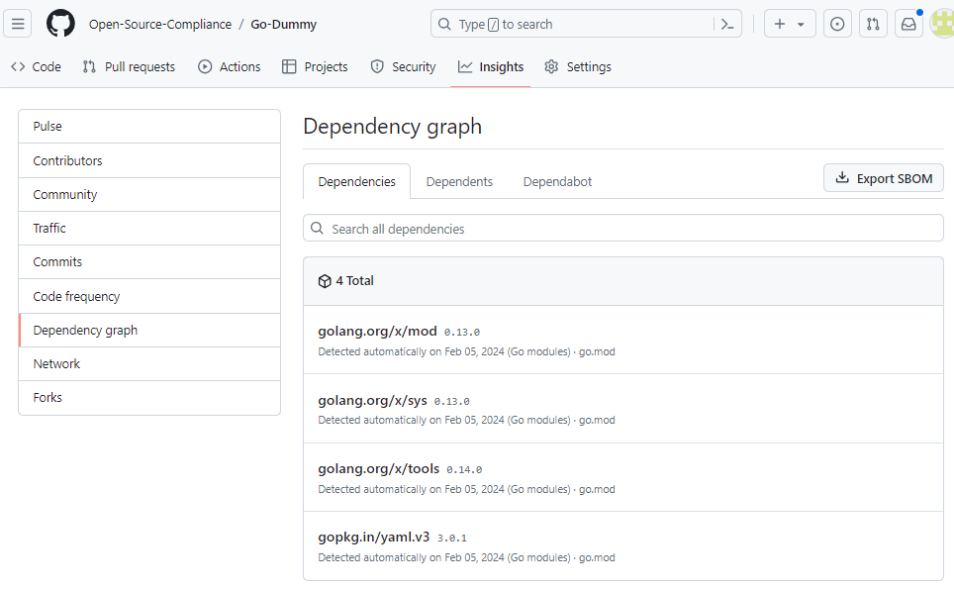
Update on setup
First repository forked for Go: https://github.com/Open-Source-Compliance/Go-Dummy
Side effect with Github Dependency Graph: first tool reference out of the box
Maintained by upstream project!

Slide 8
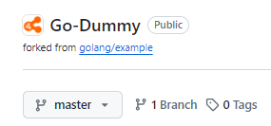
Proposed Dummy repository standard setup
„master“ stays the unchanged repository content from upstream
Dummy-specific branches are added according to the following standard:
Three sub-branches: doc, demo and test
doc – contains additional dummy-readme.md with detail-information about the demo and test-branches
E.g. detail description about demo/case_xxx
rationale: as the master-branch shall be unmodified, the documentation needs to be in an extra branch
demo with potentially several cases e.g.
demo/case_xxx with xxx as ascending identifiers – description about the contents in the „doc“ branch
test with potentially several cases e.g.
test/tc_xxx with xxx as ascending identifiers – description about the details in the „doc“ branch
The test branches shall additionally contain a tc_xxx_spec.md-file with a tool-agnostic test-specification
upstream
dummy collection
Maintained by Open Chain Automation Workgroup!

Slide 9
Setup for potential use for tool evaluation
The dummy repository may be forked into the specific tool-project or evaluation setup with all branches, e.g. https://github.com/oss-review-toolkit
The dummy-specific branches are refined for the respective tool-/evaluation-context:
doc – branch may be enhanced with more detailed description
test with test-cases may be extended in the following way
test/tc_xxx stays unmodified input for the test-case to provoque a finding
test/tc_xxx_resolution may contain necessary tool-specific resolutions handle the provoqued finding in the special setup (e.g. by an additional .ort.yml-file in the root-folder in case of OSS-review toolkit).
test/tc_xxx_auto may contain test-automation scripts and accompanying documentation for reproducability (e.g. for Robotframework) to run the test automatically
upstream
dummy collection
Maintained by the respective tool-community!
tool-project

Slide 10
Re-use for tool installation/configuration check
The tool-specific dummy repository may be used for installation checks
Once the respective tool is set up and the infrastructure is running, the dummy may be used as input
Comparing the results with the expected results will show if installation and configuration was correctly done
upstream
dummy collection
Maintained by yourself!
tool-project
installation check

Slide 11
Downstream Increment Principle
theory
practice
fork
+ local config
+ with tool-specific auto-tests test/tc_xxx_auto
+ with tool-specific resolutions test/tc_xxx_resolution
fork
+ doc_xxx – branch with tool-specific documentation
+ test – branch with general test-specifications test/tc_xxx
+ demo – branch with showcases demo/case_xxx
fork
+ doc – branch with general dummy documentation *.md
master - Core content
remains unchanged
upstream
1:1
dummy repository
1:n
tool-project
1:n
installation check
Example:
https://github.com/golang/example
https://github.com/Open-Source-Compliance/Go-Dummy (WIP)
https://github.com/eclipse-apoapsis/Go-Dummy (planned)
my local go-reference-repo (goal)

Slide 12
Next steps
PR for MD-File with description/conventions how to handle dummies
Piloting the approach with the branches on the cloned GO-Dummy
Establish first test with the GO-Dummy by adding a vulnerable dependency
Align with ORT/Eclipse apoapsis-community to set up a tool-specific test to show end-to-end setup (try to get a public test server)

Slide 13
Backup

Slide 14
Showcase 11-2023

Slide 15
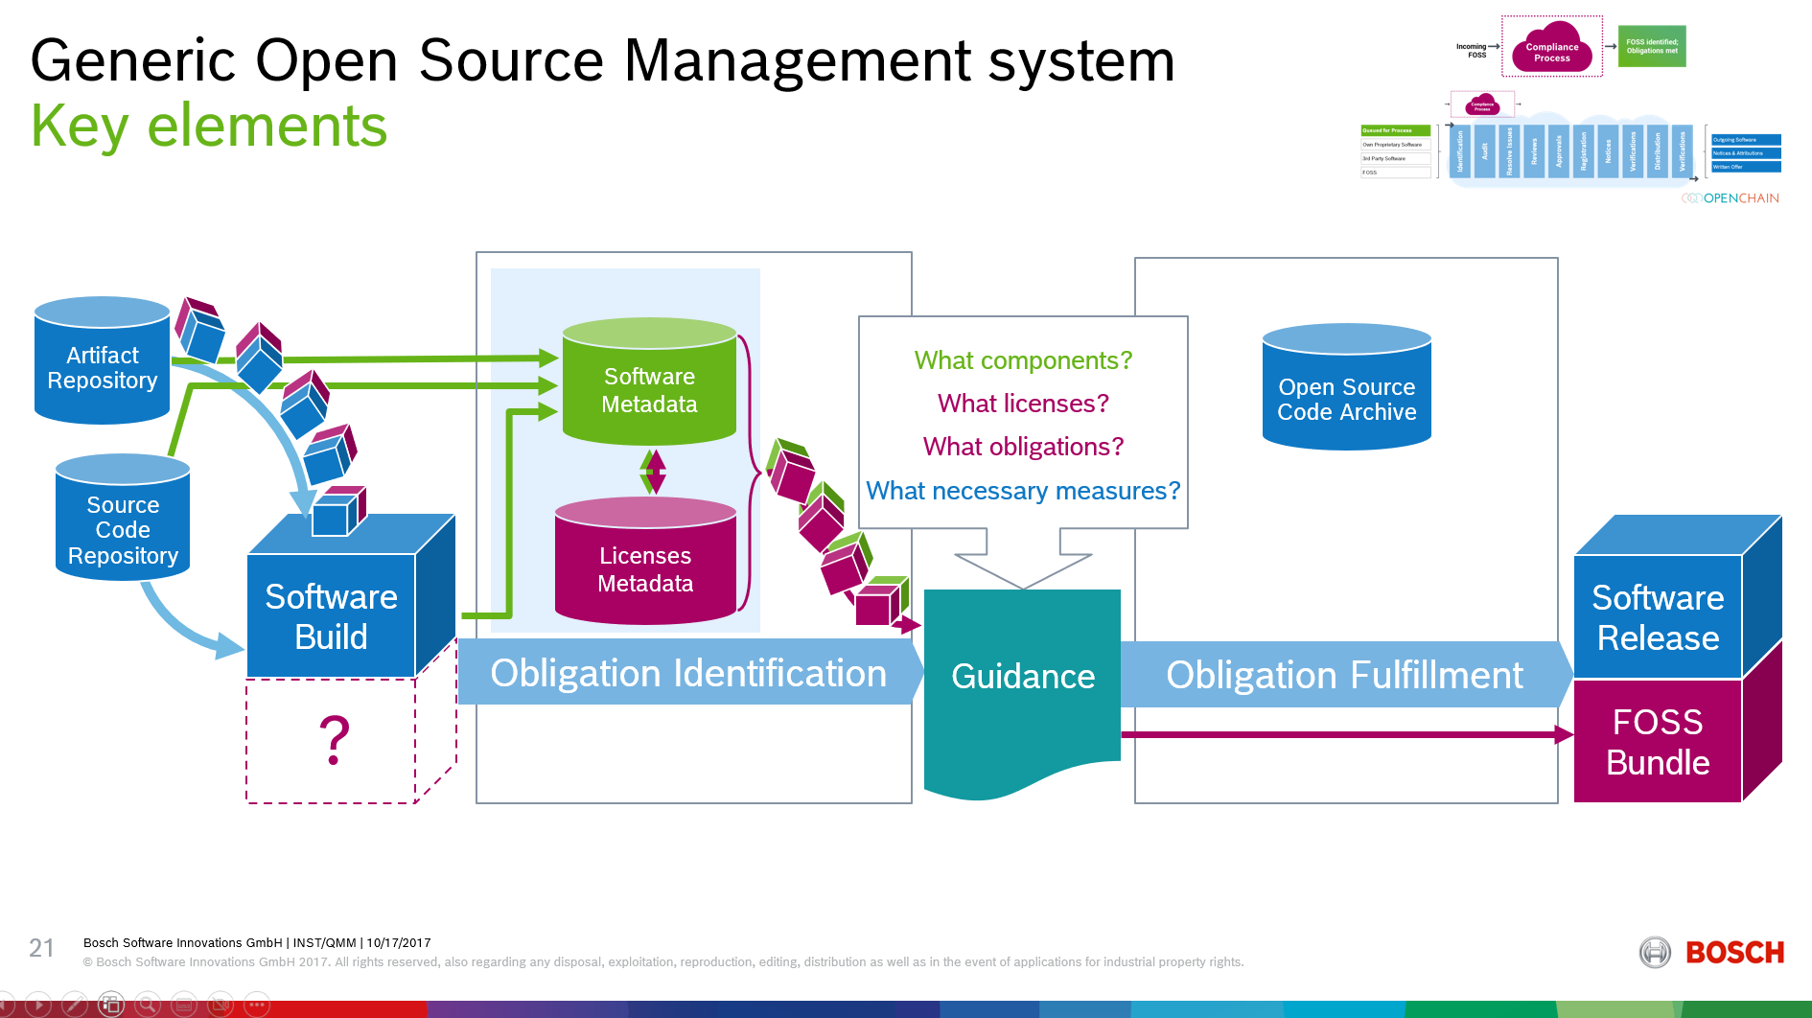
Principle
Recap
Dummy-repository
Expected Output 2
(depending on distribution context)
e.g. Branch1/log4j-Dependency
Identify Component
Identify License (Metadata)
Identify Obligation
Expected Output 1
e.g. for Branch 1: security vulnerabily

Slide 16
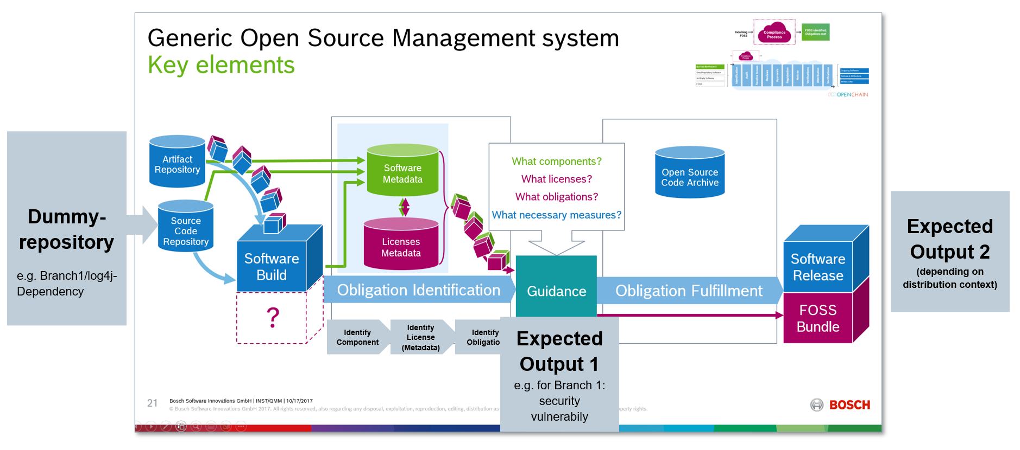
Showcase
Showcase focuses on first part

Slide 17
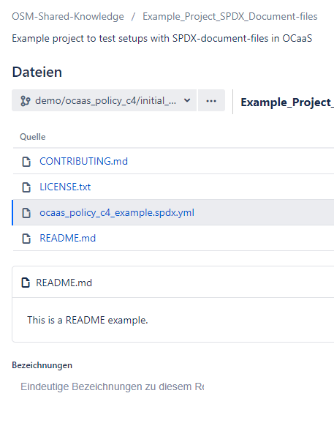
Showcase
Demo Repository (initial case)
Synthetic example based on ORTs
generic fallback*:
project.spdx.yml-file
(*details see https://github.com/oss-review-toolkit/ort/blob/main/plugins/package-managers/spdx/src/funTest/assets/projects/synthetic/inline-packages/project-xyz.spdx.yml )

Slide 18
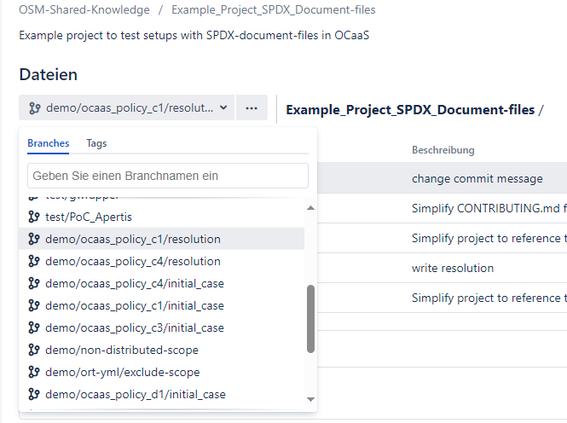
Showcase
Different branches for showcasing
For each show-case two branches:
Branch with the initial situation w/o fix
Branch with resolution
In this case e.g. we declared a commercial
license and thus provoqued a policy violation.
For results several possibilities:
- Either extra repository or another branch

Slide 19
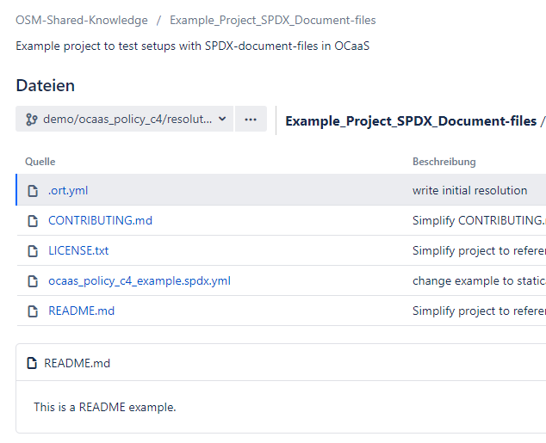
Showcase
Demo repository (resolution branch)
This is the same case with the
declared commercial license, but
we simulate that the license was acquired.
Thus the violation may be waived in
the .ort.yml-file and the violation is
gone.

Slide 20
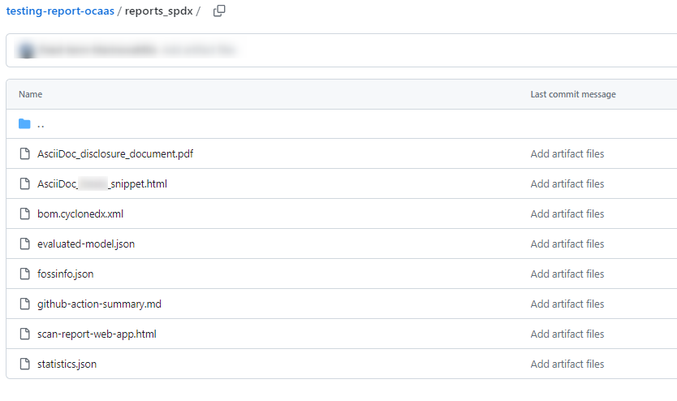
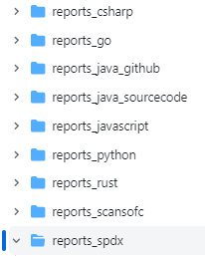
Showcase
Result repository
(scans are schedule nightly)

Slide 21
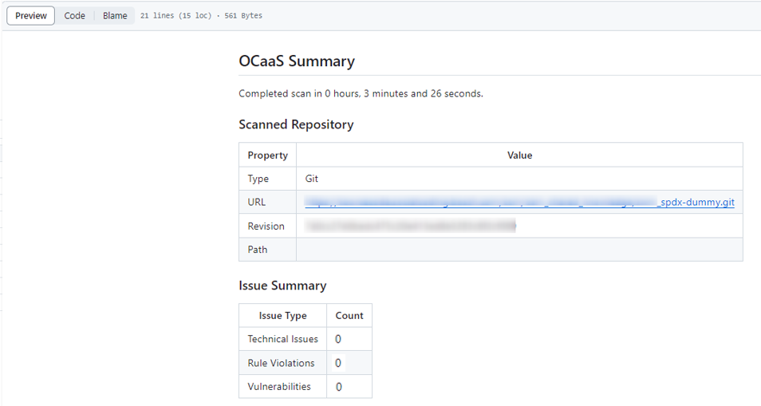
Showcase
Result repository

Slide 22

Showcase
Result repository
Extension with Test-Automation
Results may be check e.g. with RobotFramework.
Expected value for Rule Violation:
= 0
= 1

