Slide 1
Software For Scientists
George Neville-Neil
Yale, Asterope, Independent Systems Labs

Slide 2
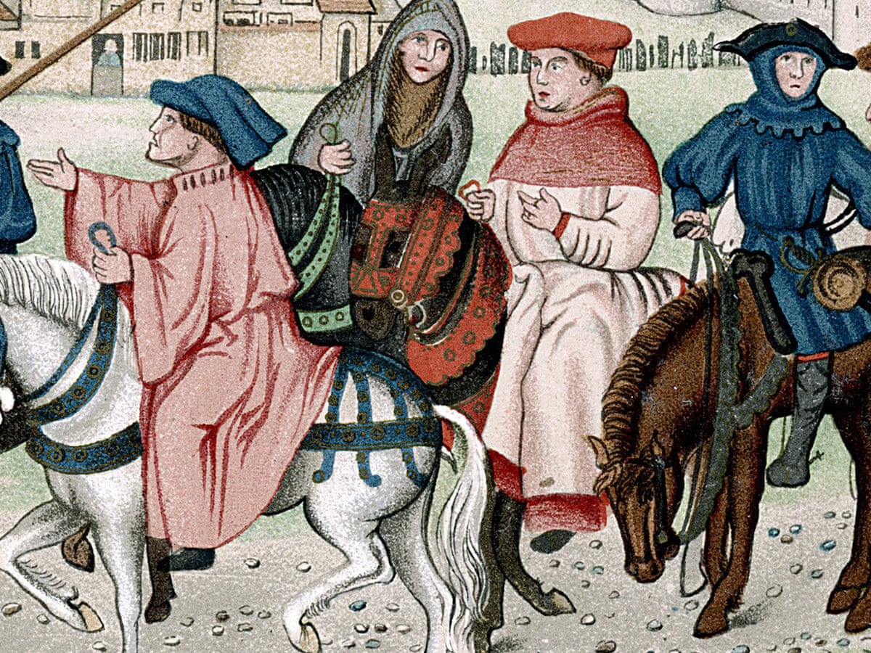
The Scientists’ Tale(s)

Slide 3
Three interviews, paraphrased…
The Biologist
  ”Devices are proprietary.” “Our instruments produce data as PDFs, or worse, that are hard to analyze or correlate.”
The Chemist
  “We use Excel.” “The paper is the record, not the data.” “Sometimes a machine just goes missing that had the data.”
The Computer Scientist
  “I spend my days massaging their code into something engineered.”
It’s all terrible

Slide 4
Does this matter?
If people who build the software understand the process of the scientist, we can accelerate their rate of discoveries
The PARC Trick
  Ask an ethnologist
  How doe scientists do their work?
  Match the tools to the people, not vice versa!
Surely LLMs will fix this!
  Science is about understanding, not just mechanics
  Go read Terrence Tao

Slide 5
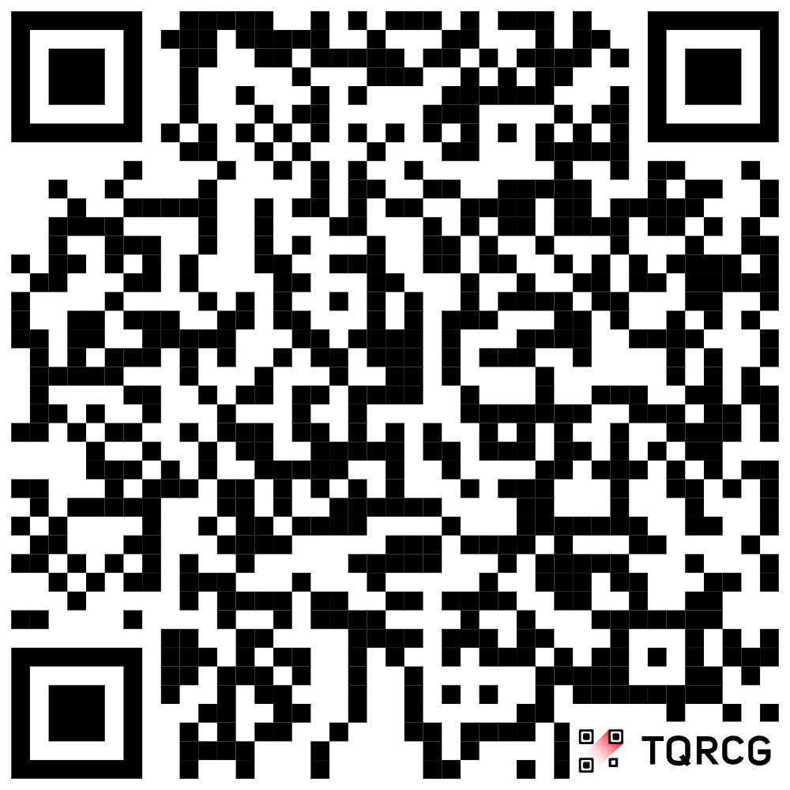
Open Science and Open Source
A global movement to make scientific research, data, code, software, and publications transparent, accessible, and reusable for everyone.
UNESCO: https://www.unesco.org/en/open-science
Center for Open Science: https://www.cos.io/open-science
Domain? No! Github! https://github.com/Open-Source-for-Open-Science

