Slide 1

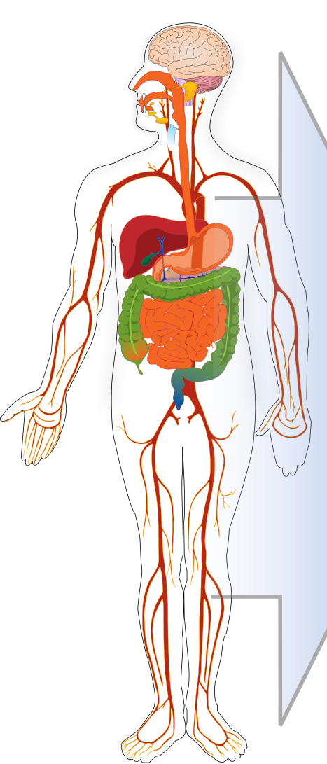

Stomach
Intestine
Feces
Portal Vein
Pancreas
Spleen
Liver
Gall-bladder
Bone
Brain
Fat
Gonads
Arterial Blood
Heart
Venous Blood
Muscle
Skin
Kidney
Urine
Lung

