Slide 1

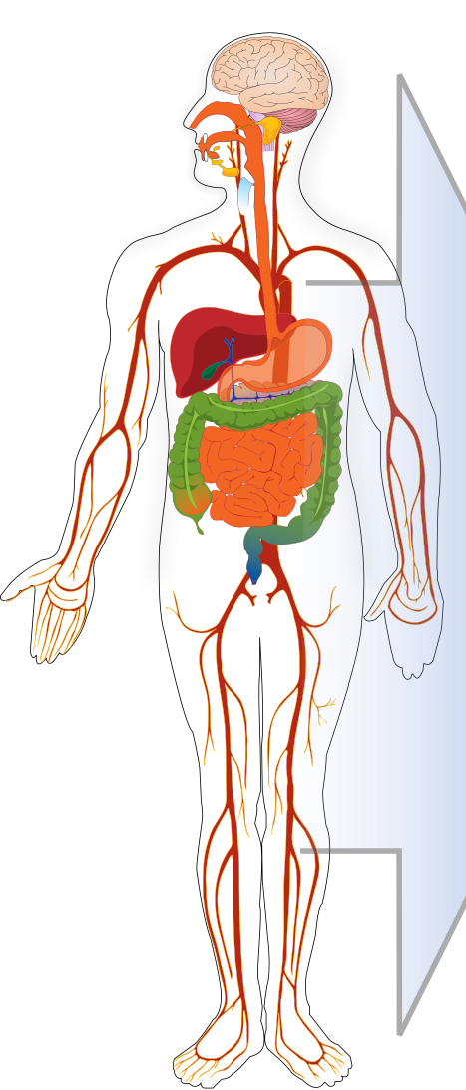

Stomach
Intestine
Met.
Feces
Portal Vein
Pancreas
Spleen
Liver
Met.
Gall-bladder
Bone
Brain
Fat
Gonads
Arterial Blood
Heart
Venous Blood
Muscle
Skin
Kidney
Met.
Urine
Lung

