Slide 1

Open-TEE – A Virtual Trusted Execution Environment
Intel Collaborative Research Institute – Security (ICRI-SC)
Brian McGillion, Tanel Dettenborn, Thomas Nyman, N. Asokan

Slide 2
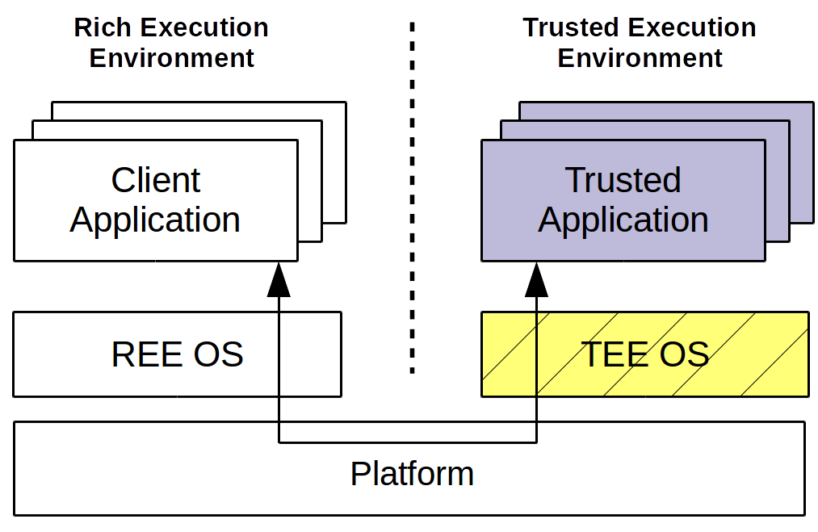
What is a TEE
Isolated Execution
Separated via HW and SW
Minimal Environment – extensible
Rich Execution Environment
  Client Applications (CA)
Trusted Execution Environment
  Trusted Applications (TA)
Adapted from http://www.globalplatform.org/specificationsdevice.asp

Slide 3
TEE Use Cases
Subsidy Locks
Secure Boot
Anti-Clone
Theft protection - “Kill switch” aka “Senate bill 962, leno. Smartphones.”
DRM
Hardware backed keystore
SRTC, monotonic counters, cryptographic accelerators
...

Slide 4
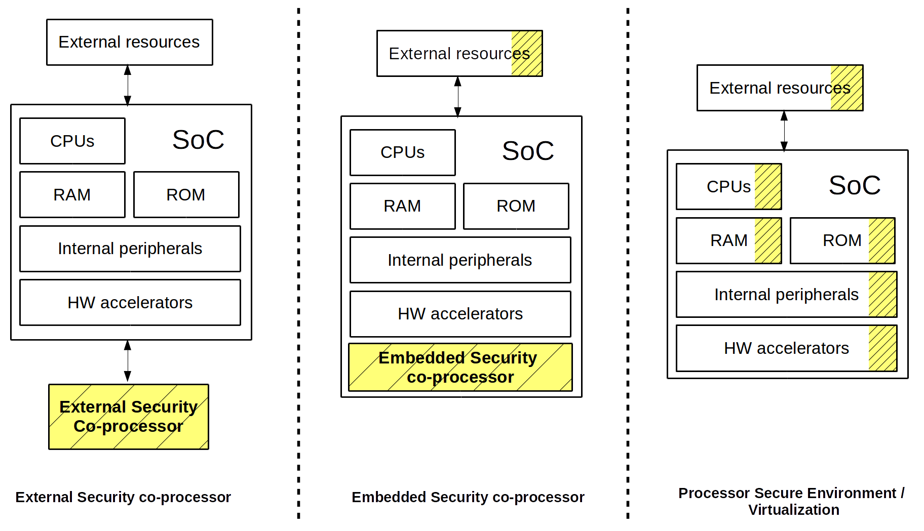
Adapted from http://www.globalplatform.org/specificationsdevice.asp

Slide 5
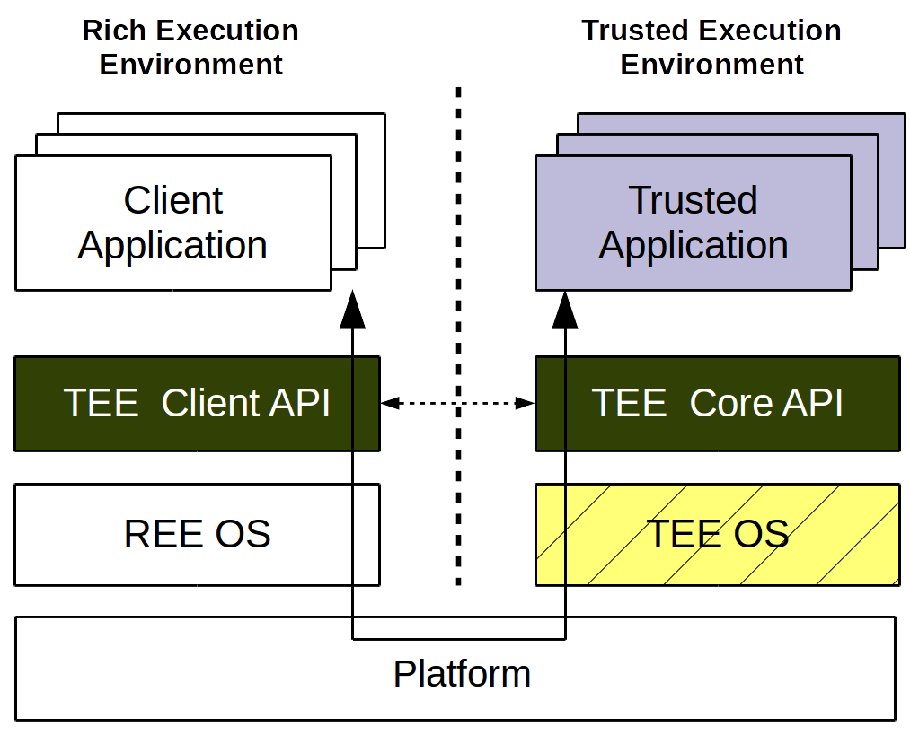
Standardizing TEE interfaces
Incompatible – same HW
  TEE OS differs
  REE drivers and userspace API differ
  Manufacturers / developers require cross-platform
GlobalPlatform - Device Spec
  TEE Client API
  TEE Core API
  Trusted UI
  TEE debug
  ...
Adapted from http://www.globalplatform.org/specificationsdevice.asp

Slide 6
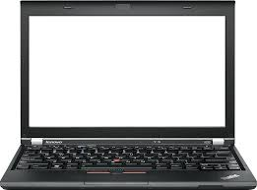
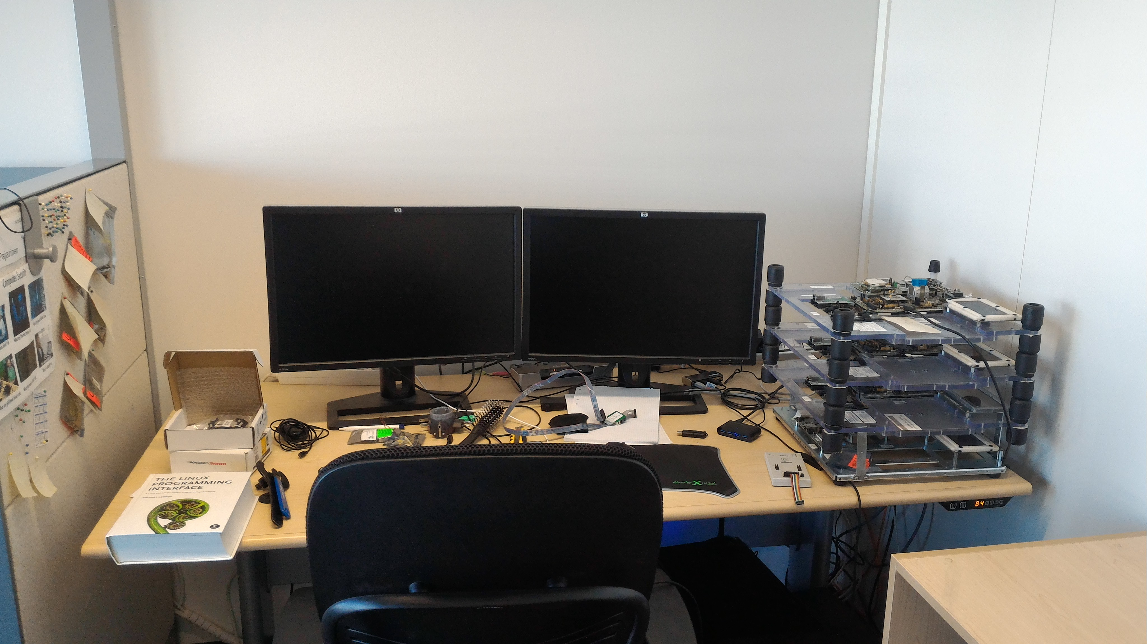
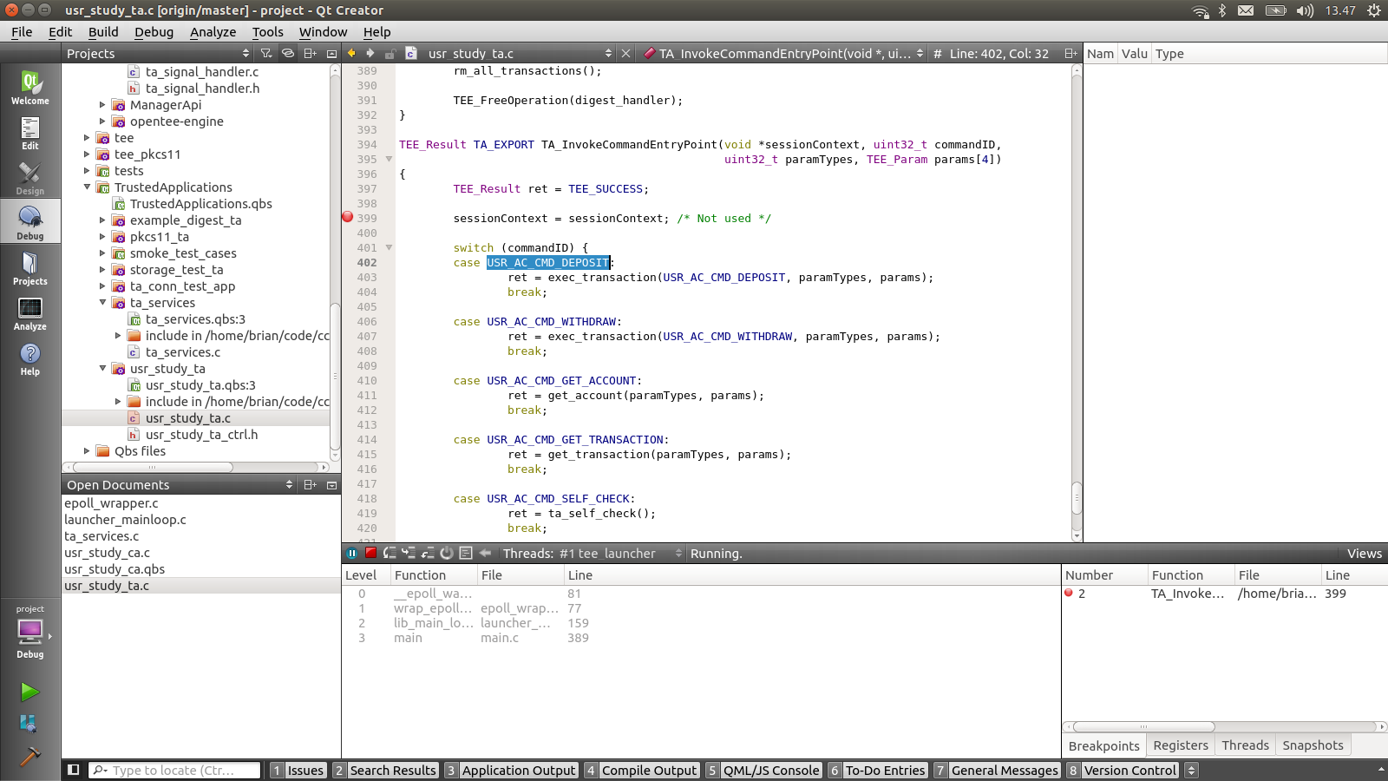
TA Development Today!
“slow execution (flash, download, reboot, run)”
“debugging TA is slow, you need to cross compile and push binary into target hardware”
“TEE itself might not work without problems, because some change have been made”
“Main difficulty is that you need development hardware, which is problematic when working outside the office.”

Slide 7
Open-TEE
Motivation
  Enable developer access
  Fast efficient prototyping environment
  Promote research into TEE services
  Promote Community involvement
Requirements
  Compliance
  Hardware-independence
  Reasonable performance
  Ease-of-use !!

Slide 8
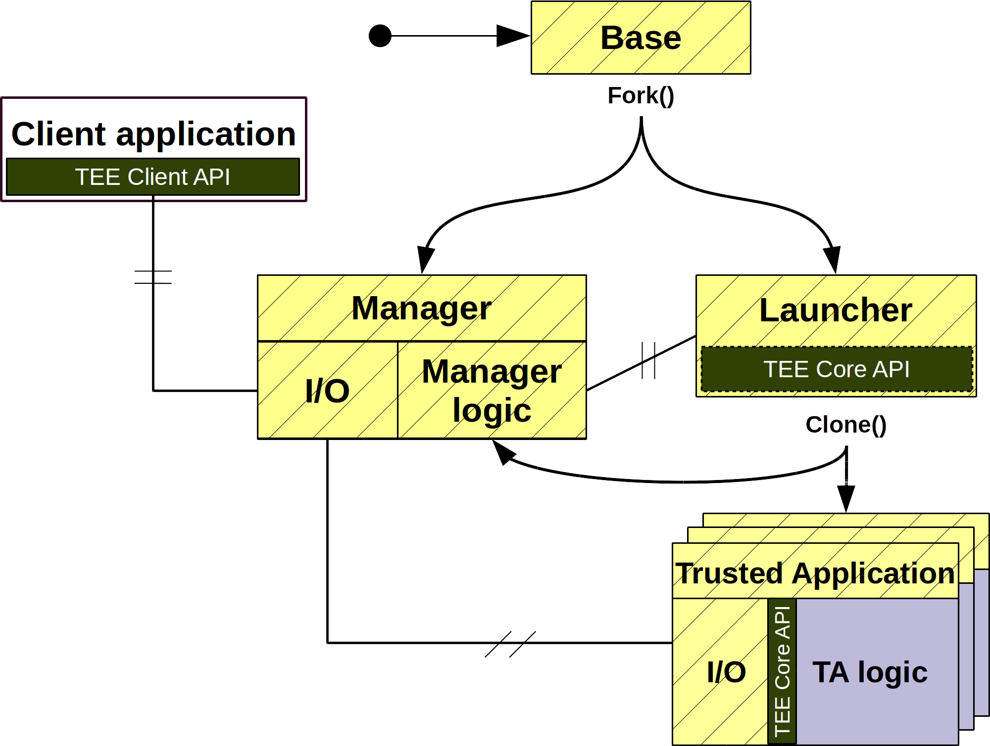
Architecture

Slide 9
Implementation and Tooling
Utilize existing functionality
  Well tested
  Familiar to developers
  Easy to setup/configure
Development Process
  Open source
  Github, GerritHub
  Coverity
  Jenkins
  Extensive testing (devs, researchers hard to please :)
Open-TEE in use
  Inconspicuous
  Abstracts implementation details
  Community involvement

Slide 11
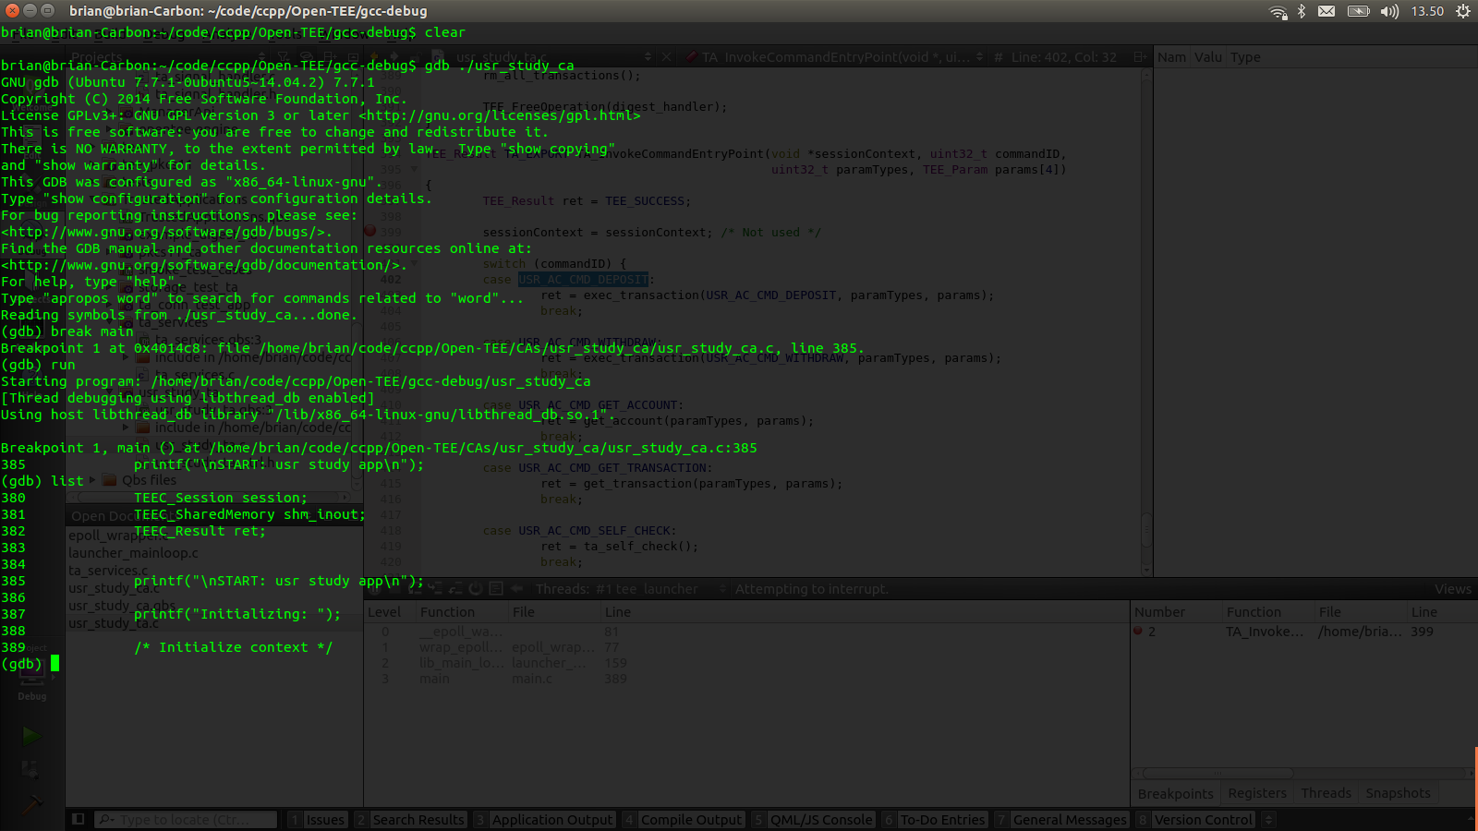

Slide 12
Evaluation
“Compliance”
  100% function coverage, ~80% algorithm coverage
Hardware independence
  Servers, desktop, laptop, tablet, phone
  Linux and Android support
  x86 and ARM
  TAs developed in Open-TEE have been compiled and run in production TEE e.g. Trustonic's

Slide 13
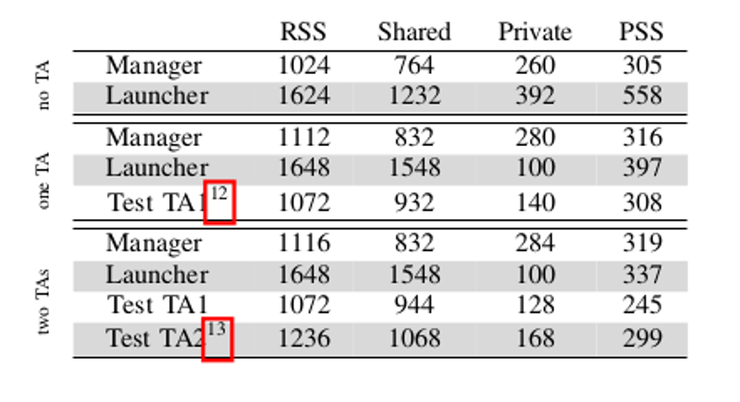
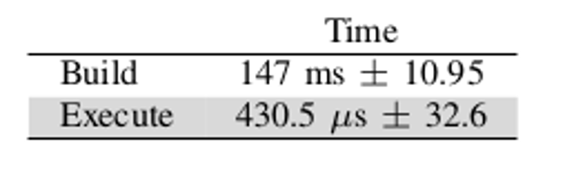
Footprint and Performance
System Impact (KB)
Developer Impact
12 – ta_conn_test_app ~100 lines of c
13 – example_digest_ta ~140 lines of c

Slide 14
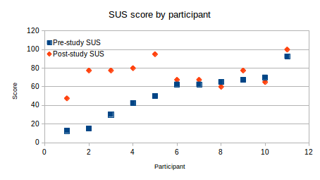
Ease of Use
Standard System Usability Scale (SUS)
  14 testers
    3 → 33 years experience
    11 with TEE experience
  Pre-Study
    Understand their current environment
  Post-Study
    Install, build, deploy, debug
Wilcoxon signed-rank test showed that the difference in SUS scores is statistically significant (z = −2.50, p < .05, r = −0.53)
9/11 (82%) devs rated Open-TEE higher than current environment

Slide 15
Post-Study free-form comments
“Debugging is easy”
“debugging is fast”
“[Open-TEE ] complements nicely my previous SDE - first preliminary testing with Open-TEE & gdb & OT_LOG(..), and only after that ARM cross compiler & FVP emulation”

Slide 16
Recap
Compliant to GP specifications
Hardware independent
Easy to use
  Minimal system requirements
  Minimal developer impact
Promote research

Slide 17
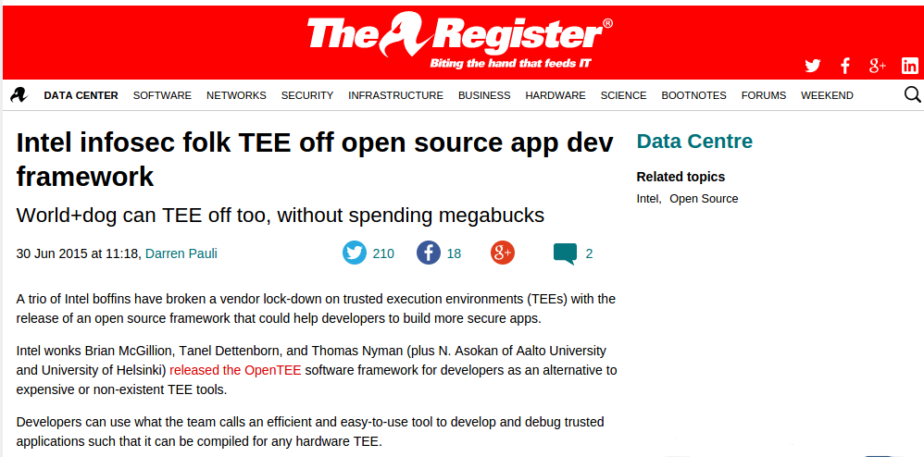
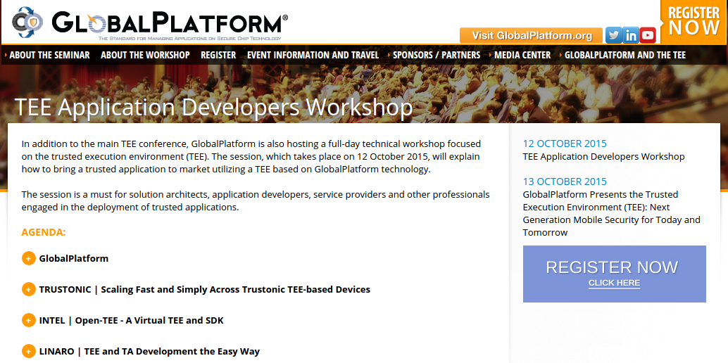
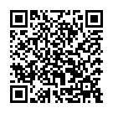
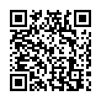
The Aftermath
http://www.globalplatform.org/TEEevent/about_the_workshop.asp
http://www.theregister.co.uk/2015/06/30/opentee_an_open_virtual_trusted_execution_environment/

Slide 18
Future Work
Expanding the developer base
  Running a workshop at the GP conference
  “On Making Emerging Trusted Execution Environments Accessible to Developers” - Nyman, McGillion, Asokan
Deploy Open-TEE on emerging TEEs
  IoT – MPU based systems
  SGX
  Hypervisors – nested hypervisors – bespoke specialized hypervisors

Slide 19

Thank You
http://open-tee.github.io/

Slide 20
