Slide 1
Introduction to Cloud Computing

Slide 2
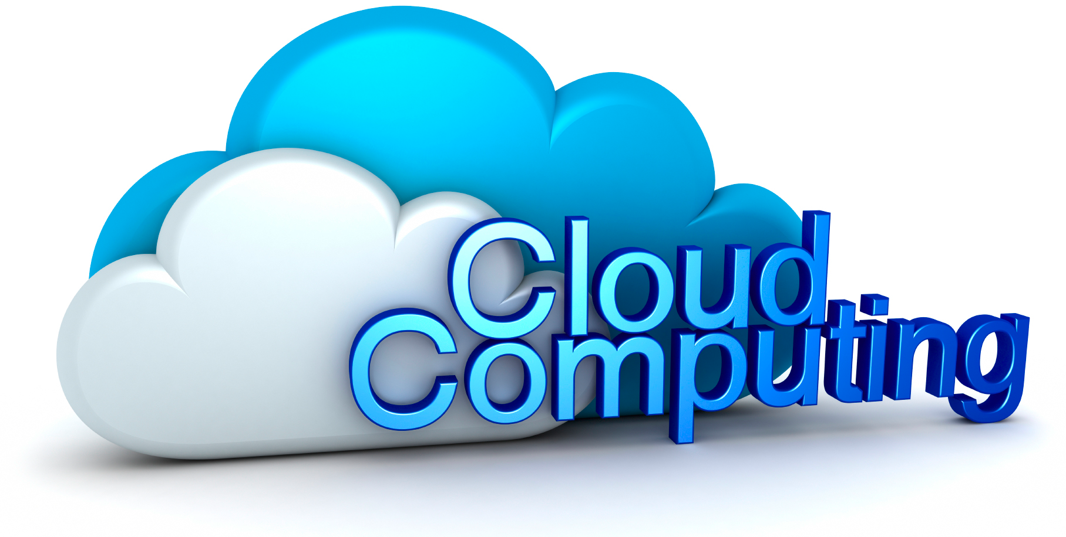
In few words...
« On-demand Software services over a network »
Cloud computing is a major trend in Software.
Cloud computing is a technical...
… a commercial...
… and an organizational revolution.

Slide 3
History

Slide 4

Amazon
Amazon is one of the biggest online stores
It hosts and manages its own infrastructure
This infrastructure is huge (several thousands of servers)
Critical period => load picks (e.g. Christmas)
Many servers stopped most of the time
Idea: why not rent them? That was in the 2000's...

Slide 5
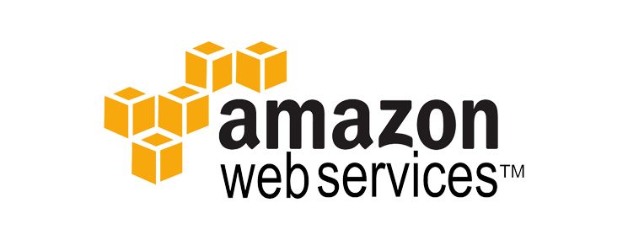
Amazon Web Services
In 2006, Amazon launched Amazon Web Services
Virtual Software infrastructure (VMs, network, etc)
Need an account
« Pay for what you use »
Manageable through a web interface
Manageable through a REST API

Slide 6
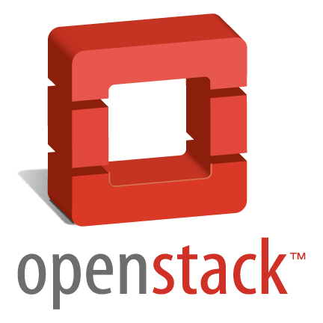

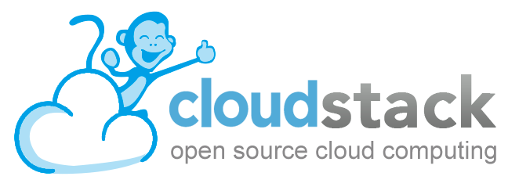
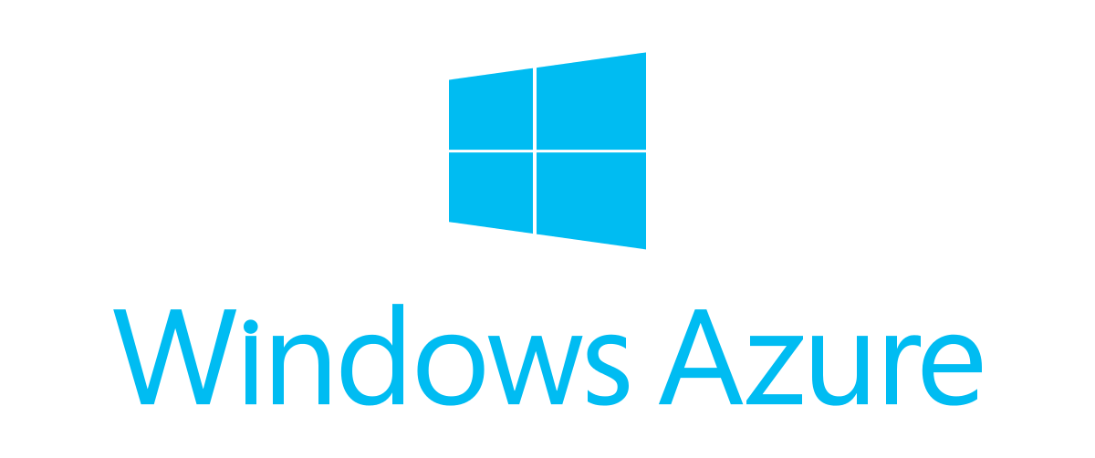
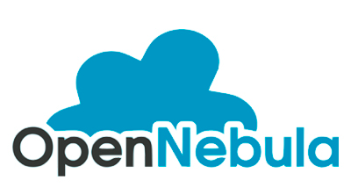

A Growing Eco-System since then...
… and went beyond just infrastructures.

Slide 7
Cloud Computing

Slide 8
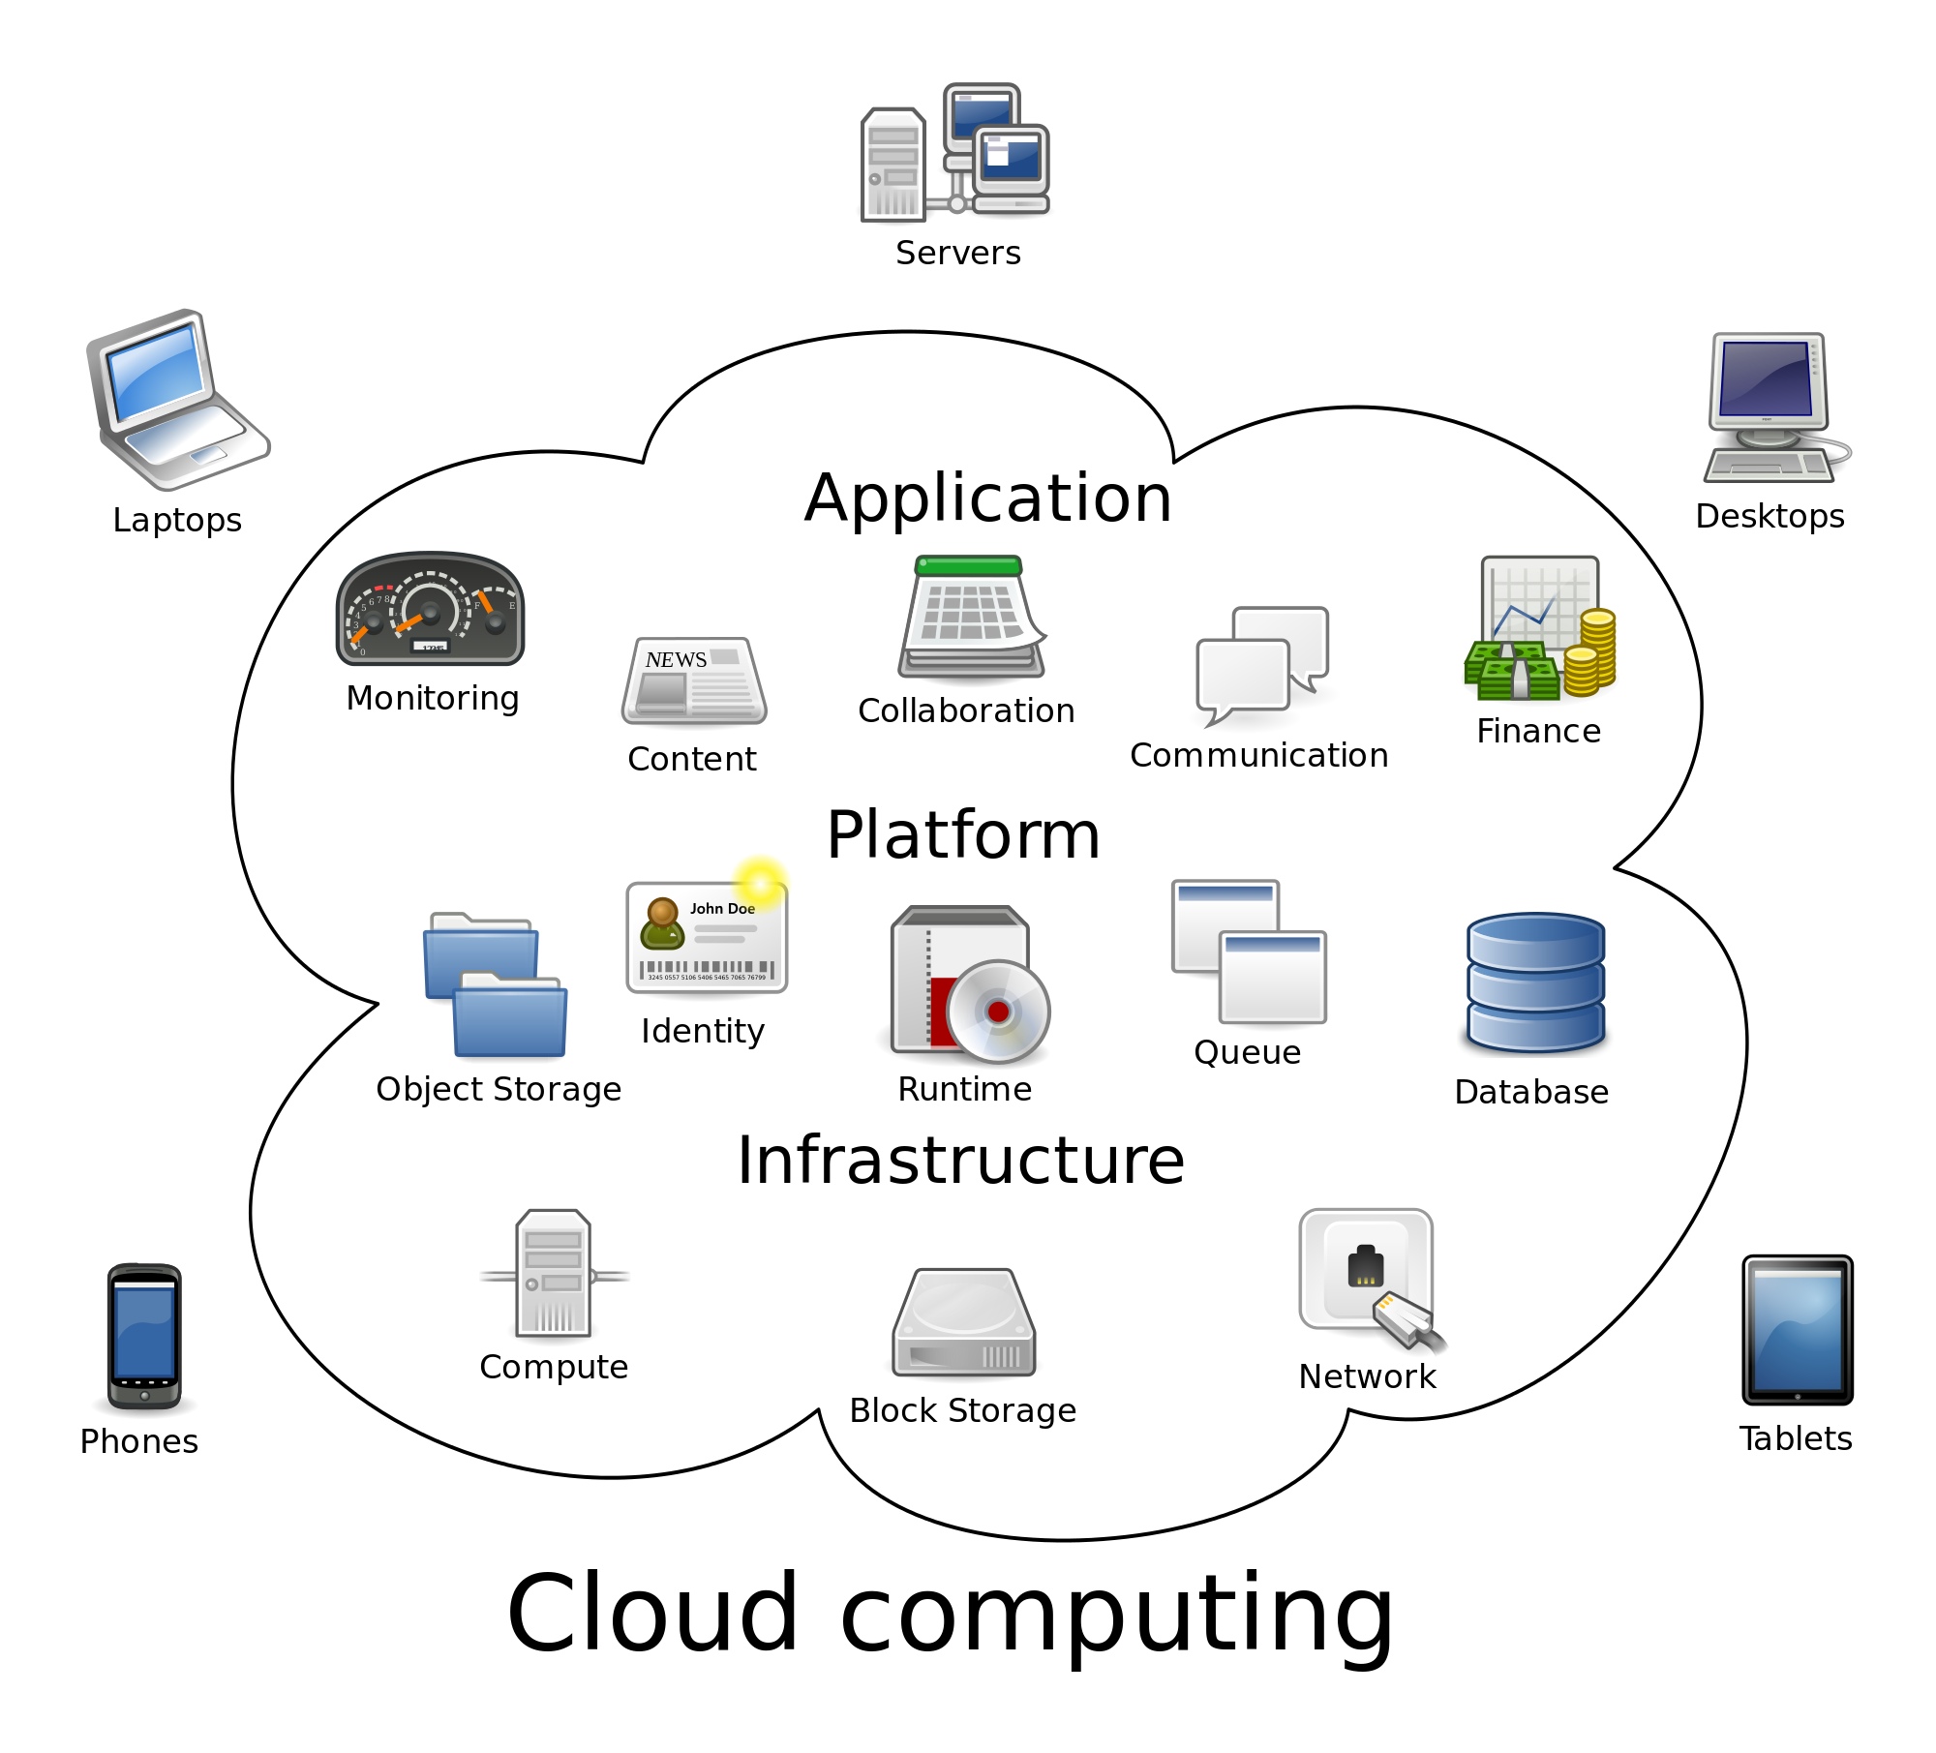
General
Source: wikipedia

Slide 9
General
3 main levels are identified
  Infrastructure as a Service (IaaS)
  Platform as a Service (PaaS)
  Software as a Service (SaaS)
Solutions made available to clients
  « Pay for what you use »
Source: wikipedia

Slide 10
IaaS
Infrastructure as a Service
  Virtualization platform (VMs)
  Manage VMs, networks, storage...
  Manageable through an API (e.g. REST) or a user interface
Each platform has its own API, but...
  Amazon Web Services' API is considered as the standard de facto
  Platforms generally support AWS' API and their own one
Attempts to create standards (OCCI Infrastructure)
  Implemented and supported by some platforms
  Rarely deployed in production
Many projects provide client libraries
  Per-IaaS ou multi-IaaS (e.g. Apache JClouds)

Slide 11
PaaS
Platform as a Service
  Generally built and deployed upon a IaaS
  Platforms to host applications and benefit from IaaS features
  Generally also cover compilation, test and deployment
These platforms target developers
  REST / CLI / Web access
  Simple integration (push on Git, commit on SVN, etc)
Highly concurrent domain
  Most of the PaaS are open source
  They try to create communities (of both users and clients)
Support for usual application patterns
  Web application, JEE, NodeJS, etc.

Slide 12
SaaS
Software as a Service
  Generally built and deployed upon a PaaS / IaaS
These solutions target end-users
  Example: accountancy application, chat, messaging, etc.
  « Pay for what you use »
Each level brings higher value for its users
  IaaS provide infrastructure
  PaaS provide solutions for application developers
  SaaS designate applications (which provide solutions for users)
XaaS
  « Everything as a Service »
  Extension of cloud concepts for whatever you want

Slide 13
Buzz Word
« Cloud » is also a buzz word
  Marketing people broadcast the word everywhere
For general publics, « cloud » means their data are hosted...
… somewhere over internet
  Not saved locally
  Available (and thus sharable) to any connected device
  There is not mandatory a real cloud infrastructure behind
Not really related to cloud computing as understood by companies and organizations
  Users will not lost data
  Way for companies to access and explore user data (business goal)

Slide 14
Technical VS. Commercial

Slide 15
Technical Overview
IaaS
  Virtualization platform with an API
  It is thus possible to build self-adapting applications
PaaS
  Macro-applications to manage development workflows
  They benefit from IaaS features (on-demand infrastructure, scalability, load picks, etc)
  Support one or many programming languages
  Support one or many programming frameworks
SaaS
  They benefit from IaaS and PaaS features
  Coherent with PaaS limits
  Developers can focus on features

Slide 16
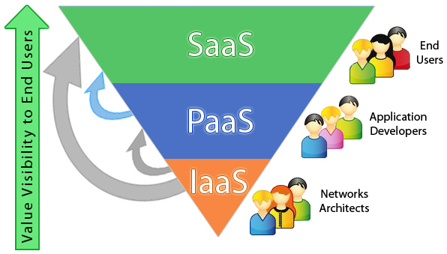
Commercial Overview
The IaaS / PaaS / SaaS trinity...
… is most of all a set of business models
  Technically, you could directly build a SaaS upon a IaaS
  Technically, you could build a SaaS upon any infrastructure
  Technically, you could build a PaaS upon usual servers
IaaS = rent infrastructure
PaaS = rent developer tools and sell one-click hosting
SaaS = sell services to end-users
Source: qarea.com

Slide 17
Cloud Philosophy
« Pay for what you use »
… and this can apply to any Software solution,
provided you make it available through an API over a network.

Slide 18
Public / Private / Hybrid Clouds

Slide 19
Public / Private / Hybrid Clouds
Public clouds designate cloud solutions available to anyone
  IaaS: AWS, Microsoft Azure, etc.
  PaaS: Heroku, etc.
  SaaS: hosted by any external service provider.
Private clouds designate internal cloud solutions
  For a company, install its own cloud solution.
  IaaS: Openstack, Open Nebula, etc.
  PaaS: Openshift, Cloud Foundry, etc.
  SaaS: hosted by the company or the organization itself.
Hybrid clouds associate public and private clouds

Slide 20
Example: US weather forecast (from a real story)
Main infrastructure hosted on a private cloud
  Keep their data safe
  Hand on the infrastructure
Weather disaster made a part of the private cloud unavailable
  Degraded service provided to users
  The disaster made people eager to get weather forecast
  Hence a high demand the infrastructure cannot face
Applications were quickly deployed to AWS (public cloud)
  Very fast deployment + Bigger infrastructure
  In less than a couple of hours, the service quality was restored

Slide 21
Pros and Cons
 | Pros | Cons
Private Clouds | - Hands on the infrastructure - Keep data private - Custom configurations | - Complex to manage
Public Clouds | - Generally big infrastructures - The hard part is managed by the hosting | - Data can leak (PRISM) - Care must be taken about the cloud location
Hybrid Clouds | - Best of both worlds - Generally, the public cloud is used in case of problem or pick load | - Requires a good design - Requires unambiguous procedures

Slide 22
Cloud Brokers

Slide 23
Cloud Brokers
Cloud brokers are proxies to cloud infrastructures
  Since « you pay for what you use »...
  … it was reasonable to think one could change its cloud provider when prices were too high.
  « Trading for cloud providers »
Cloud brokers handle...
  … user accounts, permissions and quotas
  … runtime infrastructure (VMs, configuration, etc).
Example
  ManageIQ (basis of RedHat's Cloud Forms)

Slide 24
Impact in Companies and Organizations

Slide 25
A Major Impact
Cloud computing is not just a technical change
It has a major impact on business organizations
  Classic approach: 1 project => affected machines
  Cloud approach: share the infrastructure
Team relations
  No relations required between dev' projects and infrastructure teams
  Dev' focus on their applications
  Infrastructure people monitor and manage the servers
Business Impact
  No need of a huge amount of money to start a project
  Start small and grow, rent what you need => new business players

Slide 26
Example: Netflix
Netflix is an on-demand video provider
  Internet access
  Watch films and TV series on any device
  All over the world (or almost)
Netflix infrastructure
  Most of Netflix's infrastructure is hosted by AWS
  A small part is hosted privately
  Scale the infrastructure up or down depending on user connections
Developments
  Netflix developed quite a lot of tools for AWS
  https://github.com/netflix

Slide 27
Thanks for your attention
LINAGORA – headquarters
80, rue Roque de Fillol
92800 PUTEAUX
FRANCE
Phone : +33 (0)1 46 96 63 63
Info : info@linagora.com
Web : www.linagora.com
@linagora
facebook.com/Linagora/

