Slide 1
Introduction to virtualization and KVM

Slide 2
Contents
Origins
Objectives : pros and cons
Technologies and examples
KVM

Slide 3
Origins

Slide 4








Mainframes
In the 60’s up to 80’s
  Mainframes
  Only one (very expensive) computer, many environments
  A solution :
    environments are isolated
    Their own adjustable resources

Slide 5
On Intel architectures
In the 90’s and 2000’s
  Virtualization on x86
  Software emulation
  Hardware virtualization (cpu instruction set)
  Available on low cost hardware
  A lot of free and non-free are available
    Xen, KMV, Bochs, QEMU, Linux Vserver, VirtualBox
    VirtualPC, VirtualServer, VMWare Server

Slide 6
Objectives

Slide 7
Objectives
OS or application as a simple software
  In a virtual environment (VE)
  As many computers and many OS on a single computer
Tests
  Isolated VE
  Migrate VE to more adaptated hardware
Principles
  A host OS
  A virtualisation software : hypervisor
  Other OS : guests

Slide 8
Cost reduction
energy consumption
  servers
  air conditioning
  Green factor
hardware maintenance delays
  Reduce maintenance procedures
  … the administration time consumption
Reduce hardware compatibility management
  few components expenditures
  few suppliers to manage
  Many versions of software can run longer
Hardware used efficiently
  high cost components (CPU, RAM,…) are used more or less full time
  Consolidation
  Less hardware
  Less room space

Slide 9
Easier maintenance
Reduce maintenance procedures
  Install from predifined models
  With automated IT infrastructucture integration (network, backup agent, supervision agent, …)
Central monitoring
  A central supervision point
  To decide migration action
  To react
Start/stop VM without restart physical server
  Snapshots : quick restore

Slide 10
Disavantages

Slide 11
Limitations
Compatibility
  Software may not be compatible with virtualization
  Then exceptions to manage
Security
  Hardware = single point of failure
  Data protection with delegated data center
  Server sharing
VM out of control
  To much VM where fewer are needed
  Orphan VM

Slide 12
Technologies

Slide 13
Host OS-level
Host OS isolates user spaces
  One user space = one execution environment
  No guest OS
  Low overhead rate = high performances
  Host OS dependant
Examples
  Chroot
  Docker
  Linux Vserver
  LXC

Slide 14
Full virtualization
Hypervisor first generation
  Host OS with light kernel
  Optimize transfers between guests OS and hardware
Guest OS adaptation ?
  No
  If yes, paravirtualization (guests and host OS’s cooperation)
High performances because thin layer
Examples
  Xen
  Vsphere
  Hyper-V server

Slide 15
Full virtualization
Hypervisor second generation
  Close to emulation hardware components
  Good isolation
  Thicker layer between hardware and guests OS
  Performances reduced
Examples
  VirtualBox
  KVM
  QEMU
  Bochs

Slide 16
Kernel-based Virtual Machine (KVM)
Introduction
Preparation
Guest creation
VMs management

Slide 17
Introduction

Slide 18
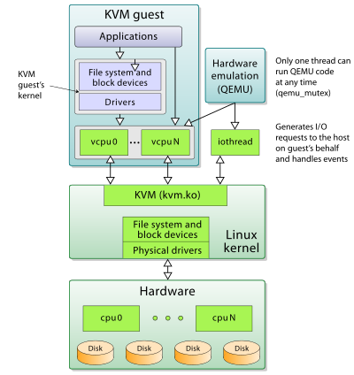
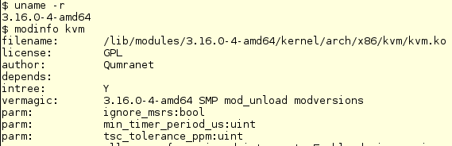
What is KVM ?
Hypervisor in a kernel module
  In Linux mainline since 2007
  Also on FreeBSD
  Architectures : x86, S/390, PowerPC, ARM
Guests
  Linux, BSD, Solaris
  Windows
  OS X
I/O hardware emulation
  Based on QEMU
  In user- space

Slide 19
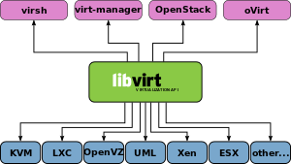
Environment
Open source
  Since 2005 (Qumranet company)
  Since 2008, RedHat
  2012 : v 1.2
Processors with Virtualization Technology
  Check BIOS
  Check CPU (/proc/cpuinfo)
Libvirt (virsh, virt-manager)
  Independent and standard VM manager on a host
  API to provision, create, modify, monitor, start, stop, migrate VM

Slide 20
Virtualized devices
Virtualized and emulated
  KVM emulates « full software » devices
  Virtual CPUs
  PCI bridges, USB controllers, IDE, AHCI controller, etc.
  Graphics, sound, network (e1000, rtl8139)
Para-virtualized devices
  Faster I/O transfers, higher I/O throughput
  Based on kernel modules : virtio-*
  Network, disks, SCSI, etc
Physical devices
  Direct access to certain hardware : passthrough
  Depends on platforms

Slide 21
Storage
Storage pools
  Local SP : attached to the host server (local devices)
  Network shared SP
Emulated storage devices
  Virtio-scsi : recommended
  IDE, CDROM, USB mass storage, AHCI for SATA
Host storage
  Raw for I/O performances
  QCOW2 for advanced features : snapshots, encryption, compression

Slide 22
Preparation

Slide 23
Host hardware
For about 10 VM :
CPU
  At least 4 cores
  Virtualization technology
Memory
  At least 8 GB
Disk drive
  At least 100 GB
Overcommitting technology
  it is possible to allocate more virtualized CPU/RAM than physical
  KVM distributes CPU/RAM to VM’s

Slide 24
Packages
Qemu-kvm
  Qemu binaries
  User-level emulator
Libvirt
  GUI tool
  Virtualization management tools
  Start
Guestfs
  Tool for offline images management

Slide 25
Guest requisites
According to VM guest goals, choose :
  number of CPU
  RAM amount
  Storage volume/technology and select host disk
  Networking
    Bridge (check bridge is set on host)
    NAT
    fixed or DHCP
  OS installation method : medium, NFS, HTTP, copy from pattern, unattended

Slide 26
Guest creation

Slide 27
Creation
Online command virt-install
  virt-install \
  --network bridge:br0 \
  --name rh7dev \
  --ram=1024 \
  --vcpus=1 \
  --disk path=/opt/vm-images/rh7dev.img,size=10 \
  --cdrom /opt/iso/rhel7.3.iso
  Other interesting options :
  --location : URL of the distribution tree installation
  --os-type : guest operating system
  --arch : if non-native architecture
  The disk is named vda.

Slide 28
Cloning
Cloning is another way to create a guest
  Stop all I/O on the VM to be cloned :
  virsh suspend rhel7dev
  Run the cloning command :
  virt-clone \
  --connect qemu:///system \
  --original rhel7dev \
  --name rhel7dev-clone \
  --file /opt/vm-images/rhel7dev-clone.img
  Resume original VM :
  virtsh resume rhel7dev
  Start the cloned VM
  virsh start rhel7dev

Slide 29
VM management

Slide 30
Current tasks
List VMs
  virtsh list –all
Show VM information
  virtsh dominfo rhel7dev
Show VCPU/Memory usage
  virt-top
Show VM disk partitions
  virt-df rhel7dev
Start VM
  virsh start rhel7dev
Stop VM (shutdown the OS)
  virsh shutdown rhel7dev

Slide 31
Other tasks
Access to VM console
  virsh shutdown rhel7dev
  first add « console=tty0 console=ttyS0,115200 » to kernel boot line in grub configuration of VM
Attach/detach storage device
  virsh attach-disk rhel7dev /dev/sdb vdb \
  --driver qemu --mode shareable
  vdb : device name mapped in th VM
  virsh detach-disk rhel7dev vdb

Slide 32
Changing VM memory dynamically
Change dynamically memory
  View current’s memory settings
  virsh dominfo rhel7dev | grep memory
  Max memory : 1048576 kB
  Used memory : 1048576 kB
  Set to 512 MB (value in kB)
  virsh setmem rhel7dev 524288
  virsh dominfo rhel7dev | grep memory
  Max memory : 1048576 kB
  Used memory : 524288 kB

Slide 33
Changing VM offline
Increase memory
  Stop VM
  virsh shutdown rhel7dev
  Edit VM’s configuration file
  virsh edit rhel7dev
  <memory unit='KiB'>2097152</memory>
  Restart the VM with the new parameter
  virsh create /etc/libvirt/qemu/rhel7dev.xml
  Check memory settings
  virsh dominfo vm1 | grep memory
  Max memory: 2097152 kB
  Used memory: 524288 kB

Slide 34
Change VPCUs
Stop the VM
  virsh shutdown rhel7dev
Modify the CPU in the configuration file
  virsh edit rhel7dev
  <vcpu>1</vcpu>
Restart VM
  virsh create /etc/libvirt/qemu/rhel7dev.xml

Slide 35
Add disk
Create a 10 GB file
  dd if=/dev/zero of=/opt/vm-images/rhel7dev-hd2.img bs=1M count=10240
Shutdown the VM
  virsh shutdown rhel7dev
Add a disk stanza in the VM configuration file
        <disk type='file' device='disk'>
          <driver name='qemu' type='raw' cache='none’ io='threads'/>
          <source file='/opt/vm-images/rhel7dev-hd2.img'/>
          <target dev='vdb' bus='virtio'/>
          <address type='pci' domain='0x0000' bus='0x00' slot='0x06' function='0x0'/>
        </disk>
Restart
  virsh create /etc/libvirt/qemu/rhel7dev.xml

Slide 36
Deleting VMs
Shutdown the VM
  virsh shutdown rhel7dev
If the VM is not responding or fails to shutdown, shut it down forcefully
  virsh destroy rhel7dev
Undefine the VMs configuration
  virsh undefine rhel7dev
Remove the VM’s image files
  rm /opt/vm-images/rhel7dev*.img

Slide 37
Improve I/O performances
Use VirtIO drivers (disk, network)
  <disk type='file' device='disk'>
  <source file='/opt/vm-images/disk1.img'/>
  <target dev='vda' bus='virtio'/>
  </disk>
Assign device disk instead of « file » disk
  <source file=’/dev/vgvm/lvdd1’/>

Slide 38
Thanks for your attention
LINAGORA – headquarters
80, rue Roque de Fillol
92800 PUTEAUX
FRANCE
Phone : +33 (0)1 46 96 63 63
Info : info@linagora.com
Web : www.linagora.com
@linagora
facebook.com/Linagora/

