Slide 1
Distributed file systems

Slide 2
Distributed file systems
Introduction
Clustering with Ceph
Types of Ceph client
Preparation of Ceph cluster
Set Ceph nodes
Set a RDB client

Slide 3
Introduction

Slide 4



What are filesystems ?
Organization of mass storage
  To store data
  To retrieve data
  To share data between multiple programs
Two points of view
  User : a filename including pathname and its content
  Operating system : metadata, pointers, blocks, chunks,…

Slide 5

Types of filesystems
Local filesystems
  On one computer
  Direct access to a block device
  Managed by one OS
  XFS, BRTFS, EXT*, ...
Shared filesystems
  Multiple OS access to one exported filesystem
  The filesystem is connected to one computer
  This computer manages its local block device
  NFS, CIFS
But problems
  I/O bottle necks
  Network latency
  Host is a SPOF

Slide 6
Solutions ?
HA cluster
  One system active
  one system standby
  One cache
Cluster filesystems
  One block device
  Block level access
  I/O cache consistency management : cache synchronization
  Multiple kernel handle I/O at any time
  SAN with OCFS, RedHat GFS, ...

Slide 7
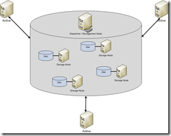
A solution : Distributed Filesystems
A file system spread over several nodes
Access by multiple clients
  Large and scalable capacities
  High I/O throughput
  Redundancy
Transparency
  Access
  Location
  Concurrency
  Failure
Examples
  GlusterFS, Gfarm, Ceph,...

Slide 8
How it works
Multiple nodes
  They run their own OS
  They access to one block device
One or more master nodes
  Dispatch requests
  Manage filesystem status
  Manage synchronization
Clients
  Mount locally logical filesystem
  Served by different nodes

Slide 9
Ceph

Slide 10
What is CEPH ?
Distributed storage system
  Software-designed
  Stores objects, blocks, files
  Self-healing
  Scalable
  Designed for cloud infrastructure
  All components are redunded
    No SPOF
    multiactive
Open Source
  Sage Weil, doctoral dissertation in 2006 (UCSC)
  2012 : Inktank Storage company
  2014 : Redhat aquires Inktank Storage
april 2016 : version 10.2.0

Slide 11
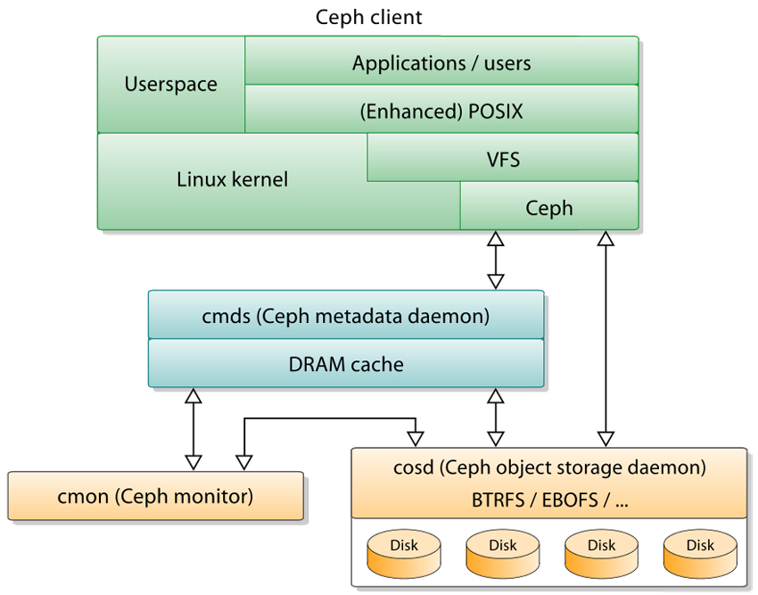
Organisation
Several daemons to deliver service

Slide 12

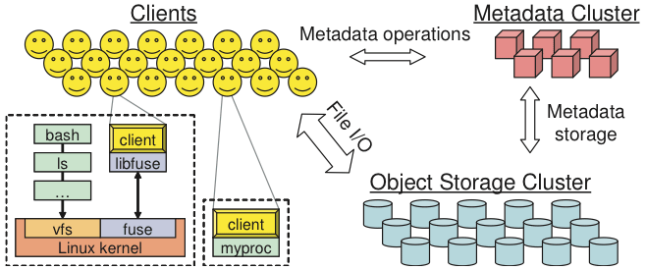
Components : nodes
An administration server : admin
  Recommended for an easier deployment
  For administrative task on the cluster
A node running the metadata server : mds
  Stores description of the user data
  Load management
At least one node running the monitor : mon
  Clients get a copy of the 5 cluster maps
    Monitor map (id, address, port,...)
    OSD map (id, data containers, status, …)
    PG – Placement group - map (status, …)
    CRUSH map (list of storage devices, rules, …)
    MDS map (list of mds, ...)
  Clusterized monitors
At least one node running the Object Storage Device : osd
  Store objects on disks
  Reports to the mon

Slide 13
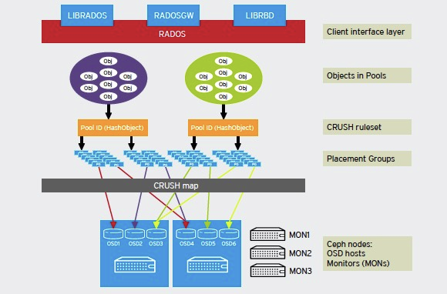
Architecture : another view
Distribution and Modularity
  Pools : ownership/access to objets,replication rules, number of PG
  PG : logical container used to spread objects on OSDs (balancing)
  CRUSH ruleset : clients compute data location and acces directly to data

Slide 14
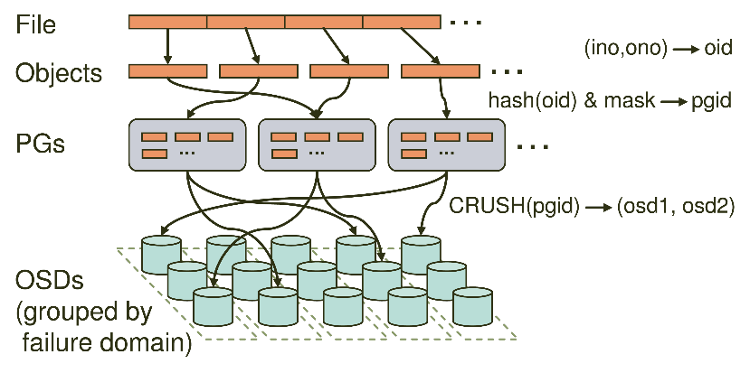
Protocol
Example with a write access
  1. client gets the updated cluster map from a MON server
  2. data are converted in objects (with object ID and pool ID)
  3. CRUSH determines PG and primary OSD where to store objects
  4. client contacts primary OSD node to store objects
  5. with CRUSH, primary OSD node searches secondary Pgs and secondary OSD nodes
  6. primary OSD replicates objects on secondary OSD nodes

Slide 15
Types of client

Slide 16
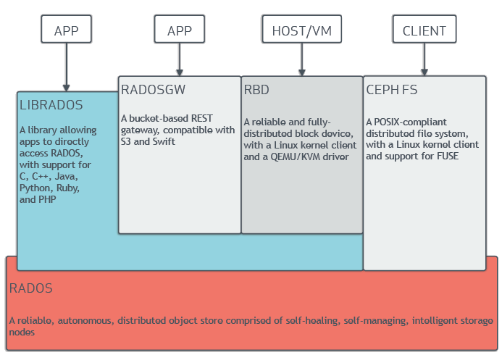
Clients
With libraries, OS or client software, client nodes access to
  Objects
  Blocks
  Files

Slide 17
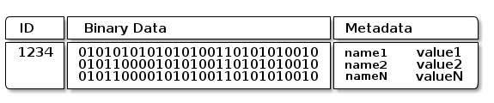
Data storage
OSD nodes
  store objects
  On a flat namespace
  No hierarchy
An object has
  An ID
  Binary data
  Metadata (name/value pairs)
  The client puts the semantic it wants
    Blocks
    Objects
    Files

Slide 18
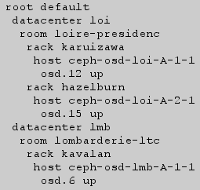
Data location
Clients and OSD nodes compute data location
  Hash algorithm
  CRUSH : Controlled Replication Under Scalable Hashing
  CRUSH used by clients to store objects
  CRUSH used by OSD nodes to store objects and their replicas
  Maps are updated

Slide 19
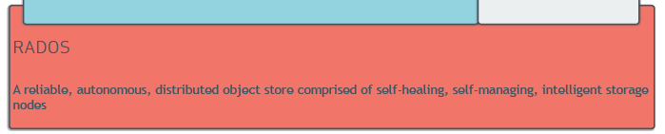
RADOS
RADOS
  Lowest layer of Ceph storage clusters
  Reliable Autonomic Distributed Object Store

Slide 20
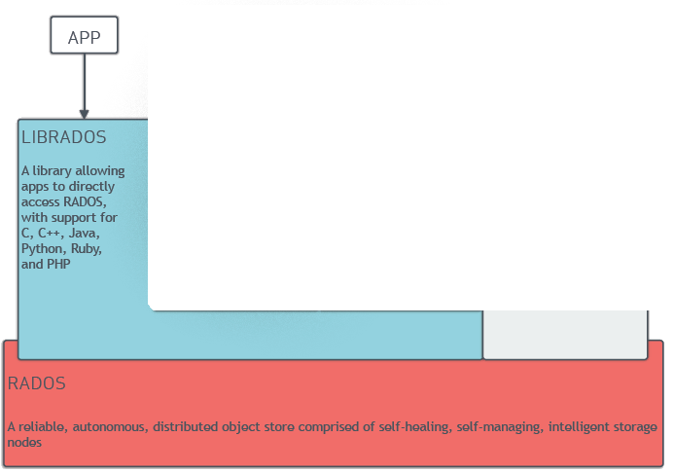
librados
Used to develop Ceph Clients
  For a parallel access object storage
  Asynchronous communication protocol
  Actions
    R/W
    Create/remove
    Append/truncate
    Manage XATTR's
    Manage Name/Value pairs
    Data stripping
    …
  Library librados

Slide 21
RBD : RADOS Block Device
Block device service
  Clients access
    with Xen, QEMU or libvirt (qemu-img create -f rbd rbd:image 2G)
    Kernel Ceph block device (modprobe rbd)
    Command rbd
  Stores blocks over multiple objects on Ceph
  Objects are mapped on PG (placement group)
  Choice of FS format (BTRFS is recommended)

Slide 22
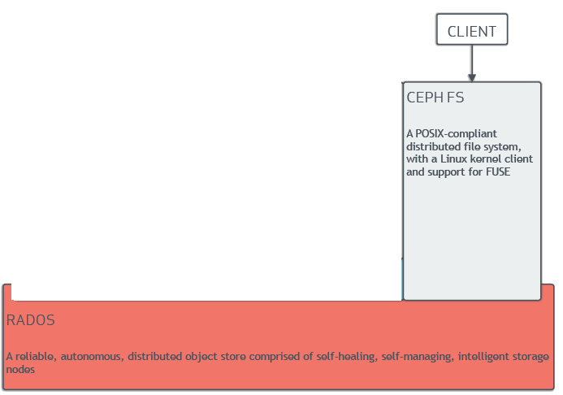
CephFS : Distributed File System
CephFS
  Clients access with mount command
    mount -t ceph -o name=LNG 172.20.106.84:/data /mnt
  Client use kernel module (ceph) or
  Filesystem in User Space (FUSE)
  MDS store directories and inodes
  OSD store data file
  High-availability
  Scalability

Slide 23
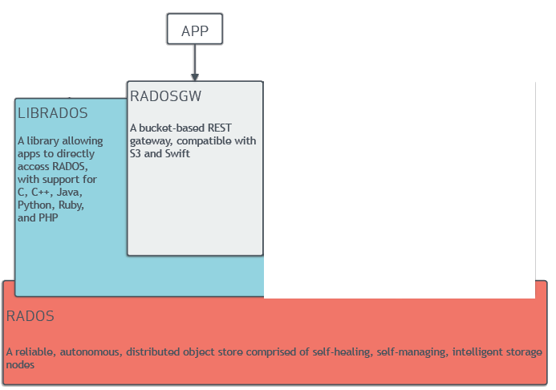
RADOS Gateway
RESTful interface
  Access to objects only
  Two standard APIs used by apps based on clusters
    Amazon-S3
    OpenStack-Swift
  Based on Ceph Object Gateway daemon : radosgw

Slide 24
Preparation

Slide 25
Needs
For a test cluster : 5 nodes
  cluster-admin
  cluster-mon
  cluster-mds
  cluster-osd1
  cluster-osd2
For a production cluster : 10 nodes
  cluster-admin
  cluster-mon1, cluster-mon1, cluster-mon2
  cluster-mds1, cluster-mds2
  cluster-osd1, cluster-osd2, cluster-osd3, cluster-osd4,
Minimun hardware
  1 CPU , 1 GB RAM per node
User
  A linux user « ceph » on all nodes

Slide 26
Helps and packages
SSH: distribute the ceph user SSH-key on all nodes
Sudo : give root access to ceph user
Name resolution
  Give a significant hostname to nodes
  Set DNS records for all
Prepare control node : on ceph-admin
  Install ceph-deploy package
Set role to monitor node(s)
  Ceph-deploy new cluster-mon
Install Ceph on nodes
  ceph-deploy install cluster-admin cluster-mon cluster-mds cluster-osd1 cluster-osd2

Slide 27
Roles definition
Define the monitor node
  ceph-deploy mon create cluster-mon
Get authentication keys from the monitor
  ceph-deploy gatherkeys cluster-mon
Select disks on data nodes (ie : /dev/sdb)
  ceph-deploy disk zap cluster-osd1:sdb (same for osd2)
Prepare data nodes
  ceph-deploy osd prepare cluster-osd1:sdb (same for osd2)
Enable data nodes
  ceph-deploy osd activate cluster-osd1:sdb (same for osd2)
Define MDS nodes
  ceph-deploy mds create cluster-mds

Slide 28

It works ?
Check it works
  ceph status
Check it works
  ceph health

Slide 29
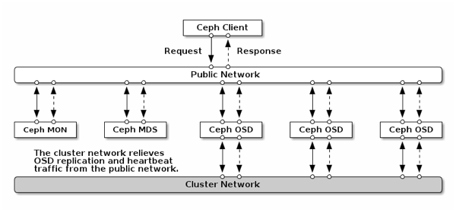
Example with 3 OSD nodes

Slide 30
RDB client access

Slide 31
Create a client
On client node called « cluster-client1 »
  Create Linux « ceph » user
  Install SSH keys
  Set Sudo access
Set DNS records for the new node
On cluster-admin node
  ceph-deploy install cluster-client1

Slide 32
Create block devices
Create a pool called « volumes » containing objects
  rados mkpool volumes
Create two objects (1GB each)
  rdb -p volumes - -size 1024 create vol1
  rdb -p volumes - -size 1024 create vol2
Map new objects (vol1, vol2) with block devices
  rbd map volumes/vol1
  rbd map volumes/vol2
Check new blocks devices exist
  /dev/rdb/volumes/rdb0
  /dev/rdb/volumes/rdb1
Format and use them !

Slide 33
Thanks for your attention
LINAGORA – headquarters
80, rue Roque de Fillol
92800 PUTEAUX
FRANCE
Phone : +33 (0)1 46 96 63 63
Info : info@linagora.com
Web : www.linagora.com
@linagora
facebook.com/Linagora/

