Slide 1
MongoDB : distributed storage

Slide 2
Content
MongoDB Presentation
Document Oriented DB
Replication Model
MongoDB distributed architecture overview
Architecture details : Replica Sets
Architecture details : Sharding

Slide 3
MongoDB : Presentation

Slide 4

MongoDB : Presentation
First version : 2009
Last stable version : 3.2 (december 2015)
Written in C++
Developped by : MongoDB Inc.
License : AGPL v3
Numerous and active community
Exhaustive documentation
Widely used (Adobe, eBay, LinkedIn)

Slide 5
MongoDB Data Model
Data model :
  Document : BSON object
  Collection : a collection of documents
  Database : a collection of collections
Each MongoDB instance can have multiple data bases

Slide 6
Document oriented DB

Slide 7
Document oriented DB
Type of noSQL data base
  Scalable using distributed architecture
  Used for high read and write performances in cloud context
Stores a list of mapping : id → object
Structure of object is known by the DB
  Enables complex queries

Slide 8
Document oriented DB
MongoDB documents format is BSON : binary JSON
  JSON + extensions to support binary data into JSON objects
BSON documents may contain :
  Nested arrays
  Nested JSON objects
  Binary data

Slide 9
Document oriented DB
To gain the benefits of the noSQL DBs :
  Documents should be denormalized (duplicated data) when needed
  Documents should be business oriented : stored data should be useable directly by the application

Slide 10
MongoDB : Replication model

Slide 11
MongoDB Replication
A single instance of MongoDB might not be enough for an application if :
  Too many documents to store
  Lots of concurrent accesses
  High performances are needed
  ...
To solve this problem, several MongoDB instances can be combined to build a storage cluster.

Slide 12
MongoDB Replication
MongoDB has 2 types of replication :
  Replica sets
  Sharding
These 2 types can be used at the same time to maximize the gain of both choices

Slide 13
MongoDB Replica Sets
Replica sets are a master slave architecture.
A replica set has one master instance and may have some slave instances.
All instances have all the data.
The slaves are read-only.
The master accepts writes of new documents and propagates the written info to the slaves.
To prevent inconsistencies, writing on a document can be blocked if a propagation is in progress.

Slide 14
MongoDB Replica Sets
Client
Read
Read
Slave1
Read
Write
Slave2
Write
Propagation
Write
Propagation
Master
Advantages :
  Fast reads
Drawbacks :
  Slow write if write propagations are blocking
  Read inconsistencies if write propagations are not blocking

Slide 15
MongoDB Sharding
Sharding is separating the data among different servers or group of servers which are called « shards ».
Each shard only has a part of the data.
The data can be split according to different criteria :
  Range-based : based on the key of the documents
  Hash-Based : based on hash of the keys
  Tag-aware : based on tags defind by the developper

Slide 16
MongoDB Sharding
Sharding is efficient if queries implying mutiple documents can be done by clients can be executed inside a single shard.
Sample of ranged-base sharding with 100 documents :
Client
Shard1 Keys 1-33
Shard2 Keys 34-66
Shard3 Keys 67-100

Slide 17
MongoDB : Distributed Achitecture

Slide 18
MongoDB distributed architecture
MongoDB allows to combine Replica Sets and Sharding.
This brings advantages of both replication architectures.
The idea is to have multiple shards with each shard being a replica set.

Slide 19
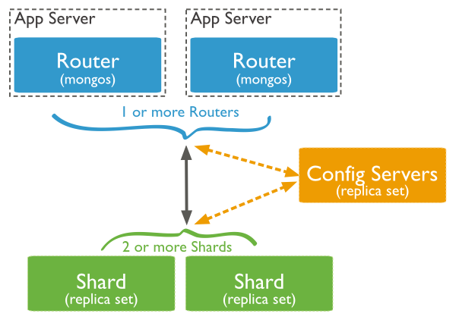
MongoDB : Replica Set + Sharding

Slide 20
Routers
Routers receive client requests
Routers forward requests to the shard having the data
Routers are « mongos » processes

Slide 21
Config servers
Config servers hold the knowledge of data repartition
Config servers responds to router : which shard has the wanted document
Config servers store information received from the shards after writes

Slide 22
Shards
Each shard is a replica set
Shards hold the application data
Shards can be added to increase system capabilities

Slide 23
Achitecture details : Replica Sets

Slide 24
Architecture details : Replica Sets
A replica set is a group of « mongod » processes
One of these processes is launched as master of the set
Other nodes are launched as slaves of this master

Slide 25
Architecture details : Replica Sets
A replica set must always have a master node
If the master node crashes :
  The other nodes should detect it
  A new master node shoudl be chosen

Slide 26
Architecture details : Replica Sets
Node crash detection :
  Nodes send each other « heartbeat » messages every 2 seconds
  A node not responding « heartbeats » for 10 seconds is marked as inacessible

Slide 27
Architecture details : Replica Sets
Master re-election :
  When master crashes, slaves choose a new master among them
  It may take a few minutes :
    Time for slaves to detect that master node is down
      PLUS
    Time for new master designation

Slide 28
Architecture details : Replica Sets
Master re-election strategy :
  Each node has a priority
  Some nodes can vote
  All voters try to make the higher priority node the new master
There can be nodes with priority 0 (non eligible)
Some nodes cannot vote

Slide 29
Architecture details : Replica Sets
Priority 0 nodes : nodes which cannot be elected as master
  Useful for multi data-center architectures
  Potential system failures if only priority 0 nodes remain active

Slide 30
Architecture details : Replica Sets
Master election :
  A replica set has up to 7 voting members
  Some nodes might not vote during the election
  The highest priority nodes asks to become master
  Other nodes vote yes/no according to the last operation available on the candidate
  Highest priority node is elected OR next highest priority tries to get elected

Slide 31
Architecture details : Replica Sets
Arbiters nodes :
  Specific nodes to avoid ties in new master election
  Arbiters do not store data
  Arbiters have priority 0 : cannot be master
  Arbiters should make the number of voters uneven

Slide 32
Architecture details : Replica Sets
Fault tolerance : Number of node that may crash without breaking the system
  There should remain enough nodes to elect a new master
Fault tolerance is a metric of the system robustness
N° of nodes | N° of nodes for elections | Fault tolerance
3 | 2 | 1
4 | 3 | 1
5 | 3 | 2
6 | 4 | 2

Slide 33
Architecture details : Replica Sets
Hidden replica set member :
  Hidden members have a copy of the data
  Hidden members cannot be reached by the client
  Used for specific purpose : reporting, backup…
  Hidden members have priority 0 and may vote

Slide 34
Architecture details : Replica Sets
Delayed replica set member :
  Delayed members have an outdated copy of the data
  Delayed members are a running history of the data
  Used for specific purpose : rollback after human error when performing massive data operations or application upgrades
  Delayed members should be hidden members

Slide 35
Architecture details : Replica Sets
Rollbacks :
  Rollbacks might be necessary on master failure :
    If write operations have sucessed on master
      AND
    These operations have not been replicated to slaves
  Rollback reverts the non propagated write operations on the failed master

Slide 36
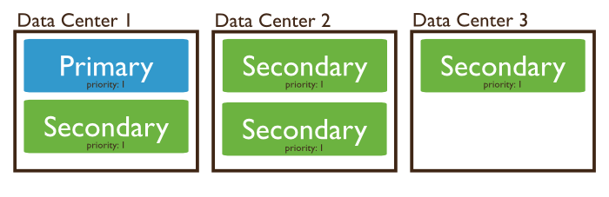
Architecture details : Replica Sets
Multi Data Center architecture :
  Splitting replica set nodes across multiple data center allows to resist data center failures
  Usual setups are :
    3 nodes across 2 data centers
    5 nodes across 3 data centers

Slide 37
Achitecture details : Sharding

Slide 38
Architecture details : Sharding
Shard key :
  Objects are distributed among the shards according to their shard key
  Shard key cannot be changed once the shard has been created
  Choice of the shard key determines the efficiency of the sharding

Slide 39
Architecture details : Sharding
Goal of the shard key:
  Splitting documents evenly between shards
  Distribute documents so that read and write are set evenly to the shards

Slide 40
Architecture details : Sharding
Shard key important properties :
  Cardinality : number of possible values for the shard key
  Frequency : how often a shard key value appears in documents
These properties and the evolution of the shard key value will result in an efficient or inefficient sharding.

Slide 41
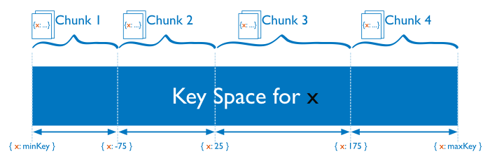
Architecture details : Sharding
Sharding strategy : range based
  Shard keys are divided into ranges, and each range is associated to a shard

Slide 42
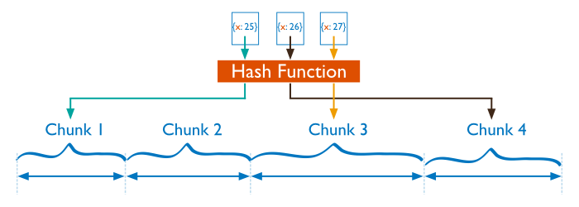
Architecture details : Sharding
Sharding strategy : hash based
  A hash is computed for each shard key. Each range of hashes is associated to a shard

Slide 43
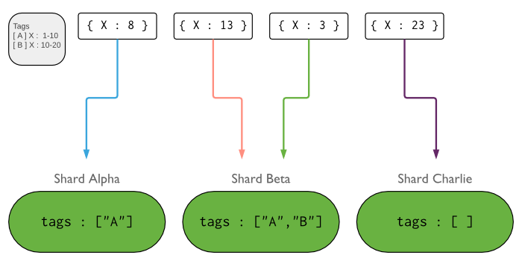
Architecture details : Sharding
Sharding strategy : tag aware
  Tags can be defined on shard keys ranges. These tags can be associated to one or more shards
  This allows to have a custom strategy for the shard repartition

Slide 44
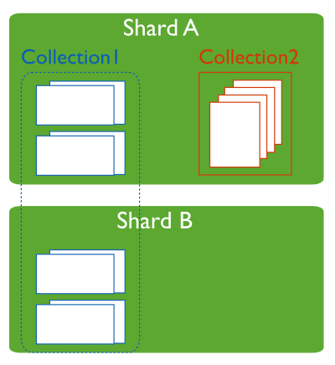
Architecture details : Sharding
Sharding is at collection level :
  Within the same mongo cluster, there might be sharded and not sharded collection

Slide 45
Xin cảm ơn !
LINAGORA – Việt Nam
Số 59A Lý Thái Tổ,
phường Tràng Tiền,
quận Hoàn Kiếm, thành phố
Hà Nội
Điện thoại : +84(0) 906 220 340
Info : vietnam@linagora.com
Web : vn.linagora.com
@LinViet
facebook.com/linagoravietnam

