Slide 1

AI Business Model Canvas Introduction
Basics of AI - ICB011AS2AE Anne Wuokko, Eira Vatanen
22.1.2024

Slide 2
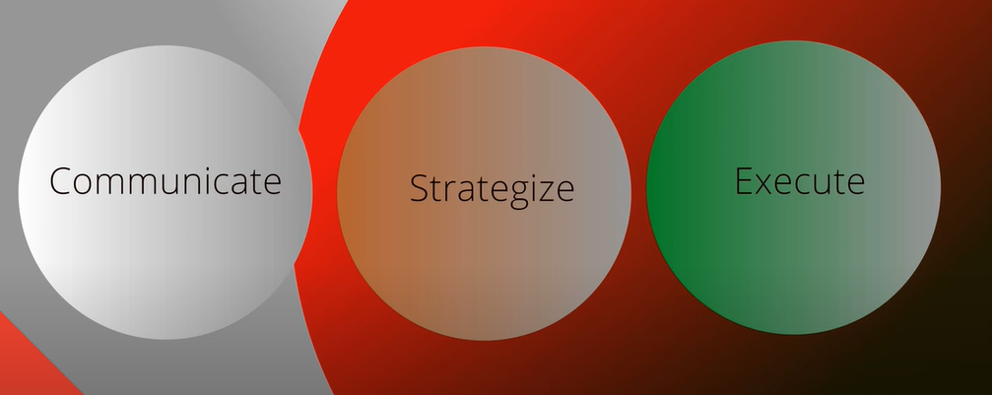
AI Business Model Canvas – Key Idea
Source: Businessleaders.ai

Slide 3
AI Business Model Canvas
Is used to develop new AI business models and to present existing models
Helps to figure out the big picture
How to use AI in business
How to proceed from idea to production
Communicates the main idea of the AI project and the AI business model from different angles in compact and easy form

Slide 4
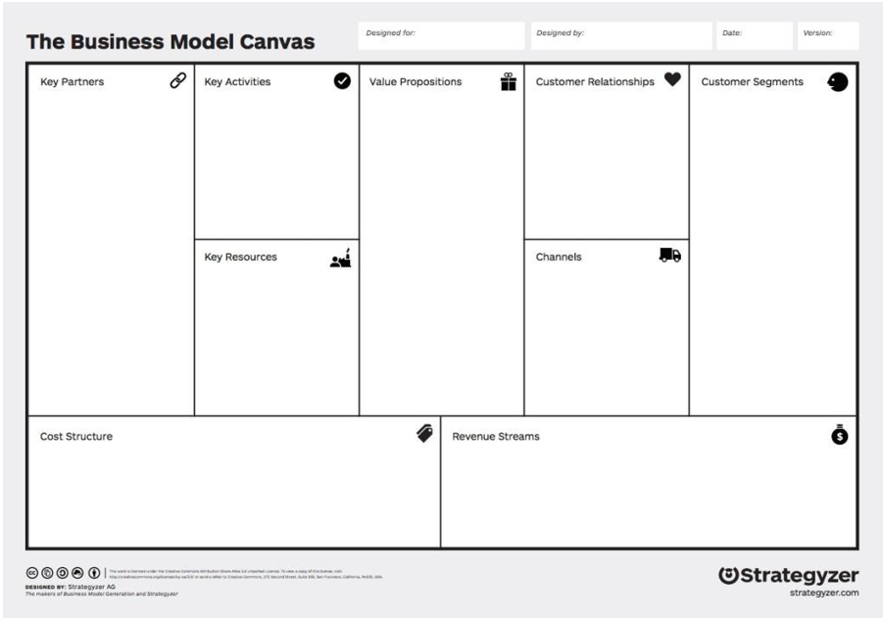
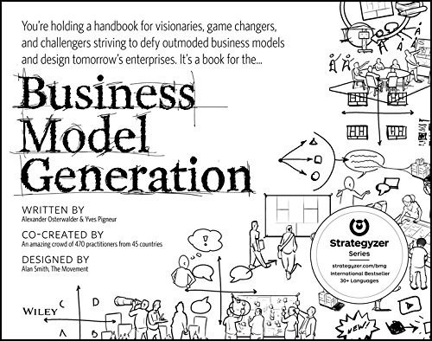
AI Business Model Canvas - base
Alex Osterwalder’s Business Model Canvas
This Photo by Unknown Author is licensed under CC BY-NC-ND

Slide 5
How to start? First choose the model
There are several different AI Business Model Canvas models e.g
AI business model canvas (BusinessLeaders.ai)
The AI Business Model Canvas (Lomas)
AI Project Canvas
Enterprise AI Business Model Canvas (Kerzel)
9.3.2023
5

Slide 6
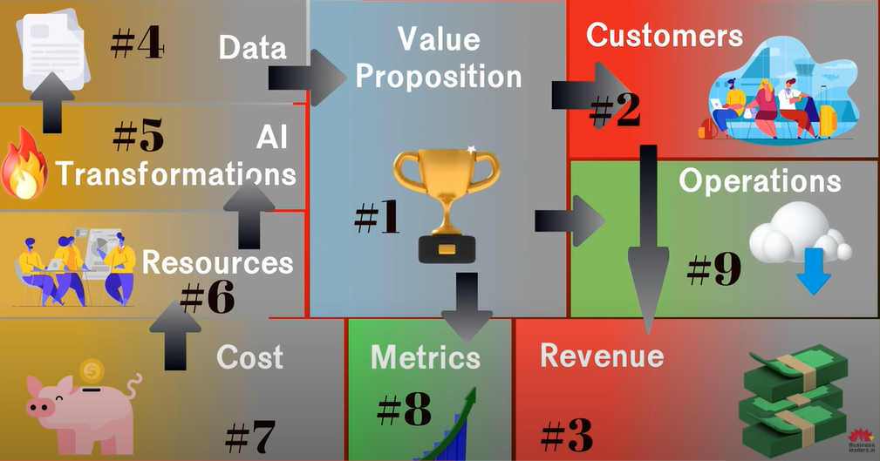
AI Business Model Canvas: BusinessLeaders.ai
(Key Activities)
(Key activities)
(incl. Key Partners)
Source: Businessleaders.ai

Slide 7
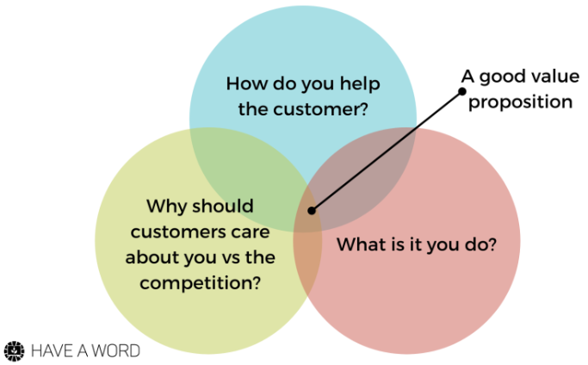
Value Proposition – 3 Questions to Answer
Source: growthmodels.co
9.3.2023
5

Slide 8
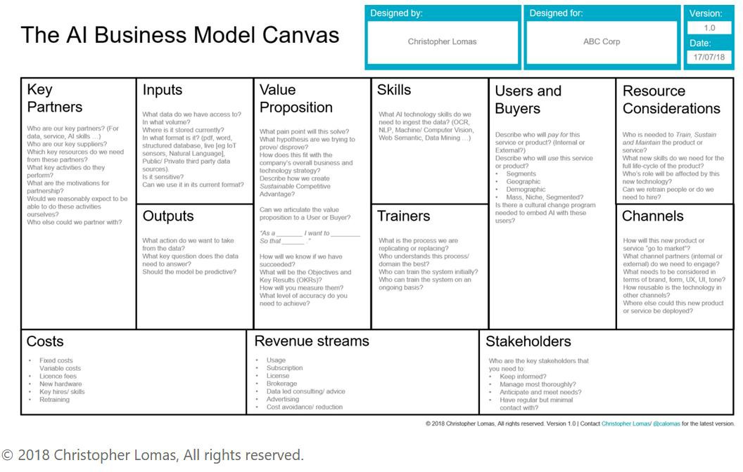
AI Business Model Canvas: Lomas

Slide 9
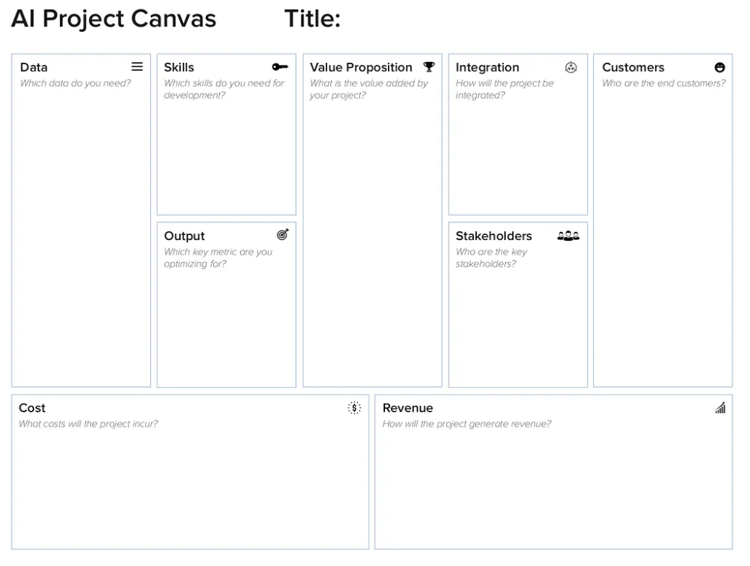
AI Business Model Canvas: AI Project Canvas

Slide 10
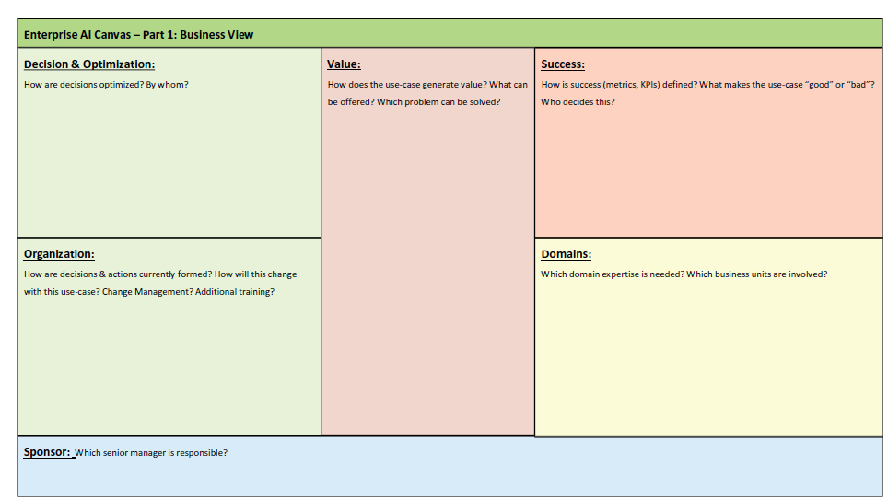
Enterprise AI Business Model Canvas (Kerzel) 1/2

Slide 11
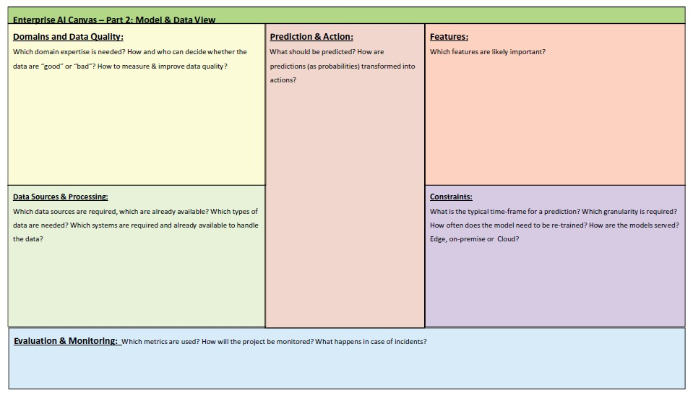
Enterprise AI Business Model Canvas (Kerzel) 2/2

Slide 12
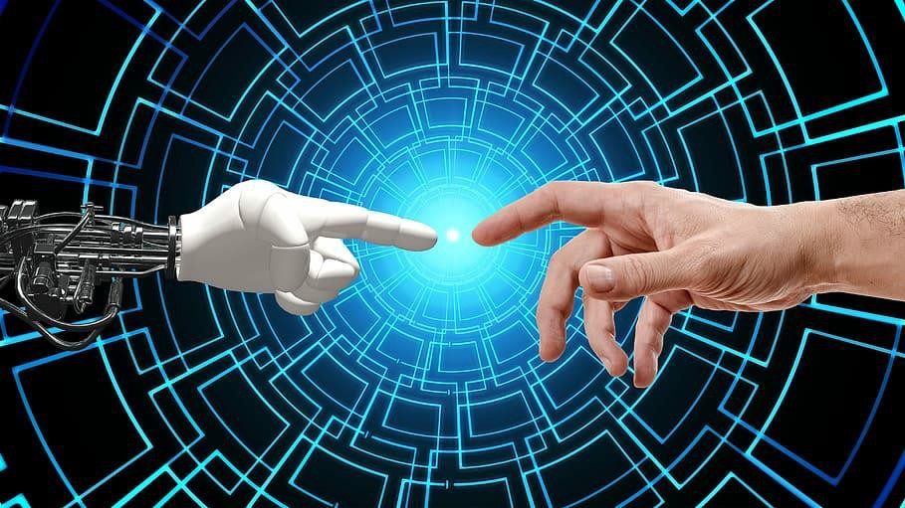
Thank you!

