Slide 1

The EC/OpenAIRE FP7
Post-Grant Open Access Pilot Implementation in Germany
Pablo de Castro
Open Access Project Officer
LIBER – Ligue des bibliothèques européennes de recherche

Slide 2
What is this FP7 Post-Grant Pilot?
• The EC FP7 Post-Grant Open Access Pilot will provide funding to cover the OA publishing fees for publications arising from completed FP7 projects
• 4 million euros are made available by the EC to fund the OA
“post-grant” publications of over 8,000 completed FP7 projects
• The Pilot will last for a maximum of two years (i.e. until Apr 30th, 2017) or until its budget is exhausted

Slide 3
Requirements for Eligibility
• The FP7 project should have finished by the time the funding is requested, but no longer than two years ago;
• A maximum of three publications will be funded per eligible FP7 project as a means to ensure a fair distribution of the funding across projects;
• Publications eligible for funding must be peer-reviewed;
• Funding requests must be submitted once the publication has been accepted;
• Publications submitted to hybrid journals will not be funded, but only those accepted at fully Open Access journals;
• Funding caps of €2,000 for research articles and €6,000 for monographs apply for this Pilot;
• The final version of the funded output must be deposited in an OpenAIRE-compliant Open Access repository.
Full Pilot policy guidelines available at: https://www.openaire.eu/postgrant/fp7-post-grant/pilot

Slide 4
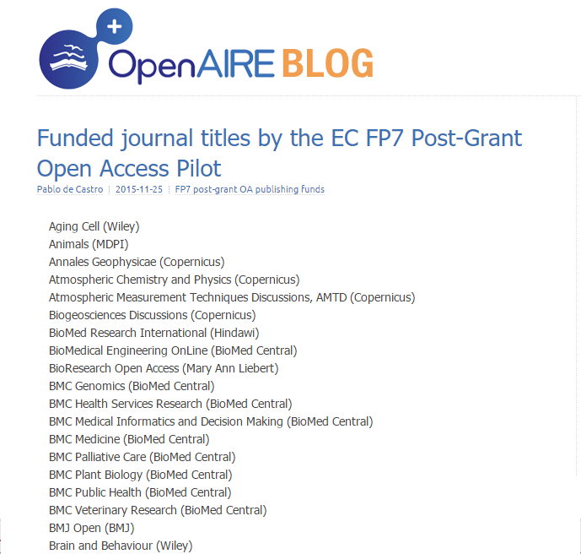
Funded Journals Thus Far
https://blogs.openaire.eu/?p=586

Slide 5
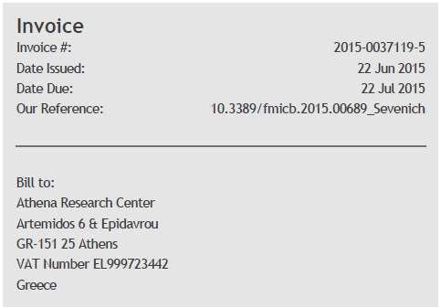
How to Apply for Funding
1. Funding requests may be directly submitted into the OpenAIRE system by researchers or by Libraries and/or Research Offices on their behalf
2. Users need to register with the System in order to submit a funding request
3. Data about the project and the accepted publication will be requested in order to check their eligibility. Once this is checked, the funding request will be approved and left pending until an invoice is available
4. Invoice for the OA publishing fee needs to be
uploaded into the Central System when made
available by the publisher. The invoice must be
issued to Athena Research Centre (ARC).
OpenAIRE System: https://postgrantoapilot.openaire.eu/

Slide 6
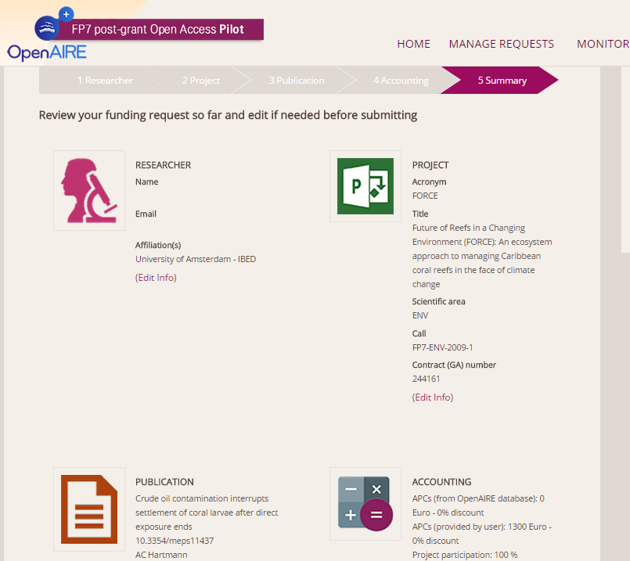
Funding Request: OpenAIRE System
System requests information on:
Researcher (at registration time)
FP7 project
Publication (article/journal/APC)
Accounting (invoicing)
An important recommendation:
Please submit your request upon completion of the publication data without waiting for an invoice to arrive

Slide 7
After filling in a funding request
1. Funding request is submitted
2. Moderator checks it and conditionally approves it if eligible
3. Automatic notification collected by requestor
4. Automatic notification collected by project coordinator for validation
5. Request stays in "conditionally approved" status until invoice addressed to Athena Research Centre is uploaded
6. If invoice is valid (VAT number must be included), the request is formally approved
7. Notification for formal approval sent to the requestor
8. Invoice processed and paid by OpenAIRE accounting office in Athens
9. Bank transfer receipt uploaded into the system by the accounting office
10. Paid request notification sent out to requestor

Slide 8
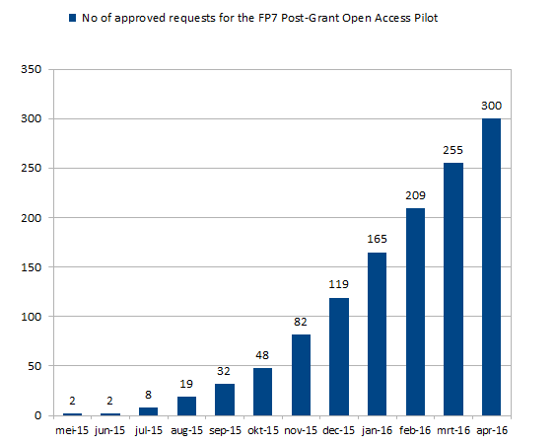
Results so far – approved requests
As of Mar 31st, 300 funding requests have been approved,
283 for journal articles,
12 for books and
5 for book chapters

Slide 9
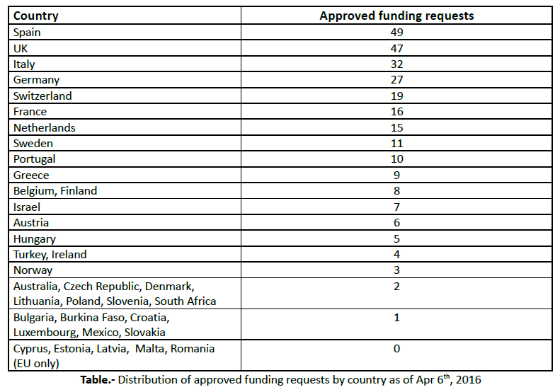
Results so far – requests by country

Slide 10
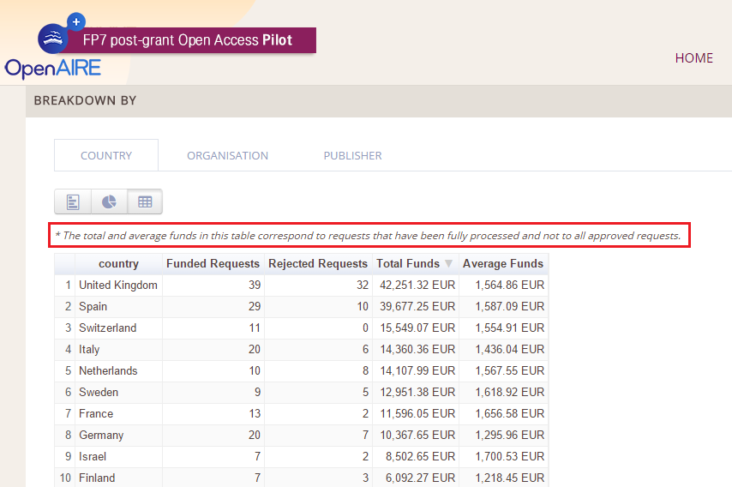
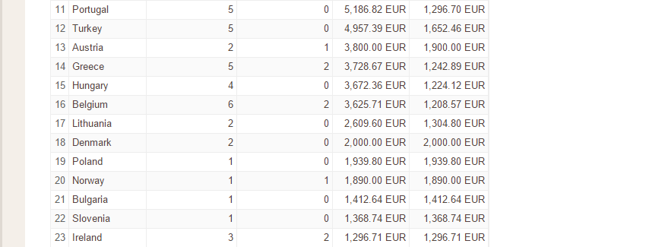
Results so far – funding by country
https://postgrantoapilot.openaire.eu/#statistics

Slide 11
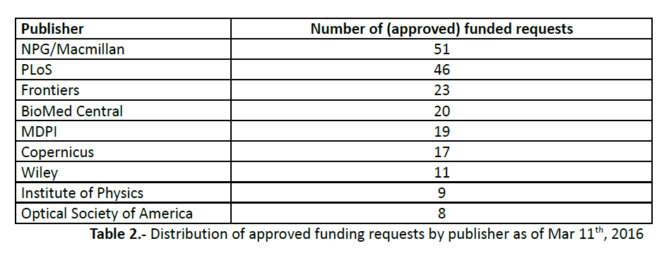
Results so far – requests by publisher

Slide 12
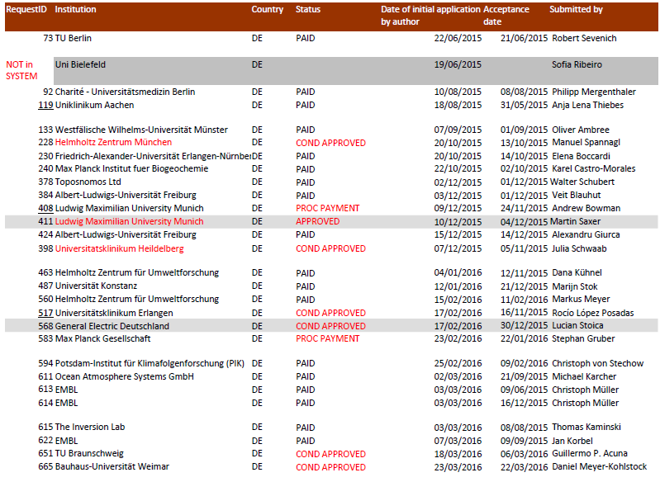
Granted requests from Germany

Slide 13
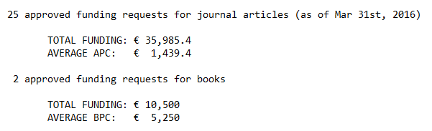
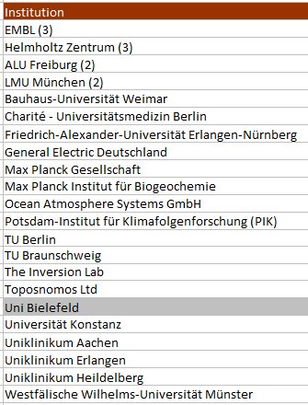
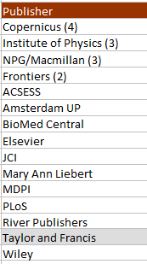
Granted funding requests: Germany

Slide 14
Issues so far: low figures
Many eligible articles are being published – only we’re not ‘catching’ them
'Competition' with other sources of funding
Low awareness by eligible researchers
HOWEVER:
Eligible articles can be tracked and identified: best practice case study in next slide
If we identify eligible journal articles even for reimbursement, this can be used for awareness-rising of the funding opportunity at ms acceptance time

Slide 15
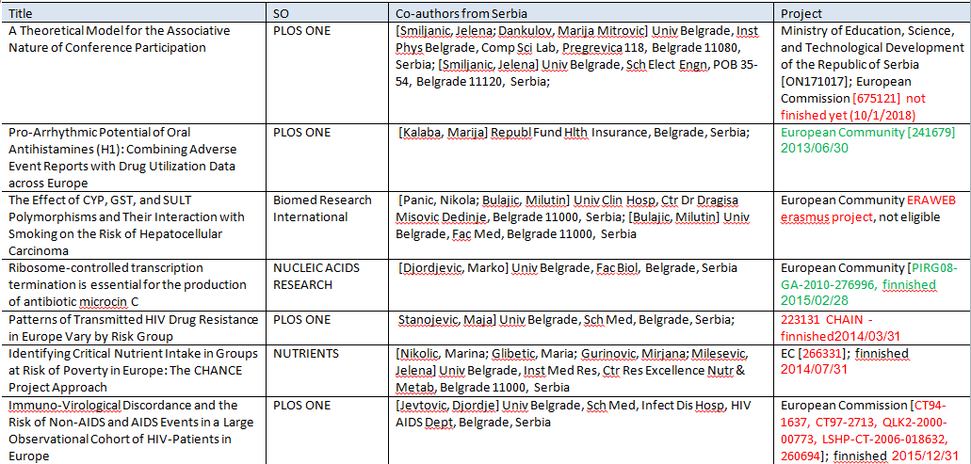
Identifying eligible publications
Available information:
List of eligible journals
funded so far
List of publications
by country/institution
Information on eligible
FP7 projects per country

Slide 16
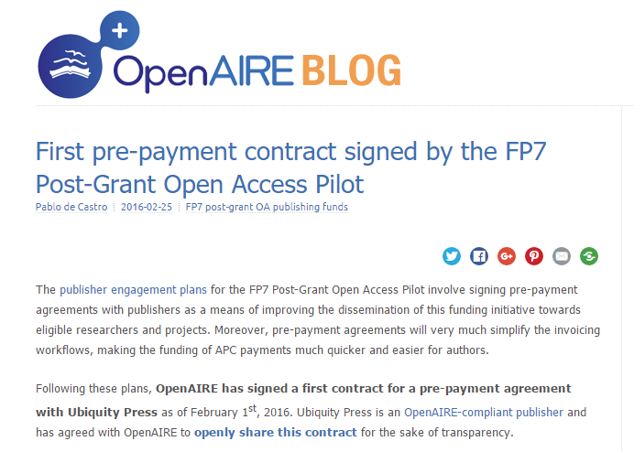
Speeding up: work with publishers...
The Pilot is starting to directly work with publishers in order to identify eligible publications at manuscript acceptance time
This involves new technical workflows that need to be tested
...and institutions

Slide 17
The Alternative Funding Mechanism
• Aims to fund OA journals that charge no APCs to their users
• Since there's no APC to fund, an alternative funding mechanism has been devised to support technical improvements in the publishing workflows
• A call for proposals will soon be put out for collecting bids from these journals/publishers on the basis of a list of recommended technical enhancements
Conceived also as a means to address the geographic bias

Slide 18
pablo.decastro@kb.nl

Slide 19
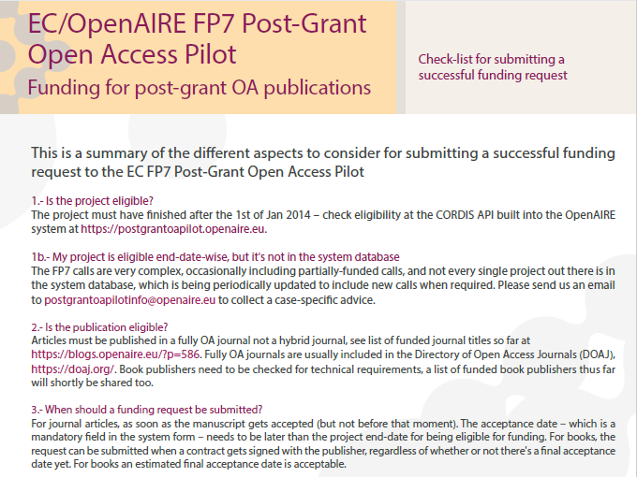
FP7 Post-Grant OA Pilot Checklist

Slide 20
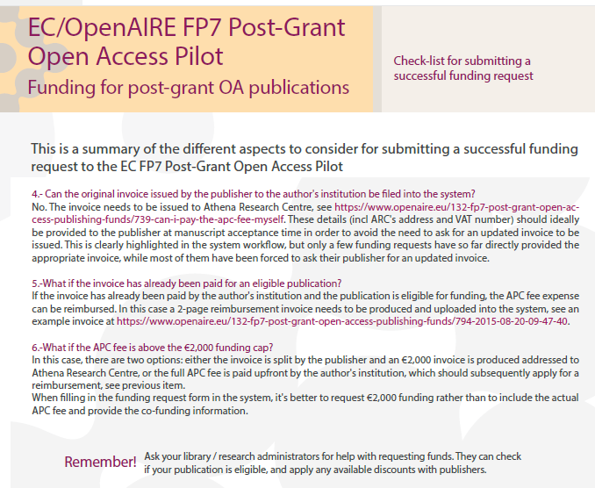
FP7 Post-Grant OA Pilot Checklist (II)

