Slide 1
Open APC im Vergleich mit internationalen APC-Datensammlungen
Open APC/ ESAC Workshop
Bielefeld, 7-8 April 2016
Dirk Pieper

Slide 2
Open APC started by Bielefeld UL 2014-06
Motivation:
Open data for APC financed journal articles
Enabling cost analysis
Reproducible reporting system
Price transparency on the APC market

Slide 3
Expanding the Open APC approach:
Grant proposal: Bielefeld UL, Institute for Interdisciplinary Studies of Science (I2SoS) Bielefeld U, MPDL
Project „INTACT - Transparent Infrastructure for Article Charges“: http://www.intact-project.org/
Started in October 2015 receiving a three-year DFG funding

Slide 4
„INTACT aims at establishing transparent and efficient procedures to manage article processing charges (APC) for open access publications. The project is based on the understanding that the transition from a subscription based market towards open access can only be achieved if higher education and research institutions and their libraries collaborate and work with publishers on both parameters and lean workflows.”

Slide 5
INTACT unites three initiatives:
Bibliometric analysis of fee-based OA publishing in academic institutions: OA Analytics (I2SoS)
Open APC (Bielefeld UL)
Efficiency and Standards for Article Charges (ESAC, MPDL)

Slide 6
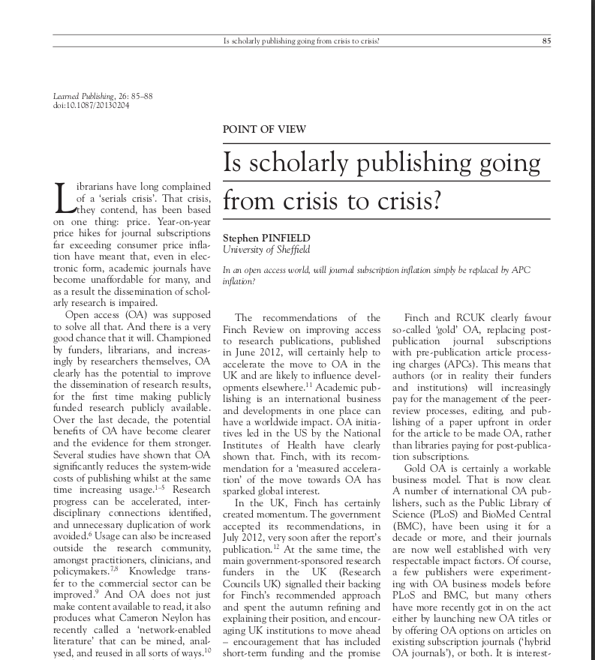
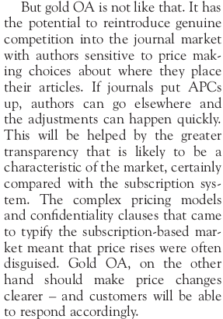
Pinfield, S. (2013): Is scholarly publishing going
from crisis to crisis? Learned Publishing , 26 (2).
pp. 85-88
http://eprints.whiterose.ac.uk/75285/

Slide 7
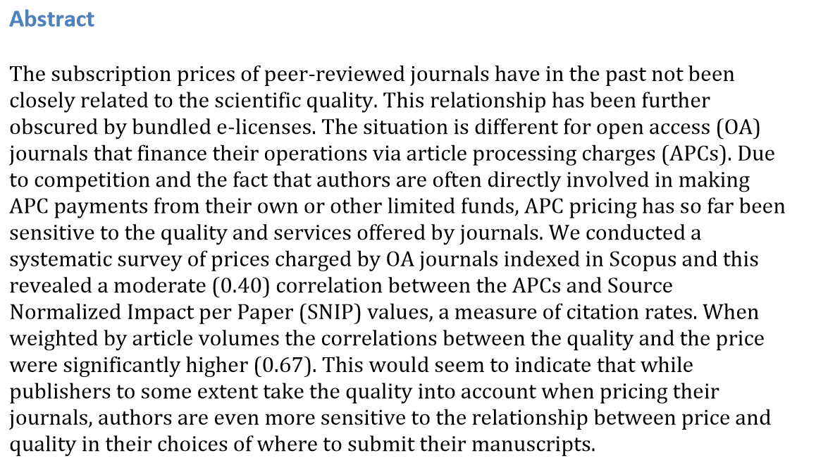
Björk, B-C./Solomon, D (2015): Article processing charges in OA journals –relationship between price and quality
http://www.openaccesspublishing.org/oa12/DOI%2010.1007s11192-015-1556-z.pdf

Slide 8


Slide 9
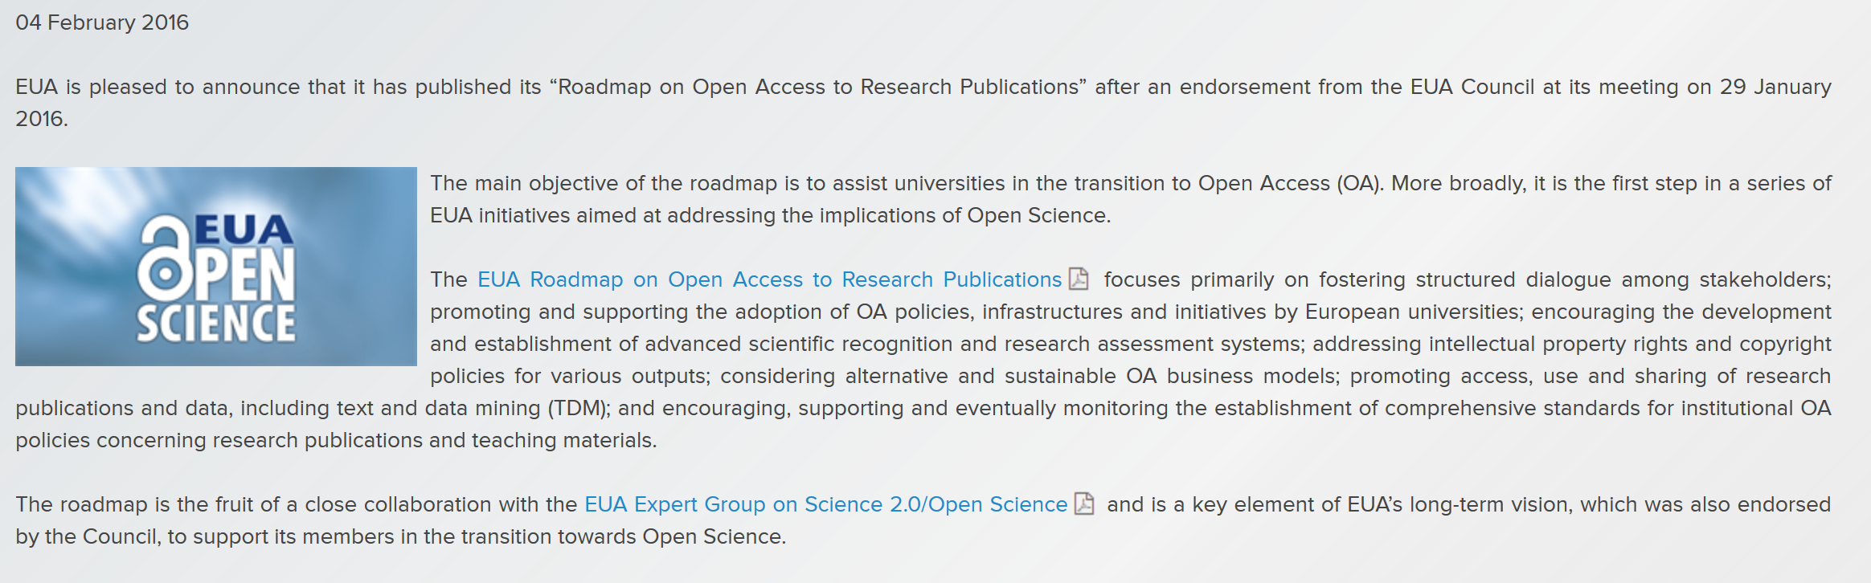

Slide 10


Slide 11
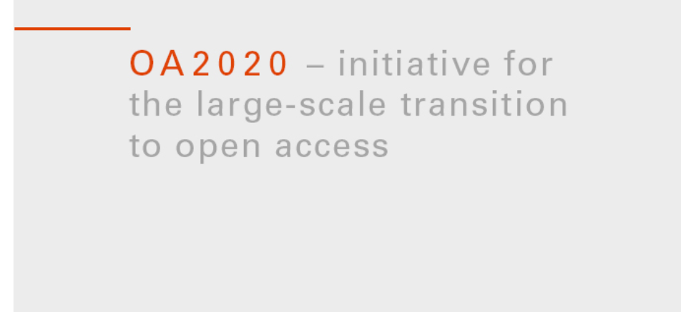

Slide 12
Demand for transparency
Academic interest on Open Access publishing
Institutions and funders need bibliographic and cost data
Transition initiatives need data and support

Slide 13


Slide 14
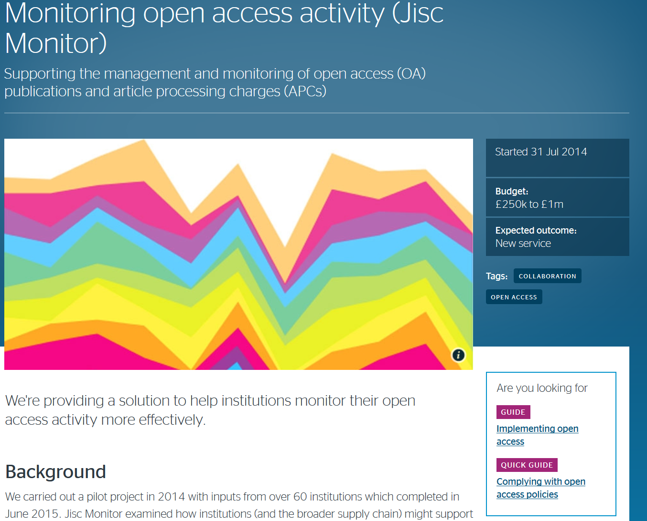
https://www.jisc.ac.uk/rd/projects/monitoring-open-access-activity

Slide 15
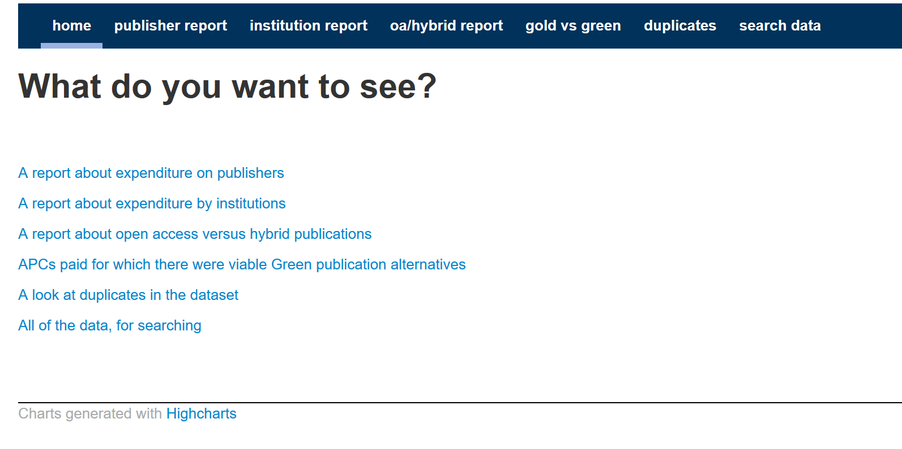
http://apc.ooz.cottagelabs.com/

Slide 16
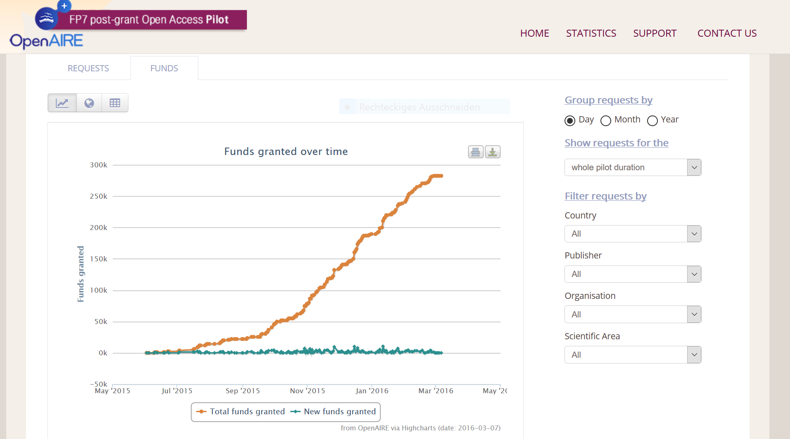
https://postgrantoapilot.openaire.eu/#statistics

Slide 17
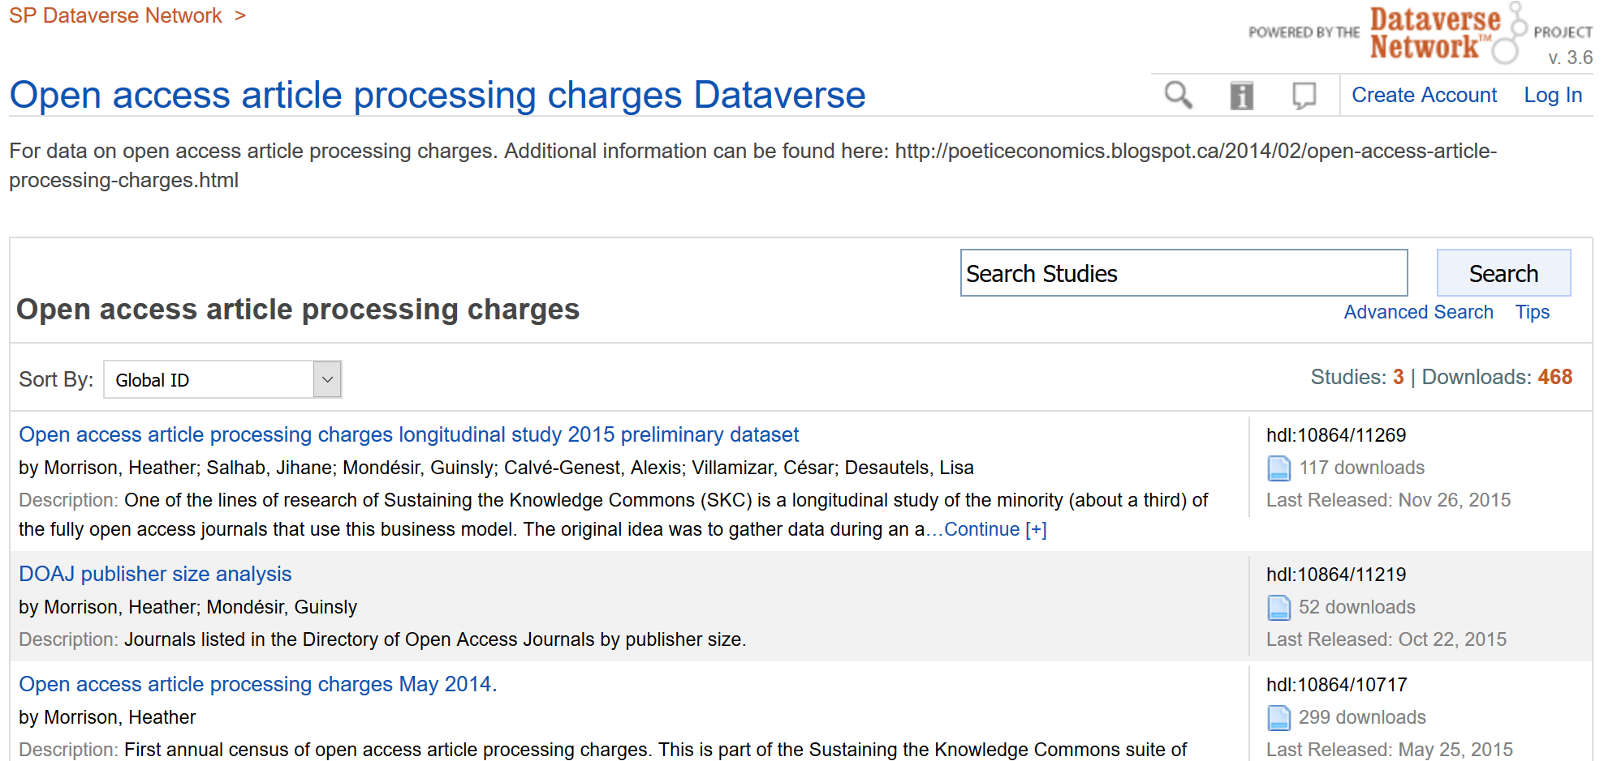
http://dataverse.scholarsportal.info/dvn/dv/oaapc

Slide 18
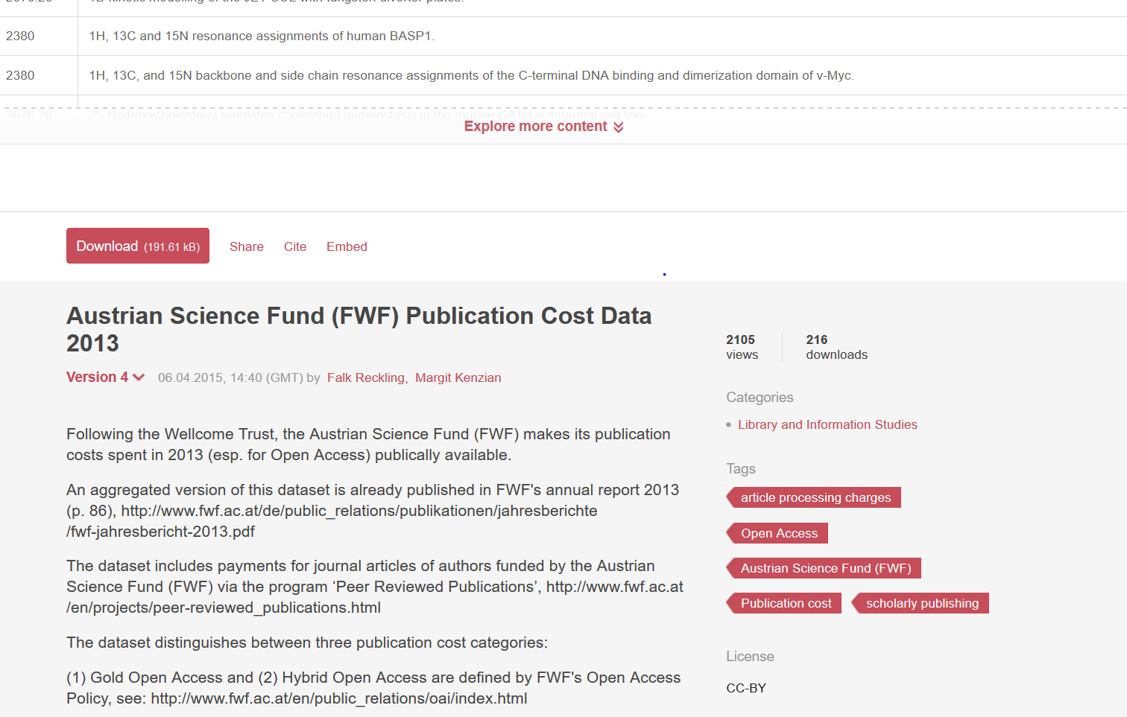
https://figshare.com/articles/Austrian_Science_Fund_FWF_Publication_Cost_
Data_2013/988754

Slide 19
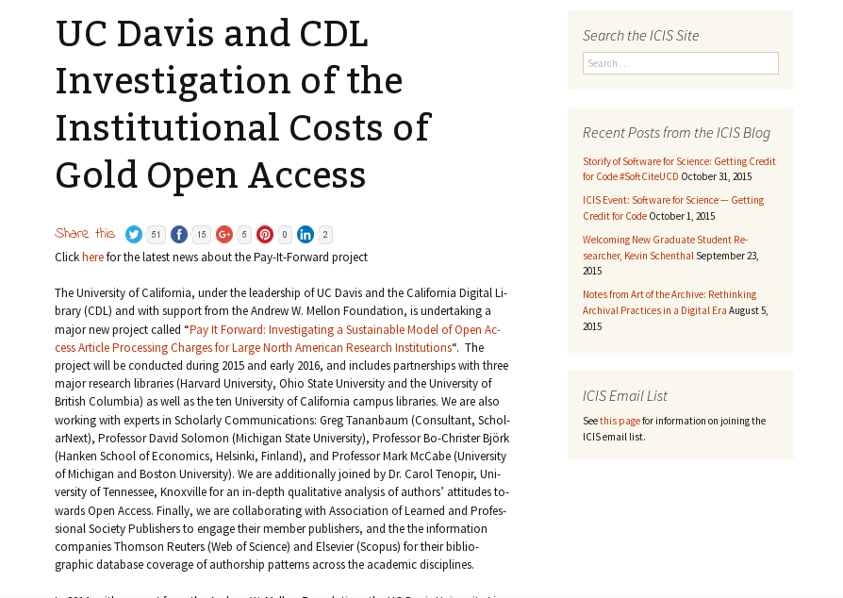

Slide 20
„Unique selling point“ of Open APC

Slide 21
Data and scripts for normalisation steps and analysis are Open Source on one repository
Automatic sync from GitHub to local GitLab installation
Version control through Git
Adding Continous-Integration- and OLAP-Servers

Slide 22
Automatic enrichment with identifiers
Disambiguation of journal titles and publisher names using CrossRef-API
Small hurdle for institutions to contribute
Incentives

Slide 23

Thank you!
INTACT Team:
I2SoS: Christine Rimmert, Mathias Winterhager, Michael
Wohlgemuth
Bielefeld UL: Christoph Broschinski, Najko Jahn, Vitali
Peil, Dirk Pieper
MPDL: Kai Geschuhn, Ralf Schimmer, Adriana Sikora

Slide 24
www.intact-project.org
Follow us: @oa_intact

