Slide 1


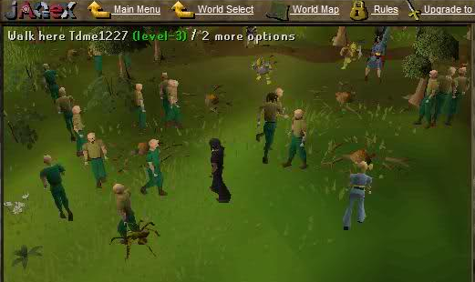




Jose Navarro – OpenAg UROP (Past)
Interests:
CS
Math
Video Games
Agriculture
Bad Bots – AI Project
+
Notes:
‹#›

Slide 2
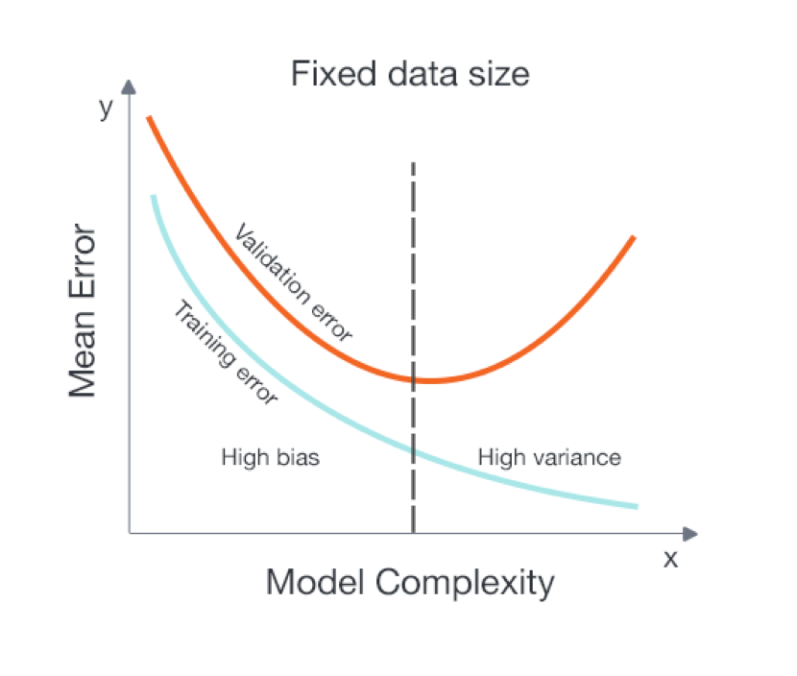
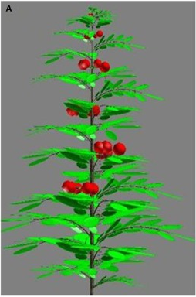
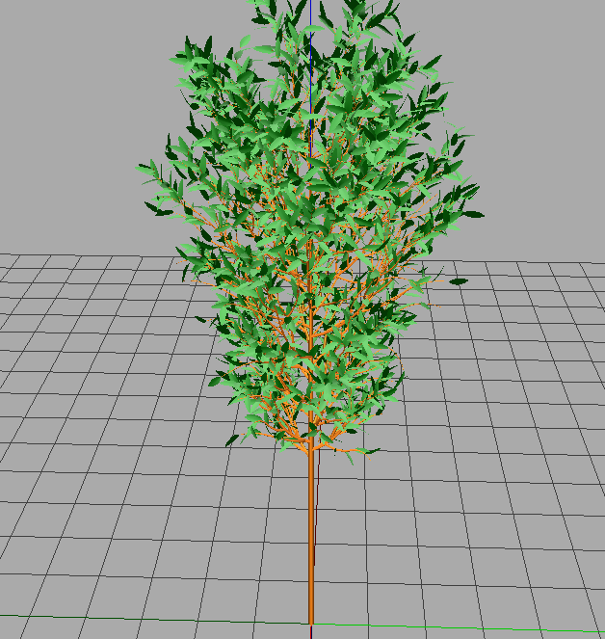
Jose Navarro – OpenAg UROP (Present)
Problem
Plants need time to grow an analyse its patterns (e.g., biomass, volume, etc.)
Solution
Simulation
+
Machine Learning
Examples
Notes:
‹#›

Slide 3
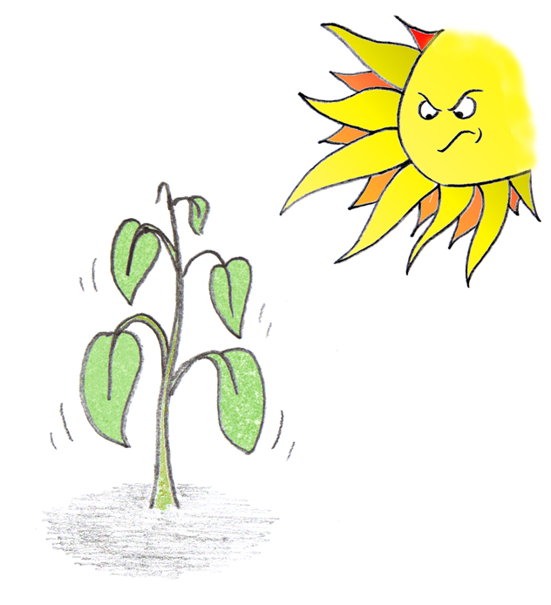
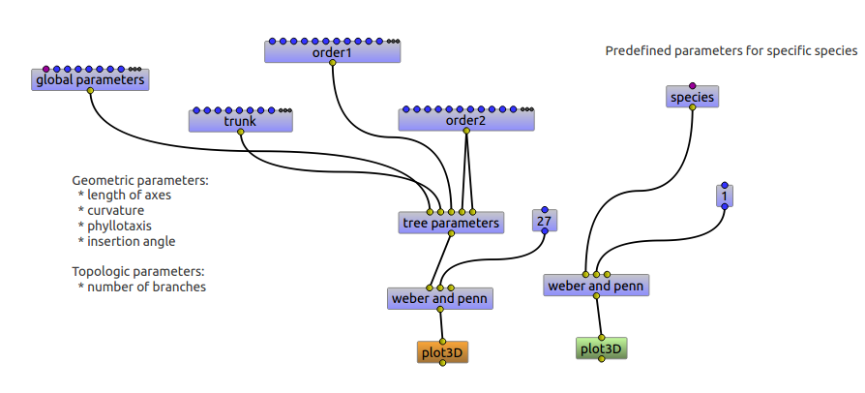
Jose Navarro – OpenAg UROP (Future)
Goals
Create new machine learning models for climate optimization using plant simulators.
Analyse relationships between actual growing conditions and optimal calibration. (Simulation vs Real-world)
Notes:
The plant reacts to the sun’s extreme temperatures by wilting an example of a reaction we should be able to detect and fix (in this case by decreasing sun’s rays).
‹#›

Slide 4
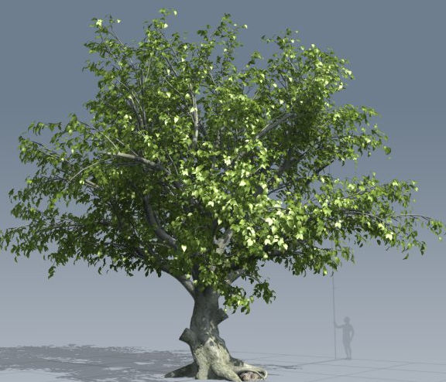
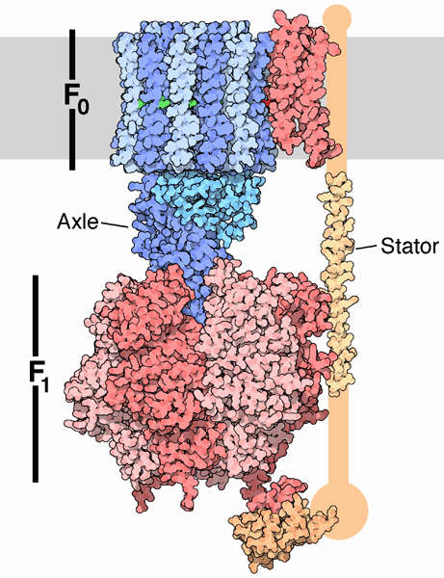
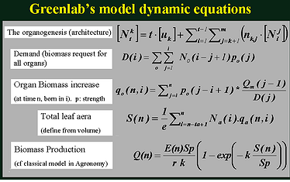
Exploring GreenLab
Correct Level of Abstraction
VS
Too abstract (Not enough) Too little Abstraction(Too much)
Testing implementations of GreenLab:
AMAPstudio and GreenScilab.

Slide 5
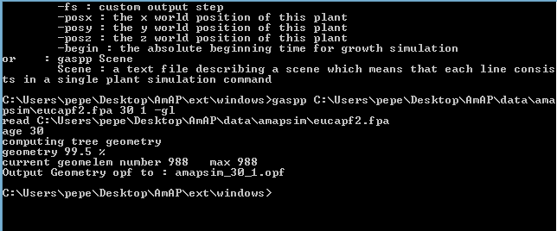
Pros/Cons of AMAPstudio
Pros:
Command Line
Plug-ins.
GUI is a nice sanity
check.
Cons: No documentation
Model we’re interested in is a .dll/.so file. We can’t be sure of how to pass parameters without source.
Written in Java.

Slide 6

Near Future
Is GreenScilab worth our time?
Test efficacy of GreenLab
Model with environments known
To be ideal.
Once Model is satisfactory, will begin to generate random distribution of climate parameters for data.
Then we’ll train this on a whole gamut of machine learning algorithms.

