Slide 1

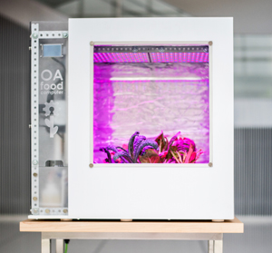
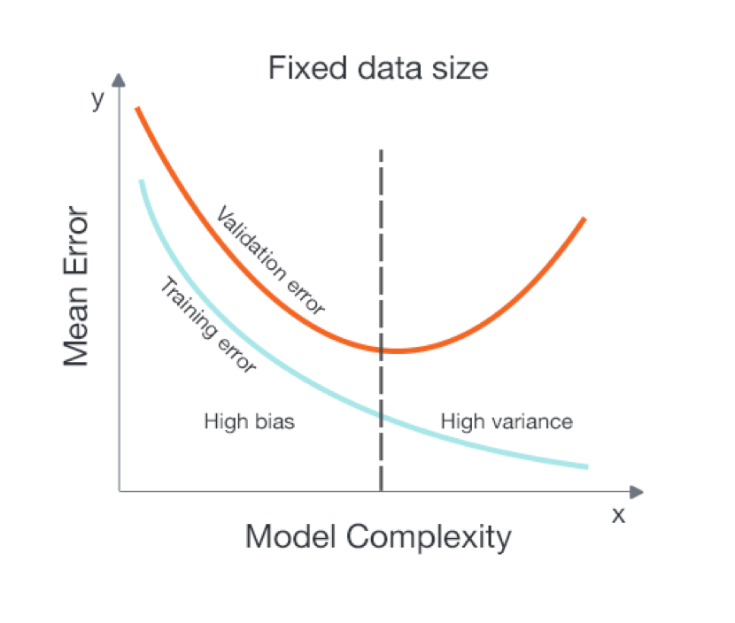
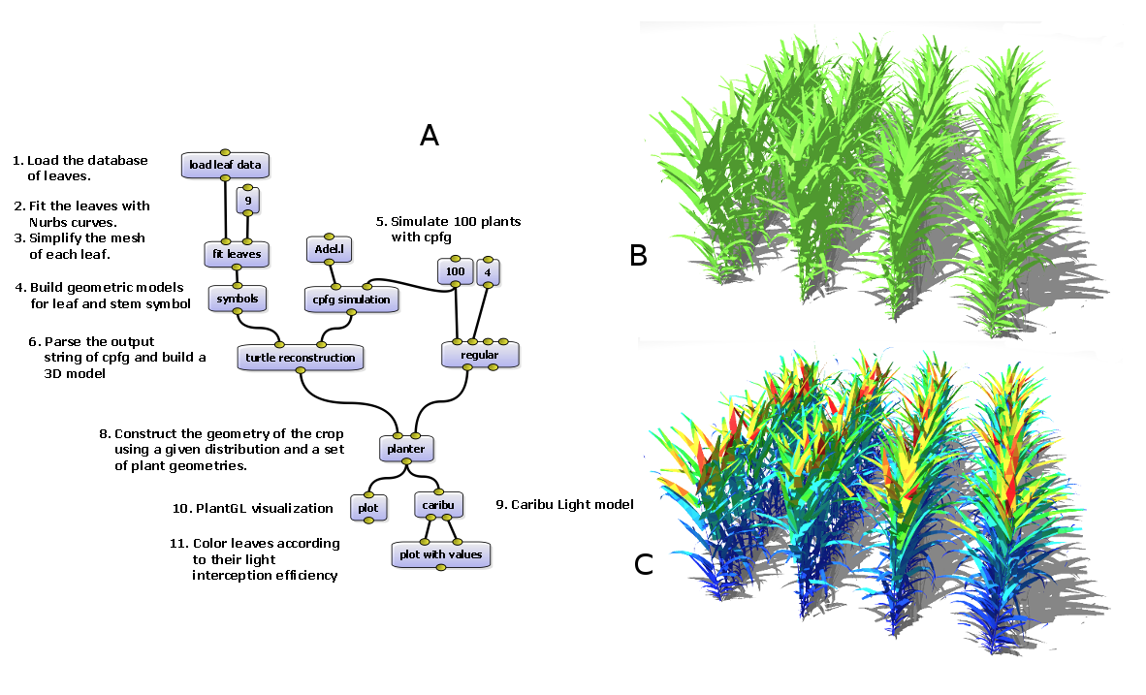
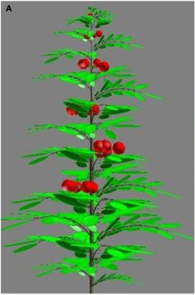
PostDoc Research Projects – OpenAg (01/19/2017)
FC A
Ongoing Projects:
Machine learning and Simulation as a climate recipe optimization mechanisms -> openag_sim
FC A
Scilab: Plant Growth cycle simulator
Machine Learning Optimization

Slide 2
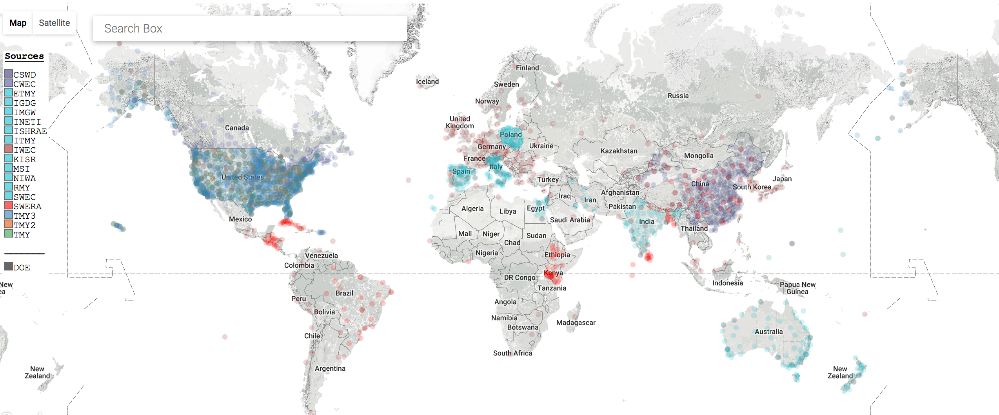
PostDoc Research Projects – OpenAg (01/19/2017)
FC A
EPW - Weather data collections

Slide 3

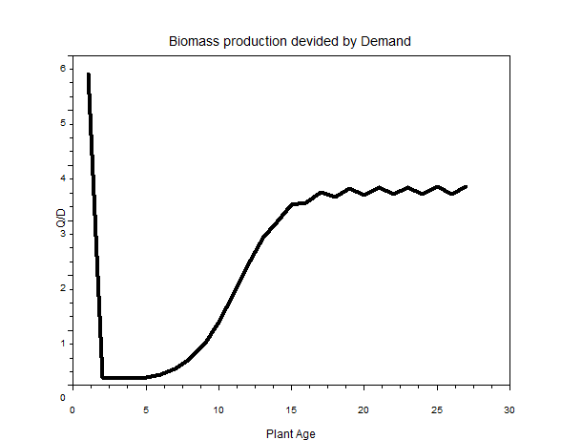
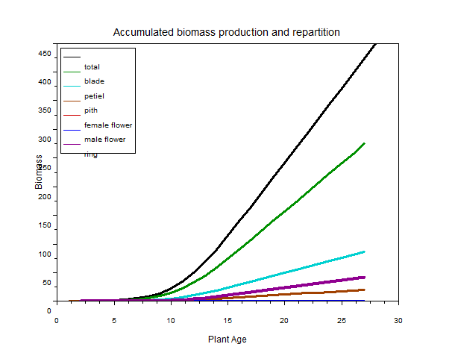
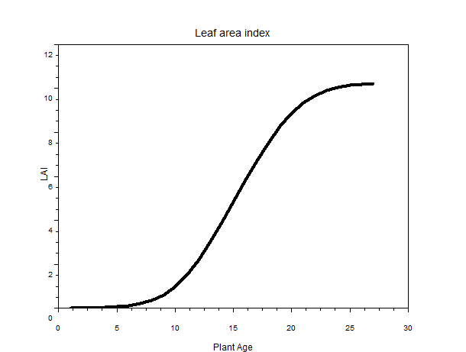
PostDoc Research Projects – OpenAg (01/19/2017)
FC A
FC A
Ongoing Projects:
Machine learning and Simulation as a climate recipe optimization mechanisms (Jose).
Scilab Sim – Greenlab Model

Slide 4
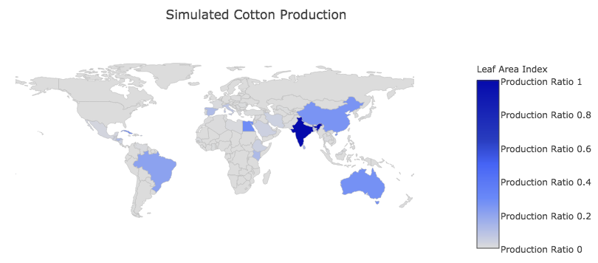
PostDoc Research Projects – OpenAg (01/19/2017)
FC A
Correlation coefficient: 75%

Slide 5
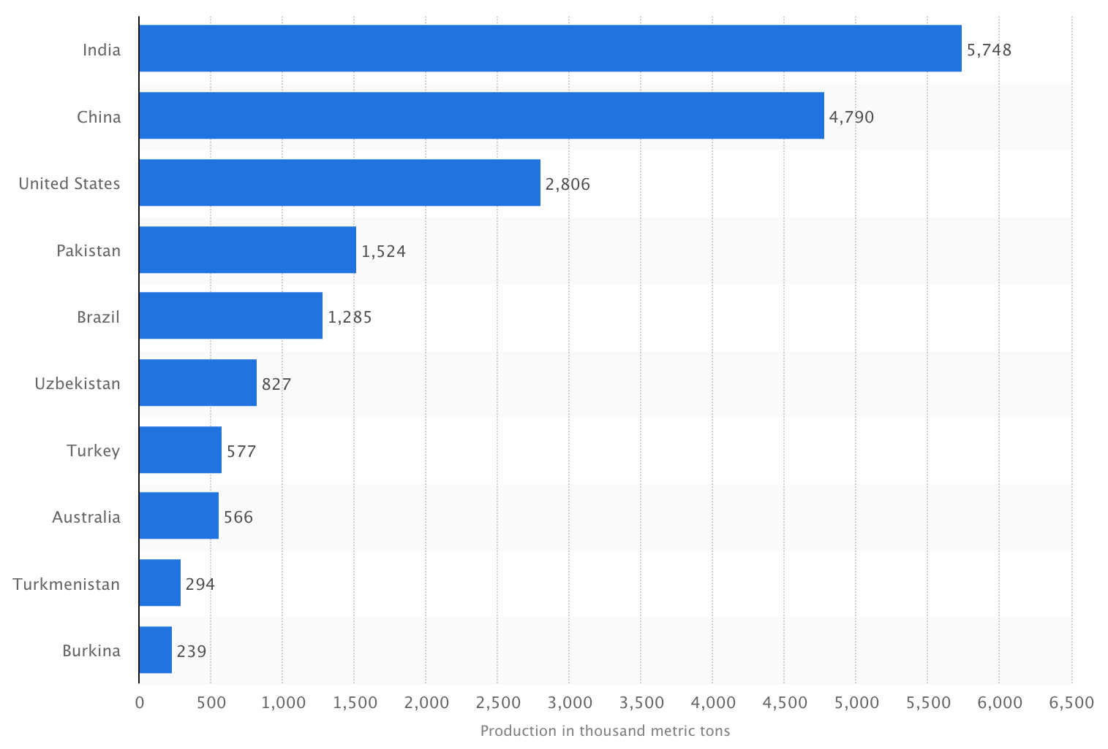
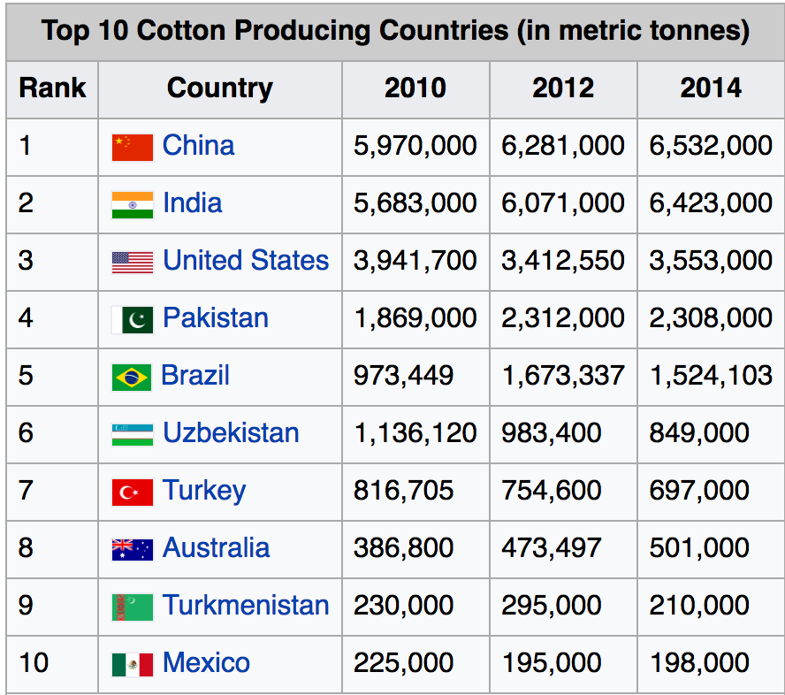
PostDoc Research Projects – OpenAg (01/19/2017)
FC A
Source: UN Food & Agriculture Organization

Slide 6
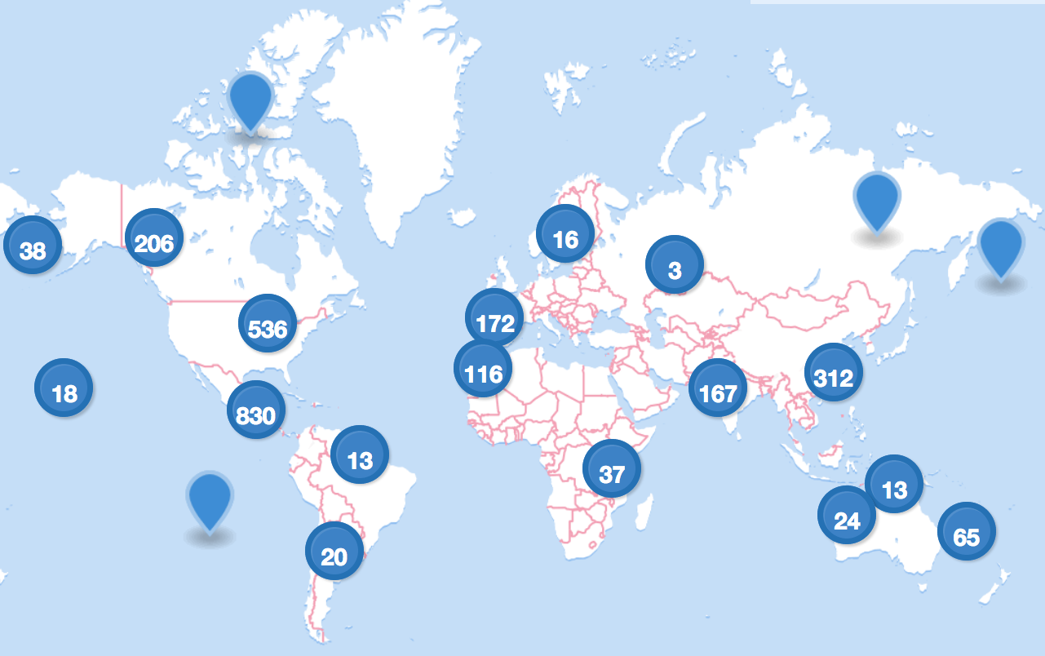
PostDoc Research Projects – OpenAg (01/19/2017)
FC A
FC A
Ongoing Projects:
Machine learning and Simulation as a climate recipe optimization mechanisms (Jose).
Scilab Sim – Greenlab Model
Weather Data

