Slide 1
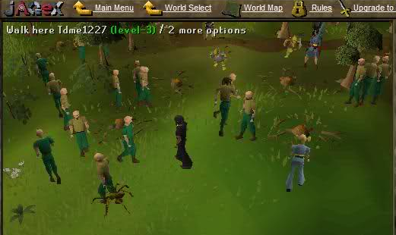
About us
Bad bots

Slide 2
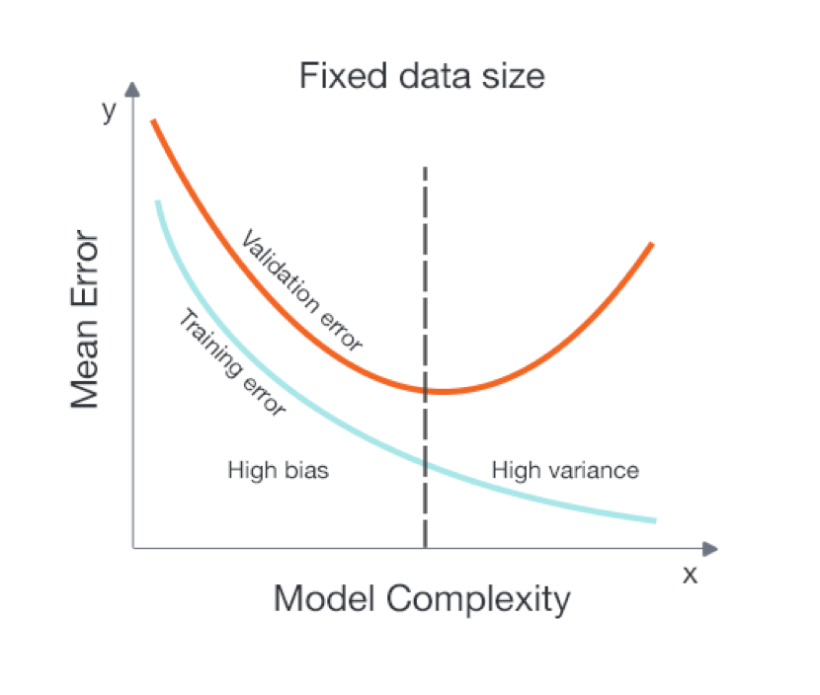
Plan
Problem: Plants need time to grow

Slide 3
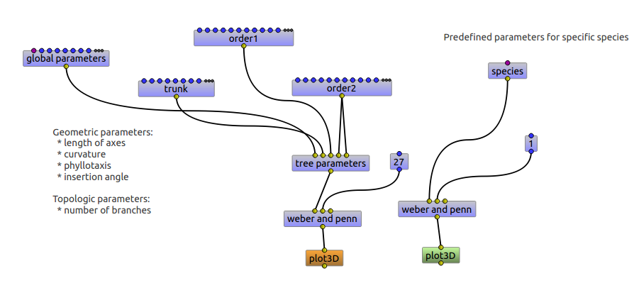
Simulation
Model: GreenLab
Glue: OpenAlea

Slide 4
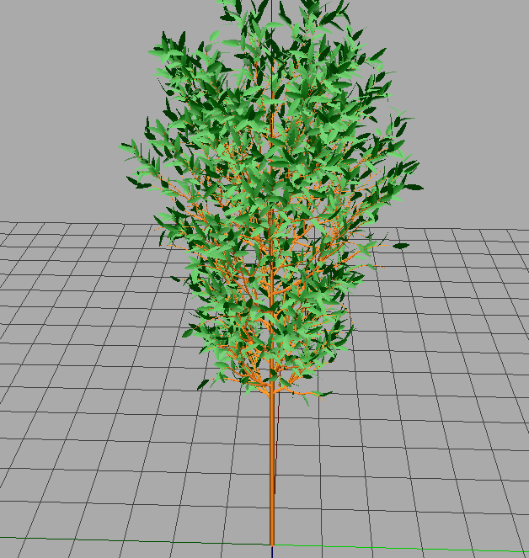
Examples

Slide 5
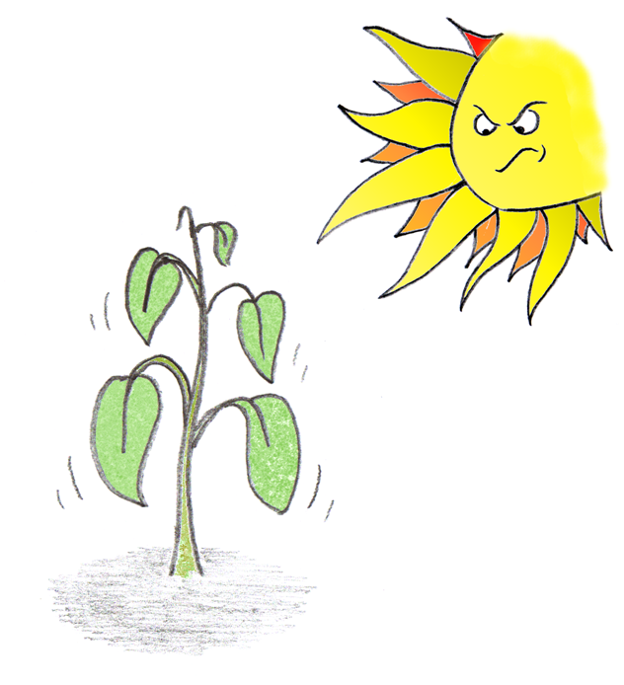
Goal
A dynamic relationship between actual growing conditions and optimal calibration.

Slide 6

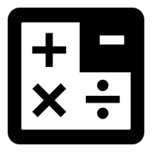




Jose Navarro – OpenAg UROP (Past)
Interests:
CS
Math
Video Games
Agriculture
Bad Bots – AI Project
+

Slide 7
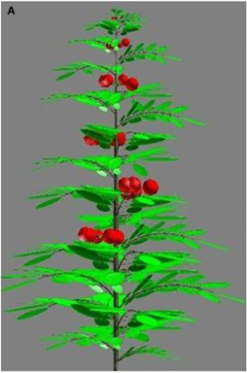
Jose Navarro – OpenAg UROP (Present)
Problem
Plants need time to grow an analyse its patterns (e.g., biomass, volume, etc.)
Solution
Simulation
+
Machine Learning
Examples

Slide 8
Jose Navarro – OpenAg UROP (Future)
Goals
Create new machine learning models for climate optimization using plant simulators.
Analyse relationships between actual growing conditions and optimal calibration. (Simulation vs Real-world)

