Slide 1
ITO Trajectory Analysis
Adriano Barbosa
Update: 08/06/2021

Slide 2
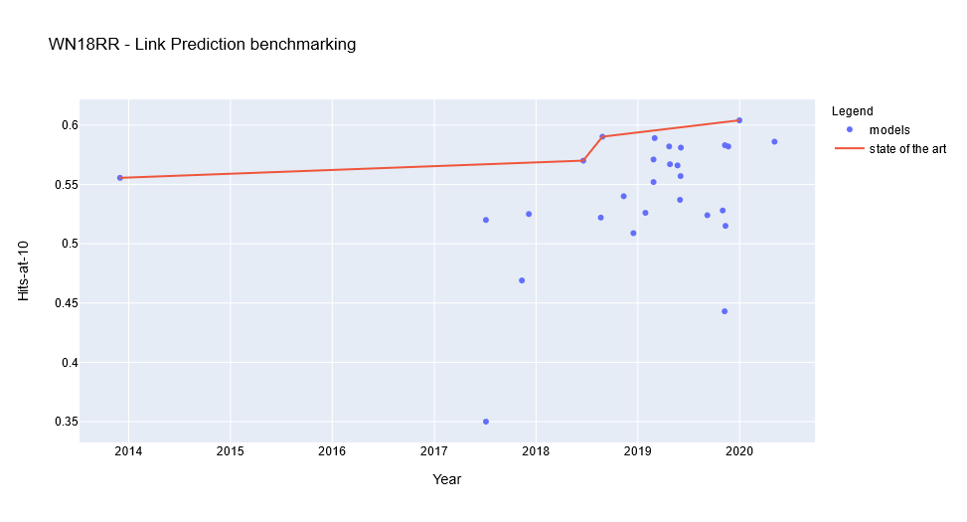
PWC trajectory-like plot

Slide 3
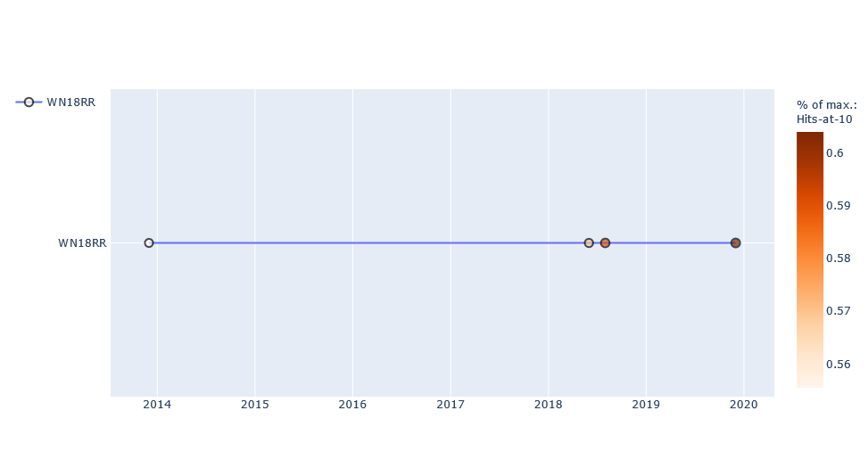
Flattened plot
This plot represents the state-of-the-art value for the selected metric obtained in the course of the years.

Slide 4
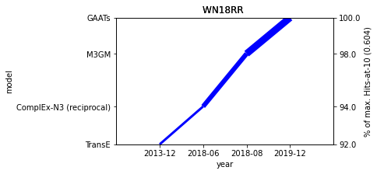
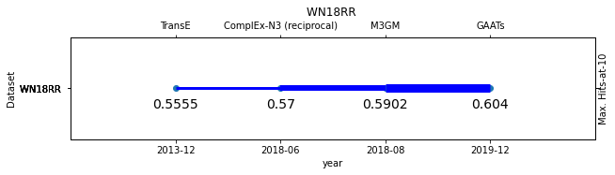
Alternative plots
Line-plot curve for the selected benchmark
Flattened line-plot curve for the selected benchmark

Slide 5
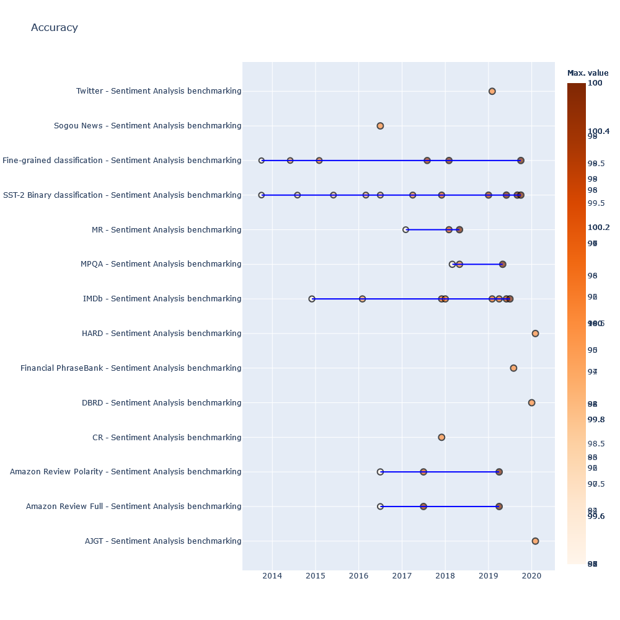
Multiple benchmarks
This plot displays the comparison of trajectories for different benchmarkings using the same metric.

Slide 6
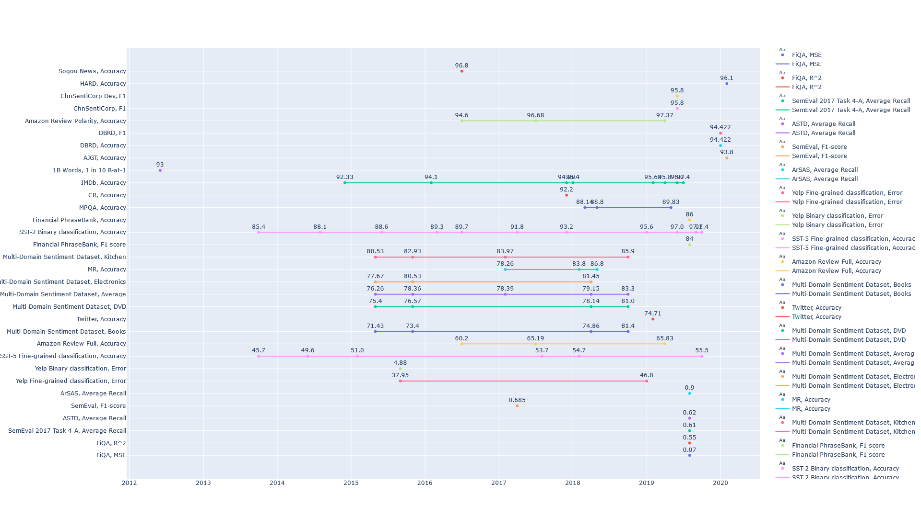
Multiple metrics and benchmarks trajectories

Slide 7
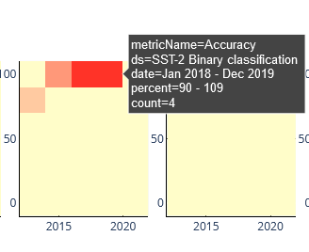
Counts of models achieving selected metrics over the years (unique benchmark example)
The heatmap displays for each date bin, the number of models that achieved such Y-value range.
In the example: 4 models achieved between 90-100% of the maximum value (Accuracy) in the time frame 2018-2019.

Slide 8
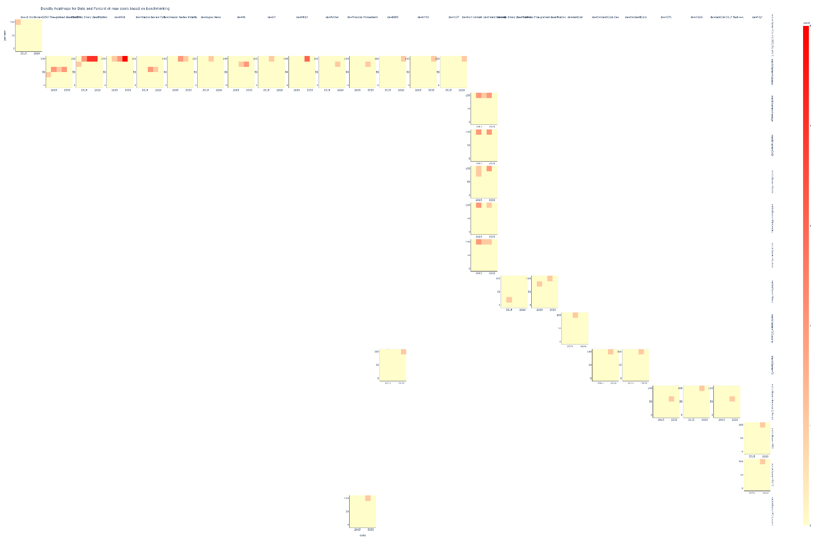
Counts of models achieving selected metrics over the years (all benchmarks/metrics)

Slide 9
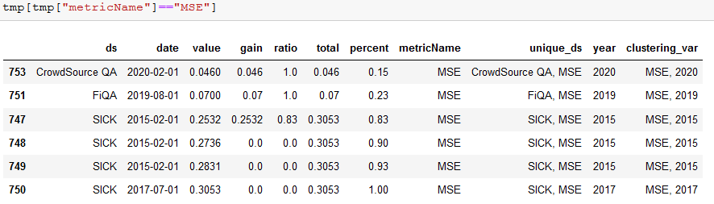
Preparing data for Hierarchical Clustering

Slide 10
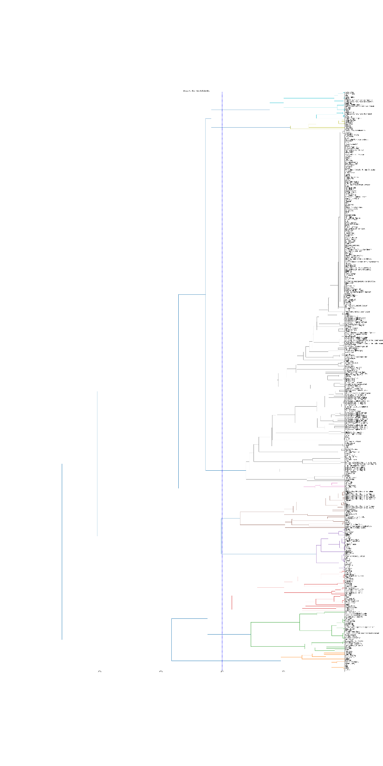
Hierarchical clustering
We have used selected variables for creating the HC plot.
The values to comput the clusters could be either the obtained values or the relative percentage to the maximum value obtained for such a metric considering all benchmarks of all tasks.

Slide 11
