Slide 1
Architecture Improvements
Resumen ejecutivo generado el 25/11/2025 10:30

Slide 2
Métricas Principales
Líneas: 381
Palabras: 1,577
Secciones: 39
Bloques de código: 2
Complejidad: 47.3

Slide 3
Puntos Clave
This document outlines the comprehensive architectural improvements being implemented to align the `production_code` directory with clean architecture principles, eliminate code duplication, standardize imports, and ensure proper layer separation.
``` ┌─────────────────────────────────────────────────────────┐ │ PRESENTATION LAYER │ │ - api/ (routes, middleware, auth, dependencies) │ │ - api_server.py, chat_server.py, cli*.py │ │ - dashboard.html │ │ Dependencies: application.service_container only │ └─────────────────────────────────────────────────────────┘ ↓ ┌─────────────────────────────────────────────────────────┐ │ APPLICATION LAYER │ │ - services/ (business logic services) │ │ - application/ (service container, orchestrators) │ │ - integration_pipeline.py, monitoring_system.py │ │ Dependencies: domain contracts, infrastructure providers│ └─────────────────────────────────────────────────────────┘ ↓ ┌─────────────────────────────────────────────────────────┐ │ DOMAIN LAYER │ │ - core/ (base classes, utilities) │ │ - memory/, research/, inference/, etc.
**Current State:** - `api_utils.py` (root, 268 lines) - Tensor validation functions - `core/api_utils.py` (231 lines) - FastAPI/Flask helpers, HTTP clients - `api/api_utils.py` (180 lines) - API route validation functions
**Files to Update:** - `api_unified.py` - Update imports - `tests/test_api_utils.py` - Update imports - Any other files importing from root `api_utils`
**Current State:** - `config_manager.py` (root, 521 lines) - `core/config_manager.py` (exists)

Slide 4
Alertas / Riesgos
Pendientes: L301: ### Pending ⏳
Advertencias: L80: 5. ✅ Add deprecation warning to root `api_utils.py`, L162: **Current Issue:**

Slide 5
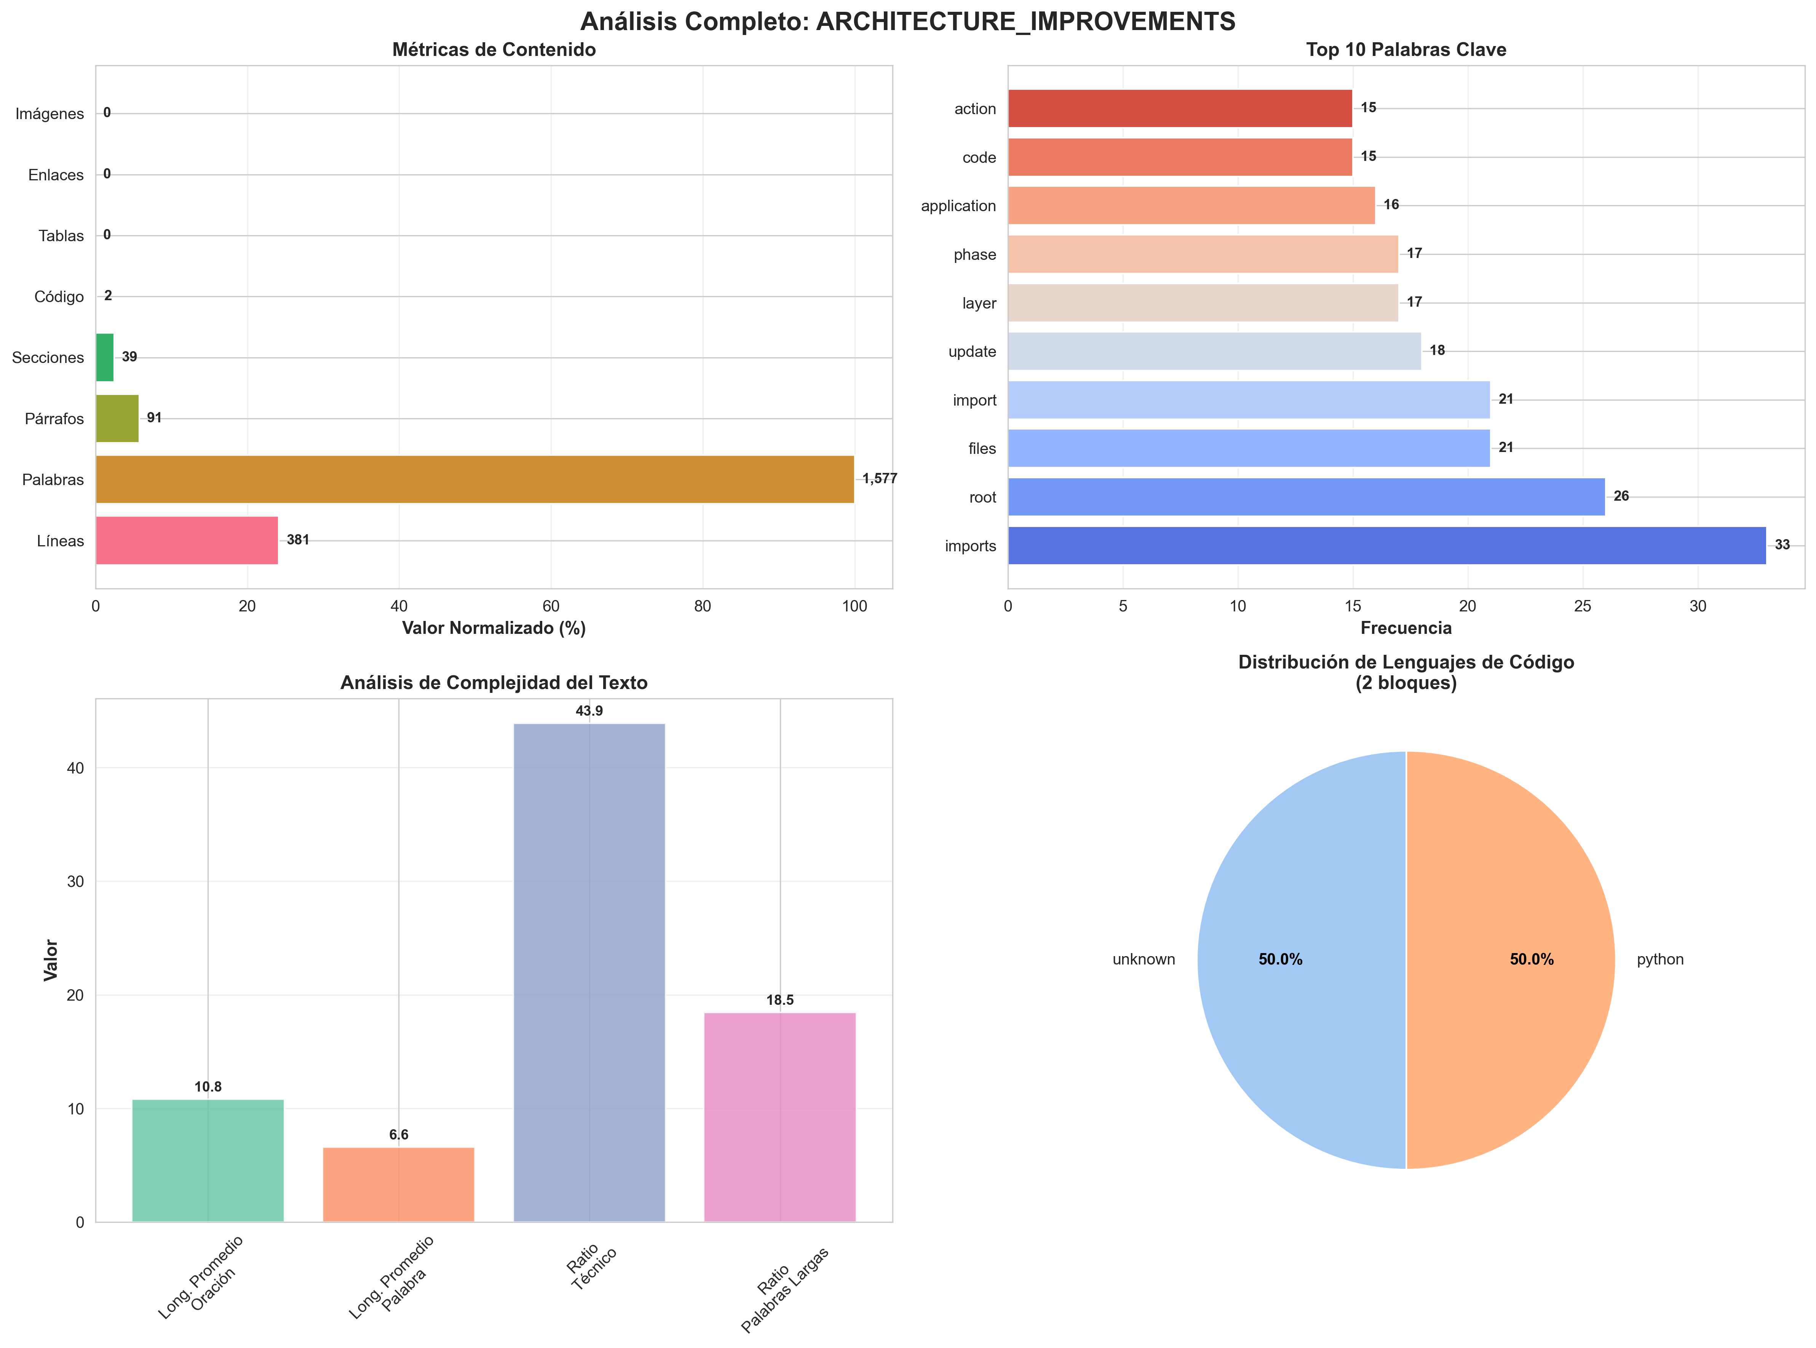
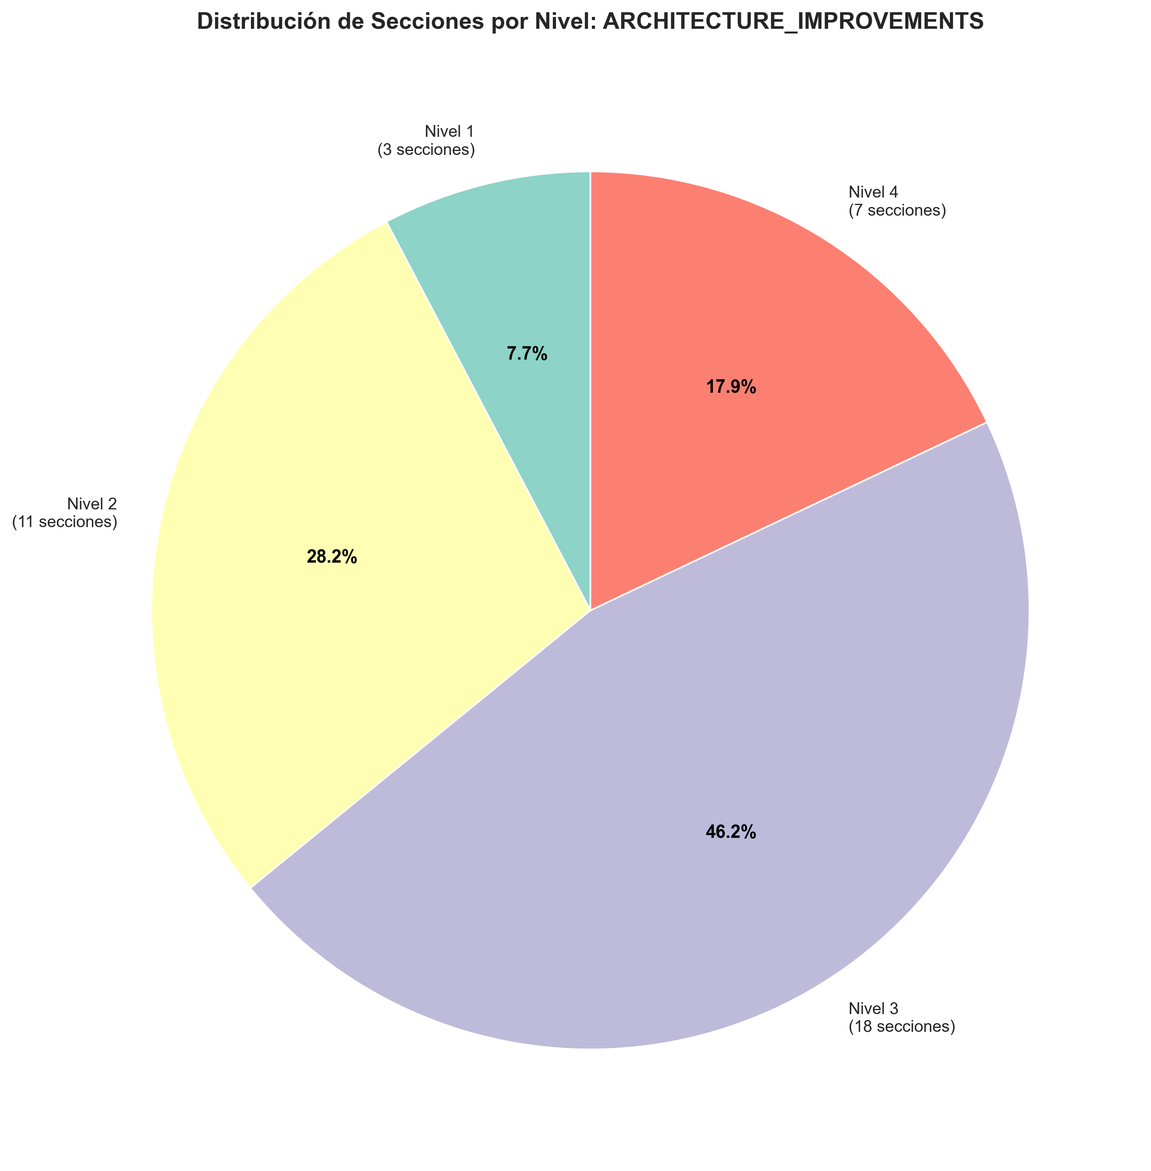
Visualizaciones Clave

