Slide 1
Refactoring Plan
Resumen ejecutivo generado el 25/11/2025 10:30

Slide 2
Métricas Principales
Líneas: 469
Palabras: 1,890
Secciones: 51
Bloques de código: 3
Complejidad: 41.4

Slide 3
Puntos Clave
**Date**: 2025-01-27 **Status**: Analysis Complete - Ready for Implementation
This document outlines a comprehensive refactoring plan for the `production_code` directory to improve code organization, eliminate duplication, resolve import inconsistencies, and align with the documented layered architecture.
**Current State:** - `api_utils.py` (root, 268 lines) - Tensor validation functions - `core/api_utils.py` (231 lines) - FastAPI/Flask helpers, HTTP clients - `api/api_utils.py` (180 lines) - API route validation functions
**Problem:** - Overlapping functionality - Inconsistent import paths - Confusion about which file to use
**Option A (Recommended):** Keep separate but clarify purposes - `api/api_utils.py` → Keep for API route validation (domain-specific) - `core/api_utils.py` → Keep for general HTTP/web utilities (reusable) - `api_utils.py` (root) → **DEPRECATE** and migrate to `api/api_utils.py`

Slide 4
Alertas / Riesgos
Advertencias: L177: **Current Issue:**, L252: - **Issue**: Doesn't use new `api/routes/` structure
Notas críticas: L341: 3. Create integration tests for critical paths

Slide 5
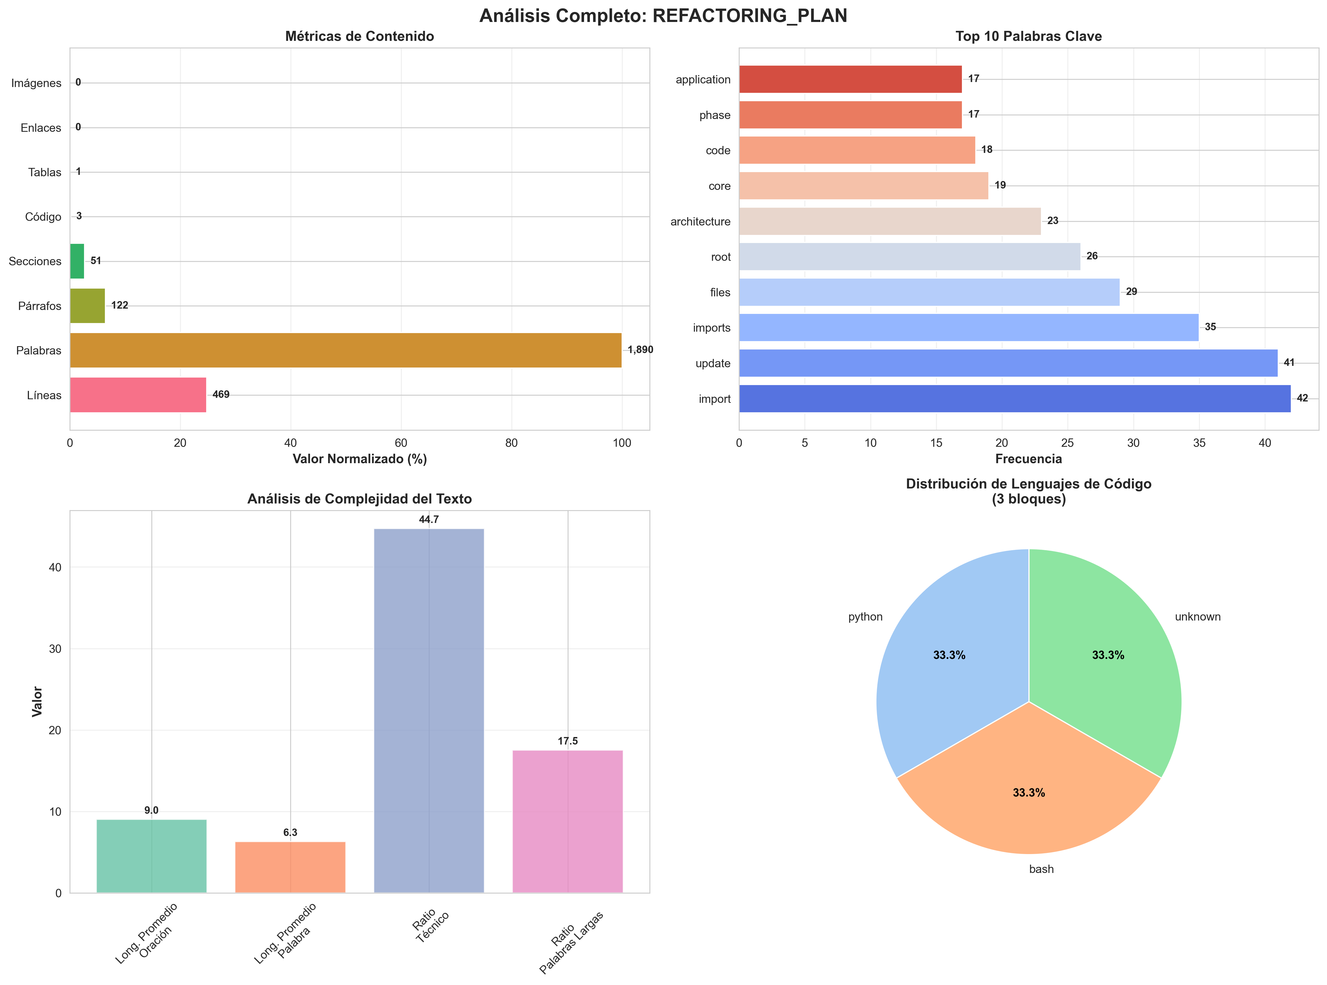
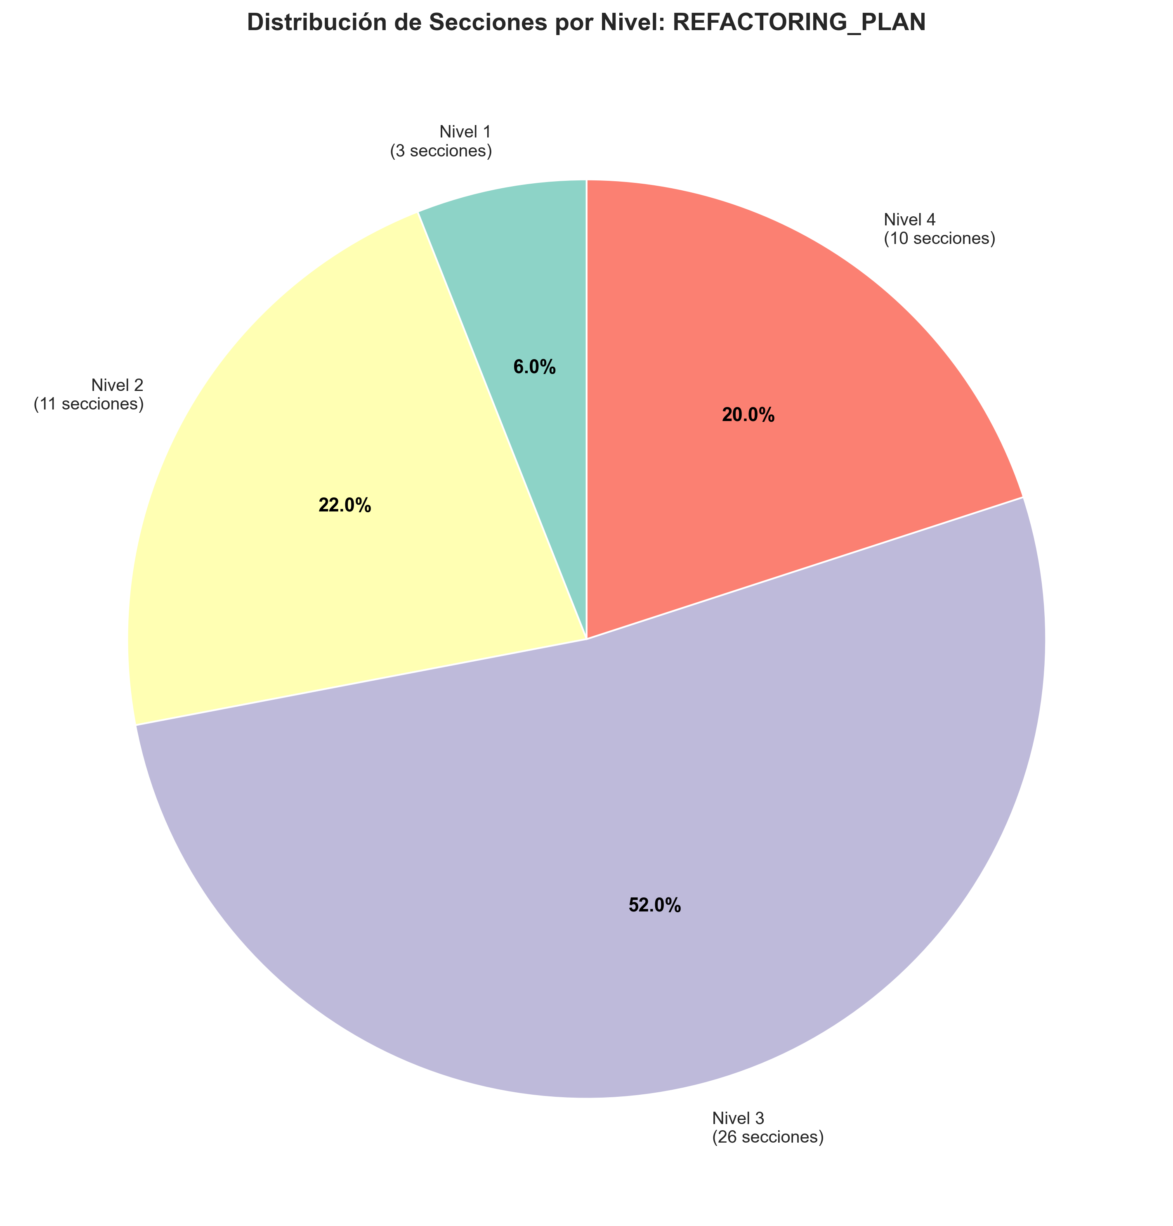
Visualizaciones Clave

